Slide 1
To save time, do this now…
Go to: http://bit.ly/SWCSoton
In the Etherpad, follow instructions for:
  ‘Connecting to the Eduroam wireless network’
  ‘Downloading the workshop repository and setting up your environment’

Slide 2

Why should scientists understand
how to write better software?
Steve Crouch, Greg Wilson
Software Carpentry
This work is licensed under the Creative Commons Attribution License
Copyright © Software Carpentry and The University of Edinburgh 2011-2012
See http://software-carpentry.org/license.html for more information.
Notes:
In this talk we set the context for Software Carpentry
and give examples of research that back up claims we make.

Slide 3
The problem with (teaching) software development

Slide 4

Once upon a time…
7 Years War (1754-63)
Britain loses 1512 sailors to enemy action…
…and almost 100,000 to scurvy
Notes:
With scurvy, your gums go black, you swell up, fingernails and teeth fall out, then the bad stuff starts!

Slide 5
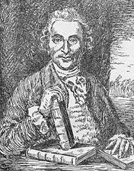
But before then…
Courtesy of the National Library of
Medicine
James Lind (1716-94)
1747: (possibly) first ever controlled medical experiment
Cider | Sea water
Sulphuric acid (!) | Oranges
Vinegar | Barley water
Notes:
~9 years before that, a Scottish surgeon James Lind found a solution.
If you pickle food, it doesn’t go bad…so can we pickle, or, preserve, sailors?
Took twelve sailors, divided them into six pairs, and gave each pair something different: cider, sea water, vitriol (which is a weak solution of sulphuric acid, must’ve been a bad day to be those guys), oranges, vinegar, and barley water.

Slide 6
Oranges (and lemons)…
Courtesy of the National Library of
Medicine
James Lind (1716-94)
1747: (possibly) first ever controlled medical experiment
Cider | Sea water
Sulphuric acid | Oranges
Vinegar | Barley water
And no-one listened…he’s not an English gentleman!
But in 1794 the Admiralty gave it a go…
…and England came out on top!
Notes:
Sailors who were given oranges were back on their feet in just a few days, while the others continued to sicken.
British expeditions that went into the South Pacific and around Africa took lime trees with them.
Many historians believe that one of the key reasons England came out of Napoleonic Wars on top.

Slide 7

Modern medicine
Medical profession eventually realised controlled studies were the right way to go
David Sackett
  Pioneer of “evidence-based medicine”
  Randomised double-blind test is a “gold standard”
Cochrane Collaboration
  http://www.cochrane.org/
  Largest collection of records
  of randomised controlled trials
  in the world
Image courtesy of Lab Science Career
Notes:
Randomised double-blind test – no drug/medicine released to market until this happens.

Slide 8

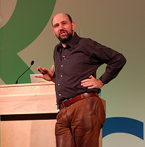
What about software development?
Martin Fowler IEEE Software, July/Aug 2009
“[Using domain specific language] leads to two primary benefits. The first, and simplest, is improved programmer productivity... The second... is... communication with domain experts.”
Image courtesy of adewale_oshineye
Notes:
He wrote the book on refactoring, literally! (In 1999)
Plus 8 other books

Slide 9

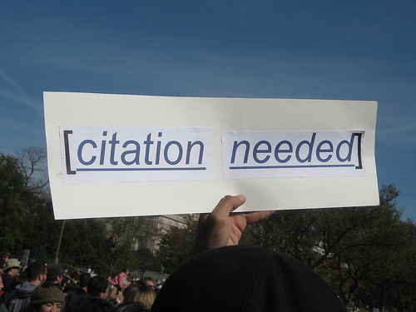
Just one more thing…
Two substantive claims…
  …without a single citation!
Where’s the proof?
“Many software researchers advocate rather than investigate” – Robert L. Glass (2002)
Par for the course!
Image courtesy of whatleydude
Image courtesy of futureatlas.com
Notes:
Perhaps it seems like a good idea – you can express the problem you want to solve in a language that is closer to the area in which you want to express it.
Advocate: RLG, Facts and Fallacies of Software Engineering – “probably true that this is the most contentious fact in this book”.
In software engineering this is par for the course, perhaps with a brief reference to an article from some guy over there who happened to agree.
But it’s not proof.

Slide 10
Simply the best?
“Exploratory experimental studies comparing online and offline programming performance”
  Sackman, Erikson and Grant (1968)
“The best programmers are up to 28 times more productive than the worst”
  So all we need are a few good people (apparently)…
1968!
  Designed to compare batch versus interactive
  12 programmers for an afternoon
Notes:
But we still have to beware!
Often expensive to do, many flawed or incomplete, but standards are improving.
Dozens of books quote this.
A few good people…like us!
Was done in 1968 and not designed to measure productivity but batch versus interactive systems!
And just used 12 programmers – bad use of statistics.
Bohen in 1975 claims up to a factor of 5 which is consistent with other disciplines.

Slide 11


Times, they are a changin’
Growing emphasis on empirical studies since the mid-1990s
Papers describing new tools or practices routinely include results from some kind of field study
International Conference on Software Engineering
Empirical Software Engineering
“It will never work in theory”
Notes:
A cultural shift.
Studies are hard to do and expensive but, compared to clinical trials, nothing.
Software controls planes, financial transactions, the results of your research! It’s important.

Slide 12
So what do we know?

Slide 13
Understand your requirements
“Some Experience with Automated Aids to the Design of Large-Scale Reliable Software”
  Boehm et al (1975)
Most errors are introduced during requirements analysis and design
The later an error is detected the more costly it is to address
  1 hour to fix in the design
  10 hours to fix in the code
  100 hours to fix after it’s gone live…
number / cost
time
Notes:
Validated by many others.
After it’s gone live when you’ve been hit with a lawsuit!
It’s also more difficult to fix a bug in code you were working on a year ago, than code you were working on last week!

Slide 14


Invite others to read your code
Rigorous inspections can remove 60-90% of errors before first test is run
  Fagan (1975) “Design and Code Inspections to Reduce Errors in Program Development"
The first review and hour matter most
  Cohen (2006) “Best Kept Secrets of Peer Code Review”
Develop code in small, readable, reviewable chunks
Notes:
Fagan – don’t run the code, don’t even test it yet…Read it!
This is one reason why we’ll recommend pair programming.
Cohen’s: footnote…
Having two or more people read the code, or for longer, doesn’t really yield a good enough return to make it worthwhile.
For best value, have one other read through the code for an hour at a time.
After an hour your brain is full and you end up finding only trivial formatting errors.
This is why we’ll recommend developing code in small, reviewable, chunks, regularly adding these to version control so others can see them.

Slide 15
Errors of a feather…
About 80% of the defects come from 20% of the modules, and about half the modules are error free
  Boehm and Basili (2001)
When you identify more errors than expected in some program module, keep looking!
Notes:
Errors cluster and we’ve known this since 1975!

Slide 16
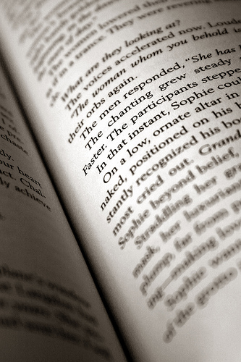
How did you learn to program?
You don’t just go out and write War and Peace
  You’d read other skilled writers first
Teach maintenance first
  Harlan Mills (1990)
“The best way to prepare [to be a programmer] is to write programs and to study great programs that other people have written” Susan Lammers, 1986, quoting a younger Bill Gates
Image courtesy of dwyman
Notes:
Quentin Tarantino made Reservoir Dogs…after watching De Palma, Leone, Scorsese, Hawks.
See how its done well (and badly) and learn, then write it yourself.
Foreign programming languages!
In more mature subjects they teach reading before writing.
SEI (Carnegie Mellon) tried to collect examples of code to read, gave up. Software engineers cannot decide on what is easy to read.

Slide 17
Beware false prophets!
“Anchoring and Adjustment in Software Estimation”
  Aranda & Easterbrook (2005)
  23 computer science students/software developers
  Split into groups, each group given a spec with 1 change
“How long do you think it will take to make a change to this program?”
Group A: “I admit I have no experience with software projects, but I guess this will take about 2 months to finish.”
Control Group: “I’d like to give an estimate for this project myself, but I admit I have no experience estimating. We’ll wait for your calculations for an estimate.”
Group B: “… I guess this will take about 20 months to finish.”
Notes:
Participants were recruited through email invitations sent to graduate computer science students and software developers.
23 participants, 57% had previous estimation experience.
Each group gets a 2 page specification, one variation.
Groups don’t know about the different guesses.

Slide 18
Anchors drag you down
Group A (lowball) | 5.1 months
Control Group | 7.8 months
Group B (highball) | 15.4 months
Novice’s estimate mattered more than…
  Experience in software engineering
  Tools used
  Formality of estimation
Notes:
Anchoring effect – cognitive bias, rely too heavily on one piece of information, in this case the estimate from the novice!
The two biggest causes of project failure are poor estimation and unstable requirements.
van Genuchten (1991) and many others.
Agile methods have shorter timescales but could still be prone to the same percentage mis-estimates.
Not (yet) studied but would be an argument in favour of agile methods IF people were more accurate at shorter period estimations.

Slide 19
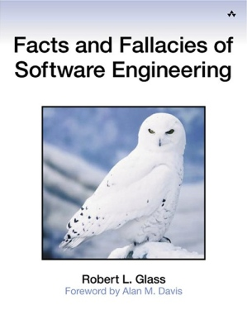
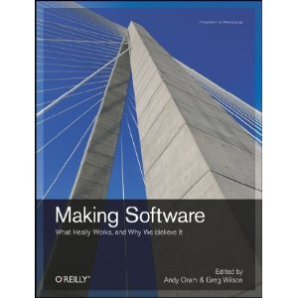
And there are many more…!
http://software-carpentry.org/4_0/softeng/ebse
Notes:
Based on empirical results and qualitative studies.
Not just hearsay, “common sense” or “what we’ve always done”.

Slide 20


So…
Shouldn’t our development practices be built around these, and other, facts?
+
Notes:
…rather than what Fred the Linux guru said in the pub because it worked for him one time.

Slide 21
One other thing we know…
Software developers and researchers differ!
Saying “this is good because software developers say it is good” is not good enough!
We say “this is good because it helps your research”
  Good software development practices contribute to good research
…which we hope to demonstrate!
Notes:
Differ in nature of job, outputs (software versus papers, release and users versus peer review) and recognition.
Though we are advocating the recognition of software and data as first-class research outputs in their own right.

Slide 22
Who are we?
Instructors
  Steve Crouch
  John Robinson
  Devasena Inupakutika
Helpers
  Olivier Philippe
  Don Cruickshank

Slide 23

Software Sustainability
Institute
Cultivate world-class research with software

Slide 24
Research Software Group
www.rsg.soton.ac.uk
Based in Electronics and Computer Science
We help to improve software developed by researchers at Southampton, through:
  Direct collaboration: we provide skilled Research Software Engineers for projects
  Software development skills training: through Software Carpentry workshops
Led by John Robinson
Contact
  rsg-info@soton.ac.uk

Slide 25
Housekeeping
Toilets
  Level 3 north: Ladies
  Level 3 south: Gentlemen
No fire drills today!
Evacuation route
  Exit main door, turn right down corridor
  Use stairs on the right to ground floor

Slide 26
Thursday 17th September
09.00 Arrival
09.30 Introduction - Steve Crouch
10.00 Automating tasks, Bash shell – Steve
11.00 Break
11.30 Bash shell continued
12.00 Break
13.00 Introduction to Python – Devasena
14.30 Break
15:00 Python continued
16:00 Wrap-up of Day 1
16:30 Close

Slide 27
Friday 18th September
09.30 Version control – John
11.00 Break
11.30 Version control continued
12.00 Break
13.00 Writing robust code & unit testing with Python – Steve
14.30 Break
15.00 Unit testing continued
15.30 Wrap-up and feedback – John
16.00 Close

Slide 28
So what’s the deal with these sticky notes anyway?

