Slide 1

Software Carpentry
National Oceanography Centre
18th - 19th September 2018 Chris Cave-Ayland, Steve Crouch, James Graham,
John Robinson
@RSGSoton @SWC
Notes:
So, on the technical front, following on from Mark, will give overview of
- The PEDASI IoT demonstrator itself
- Bring together with an overview of current architecture
- Current status
<number>

Slide 2
Software Carpentry
Before we start:
Please ensure you’ve installed the prerequisites
https://tinyurl.com/swc-nexuss-prereq
Follow the instructions on the Etherpad to download the code repository
https://tinyurl.com/swc-nexuss-etherpad

Slide 3
Software Carpentry
Housekeeping
No fire alarm tests planned
Toilets

Slide 4
Software Carpentry
Why are we here?
We’re scientists or engineers
Our research involves writing code

Slide 5
We should care about software
100%
92%
69%
50%
56%
0%
Use software
Fundamental to results
Develop own code
Source: Software Sustainability Institute Survey 2014

Slide 6
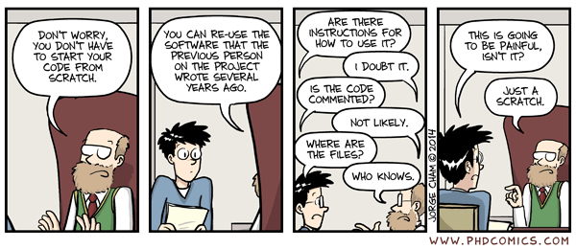
We should care about software
We want to set you on the road to writing Sustainable Software

Slide 7

Software Carpentry
The take-home message is:
This is the Software Sustainability Institute motto
www.software.ac.uk

Slide 8
Software Carpentry
“Teaching researchers the computing skills they need to get more done in less time and with less pain”
27,000 + Researchers taught since 1998 in 35 Countries
Materials are freely reusable (CCA license)

Slide 9
Who are we?
Chris Cave-Ayland: iSolutions, UoS
Steve Crouch: Research Software Group, UoS
James Graham: Research Software Group, UoS
John Robinson: Research Software Group, UoS

Slide 10
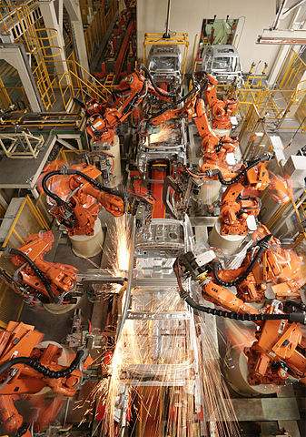
Bash Shell
Day 1 - AM
Chris Cave-Ayland
Automation
Not just about learning commands
Learning just a few things can make a huge difference to productivity

Slide 11
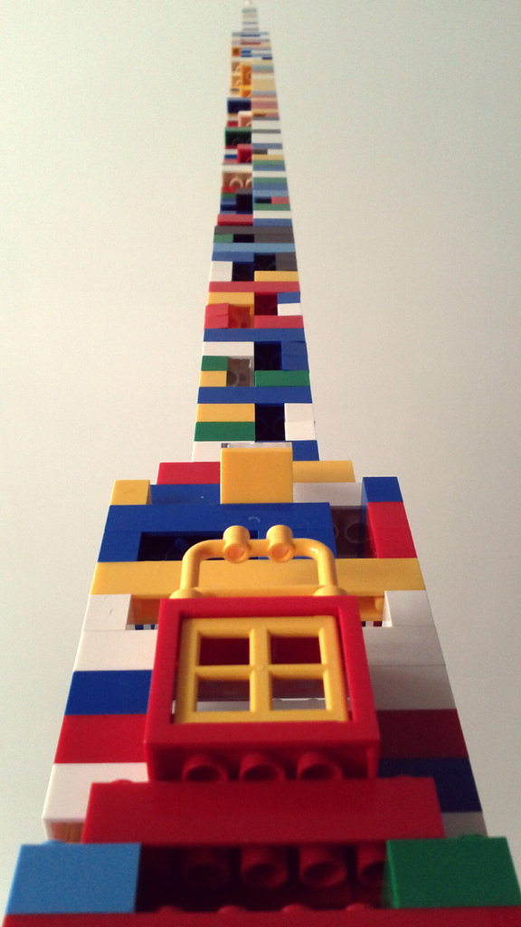
Python
Day 1 - PM
James Graham
Day 2 - AM
Steve Crouch
Beyond syntax…
How to build programs step-by-step
Comprehensive, reusable, testable

Slide 12
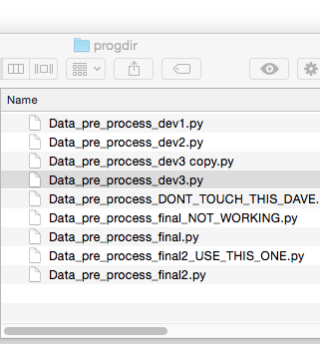
Version Control (Git)
Day 2 - PM
John Robinson
How has this code changed?
Who made this change?
Which version of this code was used to generate this result?
Reproducibility

Slide 13
Software Carpentry
Some final words

Slide 14
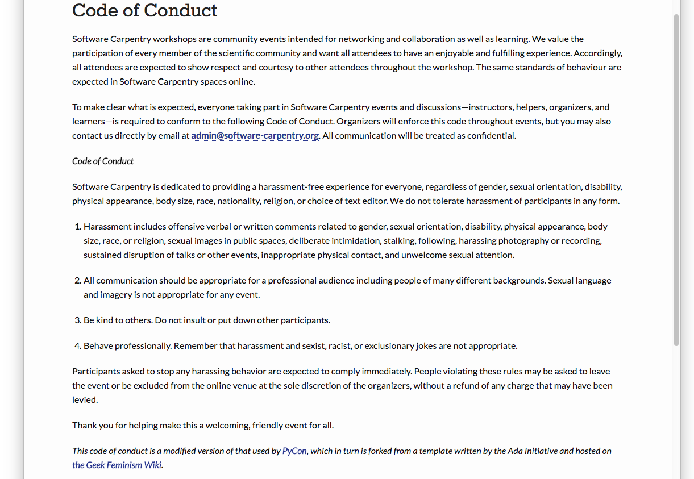
Code of Conduct
http://software-carpentry.org/conduct/

Slide 15
Need help?
Say hi to your neighbours!

Slide 16
Need help?
Sticky notes

Slide 17
Need help?
Ask the group in:
https://public.etherpad-mozilla.org/p/SWC-Soton-Sep2018

Slide 18
Pre-workshop Survey
Help us to help you, by telling us what you know
5 Questions / 1 min
https://tinyurl.com/swc-nexuss-presurvey

