Slide 1

Software Carpentry
21st - 27th May 2020
Sam Mangham, Steve Crouch, James Graham,
John Robinson, Ania Brown
@RSGSoton @swcarpentry
Notes:
So, on the technical front, following on from Mark, will give overview of
- The PEDASI IoT demonstrator itself
- Bring together with an overview of current architecture
- Current status

Slide 2
Software Carpentry
Before we start:
Ensure you’ve installed the prerequisites
  https://tinyurl.com/2020-5-21-prereq
Download the code repository
  git clone https://github.com/Southampton-RSG/2020-05-27-southampton-swc.git
Complete the pre-workshop survey:
  https://tinyurl.com/2020-5-21-before

Slide 3
Software Carpentry
Housekeeping
Disconnect from the VPN
Don’t use the SVE
Don’t save to a network drive

Slide 4
Software Carpentry
Why are we here?
We’re scientists or engineers
Our research involves writing code

Slide 5
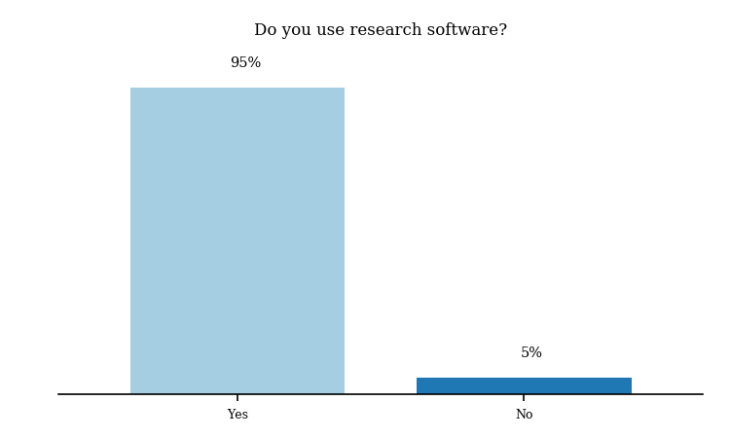
We should care about software
University of Southampton Software Survey 2019

Slide 6
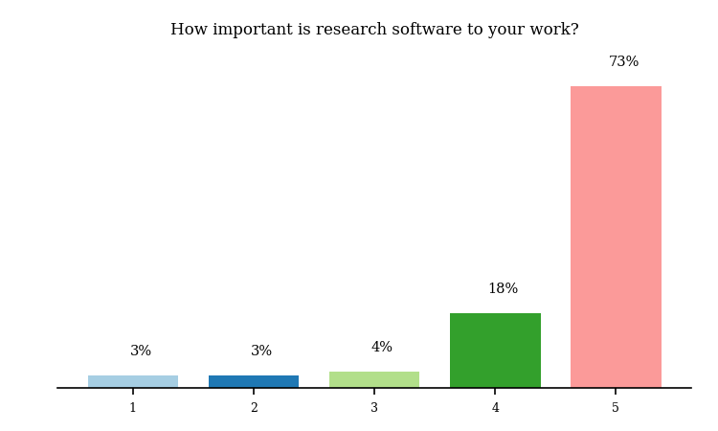
We should care about software
University of Southampton Software Survey 2019

Slide 7
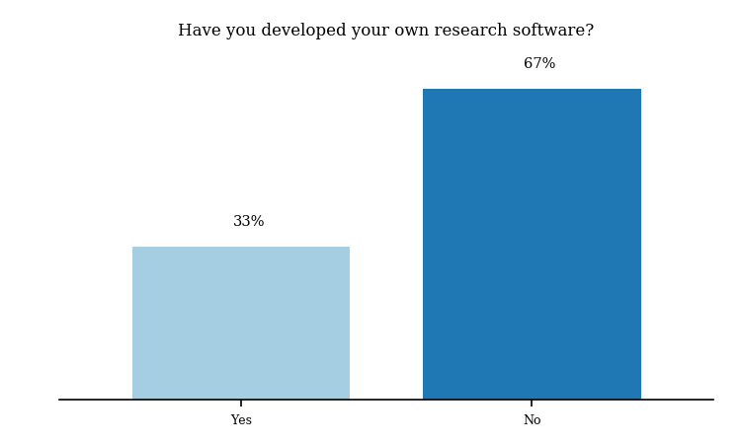
We should care about software
University of Southampton Software Survey 2019

Slide 8
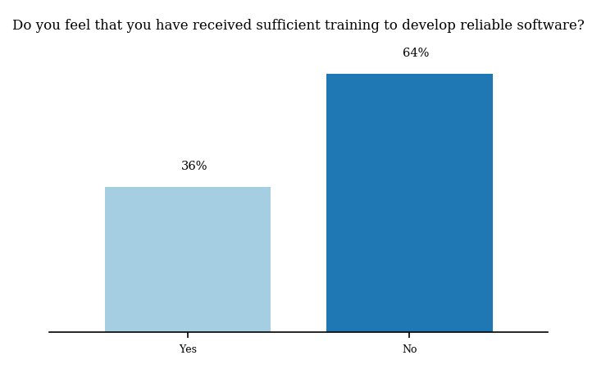
We should care about software
University of Southampton Software Survey 2019

Slide 9
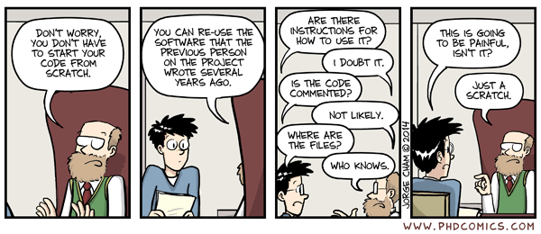
We should care about software
We want to set you on the road to writing Sustainable Software

Slide 10

Software Carpentry
The take-home message is:
This is the Software Sustainability Institute motto
www.software.ac.uk

Slide 11

Software Carpentry
“Teaching researchers the computing skills they need to get more done in less time and with less pain”
27,000 + Researchers taught since 1998 in 35 Countries
Materials are freely reusable (CCA license)

Slide 12
Who are we?
Research Software Group – rsg.southampton.ac.uk @RSGSoton
Sam Mangham, Steve Crouch, James Graham, John Robinson, Ania Brown, Pip Grylls

Slide 13
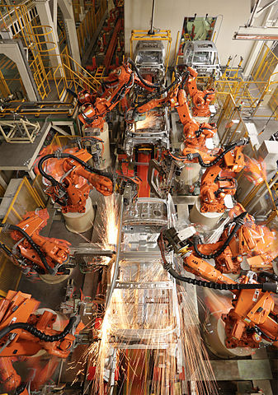
Bash Shell
Day 1 - AM
  John Robinson
Automation
Not just about learning commands
Learning just a few things can make a huge difference to productivity

Slide 14
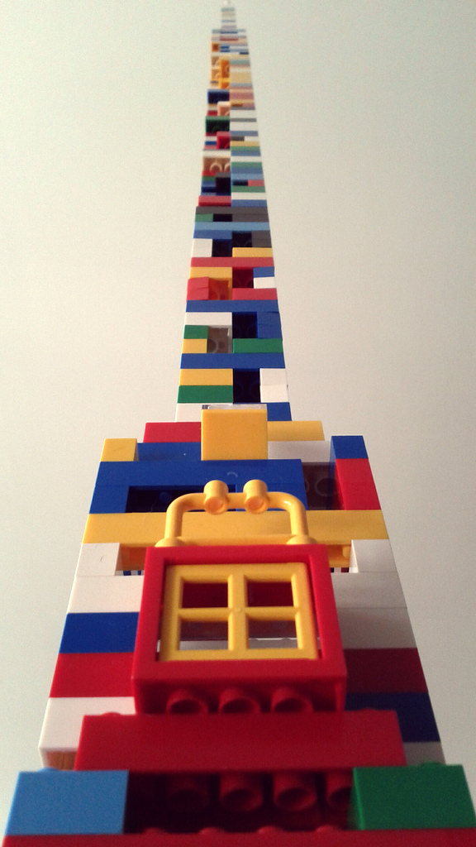
Python
Day 1 - PM
  James Graham
Day 2 - AM
  Steve Crouch
Beyond syntax…
How to build programs step-by-step
Comprehensive, reusable, testable

Slide 15
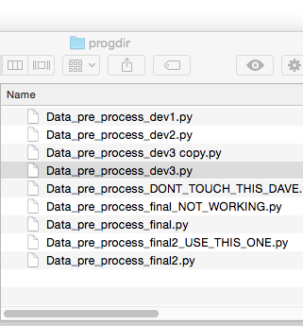
Version Control (Git)
Day 2 - PM
  Sam Mangham
How has this code changed?
Who made this change?
Which version of this code was used to generate this result?
Reproducibility

Slide 16
Software Carpentry
Some final words

Slide 17
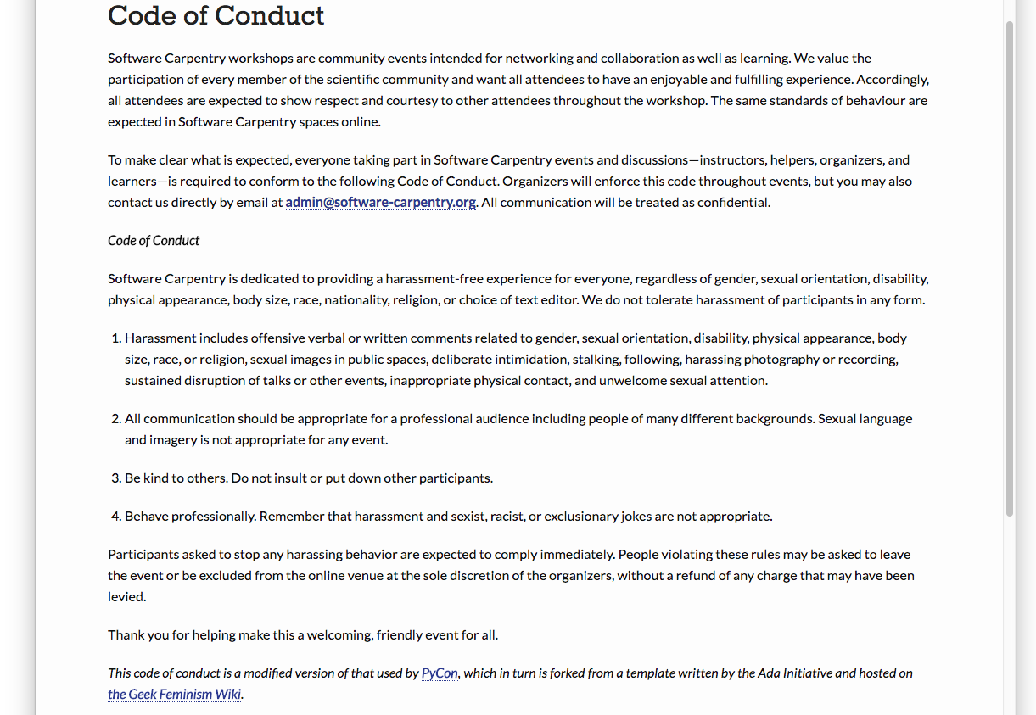
Code of Conduct
http://software-carpentry.org/conduct/

Slide 18
Need help?
Say hi to your neighbours!

Slide 19
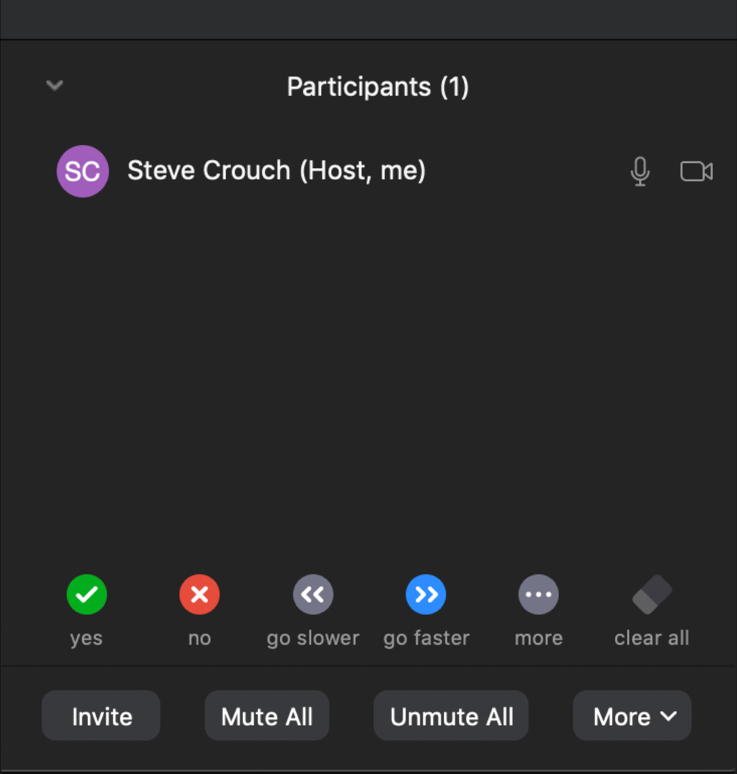
Zoom Usage
Select ‘Participants’
  Hover over your name
  Mute (e.g. when not speaking)
yes / no voting
‘… more’ for other status options
Please ask questions – vocally or via Zoom chat

Slide 20
Pre-workshop Survey
Help us to help you, by telling us what you know
5 Questions / 1 min
  https://bit.ly/2020-5-21-before

