Slide 1
Version Control with Git
Before we start
      Sign up at github.com
Notes:
Take a brief look at
what version control is,
when you might find it useful

Slide 2
What is Version Control?
(AKA revision control, source control)
Tracks changes to files
Any file can be tracked
Text (.txt, .csv, .py, .c, .r etc.) works best
            These allow smart diff / merge etc.
Notes:
Version control - aka source / rev.control - tracks changes to files
At simplest - a better way to back up your files – you never throw anything away.
But also, Helps avoid this situation ->

Slide 3

Why Use Version Control? #1
A more efficient backup
Reproducibility
Notes:
We’ve all been in this situation before! It's crazy to have lots of similar versions of the same document.
Some apps deal with this a little better - MS Word Track Changes. BUT research isn’t just Word docs.
With VC, you can label each significant change that you make and store this history with the file
at any point in the future, you can retrieve the right versions of your documents, scripts or code.
So 1yr after publishing a paper, you can instantly find the exact combination of scripts and data that you used to assemble it.
VC makes reproducibility simpler.

Slide 4

Why Use Version Control? #2
Teamwork
Notes:
Recognise these guys?
As well as keeping a rev history, VC tools help multiple authors work together on same file.
Every large software project uses VC
Keeps track of who changed what, and when. And who to blame when things to go wrong.

Slide 5
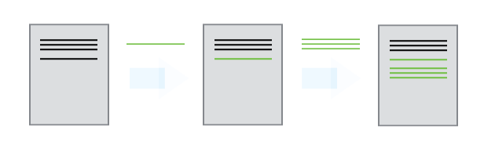
Version Control Tracks Changes
          Changes are tracked sequentially
Notes:
Let's take a high level view of how VC systems work.
As mentioned, they track CHANGES to files
Like a tape that you can rewind, and play back changes to get back to get to most recent version

Slide 6
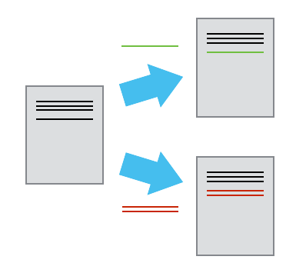
Version Control Tracks Changes
          Different versions can be saved
Notes:
Once you think of changes as separate from the document itself, you can then think about “playing back” different sets of changes onto the base document and getting different versions of the document.
For example, two users can make independent sets of changes based on the same document.

Slide 7
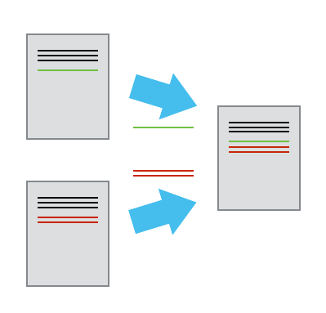
Version Control Tracks Changes
          Multiple versions can be merged
Notes:
If there aren't conflicts, you can even try to play two sets of changes onto the same base document.
A process call **merging**.

Slide 8
Version Control Alternatives
Subversion (svn) - Centralised
Mercurial (hg) - Distributed
Git (git) – Distributed
  Most widely used in academia!
N.B. GitHub != git
  Alternatives like GitLab exist
Notes:
Let's have a brief look at the most popular VC systems
If you're a greybeard like me you might have a soft spot for Subversion.
svn been around since about 2000. Dev to replace CVS. Allowed mv /ren with provenance.
hg and git arose from the need to find a new VC for the Linux Kernel, after BitKeeper → Non free
Svn has sinlge central master repository hg and git are dist VCSs. Eash devs codebase is a complete repo. Can use offline, no 1 point of fail.
Git written by Linus. Made pop in part by github, repo hosting + project man tools. Git != github

Slide 9
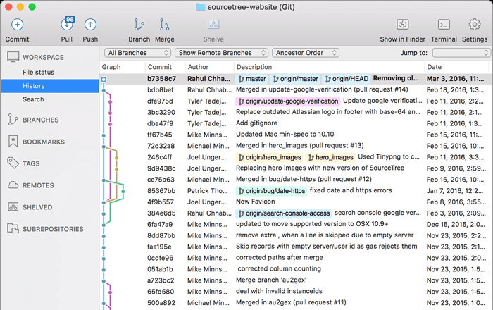
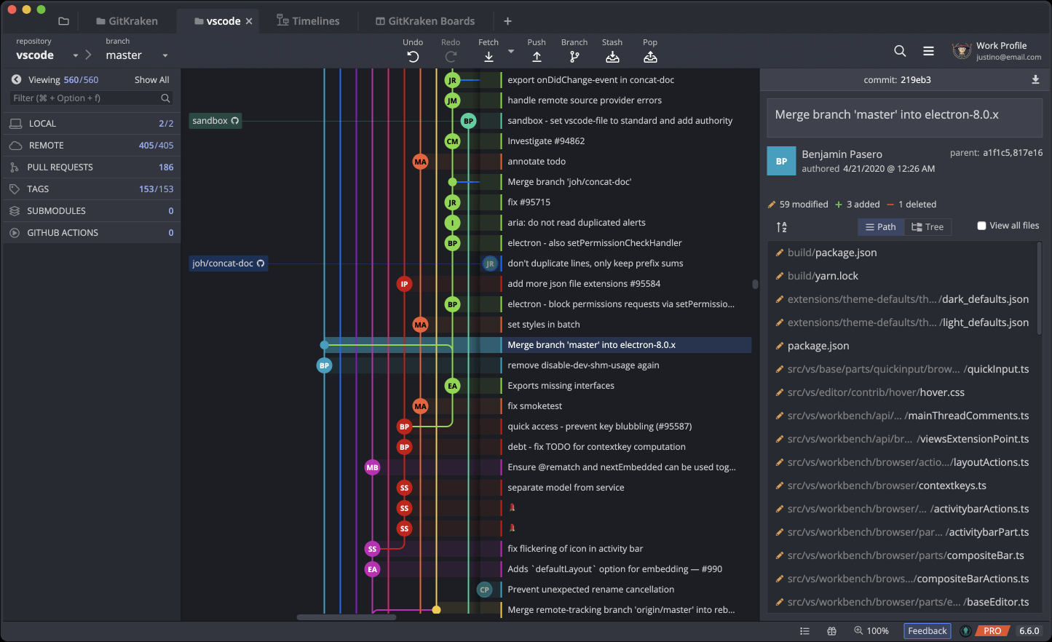
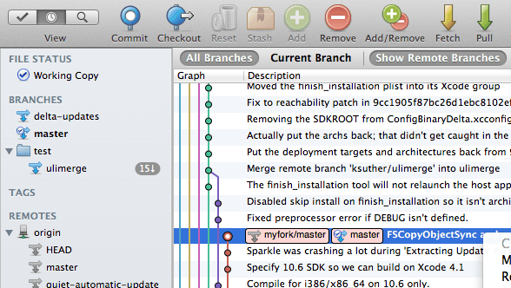
Graphical Version Control
SourceTree
Git Kraken
Git GUI
Notes:
Let's have a brief look at the most popular VC systems
If you're a greybeard like me you might have a soft spot for Subversion.
svn been around since about 2000. Dev to replace CVS. Allowed mv /ren with provenance.
hg and git arose from the need to find a new VC for the Linux Kernel, after BitKeeper → Non free
Svn has sinlge central master repository hg and git are dist VCSs. Eash devs codebase is a complete repo. Can use offline, no 1 point of fail.
Git written by Linus. Made pop in part by github, repo hosting + project man tools. Git != github

Slide 10
Local Configuration
git config

Slide 11
Getting Demo Files
git clone https://github.com/Southampton-RSG/swc-ramp-git

Slide 12
Creating a Repository
git init
git status

Slide 13
Tracking Changes to Files
git add
git commit

Slide 14
Git – add and commit
Workspace
Staging
Area
Local Repo
add
commit
Visible File System
Git Repository

Slide 15
Exploring History #1
git log
git diff

Slide 16
Git – diff #1
Workspace
Staging
Area
Local Repo
diff
diff --staged
Visible File System
Git Repository

Slide 17
Git – diff #2
Workspace
Staging
Area
Local Repo
diff sl33v51a
sl33v51a
f22b25e
g31a45d
HEAD ~2
HEAD ~1
diff HEAD
HEAD
Visible File System
Git Repository

Slide 18
Restoring Files
git checkout

Slide 19
Git - restoration
Workspace
Staging
Area
Local Repo
f22b25e
sl33v51a
checkout f22b25e
f22b25e
g31a45d
HEAD ~2
g31a45d
checkout HEAD
HEAD ~1
HEAD
Visible File System
Git Repository

Slide 20
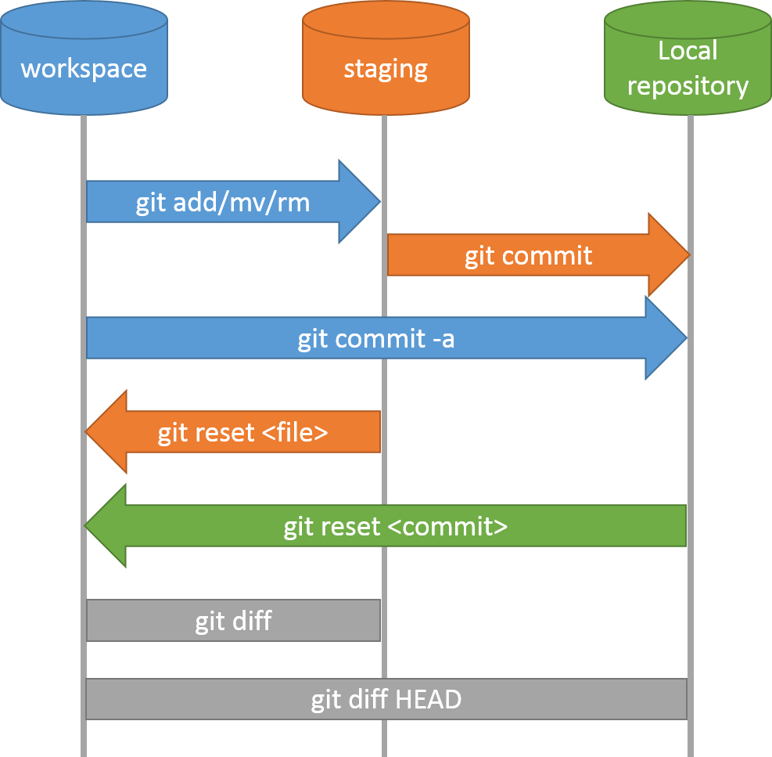
Git Workflow – Local Repo.

Slide 21
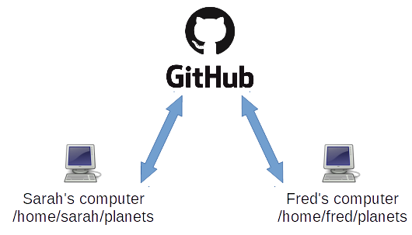
Collaboration
A
B

Slide 22
Collaboration:
Remote Repositories
Sign in https://github.com/
Create repository
git remote add
git push

Slide 23
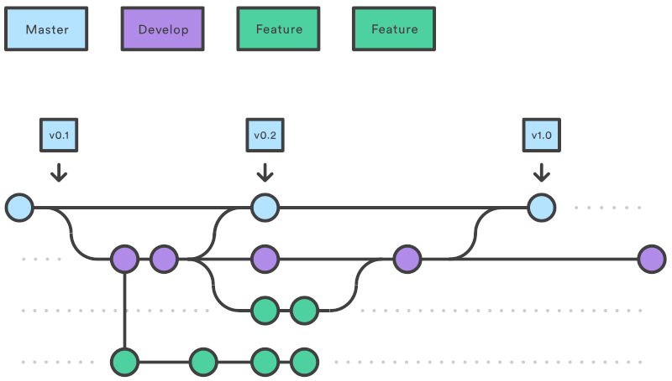
Collaboration:
Branches
https://www.atlassian.com/git/tutorials/comparing-workflows/gitflow-workflow

Slide 24
Collaboration:
Creating Branches
git branch dev
git checkout dev

Slide 25
Collaboration:
Creating Branches 2
Create rainfall_conversion.py
git add rainfall_conversion.py
git commit -m
git push -u origin dev

Slide 26
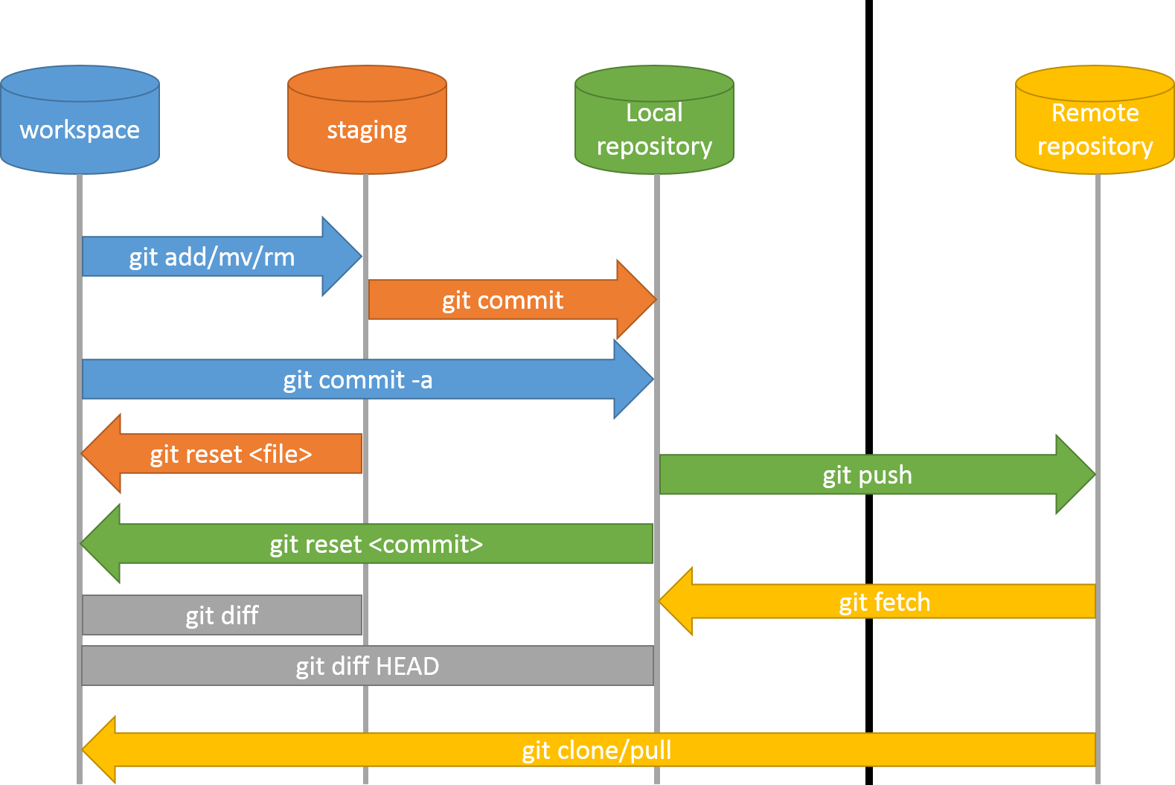
Git Workflow – Remote Repo.

Slide 27
Collaboration:
Branches
https://www.atlassian.com/git/tutorials/comparing-workflows/gitflow-workflow

Slide 28
Collaboration:
Feature Branch Exercise
Check out ‘dev’, and create a new branch called ‘docs’
Create, add and commit README.md
Push to GitHub and merge back to ‘dev’
Pull the changes back to your local ‘dev’ branch
Make sure you consider which branch you're branching off, pushing to, merging with and pulling from and to.

Slide 29
Collaboration:
Feature Branch Solution
git checkout dev
git branch docs
git checkout docs
nano README.md
git add README.md
git commit -m ‘Added documentation’
git push -u origin docs
[Pull request on GitHub]
git checkout dev
git pull

Slide 30
Collaboration:
Summary
‘master’ branch is for releases for papers and the public
‘dev’ branch is for a stable internal version you and your collaborators share
Create a new ‘feature’ branch for every new feature or substantial bug

Slide 31
Collaboration:
Joining on a Collaboration
Clone the repository
Check out ‘dev’ and pull from ‘origin’
Create a new feature branch for your feature
Upload and pull request when you’re done!

Slide 32
Conflicts:
Feature branch
Check out ‘dev’
Create a new branch called ‘inches_to_cm’
Check out ‘inches_to_cm’
Add a ToDo, commit and push to a new branch on GitHub

Slide 33
Conflicts:
Dev branch
Check out ‘dev’ again
Add a ToDo, commit and push to GitHub
Create a pull request on GitHub from inches_to_cm to dev

Slide 34
Conflicts
mm = inches * 25.4
return mm
mm = inches * 25.4
return mm
# TODO: Add function
mm = inches * 25.4
return mm
# TODO: Fix to accept
?

Slide 35
Conflicts:
Resolution
Check out ‘inches_to_cm’ again
Git pull origin dev
Fix rainfall_conversion.py, commit and push to GitHub
Finish the pull request

Slide 36
What next?
Ignore files / Forks
https://software-carpentry.org

