Slide 1


Introduction to using
Tue Vu, PhD.
AI & ML Research Scientist
SMU - OIT

Slide 2
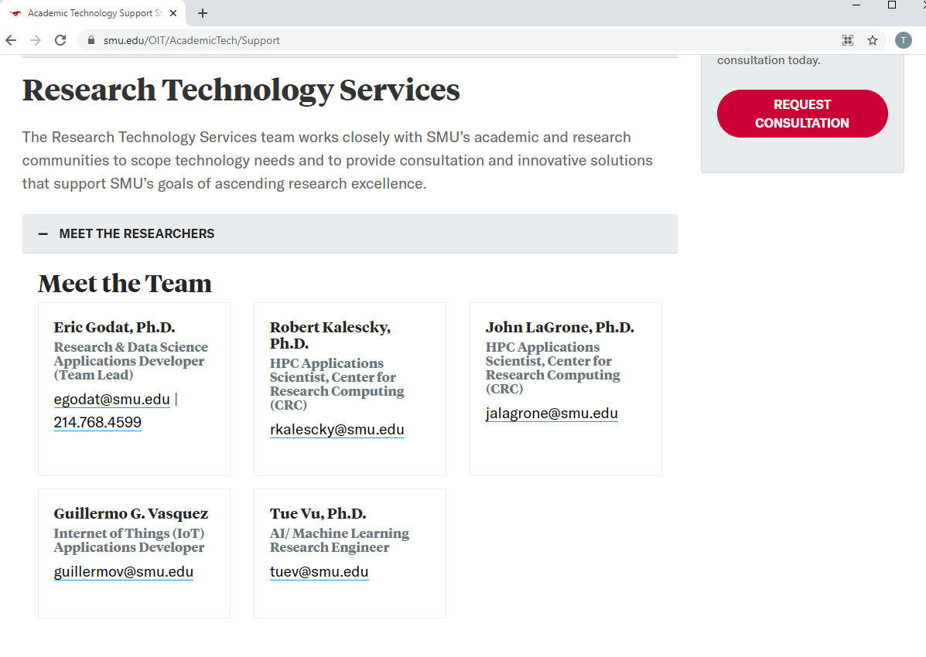
OIT: RESEARCH & DATA SCIENCE SERVICE

Slide 3
Calendar: https://www.smu.edu/libraries
All workshops are from, 1-4pm (CST)
02/16: Machine Learning with Python, part 1 (introduction, scikit-learn, supervised learning)
03/03: Data Science workflow with R (data science with R, caret package for machine learning)
03/09: Machine Learning with Python: part 2 (continued, unsupervised learning)
03/30: Deep Learning with Python: part 1(introduction, keras, basic supervised learning)
04/20: Deep Learning with Python: part 2 (Image classification with CNN, Time series forecasting with RNN)

Slide 4

Outlines:
1. Introduction to Data Science & ML
2. Why R
3. Types of Machine Learning
4. Caret package
5. Supervised Learning
6. Unsupervised Learning

Slide 5
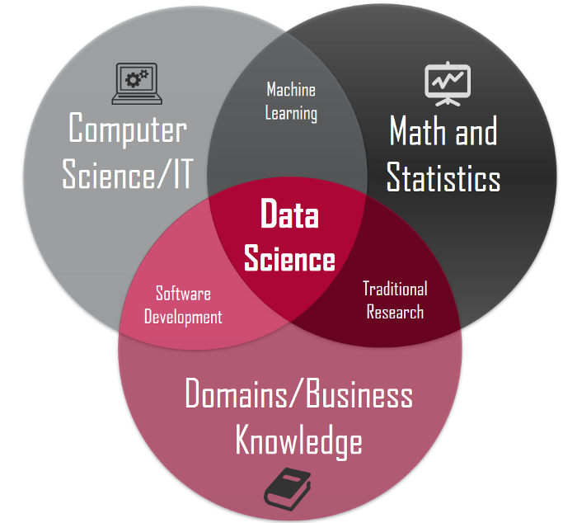
1. Introduction to Data Science & Machine Learning
What is Data Science?
Data science is an interdisciplinary field that uses scientific methods, processes, algorithms and systems to extract knowledge and insights from noisy, structured and unstructured data, and apply knowledge and actionable insights from data across a broad range of application domain

Slide 6
1. Introduction to Data Science & Machine Learning
What is Data Science?
Data science is an interdisciplinary field that uses scientific methods, processes, algorithms and systems to extract knowledge and insights from noisy, structured and unstructured data, and apply knowledge and actionable insights from data across a broad range of application domain
Artificial
Intelligence
Machine
Learning
Deep
Learning

Slide 7
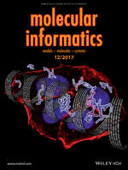




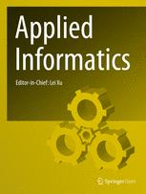


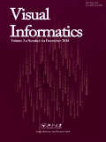


1. Introduction to Data Science & Machine Learning

Slide 8
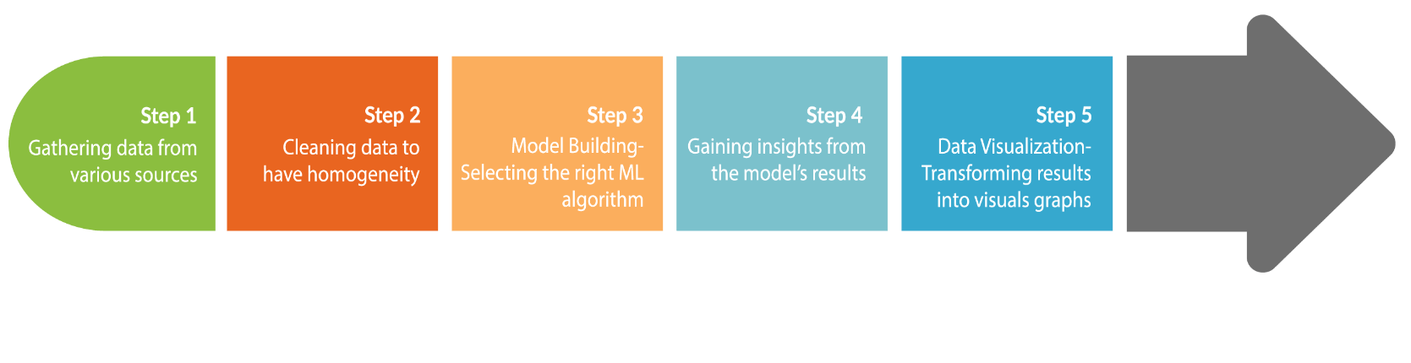
1. Introduction to Data Science & Machine Learning
Overall process of a Data Science project

Slide 9
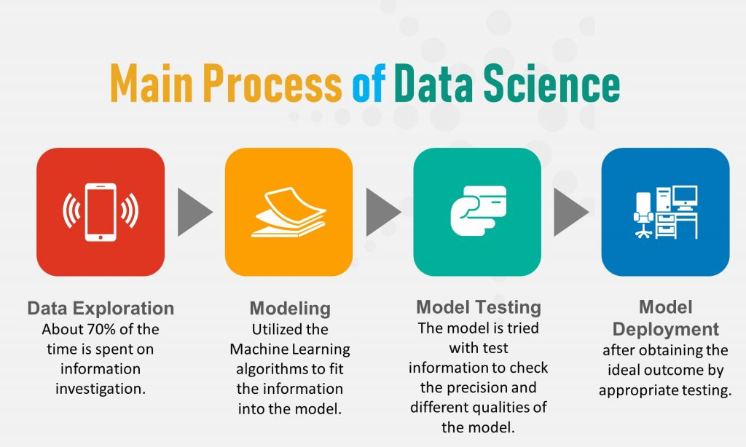
1. Introduction to Data Science & Machine Learning

Slide 10
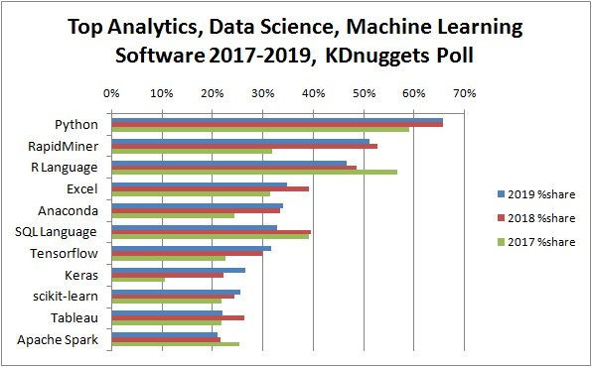
2. Why R?
R is used by the best data scientists in the world. In surveys on Kaggle (the competitive machine learning platform), R is by far on the top used machine learning tool.
R is powerful because of the breadth of techniques it offers. The platform has more techniques than any other that you will come across.
R is state-of-the-art because it is used by both academics and industry.
R is free because it is open source software. You can download it right now for free and it runs on any workstation platform you are likely to use.
R is a great tool for Statistic & Machine Learning. PhD students and researchers need lots of power for their studies and publications
https://www.kdnuggets.com/2019/05/poll-top-data-science-machine-learning-platforms.html

Slide 11
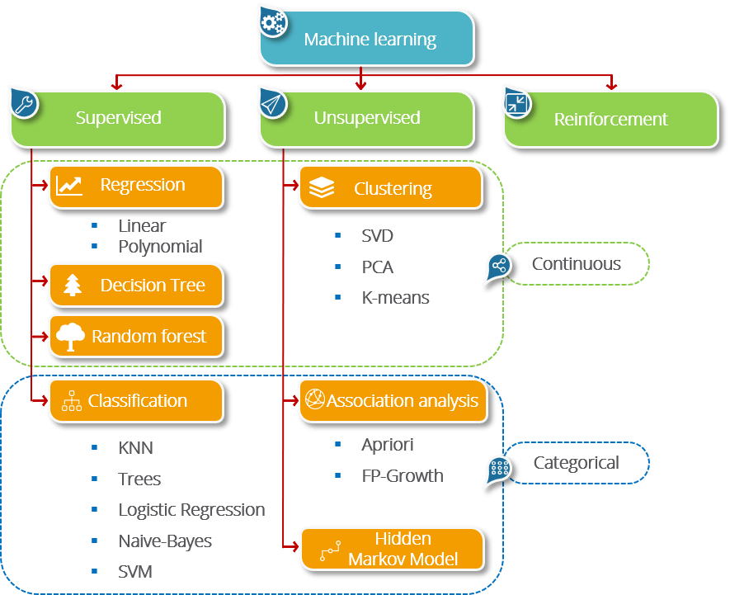
3. Types of Machine Learning
Supervised Learning – Train Me! (target are dependent variables)
Unsupervised Learning – I am self sufficient in learning
Semi-supervised Learning: combination of both methods, when cost to label are high
Reinforcement Learning – My life My rules! (Hit & Trial)
Notes:
https://www.edureka.co/blog/what-is-machine-learning/

Slide 12
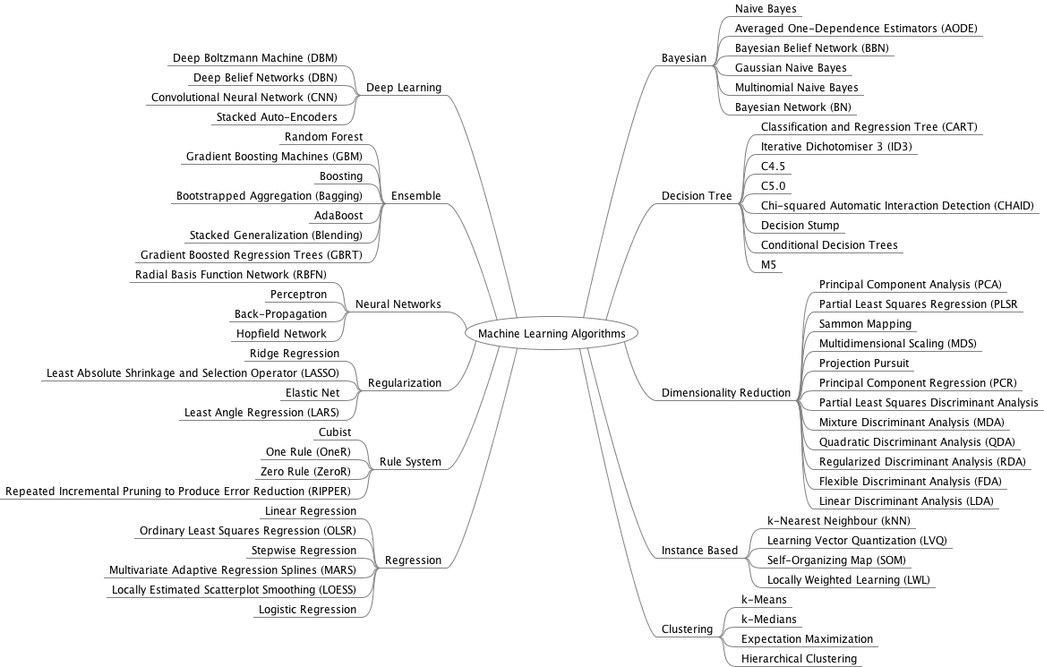
3. Types of Machine Learning
caret

Slide 13
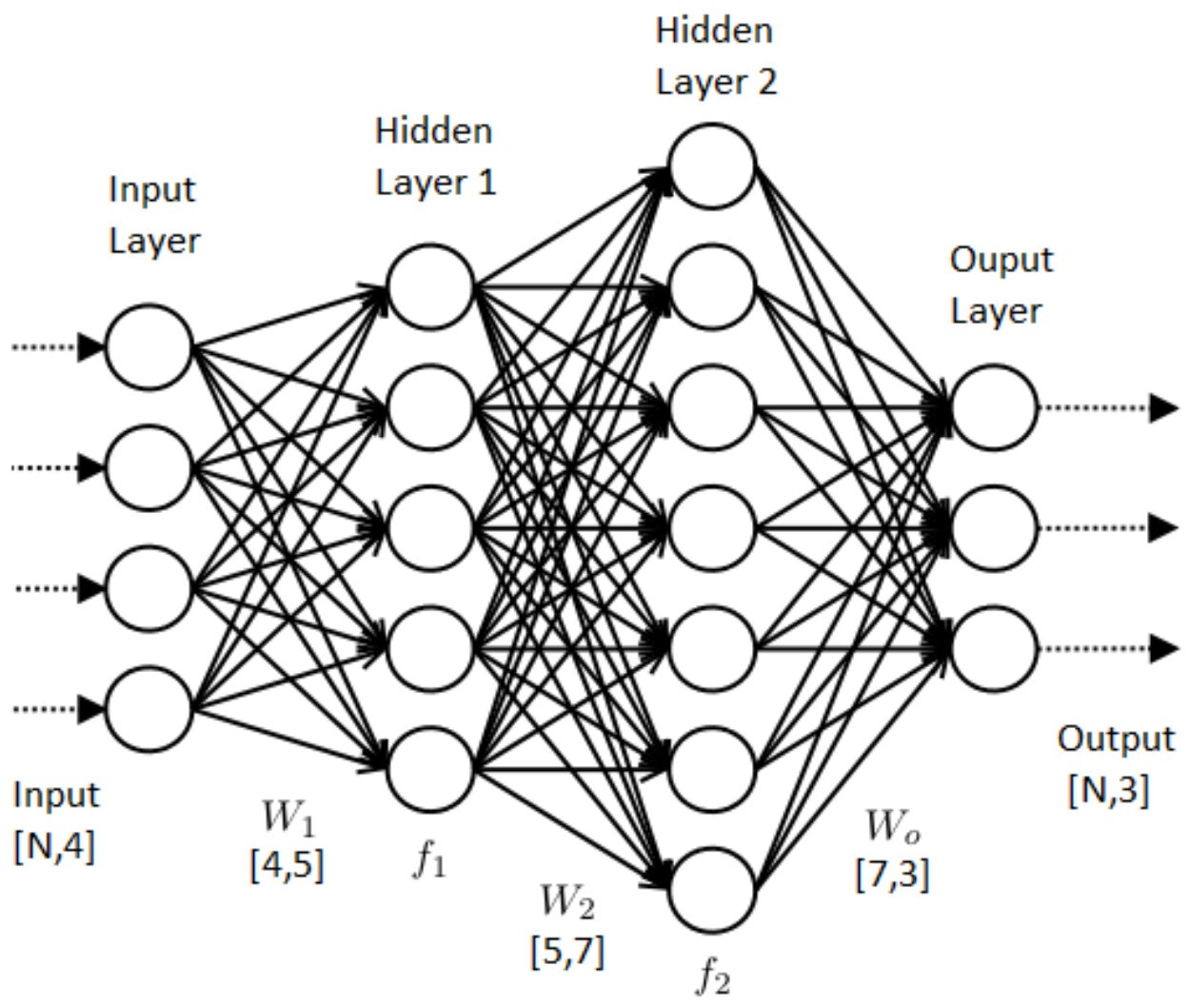
3. Types of Machine Learning
Terminology
SUPERVISED LEARNING ML ALGORITHM
Input variables
Independent variables
Predictors
Features
Input Field
Output variables
Dependent variables
Predictand
Target variables
Outcome Field

