Slide 1

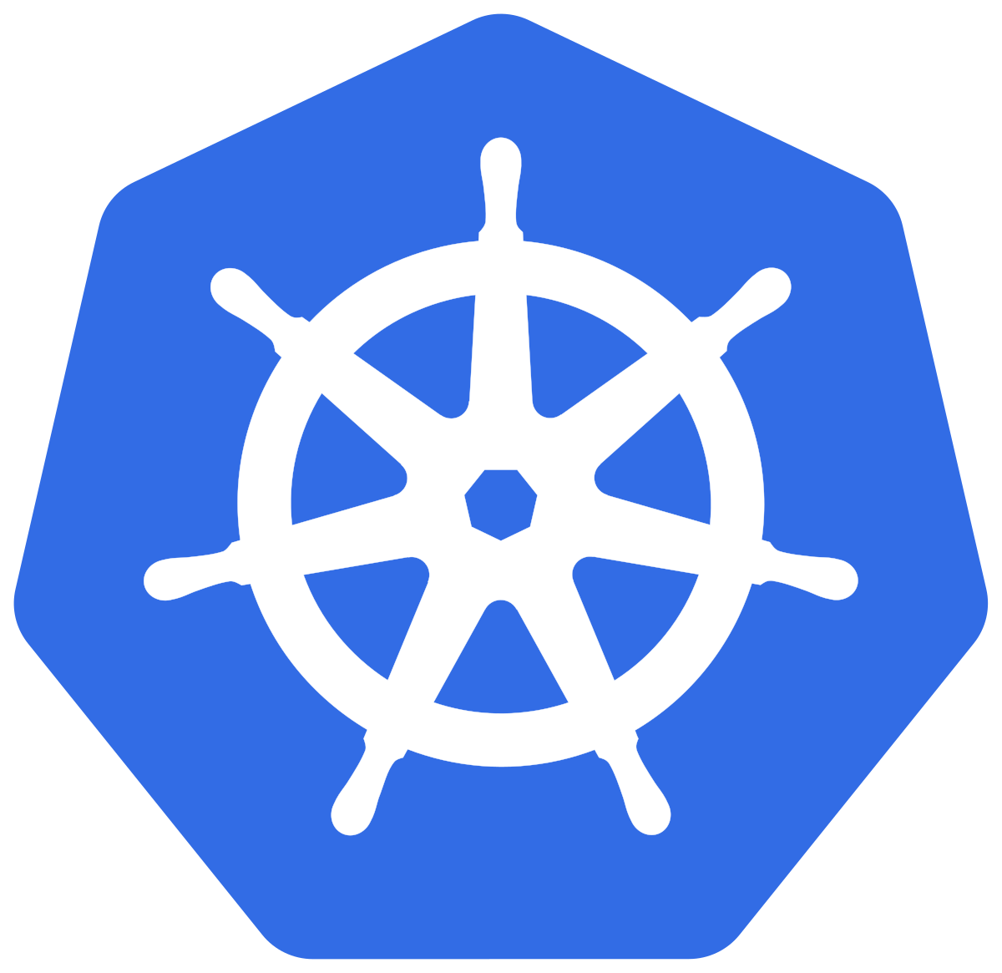


EKS Worker Node
kubelet
containerd
postgres-sakila
security-playground
hello-client

Slide 2





AWS Account sysdig-sales-engineering
Virtual private cloud (VPC) Private Subnet(s)
CloudFormation Stack for each Attendee
EKS Cluster
Amazon S3
Bucket
(to be made public to demonstrate data exfil)
Jumpbox EC2 Instance
(accessed via SSM Session Manager)
security-playground Namespace
security-playground-restricted Namespace
security-playground-restricted-nodrift Namespace
security-playground
security-playground-restricted
security-playground-restricted-nodrift
security-playground-restricted-nomalware Namespace
postgres-sakila Namespace
hello Namespace
security-playground-restricted-nomalware
postgres-sakila
hello-server
hello-client
hello-client-blocked

