Slide 1
UX principles
Closure
Symmetry
Proximity
Continuity
Focal Point
Figure-ground
Connectedness
Similarity
Common Region
Common Fate
Explanation to each principle are wrote in comment in the following slides

Slide 2

Risc Game
Username:
Password:
Login
Don’t have an account? Sign up now!

Slide 3
Risc Game
Username:
Password:
Ensure your password:
Return
Submit

Slide 4
Risc Game
New Game
Continue Game
Exit

Slide 5
2 Player
Limgrave
3 Player
Liurnia
4 Player
Caelid
5 Player
Altus

Slide 6
5 Player - Limgrave
Waiting for other players …

Slide 7
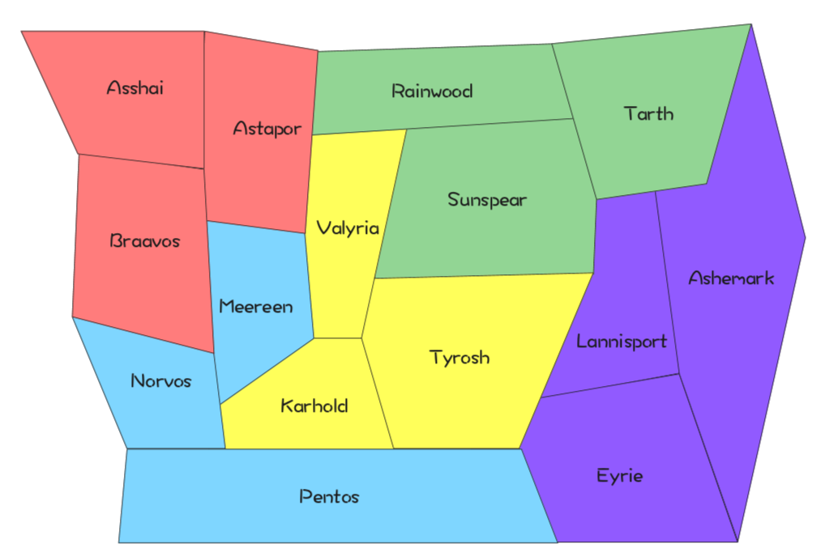
Player: Blue
Test
Unit
Table
# Unit
Source
Dest
Attack
Unit Type
Move
Unit Type
Target Type
# Unit
Units Upgrade
Tech Upgrade
Commit
Back
Food Resource:
100
Tech Resource:
50
Tech level:
1

Slide 8
Player: Blue
Test
Unit
Table
# Unit
Source
Dest
Attack
Finished operations in this turn, waiting for other players …
Unit Type
Move
Unit Type
Target Type
# Unit
Units Upgrade
Tech Upgrade
Commit
Back
Food Resource:
100
Tech Resource:
50
Tech level:
1

Slide 9
Player: Blue
Test
Unit
Table
# Unit
Source
You Win!
Congratulations！
Dest
Attack
Unit Type
Move
Unit Type
Target Type
# Unit
Units Upgrade
Tech Upgrade
Commit
Back
Food Resource:
100
Tech Resource:
50
Tech level:
1

Slide 10
Player: Blue
Test
Unit
Table
# Unit
Source
You Lose!
Dest
Attack
Unit Type
Move
Unit Type
Target Type
# Unit
Units Upgrade
Tech Upgrade
Commit
Back
Food Resource:
100
Tech Resource:
50
Tech level:
1

Slide 11
Continue Game
Join
No.3 5-player game Altus
Join
No.9 3-player game Liurnia
Join
No.20 4-player game Caelid
Join
No.31 2-player game Limgrave

Slide 12
Developer Information
Director
QQ Liu
Server Maintainer & Network Builder
Casper
Full-stack Developer
Jinger
UI & Game designer
Zed

