Slide 1

Machine Learning with TensorFlow Tuberculosis Detection Using Deep Learning Models
Sujith Reddy Chikatipalle
Souvick Chakraborty
03.07.2025

Slide 2
Table of contents
1. Introduction | Problem, dataset source, type of task
2. Literature Review | Related work and existing solutions
3. Dataset Characteristics | Data details and preprocessing steps
4. Baseline Model | Initial model and results
5. Model Definition and Evaluation | Models used and evaluation approach
6. Results | Performance metrics and comparisons
7. Challenges and Errors | Issues faced and solutions
8. Discussion | Interpretation of findings
Conclusion and Future Work | Summary and next steps

Slide 3
Introduction
Global Health Impact: Tuberculosis (TB) is one of the leading infectious diseases worldwide, posing a major public health challenge, particularly in low-resource settings. Early and accurate detection is crucial to control its spread and improve patient outcomes.
Limitations of Traditional Methods:
Sputum microscopy is time-consuming and less effective for patients with low bacterial loads.
Manual interpretation of chest X-rays is subjective, requiring experienced radiologists, leading to delays and potential errors.
Existing Computer-Aided Diagnosis (CAD) systems, while promising, often suffer from limited accuracy.
Need for Automation: There is an urgent need for advanced, automated systems that can rapidly and accurately detect TB from medical images, reducing diagnostic delays and supporting clinical decisions.

Slide 4
Objective: To develop an automated TB detection system using deep learning models to analyze chest X-ray images, enhancing diagnostic speed and reliability.
Type of Task
Binary Classification: Classifies chest X-ray images into Normal (No TB) and TB Positive
Dataset Used:
The chest X-ray dataset was sourced from Kaggle, containing images of patients diagnosed as either TB-positive or normal.
Images were resized to 224×224 pixels for consistency with deep learning model requirements.
Data balancing and augmentation techniques were applied to address class imbalance and improve model robustness
Why Deep Learning? Deep learning, particularly Convolutional Neural Networks (CNNs), offers superior capabilities in extracting complex patterns from images, enabling highly accurate, automated medical diagnoses.

Slide 5
Literature Review
1. Sharma V. et al.
Used UNet for TB lesion segmentation (96.35% accuracy, 99.00% AUC).
Xception model achieved high accuracy for TB classification.
2. Hansun S. et al.
Reviewed 47 studies on TB detection with ML/DL.
ML showed ~94% accuracy and sensitivity.
DL excelled in AUC and specificity (~92%).
Noted data bias and need for robust study designs.
3. Sana Sahar Guia et al.
Combined VGG16/VGG19 with attention mechanism.
Achieved ~99.7% validation accuracy.
Proposed reinforcement learning for further improvement.

Slide 6
Dataset Characteristics
Data Source:
Chest X-ray images sourced from Kaggle, labeled as either TB Positive or Normal.
Dataset Size & Balance:
Original dataset was imbalanced, with more normal cases than TB-positive cases.
Balanced through resampling to ensure equal representation of both classes.
Image Format:
All images converted to grayscale if needed.
Uniform size of 224×224 pixels for compatibility with deep learning architectures.

Slide 7
Dataset Characteristics
Preprocessing Steps:
Pixel intensity normalization applied for better model training.
Images resized and standardized for input consistency.
Data Augmentation Techniques:
Random rotations
Horizontal and vertical flipping
Zooming and shifting
Helps prevent overfitting and improve generalization
Feature Engineering:
Deep learning models automatically extract relevant features through convolutional layers.
Type of Task:
Binary Classification: Predicting whether a chest X-ray is TB Positive or Normal.

Slide 8
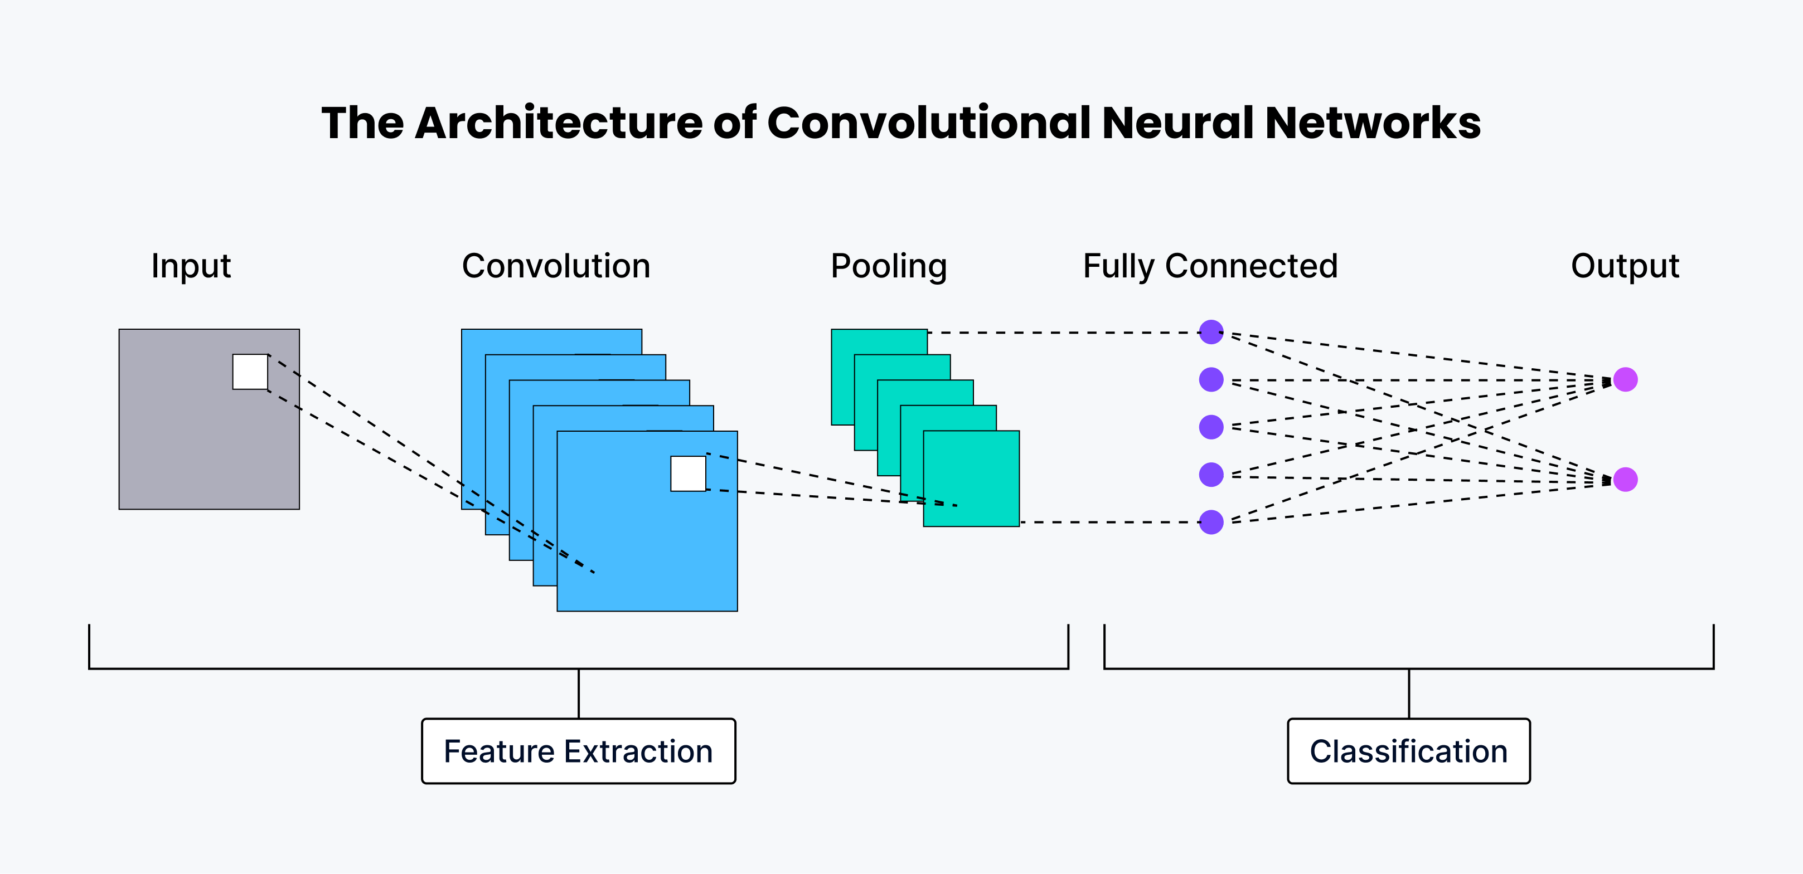
Baseline Model
A simple Convolutional Neural Network (CNN) was chosen as the baseline model to establish a reference point for evaluating more advanced deep learning architectures. This model allowed quick experimentation and provided insights into how well a custom architecture could perform TB classification before investing time and resources into complex models. It served as a useful starting point to identify strengths and limitations in handling chest X-ray images.
Why Chosen:
Quick to build and train
Easy to interpret initial results
Provides a performance benchmark
Architecture:
Convolution and pooling layers
Dense layers for classification
Dropout layers for regularization

Slide 9
Model Definition: Architectures Used
InceptionV3
Uses Inception modules to capture features at multiple scales.
Employs global average pooling to reduce parameters and overfitting.
Xception
Based on depthwise separable convolutions for better efficiency.
Achieves high accuracy with fewer parameters.
DenseNet121
Features dense connections between layers for improved gradient flow.
Encourages feature reuse and reduces vanishing gradient issues.
Custom CNN
Built from scratch with multiple convolutional and pooling layers.
Acts as a baseline for comparison with advanced architectures.

Slide 10
Feature Engineering & Preprocessing
Image Standardization:
All images resized to 224 × 224 pixels.
Pixel intensity normalization applied for consistent inputs.
Data Augmentation Techniques:
Rotation
Horizontal and vertical flipping
Zooming and shifting
Class Balancing:
Resampling techniques used to balance TB-positive and normal classes.
Feature Extraction:
No manual feature engineering—deep models automatically extract relevant features through convolutional layers.

Slide 11
Model Evaluation Strategy
Training Setup:
Models trained using binary cross-entropy loss.
Optimizer: RMSprop.
Batch size: 128, over 10 epochs.
Evaluation Metrics:
Accuracy
Precision
Recall
F1-Score
Validation Approach:
Separate validation set used to monitor overfitting.
Performance tracked through accuracy/loss curves.

Slide 12
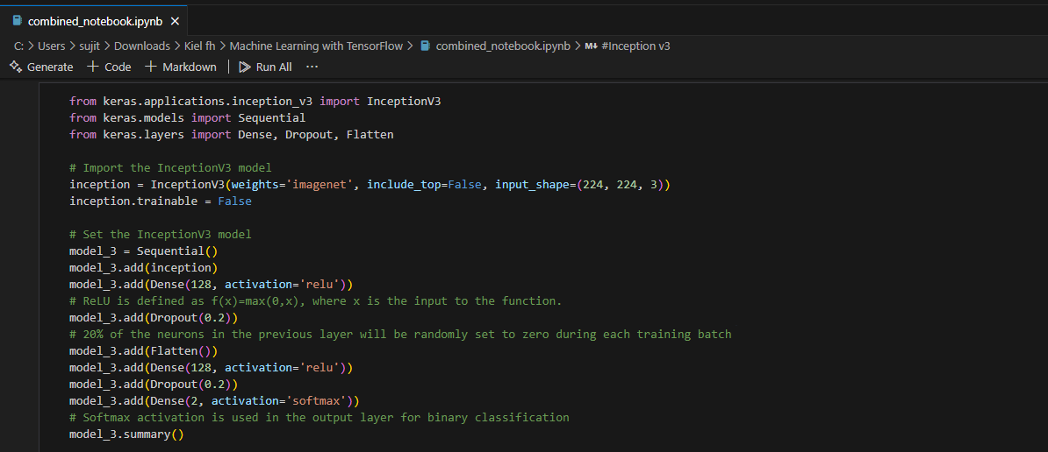
Code Implementation

Slide 13
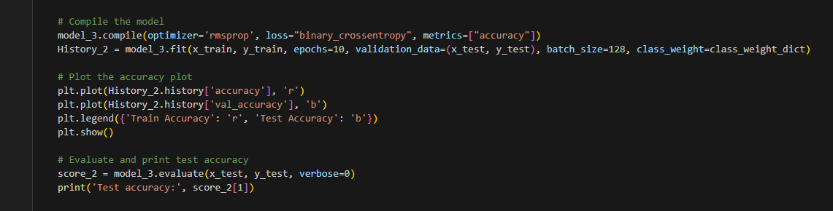
Code Implementation
This is the code used to implement the InceptionV3 model. The same structure is followed for other models like Xception and DenseNet121, with minor changes in base model and pooling layers. For the custom CNN, the architecture is built entirely from scratch without a pre-trained base. Overall, all models share a similar approach of feature extraction followed by dense layers for classification.

Slide 14
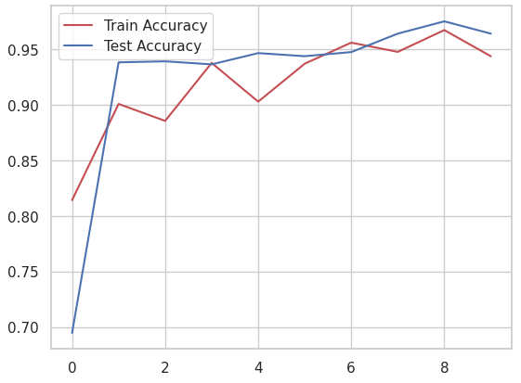
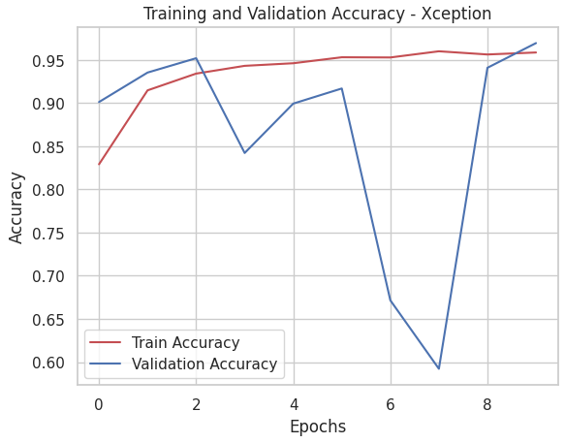
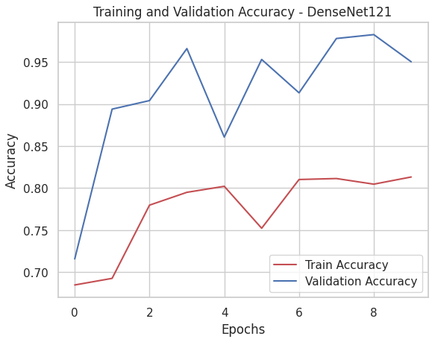
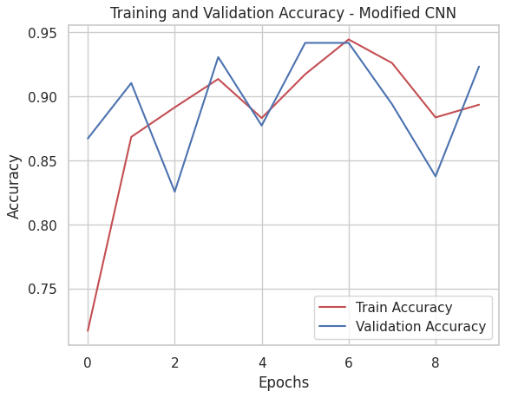
Results Overview
These are the training and validation accuracy graphs for all four models: InceptionV3, Xception, DenseNet121, and the custom CNN. They show how each model learned during training and how well they performed on unseen data.

Slide 15
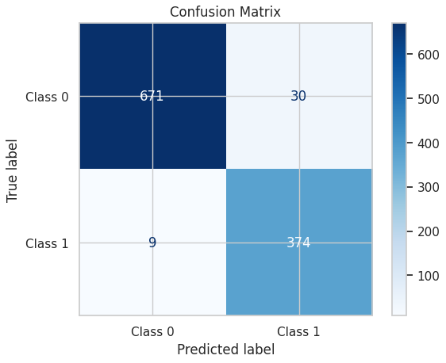
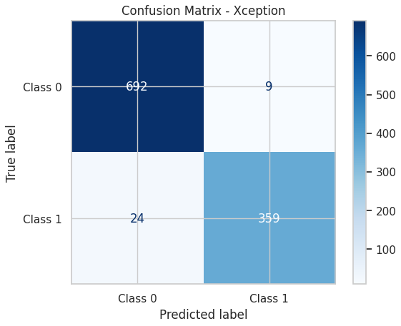
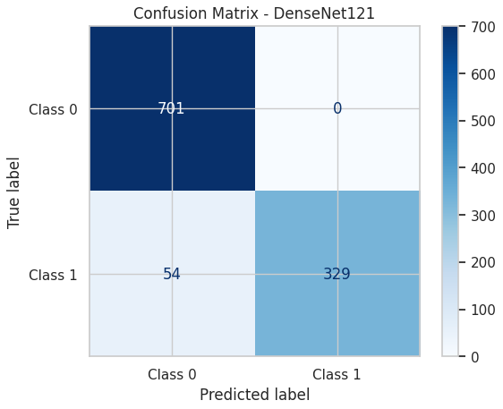
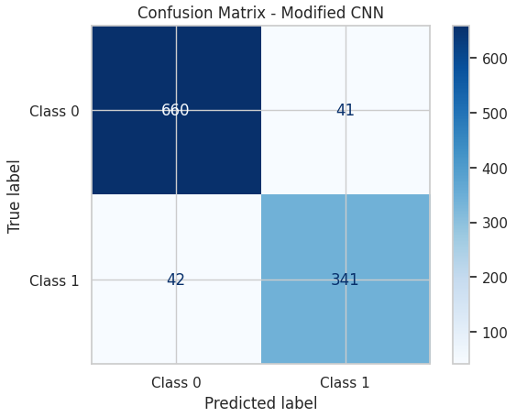
Results Overview
These confusion matrices display the number of correctly and incorrectly classified images for each model. Lower values of false positives and false negatives indicate better performance. Xception and InceptionV3 show the most balanced and accurate results.
True Positive (TP): Model correctly predicts TB-positive.
False Positive (FP): Model incorrectly predicts TB-positive when it’s normal.
True Negative (TN): Model correctly predicts normal.
False Negative (FN): Model incorrectly predicts normal when it’s TB-positive.

Slide 16
Overall Results Table
This table summarizes the key performance metrics for all four models, including accuracy, precision, recall, and F1-score. Xception achieved the best overall performance.
Metrics Derived:
Accuracy = (TP + TN) / (TP + TN + FP + FN)
Precision = TP / (TP + FP)
Recall = TP / (TP + FN)
F1-Score = 2 × (Precision × Recall) / (Precision + Recall)
Model | Accuracy (%) | Precision (%) | Recall (%) | F1-Score (%)
InceptionV3 | 96.40 | 96 | 97 | 96
Xception | 96.95 | 97 | 96 | 97
DenseNet121 | 95.01 | 96 | 93 | 94
Custom CNN | 92.34 | 92 | 92 | 92

Slide 17
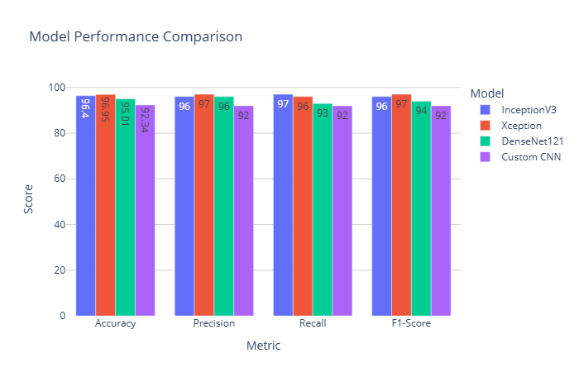
Graphical Representation of Test Results
This bar graph compares accuracy, precision, recall, and F1-score for all four models. Xception achieved the best overall performance across all metrics.

Slide 18
Challenges and Solutions
During this project, several challenges arose in both data preparation and model training.
Data Quantity and Diversity
Challenge: Deep learning models need large, diverse datasets. Obtaining enough chest X-ray images from varied populations was difficult.
Solution: Applied data augmentation techniques (rotation, flipping, zooming) and resampling to improve diversity and balance.
Interpretability of Models
Challenge: Deep learning models often act like black boxes, making predictions hard for medical professionals to interpret.
Solution: Focused on exploring explainability techniques and visualization tools to build clinical trust.
Bias and Ethical Concerns
Challenge: Risk of biases from demographic and regional differences in chest X-ray data, raising ethical concerns.
Solution: Followed ethical guidelines and worked on reducing biases during data collection and modeling.

Slide 19
Discussion
The advanced deep learning models significantly outperformed the baseline CNN in detecting tuberculosis from chest X-rays.
Performance Reflection:
The baseline CNN achieved an accuracy of 92.34%, serving as a useful benchmark.
Advanced models like Xception reached up to 96.95% accuracy, showing stronger feature extraction and generalization.
Transfer learning contributed to higher performance with less training data.
Limitations Identified:
Data Diversity: Limited diversity in available datasets may affect model generalization to new populations.
Model Interpretability: Deep learning models remain black boxes, posing challenges for clinical adoption.
Computational Demands: Training complex models requires significant computing resources.

Slide 20
Conclusion
This research represents a significant advancement in tuberculosis (TB) detection using deep learning models. A diverse chest X-ray dataset, combined with careful data balancing techniques, enabled the development of robust models capable of generalizing across varied patient groups. Among the tested algorithms, Xception emerged as the top performer, achieving exceptional accuracy and precision in distinguishing TB-positive and normal cases. The promising results from all models highlight their potential for real-time TB diagnosis. Ongoing refinement and exploration of advanced methods will further enhance accuracy and reliability, underscoring the transformative role of deep learning in medical diagnostics and public health.

Slide 21
Future Works
1. Integration of Multimodal Data
Combine clinical records, lab results, and genetic info for more precise TB predictions.
2. Explainability and Interpretability
Develop methods to explain model predictions clearly to clinicians.
3. Real-Time Deployment
Integrate models into hospital systems (e.g., PACS) for seamless clinical use.
4. Continuous Dataset Expansion
Regularly grow datasets with diverse global data to improve model robustness.
5. Benchmarking Against External Data
Test models on external datasets to ensure generalization and detect biases.

Slide 22
Thanks!

