Slide 1

Crop yield prediction using machine learning techniques Published by S Iniyan, V Akhil Varma, Ch Teja Naidu Presented by group number:-8 ( Souvick Mazumdar, Shashi Shankar, Satyam Kumar, Sayantan Dey ) Under the Guidance of Asst. Prof. Abhirup Paria

Slide 2
Index
Abstract
Introduction
Methodology
Algorithms
Results
Conclusion
Limitations
Future Scope

Slide 3
Abstract

Slide 4
The following paper investigates a variety of methods for predicting crop yields using a variety of soil and environmental variables. The main purpose of this project is to make a machine learning model make predictions. ​
By taking into account several variables, machine leaning algorithms can help farmers decide which crop to grow in addition to increasing yield. Farmers can benefit from yield estimation because it allows them to minimize crop loss and obtain the best prices for their crops. ​

Slide 5
Introduction
.

Slide 6

Yield is affected by numerous conditions like soil, climate, environment, compost use, and seed assortment.
Yield estimation is a recent revolution in agriculture that has a major economic impact. It uses satellite images, vast records of soil parameters, climate parameters, and plant history to obtain useful insights.
As a result, author have chosen to use the best performing regression models, compare their accuracies, and see which model best predicts yield when certain weather and soil parameters are input.

Slide 7
Methodology
.

Slide 8
Dataset description:
The csv dataset has different district-wise parameters of the state of Maharashtra like temperature, precipitation, humidity, soil type, crop type, season, area of the field. ​
Some models cannot take string values as inputs, so author had to do encoding of those variables. By label encoding each value is given a unique integer value based on order which is alphabetical.​
Author has implemented One hot encoding. One-Hot encoding where it creates extra features and each is assigned a Boolean value. By doing this author has solved the problem of rank.​
​

Slide 9
Proposed framework:
Performed Data preprocessing.
Splitting of data set to train the models.
For analyzing the model performance, author used the metric R-squared (Coefficient of Determination). For comparing the efficiency of these regression models, author used Mean Absolute Error, Root Mean Square Error.
​

Slide 10
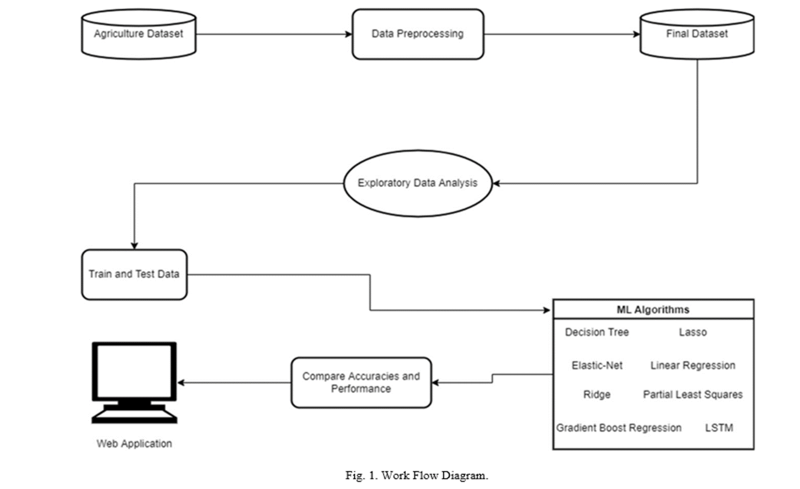
​

Slide 11
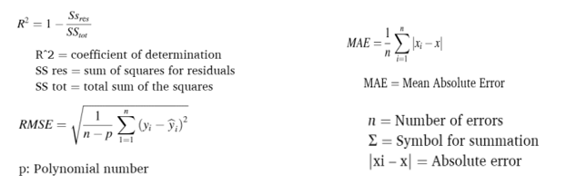

Slide 12
Exploratory data analysis(EDA):
Author used plotting to model the data, which includes scatter plots, histograms, and so on. It entails all data preprocessing steps, such as dealing with incomplete, null, extreme outliers, and redundant data points. Encoding categorical variables and bivariate analysis were also included.
Multicollinearity is a challenge posed by One-Hot Encoding. The variable inflation factor is less than 5.
​

Slide 13
Feature engineering:
​
Author has used this approach for our LSTM model, as deep learning models require more data to train and deliver better results, author planned on using features to create ones like Precipitation area ratio, precipitation humidity ratio, precipitation to mean temperature ratio. Along with adding these features, author reframed and normalized the dataset before training the model.

Slide 14
Web application implementation:
Author has built a web application using Streamlit library of Python.
This application takes input from the user for District name, crop name, soil type, season, area of the land, temperature, precipitation, humidity, and new features.
The models predicts the yield and output is displayed on the webpage. The web application is deployed on local server using command prompt. Although web­ page is useful, it is limited to working offline and on a single system.
​

Slide 15
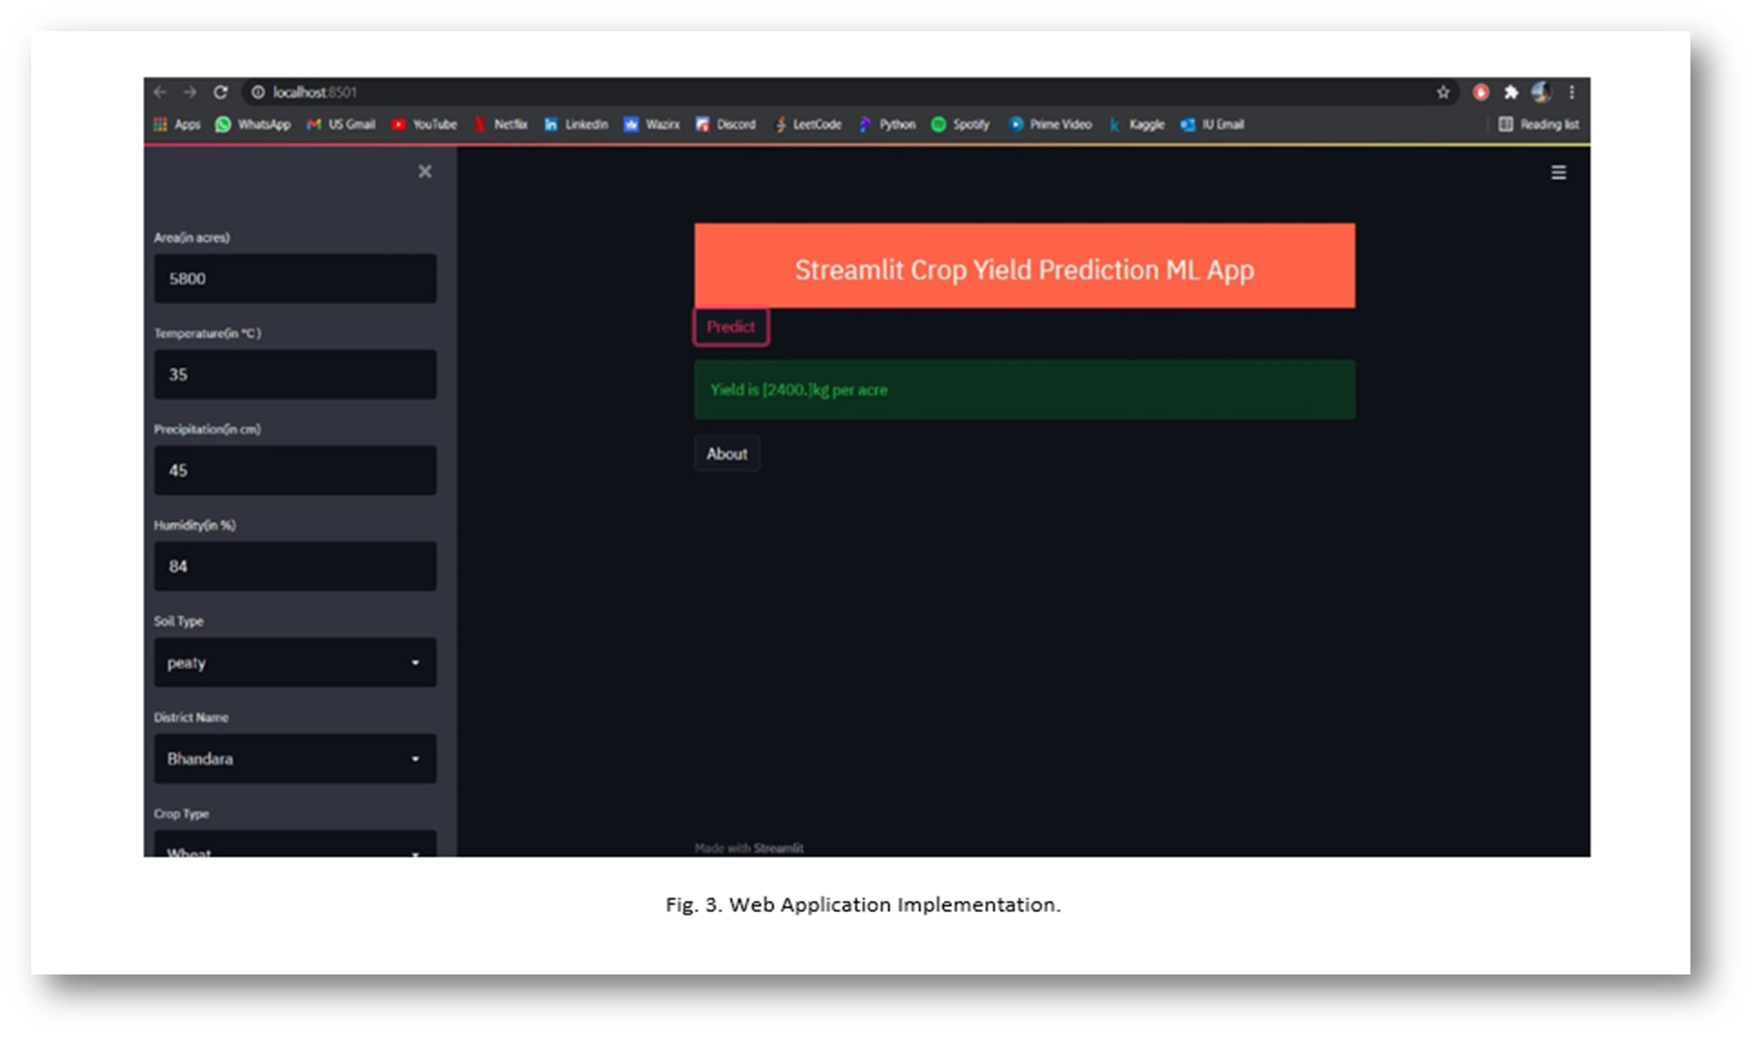
​

Slide 16
Algorithms
.

Slide 17
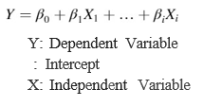
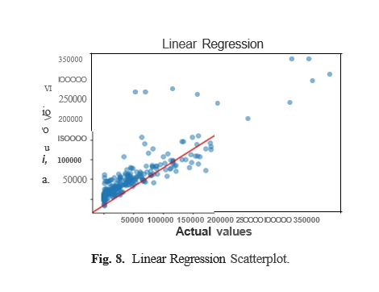
Multiple linear regression :
Multiple linear regression(MLR) is a mathematical method for predicting the result of an answer parameter by integrating several logical factors. It depicts the relationship between a continuous dependent parameter and several independent parameters.

Slide 18
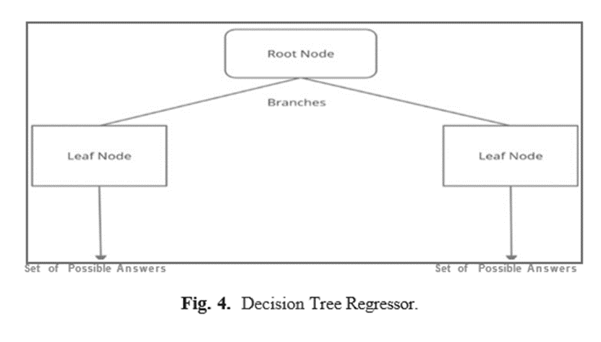
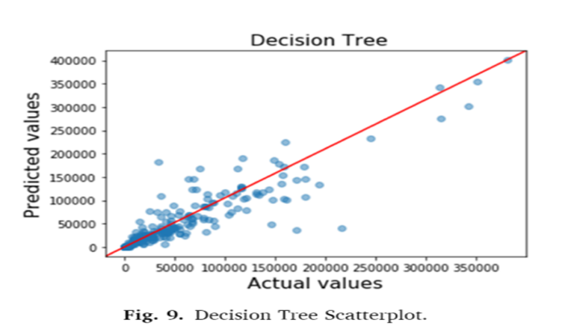
Decision tree regressor:
The Decision Tree is a Supervised Machine Learning technique that learns decision tools from associated features to estimate a target value.
A tree with leaf and decision nodes is the final product. A leaf node has more than two branches that represent the attribute values that have been evaluated. When compared to other models these do not require more effort for preprocessing. They don't need data normalization or scaling.

Slide 19
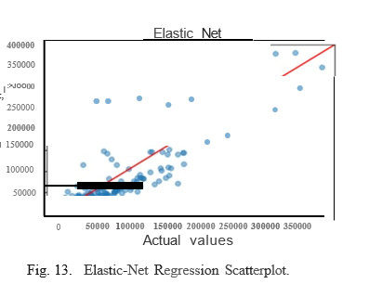

Elastic-Net:
Elastic-Net is a normal regression approach that incorporates the Ridge and the Lasso regression's L1 and L2 penalties.
Elastic net can deal with a large number of parameters and even when there exists a correlation between the parameters. It can decrease the effect of various parameters without completely removing all of the parameters.

Slide 20
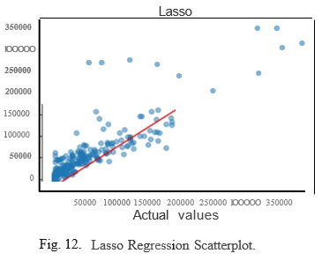
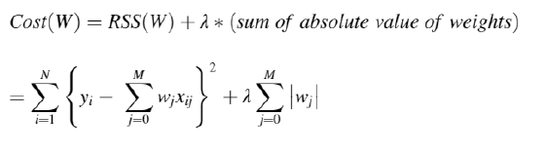
Lasso regression:
LASSO is known as Least Absolute Shrinkage and Selection Operator. It's a modified form of linear regression that implements shrinkage as a factor.
Lasso is very reliable when using variable selection or feature selection/elimination.

Slide 21
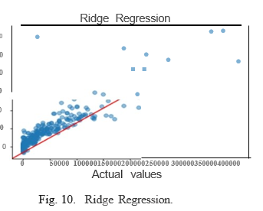
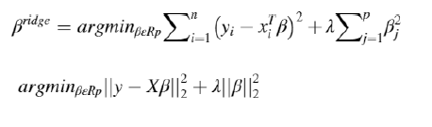
Ridge regression:
The Ridge Regression is a method for assessing multicollinear values in these models. Where there is multicollinearity, the least squares es­timates are without bias, but the values of variance are noted to be high, so they may be distant from the actual value.

Slide 22
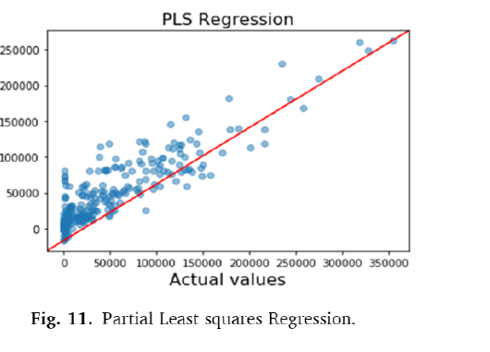

Partial least square regression:
In industrial applications, partial least squares (PLS) is a common method for soft modeling.
Where the parameters are multiple and strongly collinear, partial least squares (PLS) is a tool for constructing predictive models.

Slide 23
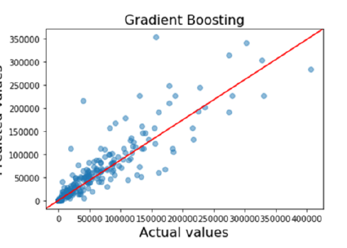
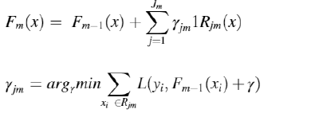
Gradient boosting regression:
Gradient boosting is a machine learning technique that can be used for a variety of applications, including regression and classification.
The resulting approach is called gradient-boosted trees when a decision tree is the weak learner, it usually outperforms random forest.

Slide 24
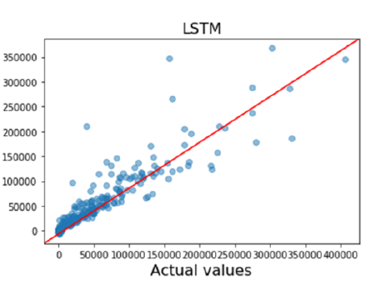
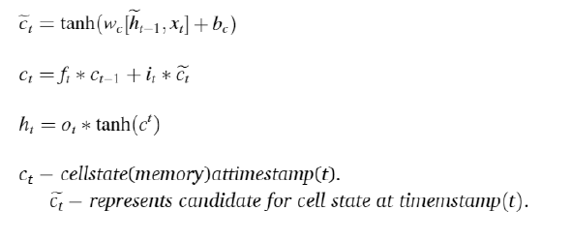
Long short-term memory (LSTM):
The main principle of RNN is that it, saves the output of a layer then feeds it back to the input to guess the output. Multiple RNNs that are each trained for a particular task are controlled by logic gates in the long short-term memory.
LSTM determines the temporal relation during crop growing season.

Slide 25
Results
.

Slide 26
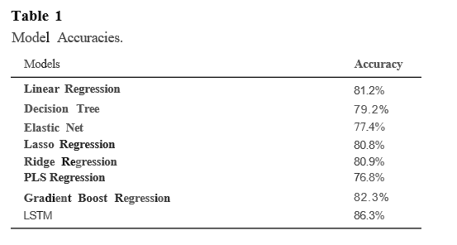

Slide 27
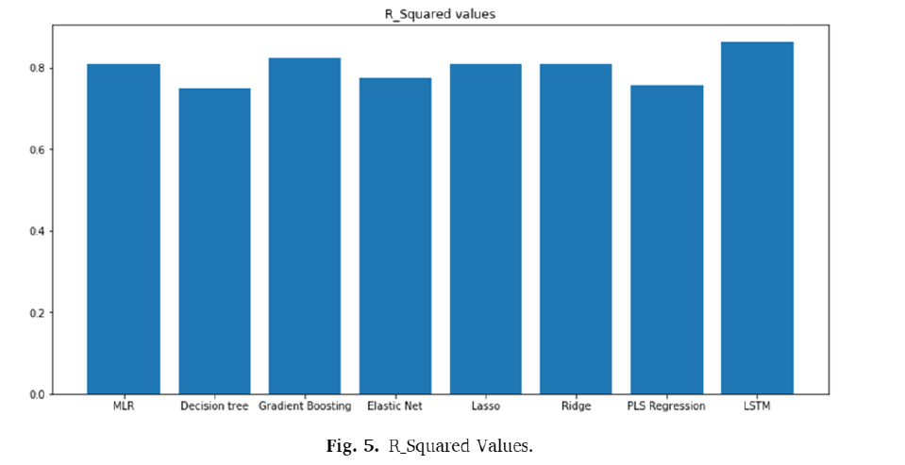
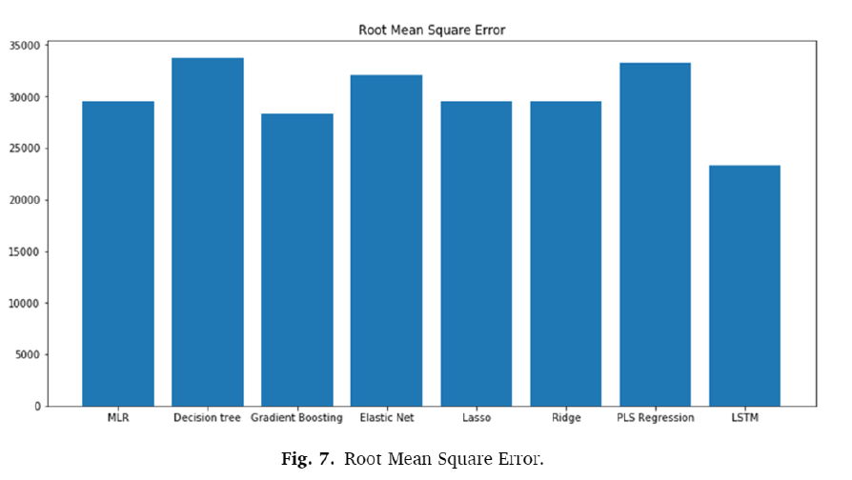
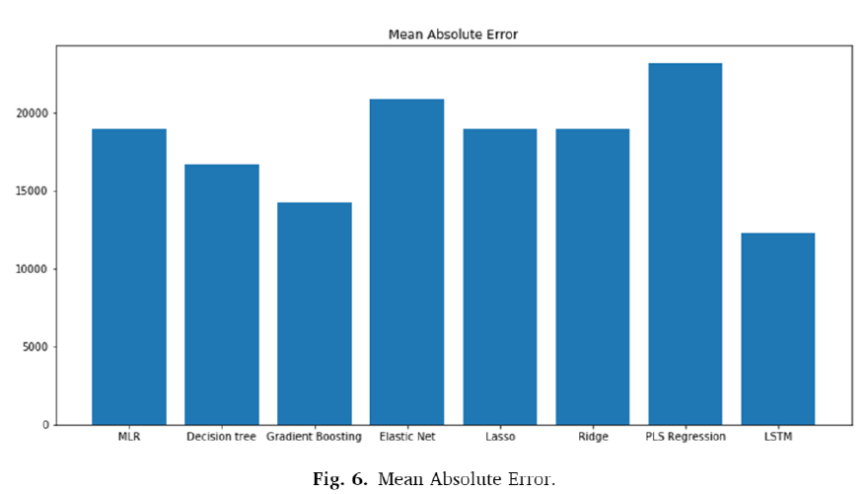
.

Slide 28
Conclusion
.

Slide 29
In the project, author has implemented crop yield prediction by using various regression models and found the feature engineering-based LSTM is the most efficient model, which gives the best accuracy 86.3%, and the least mean absolute error, root mean square error when compared to others.
With an increase in data, author can also increase ac­curacy. Author made this project end-to-end so that farmers can directly use their web to decide which new crops to try out in a certain field that will bring maximum yield and more profits. It will also help in improving our economy and help policymakers make better decisions.

Slide 30
Limitations

Slide 31
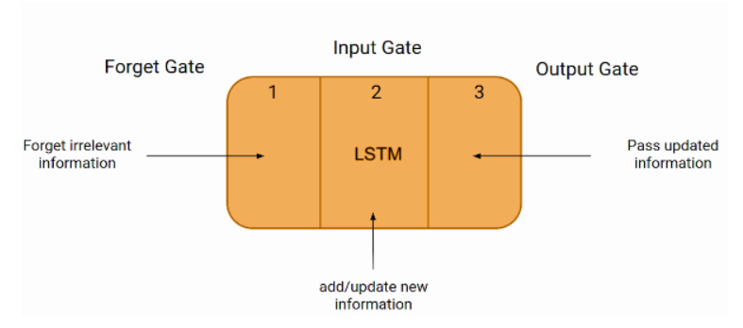
The only area where LSTM model can limit is the presence of long term dependencies. This was demonstrated in a paper published by Google Brain researchers in 2016.
Another limitation of LSTMs is their limited context window size. This means that an LSTM can only consider a limited number of inputs when making predictions; anything outside of the context window is ignored completely.

Slide 32
Future Scope
.

Slide 33
By the use of Bidirectional LSTM and Neural Stack Machine we can find something more better than LSTM.
We can also merge image input to get more info. In that case we can also merge the power of CNN (Convolutional Neural Network).
Can perform some kind of Ensemble Learning.
Deployment of the web app.

Slide 34
Thank you
.

