Slide 1
TCP
The Internet Protocol Suite (commonly known as TCP/IP) is the set of communications protocols used for the Internet and other similar networks.
It is named from two of the most important protocols in it:
the Transmission Control Protocol (TCP) and
the Internet Protocol (IP), which were the first two networking protocols defined in this standard.

Slide 2
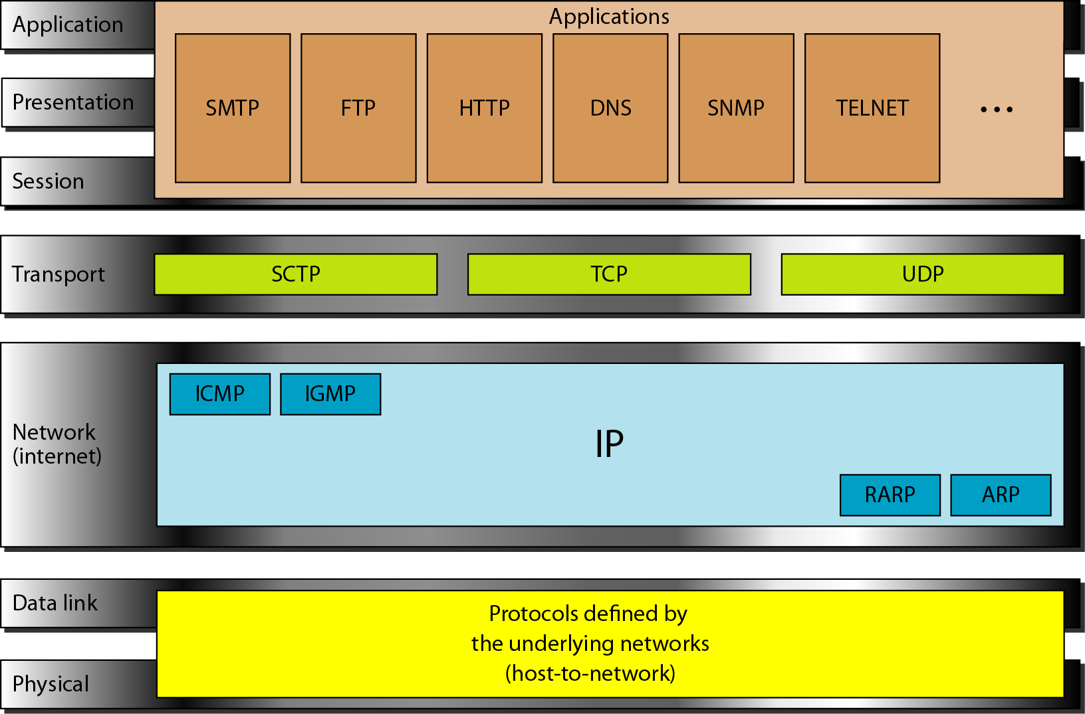
TCP/IP MODEL

Slide 3
INTERNET LAYER
An internet layer is the second layer of the TCP/IP model.
An internet layer is also known as the network layer.
The main responsibility of the internet layer is to send the packets from any network, and they arrive at the destination irrespective of the route they take.

