Slide 1
The Pair Class in Java
1. How and Why
2. PairDemoBasic and PairDemo
3. PairDemo2

Slide 2
How and Why
Format: Pair<Class1, Class2> name = new Pair<>(Ins1, Ins2)
Use name.getKey for Ins1; use name.getValue for Ins2.
Creates an instance of a Pair class, which is a collection of two instances (Ins1 and Ins2) of two classes (Class1 and Class2) respectively.
Class1 and Class2 may be of a few different types.
Integer, Double, String, Character
Custom classes

Slide 3
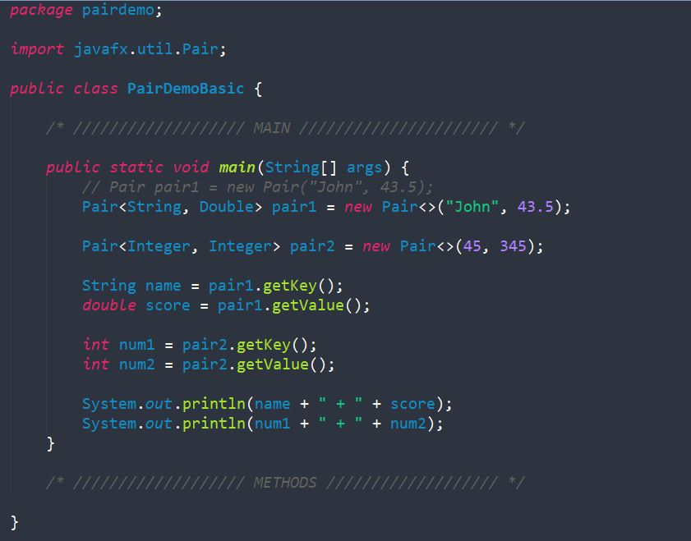
PairDemoBasics

Slide 4
PairDemo
Ask for student's name and score using Scanner and
adds to array list.
WHILE LOOP
Do you want to continue?
Write all the names and scores to .txt file.
Yes
No
Do you want to read .txt file?
Lists all the student names and scores in the file.
Yes
No
Exit
Exit

Slide 5
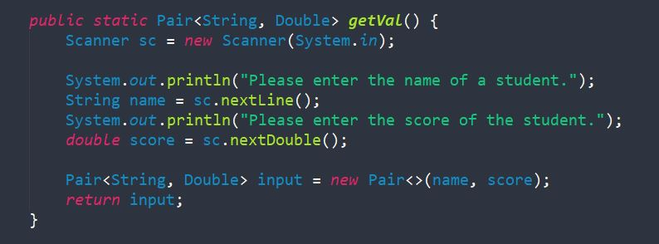
Regular method:
public static typeOfOutput name(parameters)
{
// code for the method
}
PairDemo

Slide 6
PairDemo2
Pair 1
Employee 1 (Employee)
Name: Jack
ID: 12345
Department: Accounting
Position: President
Employee 1 Status (String)
"Full time"
Pair 2
Employee 2 (Employee)
Name: Jill
ID: 67890
Department: IT
Position: Chairman
Employee 2 Status (String)
"Part time"

Slide 7
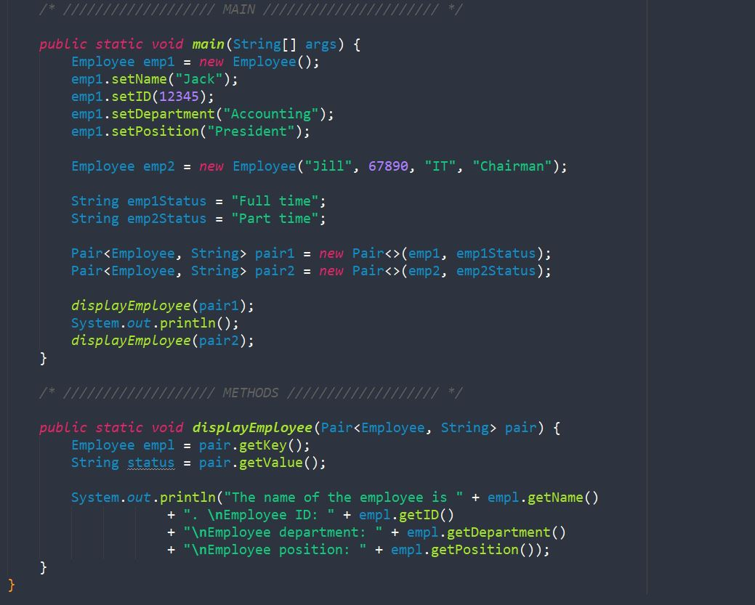
PairDemo2

Slide 8
Thank You!
Email: souviksaha204@gmail.com
Shoot me an email if you want the files used today!

