Slide 1

WIPRO NGA Program – 25SUB4508_LSP
Capstone Project Presentation – 13th Feb2026
Project Title Here - Enterprise Concurrent Signal Broadcast Framework (ECSBF)
Presented by – SOUVIK ROY, KRITHIV DHARAN, ALISHA PARVEEN, RITTWIKA DATTA
www.rpsconsulting.in

Slide 2

Enterprise Concurrent Signal Broadcast Framework (ECSBF)
Introduction:
A high-performance distributed communication framework for real-time signal propagation.
Designed to enable secure and reliable communication across multiple networked nodes.
Uses a centralized Engine to manage authentication, sessions, and broadcasting.
Built with concurrency, fault tolerance, and encryption as core principles.
Ensures synchronized, traceable, and secure enterprise communication.
2026 - RPS Consulting all rights reserved

Slide 3
Enterprise Concurrent Signal Broadcast Framework (ECSBF)
PROBLEM STATEMENT:
Distributed systems require secure and synchronized real-time communication.
Managing multiple concurrent node connections is complex and error-prone.
Unauthorized access can lead to signal injection and security breaches.
Network failures may disrupt sessions and cause data inconsistency.
Lack of centralized observability makes debugging and monitoring difficult

Slide 4
Enterprise Concurrent Signal Broadcast Framework (ECSBF)
SOLUTION:
Centralized ECSBF Engine manages all node communication securely.
Global Identity Registry ensures only provisioned nodes can connect.
Multi-threaded concurrency engine handles simultaneous signal requests.
Encrypted signal broadcasting ensures confidentiality and integrity.
Diagnostic logging provides observability and system transparency.

Slide 5
Enterprise Concurrent Signal Broadcast Framework (ECSBF)
WORKFLOW:
Endpoint Nodes connect to the ECSBF Engine via secure TCP/IP channels.
Secure handshake verifies node identity before session establishment.
Engine Control Process manages authentication and validation.
Concurrency Engine processes signals from multiple nodes simultaneously.
Signal Broadcaster distributes validated signals to all active nodes.
Diagnostic Logger records system activities at multiple severity levels.

Slide 6
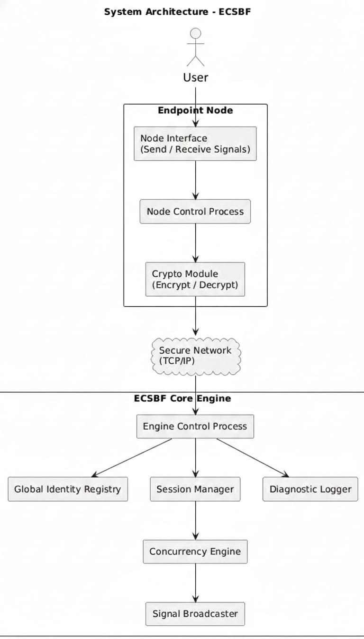
Enterprise Concurrent Signal Broadcast Framework (ECSBF)
SYSTEM ARCHITECTURE DIAGRAM:

Slide 7
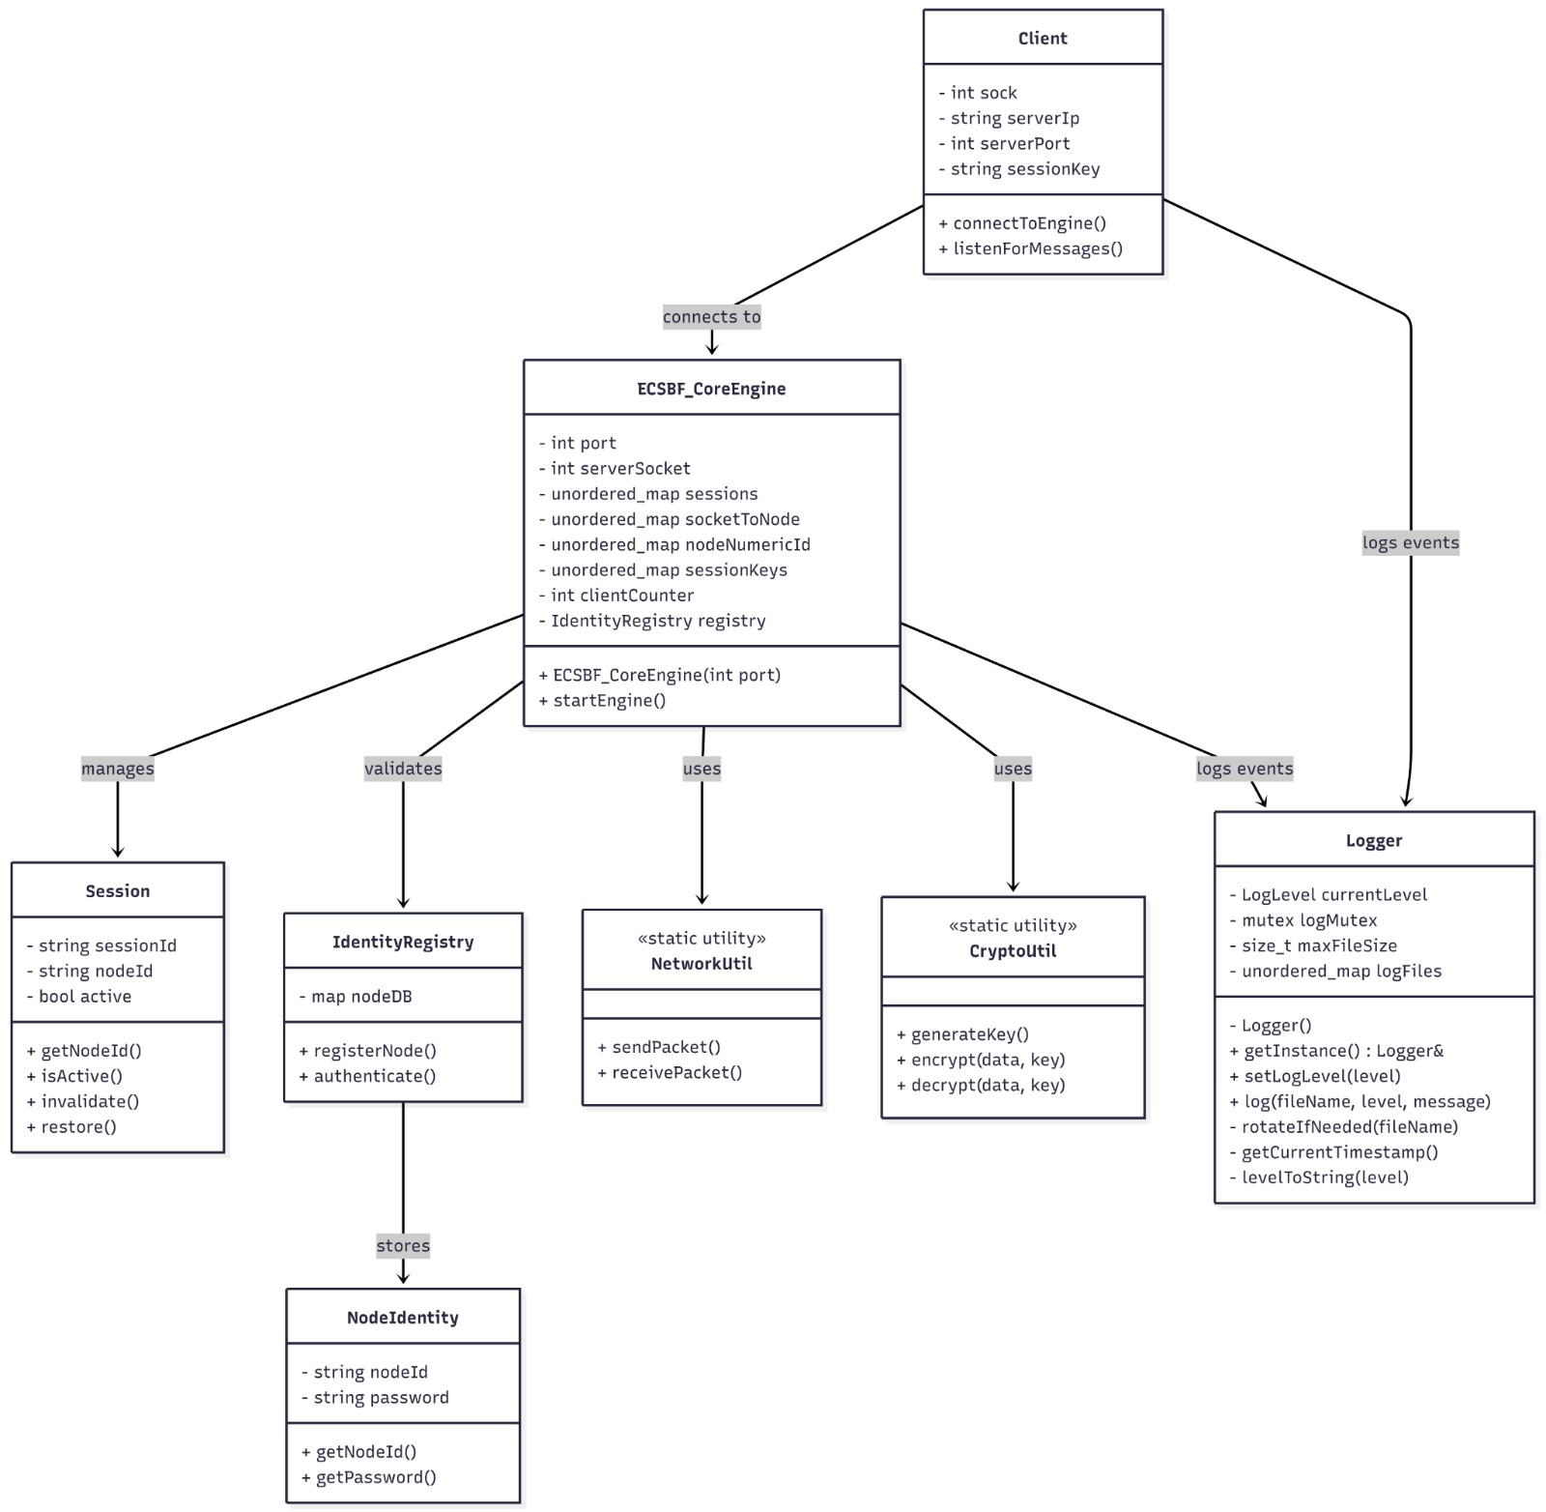
Enterprise Concurrent Signal Broadcast Framework (ECSBF)
CLASS DIAGRAM:

Slide 8
Enterprise Concurrent Signal Broadcast Framework (ECSBF)
PRACTICAL OUTCOMES – STEP 1 (Node Registration & Session Setup)
Node initiates secure connection request to the Engine.
Engine verifies identity from Global Identity Registry.
Successful verification establishes a persistent session.
Unauthorized nodes are rejected and logged securely.

Slide 9
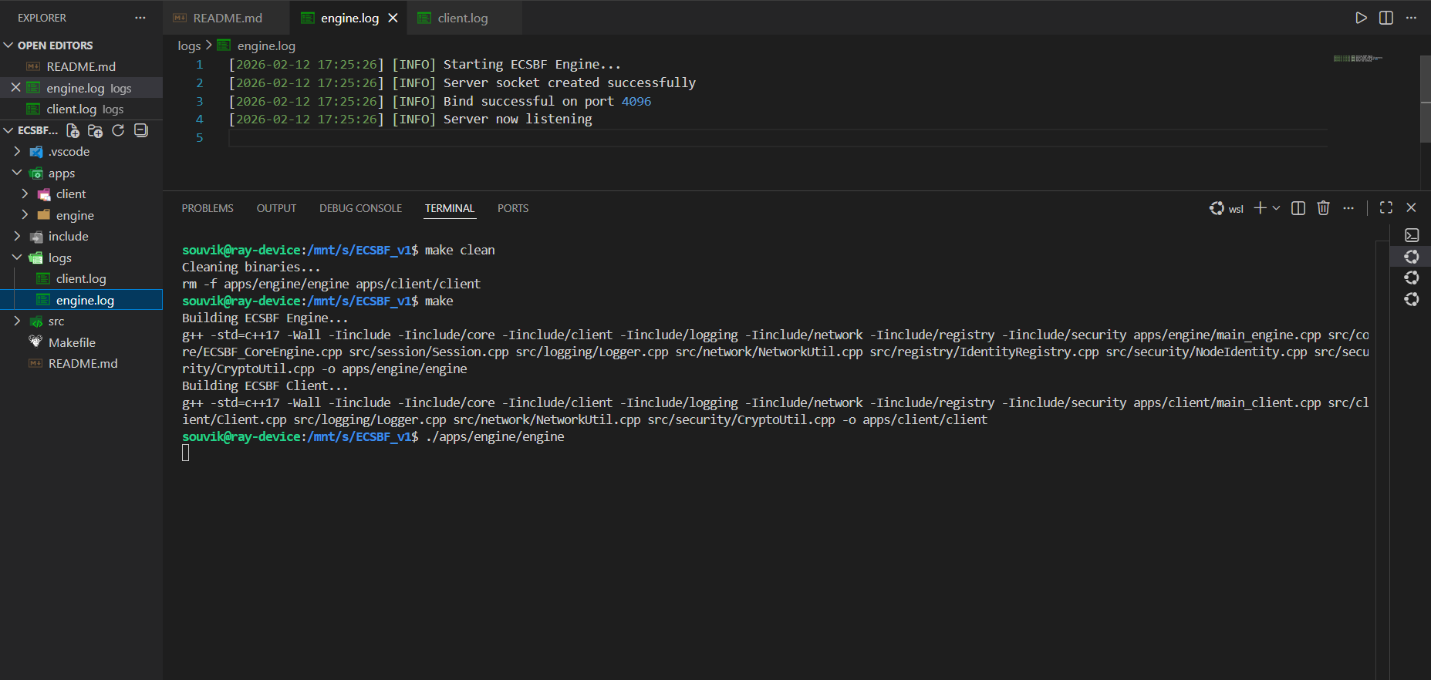
Enterprise Concurrent Signal Broadcast Framework (ECSBF)

Slide 10
Enterprise Concurrent Signal Broadcast Framework (ECSBF)
PRACTICAL OUTCOMES – STEP 2 (Signal Transmission & Broadcasting)
Authenticated node sends encrypted signal payload to Engine.
Engine validates active session before processing signal.
Signal is tagged with source identifier for traceability.
Broadcast mechanism sends signal to all active nodes concurrently.

Slide 11
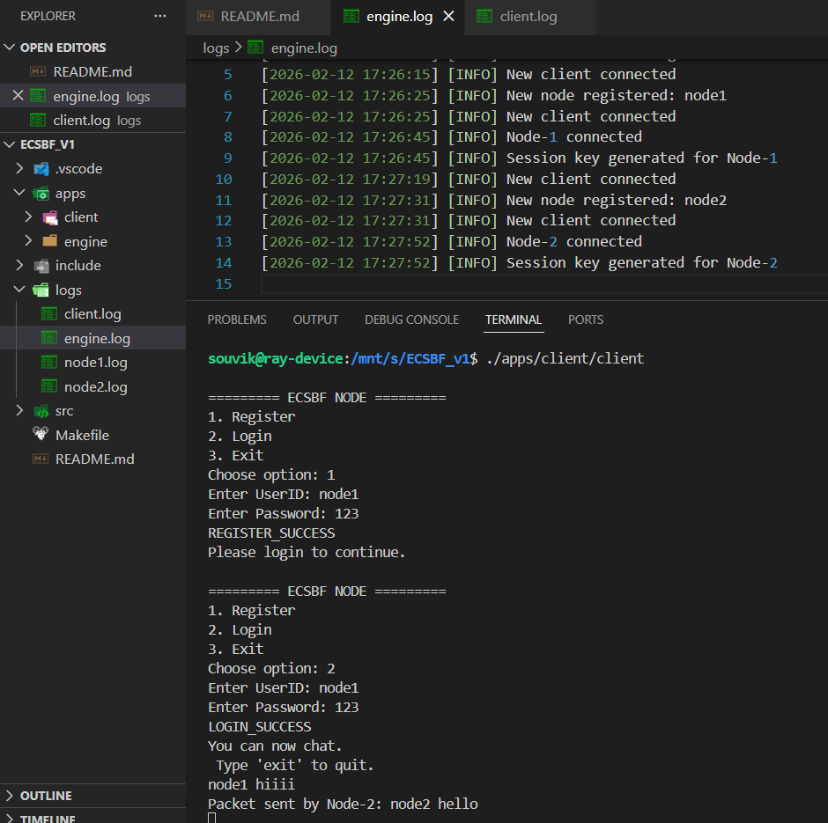
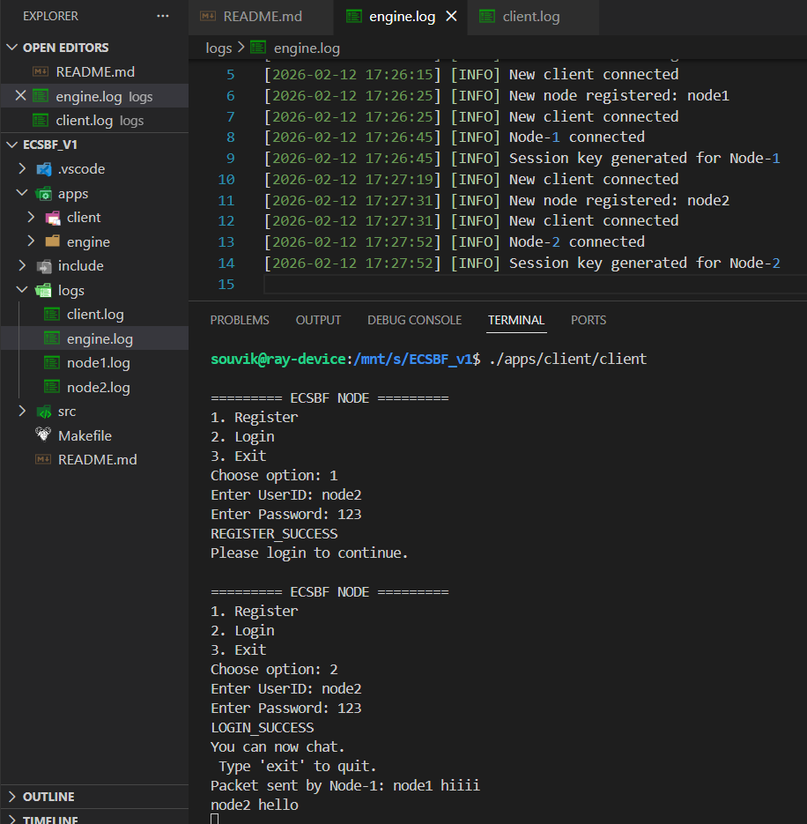
Enterprise Concurrent Signal Broadcast Framework (ECSBF)

Slide 12
Enterprise Concurrent Signal Broadcast Framework (ECSBF)
PRACTICAL OUTCOMES – STEP 3 (Concurrent Processing & Logging)
Engine handles multiple node signals using multi-threading.
Sessions remain stable under simultaneous traffic load.
Diagnostic logs capture INFO, WARNING, DEBUG, and FATAL events.
System maintains low latency and real-time propagation.

Slide 13
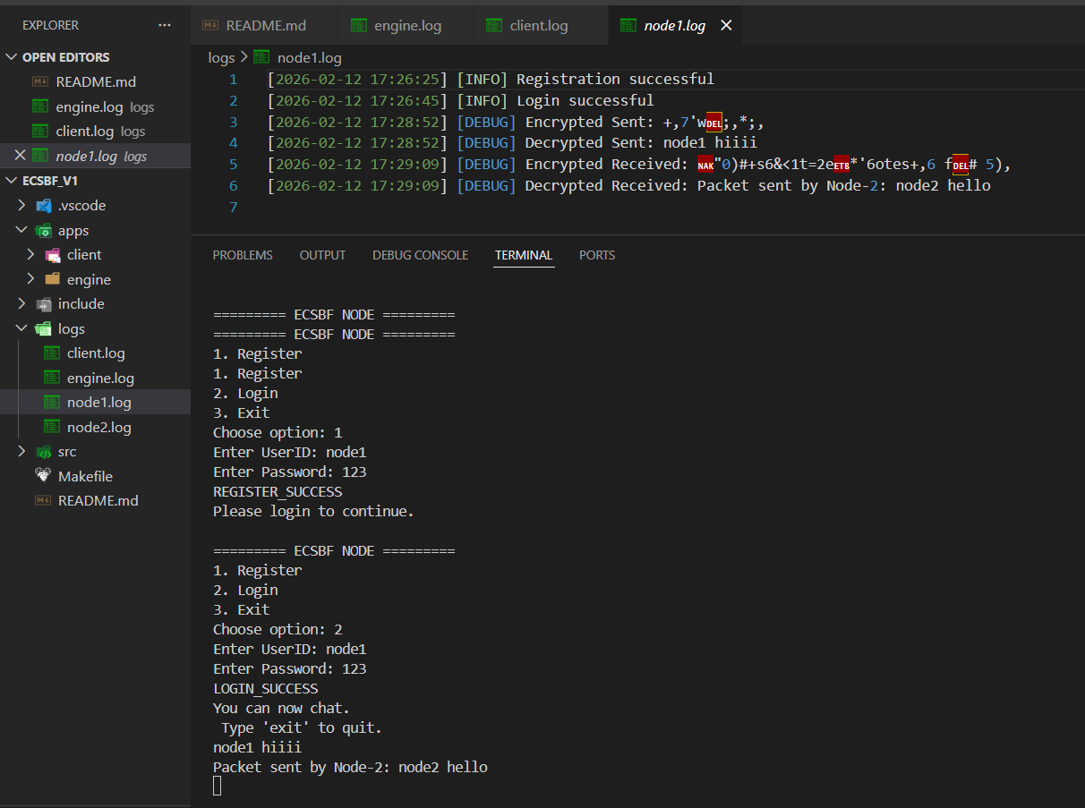
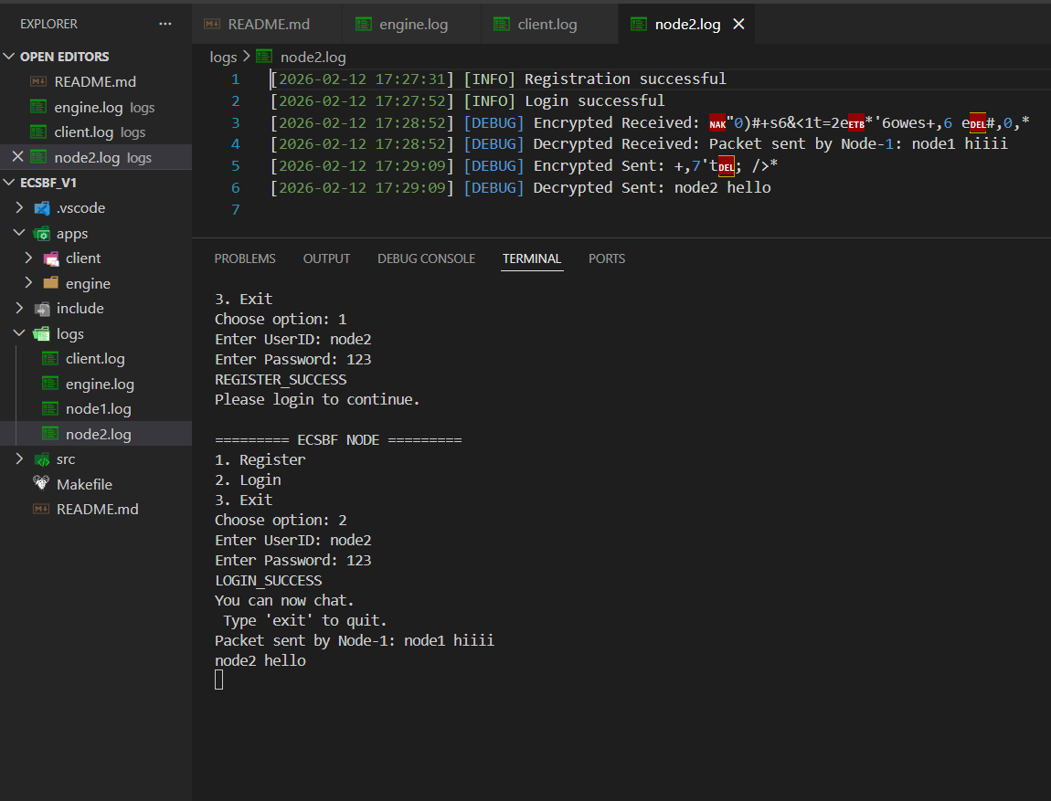
Enterprise Concurrent Signal Broadcast Framework (ECSBF)

Slide 14
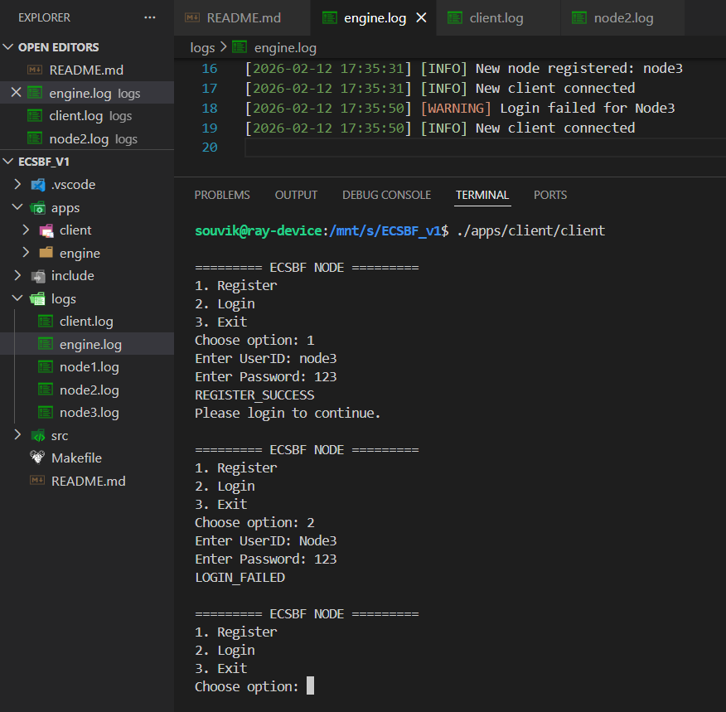
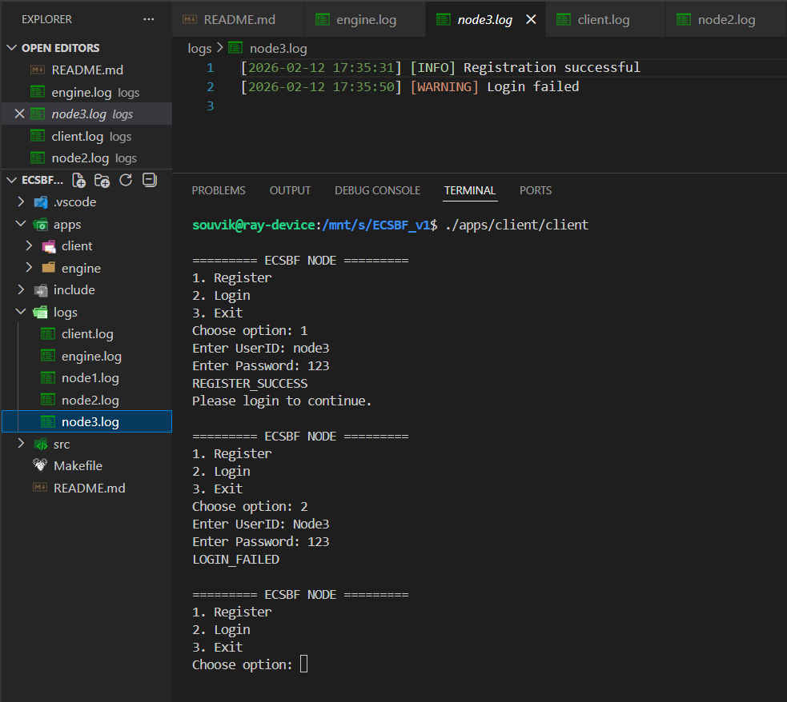
Enterprise Concurrent Signal Broadcast Framework (ECSBF)

Slide 15
Enterprise Concurrent Signal Broadcast Framework (ECSBF)
PRACTICAL OUTCOMES – STEP 4 (Session Termination)
Engine detects node disconnection or timeout event.
Session is formally terminated to prevent orphan processes.
Logging mechanism records session closure event.

Slide 16
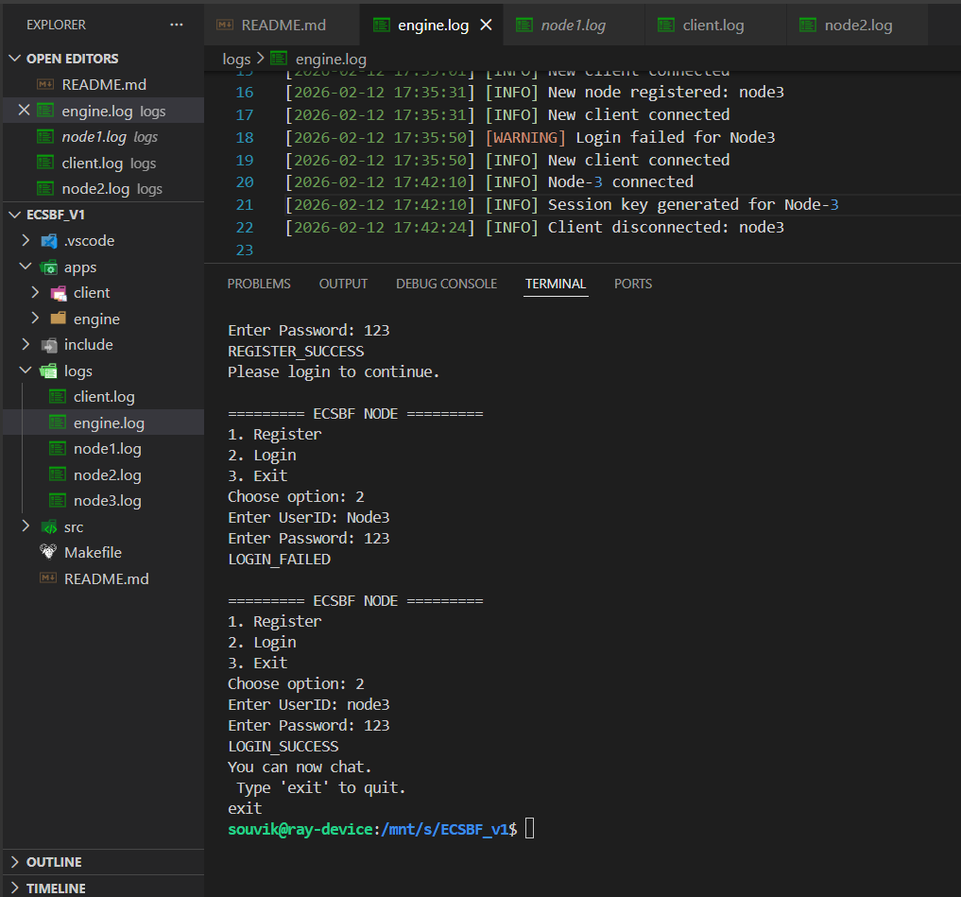
Enterprise Concurrent Signal Broadcast Framework (ECSBF)

Slide 17
Enterprise Concurrent Signal Broadcast Framework (ECSBF)
LIMITATIONS:
Requires stable TCP/IP network connectivity for optimal performance.
Centralized Engine may become bottleneck under extreme scale.
Currently backend-focused with no dedicated graphical UI.
Performance depends on underlying hardware and OS thread management.
Encryption overhead may slightly increase processing latency.

Slide 18
Enterprise Concurrent Signal Broadcast Framework (ECSBF)
CONCLUSION:
ECSBF provides secure, scalable, and concurrent signal broadcasting.
Strong identity verification prevents unauthorized system access.
Multi-threaded architecture ensures high-performance communication.
Persistent session management enhances reliability and resilience.
Modular and extensible design supports future enterprise enhancements.

Slide 19


Slide 20
