Slide 1
THE ANALYTICS TEAM
Sprocket Central Pty Ltd
Data analytics approach
SOUVIK DEB

Slide 2
AGENDA
1.Introduction
2.Data Exploration
3.Model Development
4.Interpretation

Slide 3

INTRODUCTION
ANALYSE AND RECOMMEND TARGET CUSTOMERS
Age distributions
Bike related purchases in 3 years by gender
Job industry distribution
Wealth segmentation by age category
Number of cars own by states
Customer analysis

Slide 4
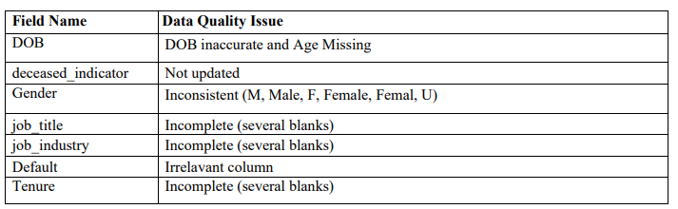
DATA EXPLORATION
DATA QUALITY ASSESSMENT
Key issues for Data quality assesment need to be looked into
An in-depth analysis has been sent via email

Slide 5
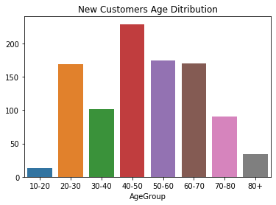
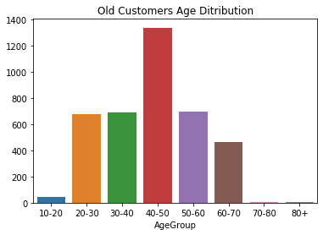
DATA EXPLORATION
AGE DATA DISTRIBUTIONS
Mostly old customers and even new ones are in the age range of 40-50
The lowest age groups are 10-20 in both new and old customers
There is a big increase in customers in who are 80+
There is a big drop in customers in the age range 50-60 and 60-70

Slide 6
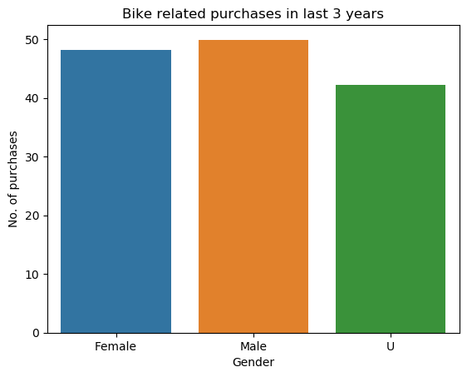
DATA EXPLORATION
BIKE RELATED PURCHASES
Clearly Male customers who bought bike related goods are a little more than female customers.

Slide 7
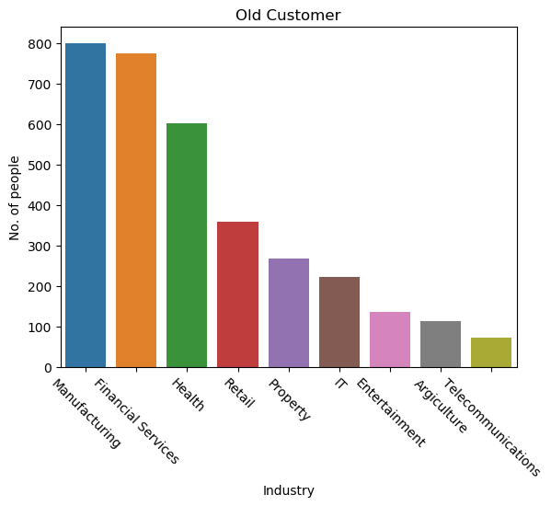
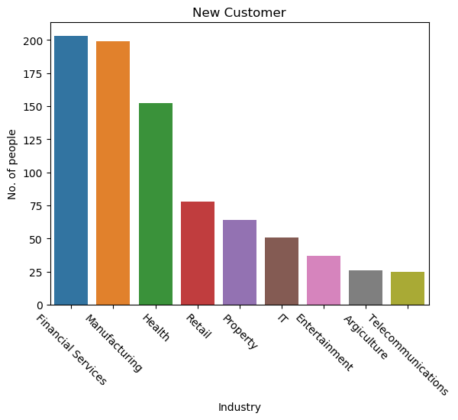
DATA EXPLORATION
JOB INDUSTRY DISTRIBUTION
Most of the old and also the new customers are from Financial services and manufacture industries

Slide 8
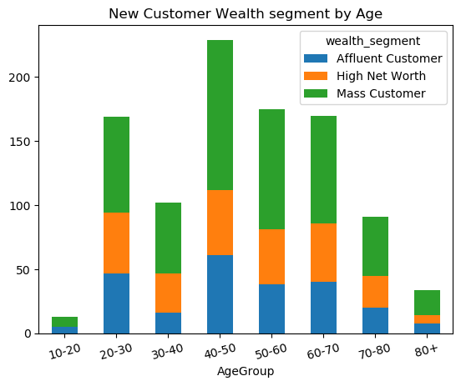
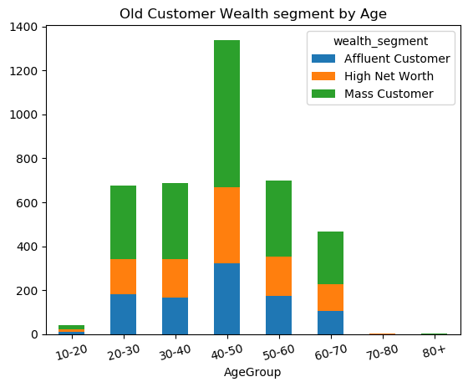
DATA EXPLORATION
WEALTH SEGMENTATION BY AGE CATEGORY
In all age groups, the number of Mass Customers is the highest and Affluent customers are least in numbers.

Slide 9
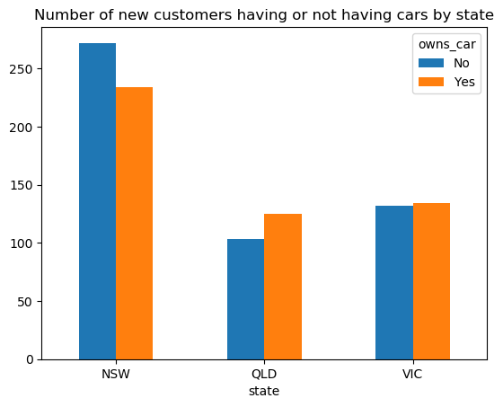
DATA EXPLORATION
STATEWISE CAR OWNER DATA DISTRIBUTION
NSW has the most number of people overall
NSW is the only state where number of car owners are less than number of people not owning cars

Slide 10
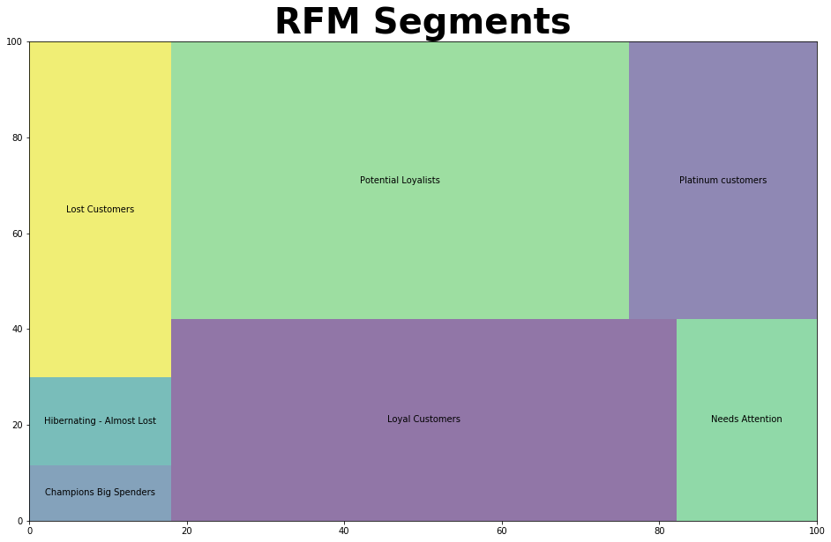
MODEL DEVELOPMENT
RFM ANALYSIS
RFM analysis is done to determine target customers

Slide 11
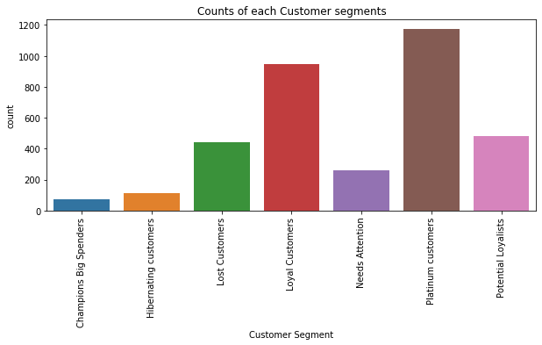
MODEL DEVELOPMENT
CUSTOMER TITLE COUNT

Slide 12


MODEL DEVELOPMENT
SEGMENT-WISE MARKETING ACTIONS
1
2
3
4
5
6
7
Champions Big Spenders
Hibernating customers
Lost Customers
Loyal Customers
Needs Attention
Platinum customers
Potential Loyalists
Upsell most expensive items
Aggressive price incentives
Don't spend too much trying to re-acquire
Loyalty programs,
Cross Sell
Price incentives and Limited time offer
No Price Incentives, Offer Limited edition and Loyalty programs
Cross Sell Recommendations and Discount coupons

Slide 13
INTERPRETATION
CUSTOMER TARGET AND METHODOLOGY
Filter through the customer list by executing Marketing actions discussed in the graphic above
RFM analysis clearly shows the target customer base and can be relied upon for such analysis

