Slide 1

Seasonal Agriculture Performance Analysis
AICTE VOIS MAJOR PROJECT 2026-27
Name: Sovan Kar
College: Techno Main Salt Lake
AICTE STU ID : STU6824a3b992e1e1747231673

Slide 2

PROBLEM STATEMENT
Agricultural activities are influenced by seasonal variations in environmental conditions, farming practices, resource availability and market conditions.
As a result, agricultural performance may differ from one season to another. However, raw agricultural data does not clearly explain how agricultural performance changes across seasons or what patterns can be observed in different seasonal conditions.
The problem is to analyze the given agricultural dataset and investigate seasonal differences in agricultural performance by identifying meaningful patterns, trends, relationships and variations within the available data.

Slide 3
Project Description
This project analyzes 4,000 farm records spanning 8 Indian states, 8 crops, and three cropping seasons – Kharif, Rabi, and Zaid – to understand how seasonal conditions shape agricultural performance.
Using Python (Pandas, Seaborn, SciPy) in Google Colab, the data is cleaned, explored, and visualized to compare yield, resource usage, and economic outcomes across seasons, with one-way ANOVA used to statistically validate the differences observed.
The result is a set of evidence-based, season-specific insights and recommendations to support better agricultural planning.

Slide 4

WHO ARE THE END USERS?
Farmers & agricultural cooperatives – season-wise crop, irrigation, and resource planning
State agriculture departments – evidence-based policy and subsidy planning
Agri-input & agtech companies – targeting products by season and region
Researchers & data analysts – a benchmark dataset for further agricultural studies

Slide 5

Technology Used
Python – Pandas & NumPy for data cleaning and analysis
Matplotlib & Seaborn – statistical visualization
SciPy – one-way ANOVA for statistical validation
Google Colab – cloud notebook environment
GitHub – version control and project submission

Slide 6
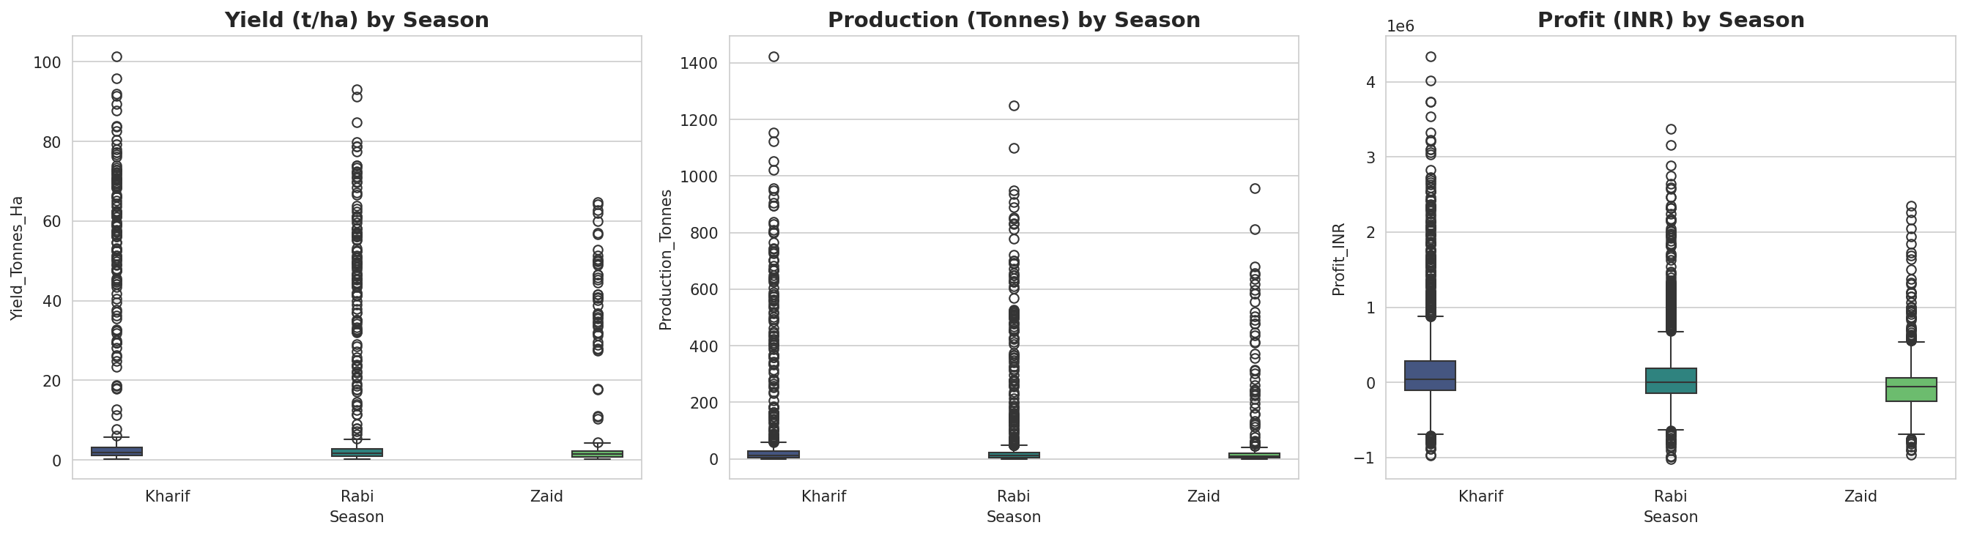
RESULTS
Q1 – Seasonal Performance Overview (Yield, Production & Profit)

Slide 7
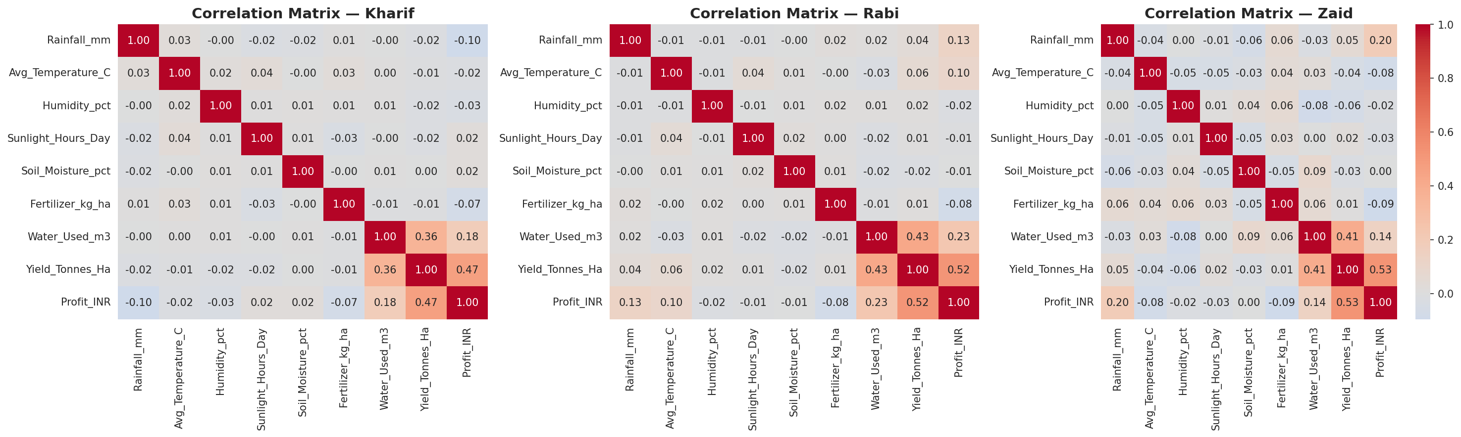
RESULTS
Q6 – Environment–Performance Correlations by Season

Slide 8
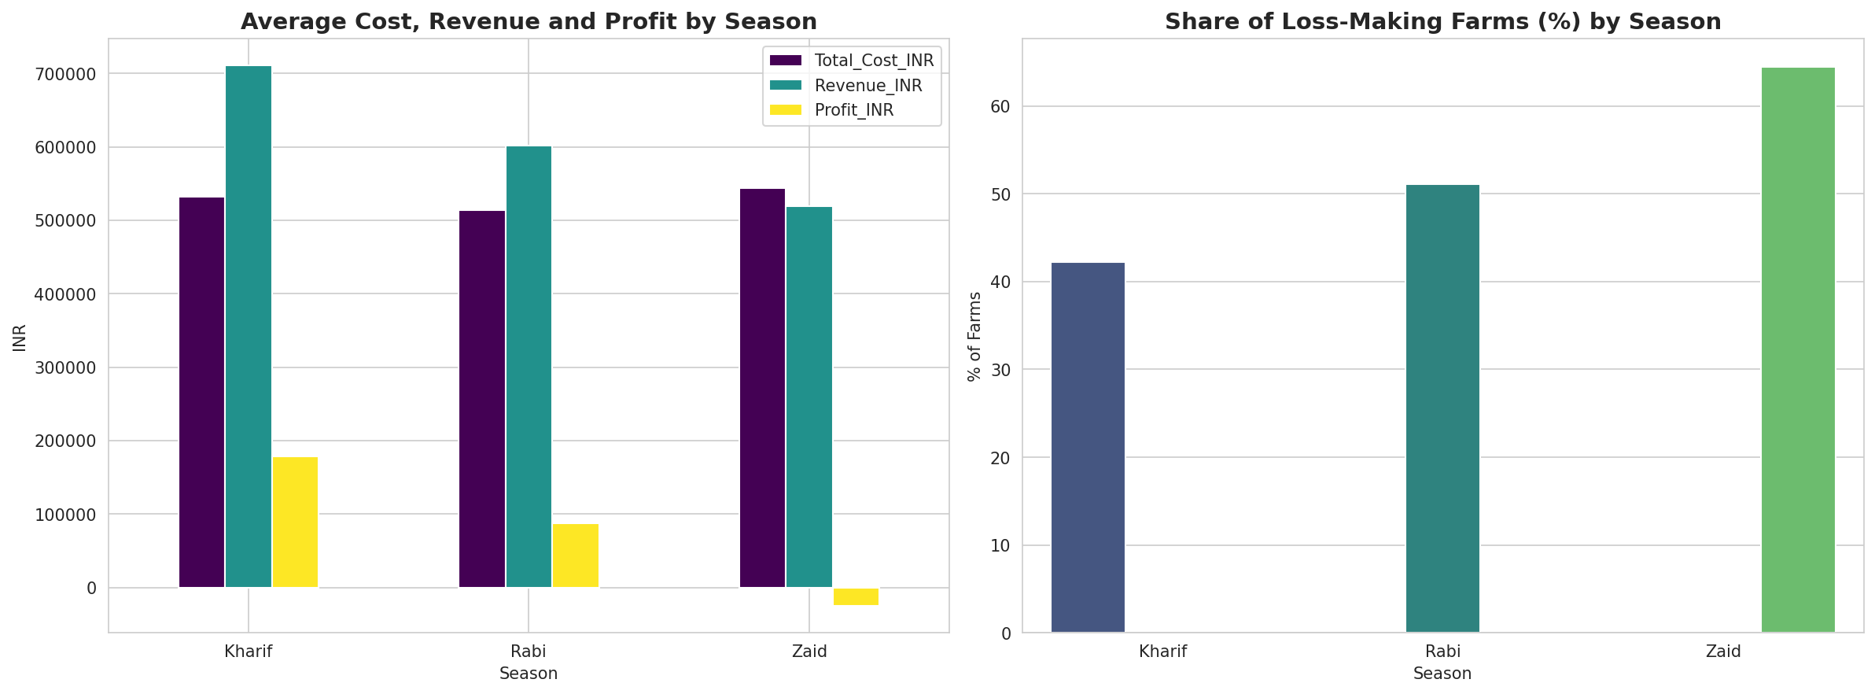
RESULTS
Q7 – Economic Outcomes & Loss-Making Farms by Season

Slide 9
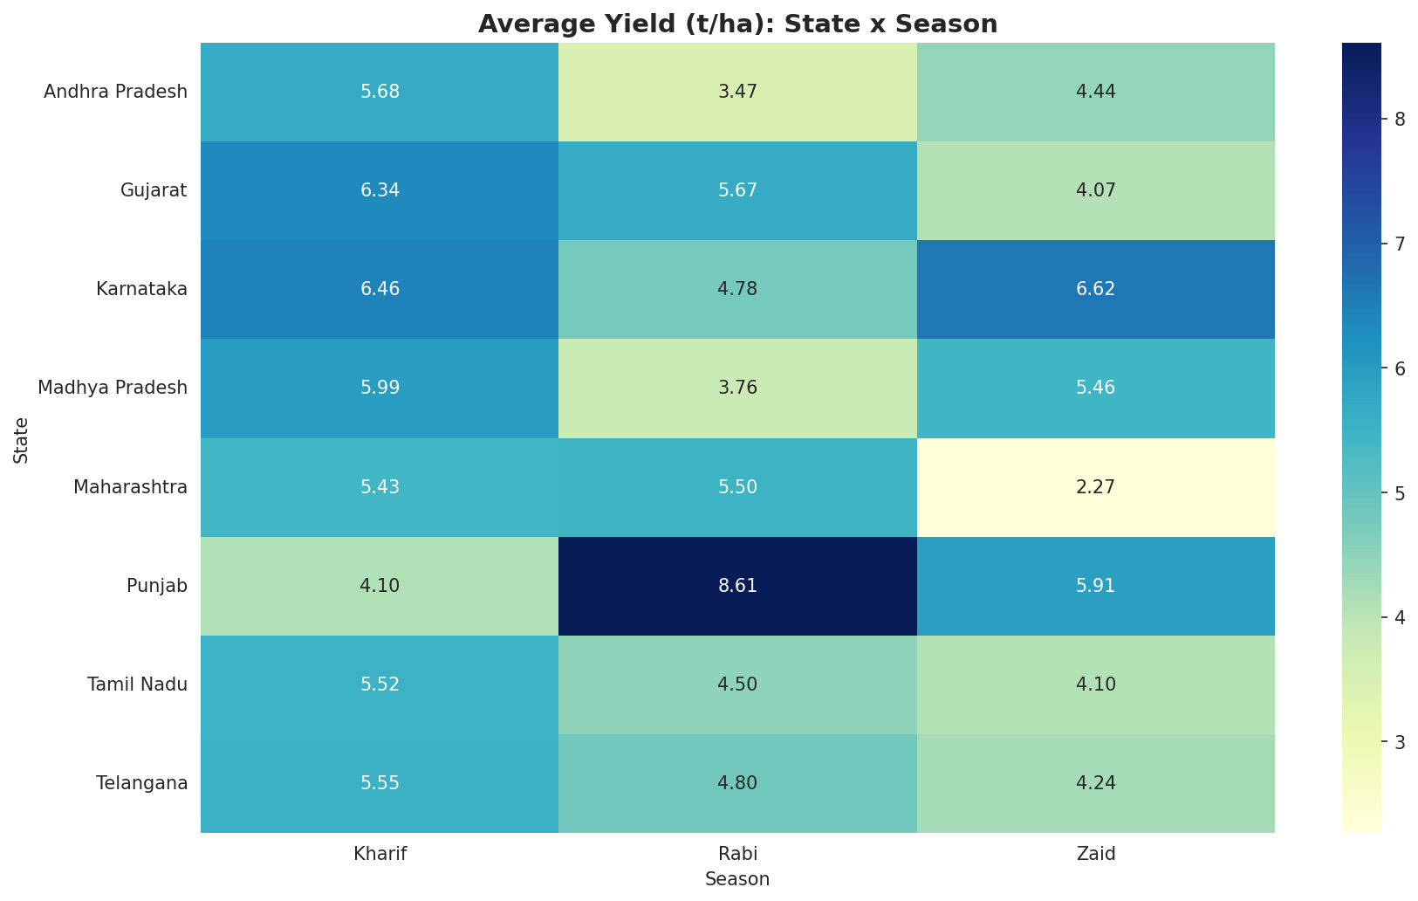
RESULTS
Q8 – Regional Consistency: Yield by State & Season

Slide 10
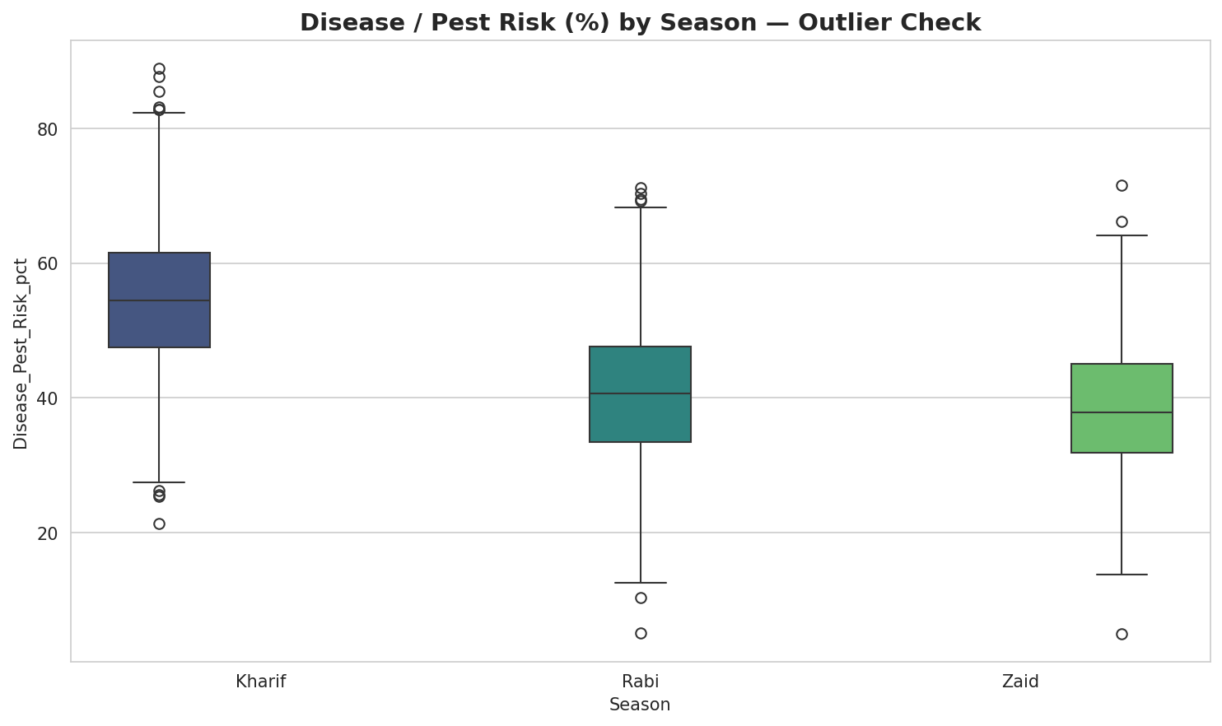
RESULTS
Q9 – Unusual Patterns: Disease/Pest Risk by Season

Slide 11
Future scope
Real-time seasonal advisory dashboard
Live weather & mandi price API integration
ML-based yield & price forecasting
State & crop-specific policy recommendations

Slide 12
GitHub Link
GitHub: https://github.com/Sovan/Seasonal_Agriculture_Performance_Analysis.git
Colab Link : https://colab.research.google.com/drive/166Zww49hSkp-s7VEAGbIVGXQI_g3Cd3q?usp=sharing

Slide 13

VOIS Course completion certificate - Course name- Data Visualization

Slide 14

Thank you to Ashwini sir and Amisha Ma'am to guide me all the time in this internship period
.
.

