Slide 1



ＡＩ ＆ Ｂｉｇ Ｄａｔａ
Ｃ Ｐｒｏｇｒａｍｍｉｎｇ
miricanvas.com

Slide 2

ＡＩ ＆ Ｂｉｇ Ｄａｔａ
Who am I?
01
Major in Computer Science
Professor
Kweon, Tae Deok
02
Samsung Electronics.
Video Display Division
(Advanced Tech.)
03
Samsung Global R&D Center
@shaghai (Director)
tdkweon@wsu.ac.kr
04
Samsung Electronics.
Manufacturing Process Tech.
(Smart Factory)

Slide 3
ＡＩ ＆ Ｂｉｇ Ｄａｔａ
Who are you?
Write about yourself in the postage
01
Name
02
Gender / Email / Phone Num.
1. I don't know anything at all
2. I have no programming experience
3. I have some programming experience
4. I can write my own programs
Disable Korean
Vocabulary
Sentence
03
Nationality
04
Programming skill (1 ~ 4) ex) c (1)
Korean ability(1~3)

Slide 4
ＡＩ ＆ Ｂｉｇ Ｄａｔａ
Things to do today
01
Contents of C course to learn during the semester
02
About codyssey
03
Course evaluation
04
Development environment & setup

Slide 5
ＡＩ ＆ Ｂｉｇ Ｄａｔａ
Contents of C course to learn during the semester
Week | Contents
1 | Introduction of C
2 | Data type, Operator
3 | Statement (Condition, Loop)
4 | Standard Input/Output
5~6 | Arrays
7~8 | Structures
9 | Pointers
10 | Function Pointers, Pointer Operations
11 | File Input/Output
12 | Dynamic Memory Allocation
13 | Preprocessing, External Variables, Split Compilation
14 | Linked List
15 | Final exam
Notes:
C 프로그램 보여주기(c_features.c)

Slide 6
ＡＩ ＆ Ｂｉｇ Ｄａｔａ
About codyssey
01
What is codyssey
02
Class with codyssey (Requirement, discussion, coding)
03
Homework with Codyssey
04
Peer evaluation & review

Slide 7
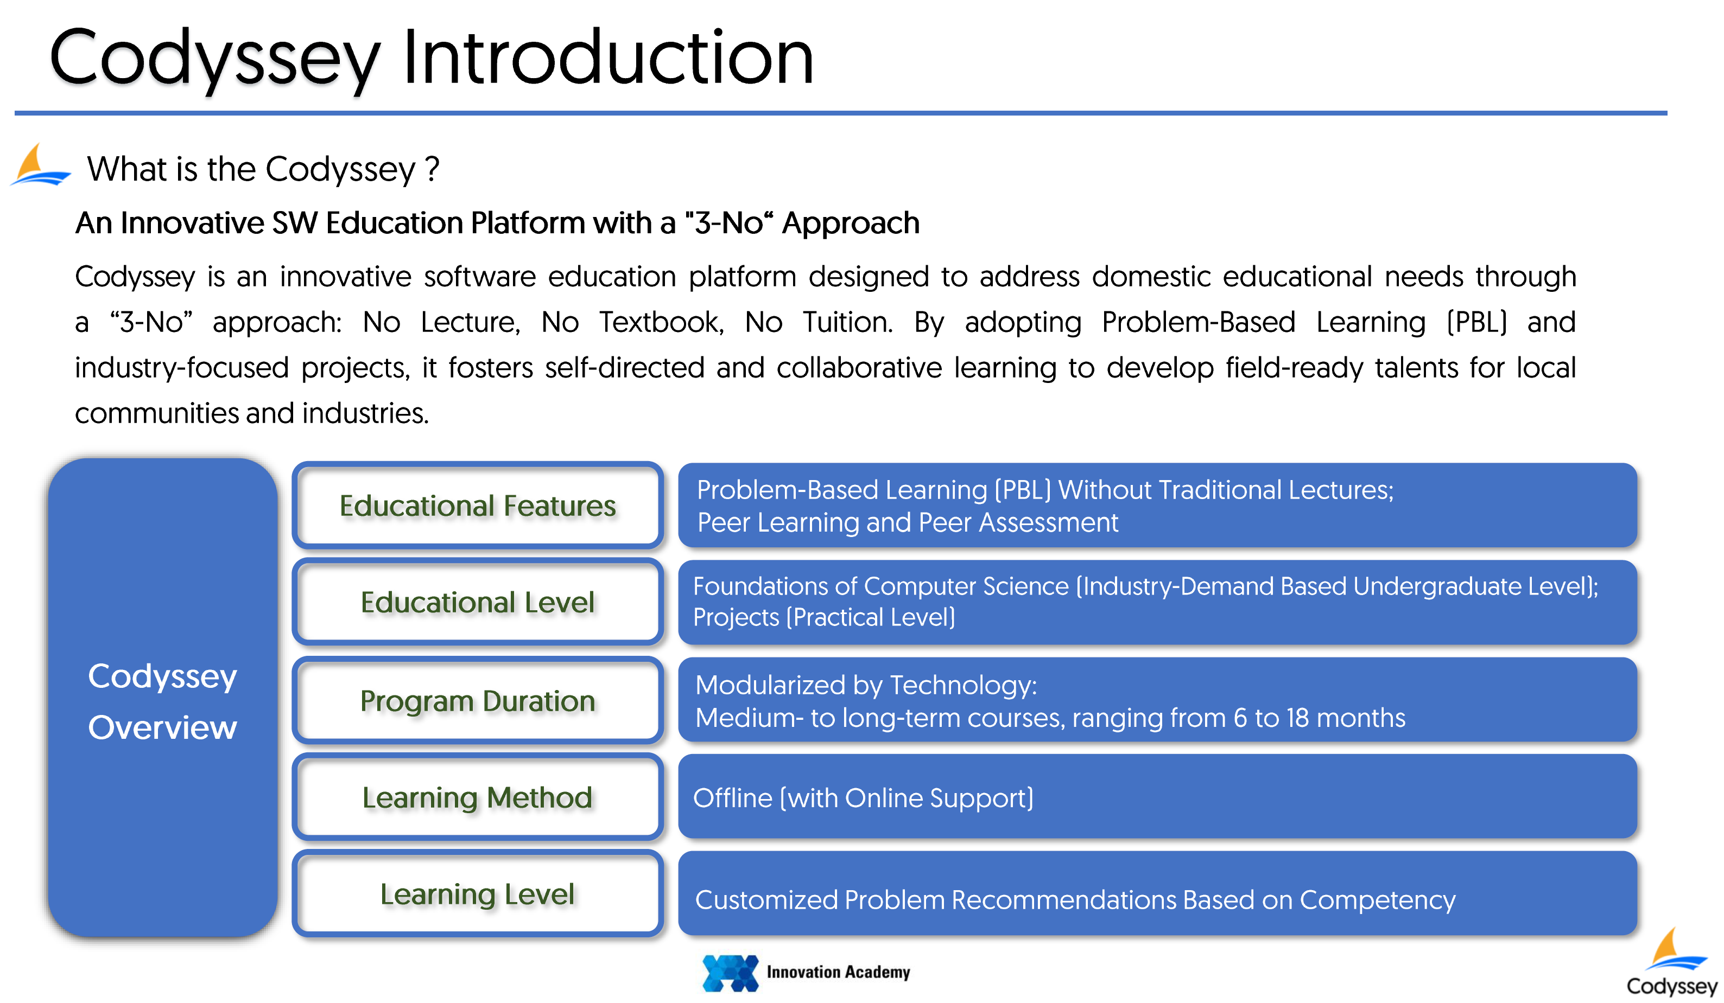
ＡＩ ＆ Ｂｉｇ Ｄａｔａ
https://www.innovationacademy.kr/en/innovation_academy/business_info/codyssey.html

Slide 8
ＡＩ ＆ Ｂｉｇ Ｄａｔａ
Course evaluation
Important! MUST finish homework before the class!!
Course evaluation | Distribution of points | Note
Attendance | 20 points | -1 point per absence
Codyssey | 40 points | 20 essential problems: 2 point per a problem
 | Extra points | 60 optional problems: 0.5 point per a problem
 | 20 points | Contribution (Peer evaluation & review)
Final exam | 20 points | Open book
Total | 100 | Complete Codyssey 80 problems: A+
* Grades are determined based on relative evaluation.

Slide 9
ＡＩ ＆ Ｂｉｇ Ｄａｔａ
Course structure & method
Course duration: 15 weeks
(Codyssey) Problems: 10 sub-courses with 80 problems
Essential: 20 problems, Optional: 60 problems
Course operation:
Introductory lectures: 1 ~ 4 weeks
PBL classes: 10~13 weeks
Examination: 1 week (Open book, Don't memorize, Do understand)
PBL class operation:
Lecture with 1~2 problems solving of the week
In-class exercise with 1~2 problems (Team)
Assignments with 16 problems, followed by group sharing in the next weeks
Notes:
Final 시험은 codyssey 문제를 풀면 해결하수 있는 문제들

Slide 10
ＡＩ ＆ Ｂｉｇ Ｄａｔａ
Break time (Start at 10:30)
miricanvas.com

Slide 11
ＡＩ ＆ Ｂｉｇ Ｄａｔａ
Development Environment & setup
01
Codyssey
02
Github & Codyssey
Codyssey with github
03
IDE (VS code) & MinGW
https://code.visualstudio.com/
04
Make the first my program
Notes:
Github & Codyssey
- Github account 만들기
IDE (VS code) & MinGW
- install
Make the first my program
- console 에서
- VSC 에서
- codespaces에서

Slide 12
ＡＩ ＆ Ｂｉｇ Ｄａｔａ
Development Environment & setup - Codyssey
01
Check login
https://usr.codyssey.kr/main/
02
Explore menu tree & read a project story
03
Team discussion & Peer evaluation/review
Next week
Notes:
Github & Codyssey
- Github account 만들기
IDE (VS code) & MinGW
- install
Make the first my program
- console 에서
- VSC 에서
- codespaces에서

Slide 13
ＡＩ ＆ Ｂｉｇ Ｄａｔａ
Development Environment & setup – Github & Git
01
Make an account
02
Create a repository
Codyssey with github
03
Edit readme.rd
04
Upload & Download files with github
https://github.com/prof-kweon/C-Language-Course/tree/main
Notes:
Github 설명
Git 설명

Slide 14
ＡＩ ＆ Ｂｉｇ Ｄａｔａ
Development Environment & setup - IDE (VSCode) & MinGW
01
Install VSCode
https://code.visualstudio.com/
02
Connect VSCode & Codyssey
Codyssey with github
03
Install MinGW (Only for personal Notebook, windows)
https://code.visualstudio.com/
Codyssey with github
04
Verify installation
Notes:
Github & Codyssey
- Github account 만들기
IDE (VS code) & MinGW
- install
Make the first my program
- console 에서
- VSC 에서
- codespaces에서

Slide 15
ＡＩ ＆ Ｂｉｇ Ｄａｔａ
Development Environment & setup - Make the first my program
01
@ windows cmd console
02
@ VSCode (with your notebook) - recommend
03
@ Codespaces (in the class) - recommend
Notes:
Make the first my program 실습
- console 에서
- VSC 에서
- codespaces에서

Slide 16
ＡＩ ＆ Ｂｉｇ Ｄａｔａ
Write the first my program
main.c
#include <stdio.h>
int main() {
printf("Hello world!\n");
return 0;}

Slide 17
ＡＩ ＆ Ｂｉｇ Ｄａｔａ
Build the first my program
Use the -c flag with gcc to compile the source code into an object file without linking.
gcc –c main.c => main.o
gcc main.o -o my_program => my_program
If you don’t need an object file and just want an executable, omit the –c flag and
use –o flag.
gcc main.c –o my_gragram => my_program

Slide 18

ＡＩ ＆ Ｂｉｇ Ｄａｔａ
Homework
Explore the entire codyssey menu tree
2. Read Step 1, Course 1, Problem 1
(Think over the requirements)

Slide 19
ＡＩ ＆ Ｂｉｇ Ｄａｔａ
See you next week!
DO NOT miss the classes
miricanvas.com

