Slide 1



ＡＩ ＆ Ｂｉｇ Ｄａｔａ
Ｃ Programming (W14)
Welcome!!
Please check attendance individually.
(Mobile App)
miricanvas.com
Notes:
001 분반 보강 날짜 확인 (3/12)

Slide 2

ＡＩ ＆ Ｂｉｇ Ｄａｔａ
Things to do today
01
Notice : The schedule of final exam & Policy
02
Confirm practice submission
03
Homework : Codyssey All (10 Questions) ~6/13
Announce:

Slide 3
ＡＩ ＆ Ｂｉｇ Ｄａｔａ
Schedule of final exam
 | C-001(Mon) | C-002(Tue) | C-004(Wed) | C-003(Thur)
Review class | 06/16 | 06/10 | 06/04 | 06/12
Notes |  |  | 2025-06-11 No class
Final exam | 2025-06-18 (수) | 2025-06-17 (Tue) | 2025-06-18 (Wed) | 2025-06-19 (Thur)
Room |  | S2 302 (9:00 ~ 12:00) | S2 301 (9:00 ~ 12:00) S2 302 (9:00 ~ 12:00) | S2 302 (9:00 ~ 12:00)

Slide 4
Course evaluation
ＡＩ ＆ Ｂｉｇ Ｄａｔａ
Course evaluation | Distribution of points | Note
Attendance | 20 points | -1 point per absence
Codyssey | 30 points | 10 essential problems: 3 point per a problem (Q.2 ~ 11)
 | Extra points | 9 optional problems: 0.5 point per a problem (Q.12 ~ 20)
 | 10 points | Contribution (Peer evaluation & review)
Practice & Quiz | 20 points | Practice: Every class (2 ~ 5 practices) - send an email by the same day with screen capture of results Quiz: In class, depends on schedule
Final exam | 20 points | Open book (Allow A4, 2Pages Summary)
Total | 100 | * if complete Codyssey 80 problems: A+
* Grades are determined based on relative evaluation.

Slide 5
ＡＩ ＆ Ｂｉｇ Ｄａｔａ
Codyssey problems for extra points
If too many students have solved all the Codyssey problems,
please be advised in advance that all factors such as the final exams, practices, mini-projects and attendance including codyssey problems must be considered together to determine the final grades.
Please keep the results of solving optional codyssey problems separately in a private github. And add professor’s email as a collaborator.
If you have solved more than 10 codyssey problems, please submit the following information to the professor by email (by ~6/13)
Name / C section / Student ID
Private github address / How many problems you solve.

Slide 6
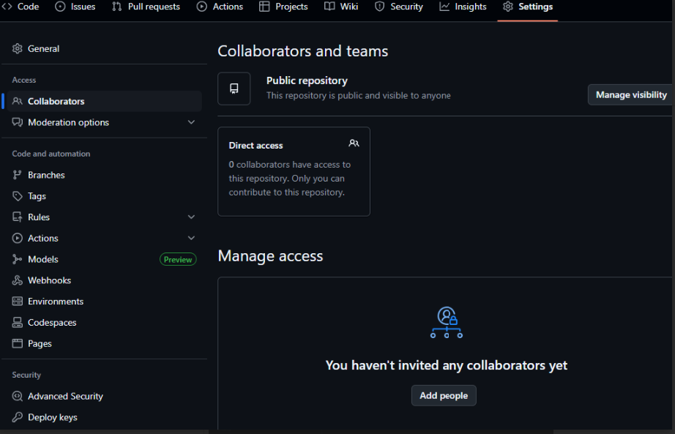

Slide 7
ＡＩ ＆ Ｂｉｇ Ｄａｔａ
Codyssey Policy
I know that some students completed the optional Codyssey problems to earn extra points. To ensure fairness for those who studied and solved the problems themselves, I need to distinguish between students who genuinely worked on them and those who simply copied and pasted the solutions on GitHub.
After verification, you may be asked to explain the contents of your code, if necessary.

Slide 8
Subproject | SLearning Course | Problem |  | Essential
Step 1: Audition for Cody Enter | Process 1: Wasteland with Value, Magratea (Standard Input/Output) | 01 Question 1 Introduce myself |  | X
 |  | 02 Question 2 Project Kick-Off! | 1 | O
 |  | 03 Question 3 Children who became Milliways candidates | 2 | O
 |  | 04 Question 4 Who will choose the one who will hold the key to destiny? | 3 | O
Step 2: 8-Step Training Program | Process 2: Sprouts Blooming in the Wasteland (Multidimensional Arrays) | 01 Question 1 8-step training program | 4 | O
 |  | 02 Question 2 Dumbass, the problem is physical strength! | 5 | O
 |  | 03 Question 3 My Basic Workout Routine | 6 | O
 | Process 3: Wounds Heal in the Gardener's Hands (Structures) | 01 Question 1 A Fight with Yourself | 7 | O
 |  | 02 Question 2 Facing Trauma | 8 | O
 |  | 03 Question 3 There is No Way to Escape Your Own Ghosts | 9 | O
 | Process 4: Temperature of Language (Pointers) | 01Question 1 How Good is My Korean? | 10 | O
 |  | 02 Question 2 Consonants and Vowels |  | X
 |  | 03 Question 3 Basic Grammar Learned through Puzzles |  | X
 | Process 5: Temperature of Sound (Function Pointers, Pointer Operations) | 01 Question 1 Facing the Present |  | X
 |  | 02 Question 2 Finding My Voice |  | X
 |  | 03 Question 3 Those Who Realized the Principle |  | X
 | Process 6: A Body Like Dry Firewood is Reborn (File Input/Output) | 01 Question 1 Body and Mind Separately |  | X
 |  | 02 Question 2 Surrendering Your Body to the Pattern |  | X
 | Process 7: I'm Not the Same as I Was Yesterday (Dynamic Memory Allocation) | 01 Question 1 People Make People |  | X
 | Process 9: The Distance I Can Reach Out (Preprocessing, External Variables, Split Compilation) | 01 Question 1 Shadow Life |  | X
Step 3: Debut | Process 10: |  |  | 10

Slide 9
ＡＩ ＆ Ｂｉｇ Ｄａｔａ
Practice evaluation
The full score for the one-week practices is 100 points.
Let’s check the number of submissions so far.
100 | Perfect with minor problems
90 | No src code or No results
75 | Done 3/4
50 | Done 2/4
25 | Done 1/4
0 | No email
-10 | Each day (except weekend) Within 24 hours, it is considered the same day.

Slide 10
ＡＩ ＆ Ｂｉｇ Ｄａｔａ
Cheating Policy
No computer, no phone, no extra material allowed.
Only A4 2 pages written by yourself are allowed, and
A4 2 pages must be submitted together with the exam answer sheet after the final exam. (Expect 2 Hr)
If you look at other people's answer sheets or discuss together during the exam, it will be considered cheating and you will receive an F, so don’t do.

Slide 11
ＡＩ ＆ Ｂｉｇ Ｄａｔａ
Cheating Policy
No computer, No phone, No extra material.
오직 본인이 작성한 A4 2장만 허락되며,
시험 답안지와 함께 2장의 A4용지는 같이 제출해야 한다.
만일 시험 중에 다른 사람의 답안지를 보거나, 서로 협의 하는 것은 부정행위로 간주되고 F를 받을 수 있습니다.

Slide 12
ＡＩ ＆ Ｂｉｇ Ｄａｔａ
Codyssey Policy
많은 학생들이 추가 점수를 받기 위해 선택적인 코디세이 문제를 풀었다는 것을 알고 있습니다. 혼자 힘으로 문제를 풀고 공부한 학생들의 공정성을 위해, 코드를 복사하여 github에 붙여 넣은 학생들과 그렇지 않은 학생들을 구분이 필요합니다.
10개 이상의 문제를 풀었던 학생들은 교수님께 이메일로 github 주소를 보내주시기 바랍니다.
확인 후, 필요한 경우 코드 내용에 대한 설명을 요청드릴 수 있습니다.

Slide 13
ＡＩ ＆ Ｂｉｇ Ｄａｔａ
Mini Project
Today is our final class, and we’ll be working on a mini project.
To become truly skilled at programming, understanding the overall data flow and properly modularizing functions is more important than just writing technical code.
It is recommended to form teams of 4 to 6 members.
Each team will give a presentation starting at 11 a.m. to explain the reasoning behind their project design. (5 ~ 10 minutes)

Slide 14
ＡＩ ＆ Ｂｉｇ Ｄａｔａ
Mini Project (example)
We want to store information of 10 students and print out the information of the students. Consider modularization and write a structure and member functions.
[Structure]
- Student name, student ID, student grades
[Member functions]
- Function that prints only the student name
- Function that prints only the student ID
- Function that prints only the student grades
- Function that prints the student name, ID, and grades
- Function that prints the average grade of all students

Slide 15
ＡＩ ＆ Ｂｉｇ Ｄａｔａ
Mini Project (1)
학생 10명의 정보를 저장하고 학생들의 정보를 출력하고자 한다. 모듈화를 고려해서 구조체와 멤버 함수를 작성하시요.
[ 구조체 ]
- 학생 이름, 학생 ID, 학생 성적
[ 멤버 함수]
- 학생 이름만 출력하는 함수
- 학생 ID만 출력하는 함수
- 학생 성적만 출력하는 함수
- 학생 이름, ID, 성적을 출력하는 함수
- 학생 전체 평균 성적을 출력하는 함수

Slide 16

ＡＩ ＆ Ｂｉｇ Ｄａｔａ
Mini Project
Write a car structure and a program to move the car from the starting point to the destination.
The car moves one step( x or y) at a time on the coordinates by receiving the driver input or by calculating coordinate automatically.
Input: Start, Left Turn, Right Turn, Backward, Stop
[ Car Structure ]
-
[ Car Control Function ]
-
Destination
Y
X

Slide 17
[ Step 1 ]
Define a Car struct with 4+ member variables
Create an array of Car structs (initialize 5 or more)
Get user input for one Car, then store new Car into the array of struct
Function to print all Car information
Function to print selected Car only
[ Step 2 ]
Set the current car position (x, y) = (0, 0)
Get destination coordinates from the user
Function to move car step-by-step to the destination (print each step)
. By user input
. Calculate automatically
Create a main function to complete all steps

Slide 18
ＡＩ ＆ Ｂｉｇ Ｄａｔａ
Mini Project (2)
자동차 구조체를 작성하고, 자동차를 출발지에서 목적지까지 이동하도록 하는 프로그램을 작성하시요
자동차는 조정자 입력을 받아 좌표의 한칸씩 이동한다.
Input: 출발, 좌회전, 우회전, 후진, 멈춤
[ 자동차 구조체 ]
-
[ 자동차 조절 함수 ]
-
목적지
Y
X

Slide 19
ＡＩ ＆ Ｂｉｇ Ｄａｔａ
See you next week!
DO NOT miss a final exam
miricanvas.com

