Slide 1


Building a Trustworthy, Human-Centered Social Infrastructure for Digitally Sovereign Communities
Empowering communities through secure and human-focused digital systems
Notes:
AI-generated content may be incorrect. ---

Slide 2
Sovernly
Digital Social Infrastructure
Notes:
Empowering Citizens Through Digital Sovereignty

Slide 3

Empowering Citizens Through Digital Sovereignty
Local Control Over Data
Digital sovereignty stresses local ownership and control of digital infrastructure and data by citizens.
Human-Centered Infrastructure
Building trustworthy, transparent systems focused on empowering communities and restoring autonomy.
Restoring Agency and Trust
The initiative aims to foster trust and resilience through accountable governance by the people served.
Notes:
The concept of digital sovereignty emphasizes the importance of local control over digital infrastructure and data. In today's interconnected world, citizens often rely on centralized platforms that prioritize profit over people, leading to a loss of autonomy and trust. This presentation introduces a vision for a trustworthy, human-centered social infrastructure that empowers communities to reclaim control. By focusing on digital sovereignty, we aim to build systems that are transparent, accountable, and governed by the people they serve. This initiative is not just about technology—it’s about restoring agency, fostering trust, and creating resilient communities that can thrive in the digital age.

Slide 4
Challenges in Current Systems
Notes:
Why Our Current Systems Are Failing Citizens

Slide 5
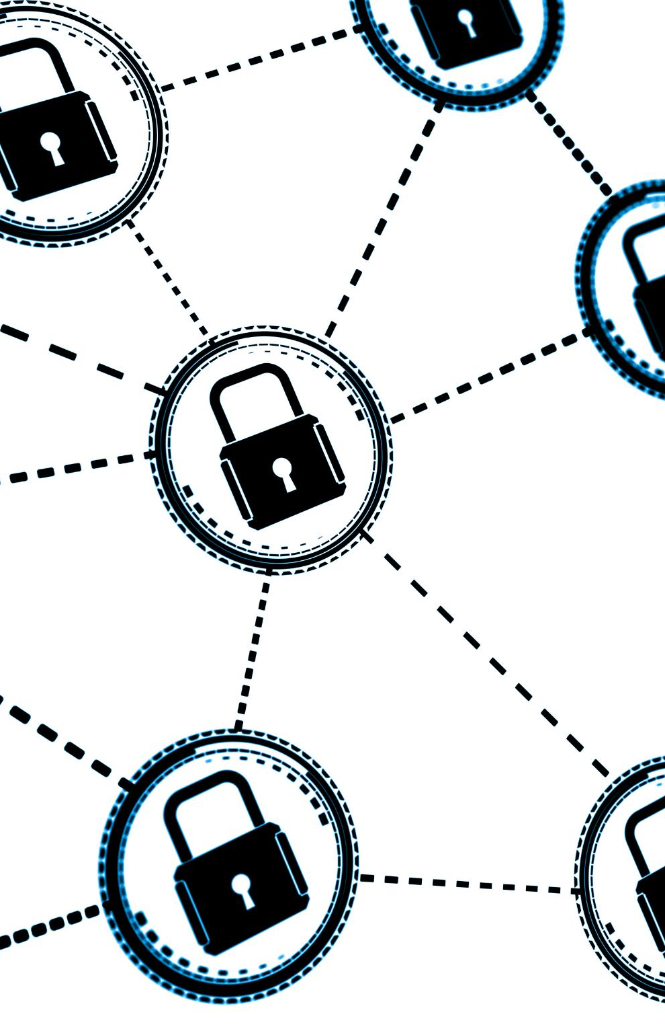
Why Our Current Systems Are Failing Citizens
Centralized Control Issues
Centralized digital platforms limit local autonomy and often ignore community input in decision making.
Privacy and Security Risks
External entities control essential digital services, risking citizens' privacy, security, and trust.
Erosion of Institutional Trust
Opaque governance and lack of accountability reduce citizens' trust in institutions and systems.
Need for Human-Centered Systems
A shift to systems prioritizing human values and community control is essential for better serving the needs of citizens.
Notes:
Modern digital systems often fail to serve the interests of citizens due to centralized control and profit-driven motives. These platforms erode local autonomy by making decisions without community input, leading to a disconnect between services and actual needs. Additionally, the lack of ownership over essential digital services means that citizens are at the mercy of external entities, which can compromise privacy, security, and trust. The decline in institutional trust is a direct result of opaque governance and the absence of human accountability. Addressing these issues requires a fundamental shift towards systems that prioritize human values and community control.

Slide 6
Vision and Principles
Notes:
A Human-Only, Trust-Based Social Infrastructure, Foundational Values

Slide 7

A Human-Only, Trust-Based Social Infrastructure
Human-Centric Governance
Governance is performed solely by humans to ensure transparency and accountability in decision-making processes.
Local Control and Management
Citizens have the power to manage and maintain essential services, reinforcing community autonomy and trust.
Support for Essential Applications
Infrastructure supports communication, civic engagement, and resource sharing within an ethical human framework.
Ethical Responsibility in Digital Environments
Removing AI from governance highlights the importance of human judgment and ethical responsibility.
Notes:
The envisioned social infrastructure is built exclusively by and for humans, eliminating automated decision-making in governance. This approach ensures that all processes are transparent and accountable, fostering trust within communities. Local control is a cornerstone of this vision, allowing citizens to manage and maintain the services they rely on. The infrastructure is designed to support essential applications such as communication, civic engagement, and resource sharing, all within a framework that respects human dignity and autonomy. By removing AI from governance roles, we reinforce the importance of human judgment and ethical responsibility in shaping our digital environments.

Slide 8

Foundational Values
Digital Sovereignty
Digital sovereignty allows communities to control their digital tools and data for self-determination.
Trust and Accountability
Trust is built through transparent processes and human accountability enabling meaningful engagement.
Inclusivity and Access
Inclusivity ensures infrastructure accessibility for all citizens, promoting equity and participation.
Resilience and Sustainability
Resilience enables systems to adapt and endure challenges for long-term sustainability, guided always by locality of concerns rather than the global mean or median..
Notes:
The foundation of this social infrastructure rests on four key values: digital sovereignty, trust, inclusivity, and resilience. Digital sovereignty ensures that communities have control over their digital tools and data, enabling self-determination. Trust is cultivated through human accountability and transparent processes, which are essential for meaningful engagement. Inclusivity guarantees that the infrastructure is accessible to all citizens, regardless of background or ability, promoting equity and participation. Resilience refers to the system’s ability to adapt and endure in the face of challenges, ensuring long-term sustainability. Together, these values create a robust framework for empowering communities in the digital age.

Slide 9
Infrastructure Components
Notes:
What the Infrastructure Includes

Slide 10
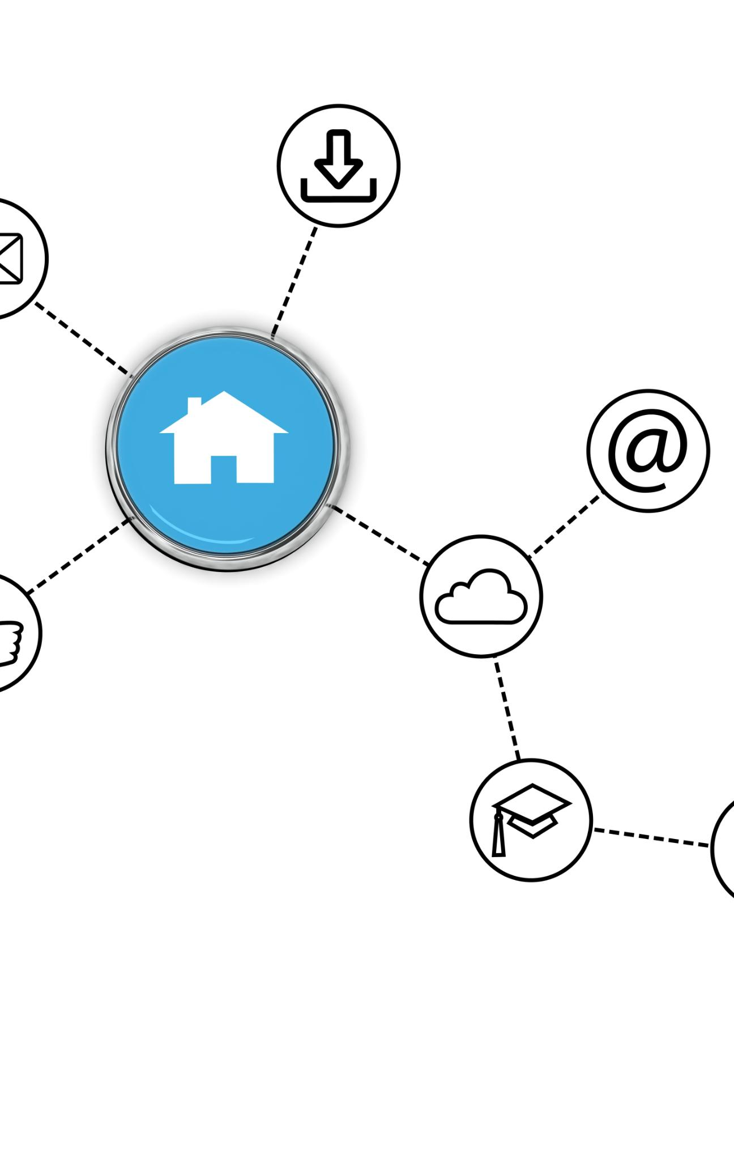
What the Infrastructure Includes
Communication Platforms
Messaging apps and forums provide spaces for dialogue and collaboration within communities.
Civic Participation Tools
Voting systems, petitions, and virtual town halls enable active citizen involvement in governance.
Resource Sharing Mechanisms
Local marketplaces and mutual aid networks strengthen economic resilience and community bonds.
Identity and Reputation Systems
Human-verified identity systems build trust and accountability without relying on algorithms.
Notes:
The proposed infrastructure encompasses a range of essential services designed to support community needs. Communication platforms such as messaging apps and forums facilitate dialogue and collaboration. Civic tools like voting systems, petitions, and virtual town halls enable active participation in governance. Resource sharing mechanisms, including local marketplaces and mutual aid networks, strengthen community bonds and economic resilience. Identity and reputation systems, verified by humans, ensure trust and accountability without relying on automated algorithms. These components work together to create a comprehensive ecosystem that empowers citizens and reinforces the principles of digital sovereignty.

Slide 11
Governance and Technology
Notes:
Digitally Sovereign Control, Human-Centric Tech

Slide 12

Digitally Sovereign Control
Community-Led Governance
Communities manage their own digital systems through transparent, participatory decision-making processes.
Local Decision-Making Bodies
Local councils or assemblies ensure policies reflect community values and needs effectively.
Citizen Ownership and Responsibility
Development and maintenance are citizen-led, fostering ownership and accountability in governance.
Independence from External Influence
No involvement from corporations or AI preserves the system’s integrity and sovereignty.
Notes:
Governance within this infrastructure is rooted in digitally sovereign control, where communities manage their own systems through transparent and participatory processes. Local councils or assemblies serve as decision-making bodies, ensuring that policies reflect the needs and values of the people. Development and maintenance are citizen-led, fostering a sense of ownership and responsibility. Crucially, there is no influence from external corporations or AI, preserving the integrity and independence of the infrastructure. This model promotes democratic engagement and empowers citizens to shape their digital environments in alignment with their collective vision.

Slide 13

Human-Centric Tech
Open-Source Transparency
Open-source software promotes transparency and adaptability, enabling communities to tailor tools to their specific needs.
Decentralized Communication
Peer-to-peer networks support decentralized communication and data sharing, reducing dependence on central servers.
Privacy-First Architecture
Privacy-first architecture protects user data and builds trust through secure design principles.
Human Moderation
Human oversight ensures content and interactions follow ethical standards and community norms instead of automation.
Notes:
The technology stack supporting this infrastructure is designed with humans at the center. Open-source software ensures transparency and adaptability, allowing communities to customize tools to their specific needs. Peer-to-peer networks facilitate decentralized communication and data sharing, reducing reliance on centralized servers. Privacy-first architecture protects user data and reinforces trust. Human moderation and oversight replace automated systems, ensuring that content and interactions are guided by ethical standards and community norms. This human-centric approach to technology prioritizes empowerment, security, and inclusivity, laying the groundwork for a truly sovereign digital ecosystem.

Slide 14
Citizen Empowerment
Notes:
Empowerment Through Ownership

Slide 15

Empowerment Through Ownership
Citizen Control Over Digital Lives
Ownership enables citizens to manage their own digital platforms and services, reflecting their values and priorities.
Strengthening Community Bonds
Community autonomy fosters cooperation and shared resource maintenance among individuals, enhancing unity.
Data Privacy and Security
Ownership protects citizens from external exploitation by ensuring private and secure data interactions.
Foundation for Collective Action
This ownership framework empowers communities to confidently address challenges and pursue new opportunities.
Notes:
Ownership is a powerful tool for empowerment, and this infrastructure is designed to give citizens control over their digital lives. By managing their own platforms and services, communities can make decisions that reflect their values and priorities. This autonomy fosters stronger community bonds, as individuals work together to build and maintain shared resources. It also protects citizens from exploitation by external entities, ensuring that their data and interactions remain private and secure. Ultimately, this framework provides a foundation for collective action, enabling communities to address challenges and pursue opportunities with confidence and unity.

Slide 16
Call to Action
Notes:
Join the Movement

Slide 17

Join the Movement
Collective Effort Importance
Building social infrastructure depends on active participation and collective contributions from all citizens.
Democratic Participation
Engaging in local governance ensures decisions reflect community needs and are made democratically.
Prioritizing Human Values
Creating systems focused on human values and digital sovereignty fosters trust and resilience.
Building a Thriving Future
Collaboration and shared ownership empower communities to thrive and shape a better future.
Notes:
Building a trustworthy, human-centered social infrastructure requires collective effort and active participation. Citizens are invited to help shape the framework by contributing their skills, ideas, and perspectives. Participation in local governance ensures that decisions are made democratically and reflect the community’s needs. By joining this movement, individuals can play a vital role in creating systems that prioritize human values and digital sovereignty. Together, we can build trust, foster resilience, and create a future where communities thrive through collaboration and shared ownership.

Slide 18
Discussion
Notes:
Q&A / Discussion

Slide 19

Q&A / Discussion
Encouraging Open Dialogue
Open dialogue invites feedback and questions essential for refining shared visions and strategies.
Collaborative Problem Solving
Participants share experiences and propose solutions to address community needs effectively.
Building Trust and Transparency
Mutual understanding fosters trust and transparency, strengthening collective efforts and partnerships.
Co-creating a Digital Future
Working together enables creation of a digitally sovereign future empowering citizens and sustainable development.
Notes:
This final section invites feedback, questions, and ideas for collaboration. Engaging in open dialogue is essential for refining the vision and ensuring that the infrastructure meets the diverse needs of communities. Participants are encouraged to share their experiences, raise concerns, and propose solutions. This collaborative approach fosters mutual understanding and strengthens the foundation of trust and transparency. By working together, we can co-create a digitally sovereign future that empowers citizens and supports sustainable, human-centered development.

