Slide 1
Twitter Semantic Analysis (NLP)
- Mentored By Madishetti Rajashekhar and
Bapuram Pallavi
Saurav Srikant Deshmukh
Rishikesh Sharad Memane
Tasmia Rahath
Nallagonda Srinivas
Amar Shivaji Kasbe.
Sarvesh Kashinath Joshi
Sameeh Ali

Slide 2
01
INTRODUCTION

Slide 3
Twitter Semantic Analysis, also known as Twitter Sentiment Analysis or Opinion Mining is a data analysis technique that focuses on understanding and extracting the meaning, sentiment, or emotions expressed in tweets posted on the Twitter platform.
It involves using natural language processing (NLP) and machine learning techniques to analyze the text content of tweets to determine the underlying sentiment or context.
Tweets are often useful in generating a vast amount of sentiment data upon analysis
These data are useful in understanding the opinion of people on social media for a variety of topics.

Slide 4
02
BUSINESS OBJECTIVE

Slide 5
Business Problem:
To Perform sentiment analysis of tweets, gauge its impact and type.
Architecture level analysis:
Data transformation/Text processing using R/Python.
To get sentiments Analysis and Emotion mining with some charts like histogram, Density plot, Barplot, pie-plot etc.
Deployment through R Shiny or Flask/ Streamlit.

Slide 6
About Dataset:
This is a dataset of tweets classified into one of the 4 classes - Regular, Sarcasm, Figurative and Irony.
The dataset consists of :
1. Tweet: The text of the tweet
2. Class: The respective class to which the tweet belongs.
There are 4 classes:
I) Irony
II) Sarcasm
III) Regular
IV) Figurative (both irony and sarcasm)

Slide 7
03
PROJECT WORKFLOW

Slide 8
Data Collection and Data Preprocessing
Sentiment Analysis
and Feature Engineering
Data Visualizations
Step 1
Step 3
Step 5
2019
Text Processing
Model building and Evaluation
Step 6
2018
Deployment
Step 2
Step 4

Slide 9
DATA PREPROCESSING
Text Cleaning:
Lowercasing: Convert all text to lowercase to ensure uniformity in text data.
Removing Special Characters: Remove punctuation, symbols, and non-alphanumeric characters as they may not carry sentiment information.
Tokenization:
Word Tokenization: Split the text into individual words or tokens. This step is essential for further analysis.
Sentence Tokenization: If needed, segment the text into sentences, which can be useful for context-aware sentiment analysis.
Stop Word Removal:
Remove common stop words (e.g., "and," "the," "in") that do not carry significant sentiment information. However, be cautious, as some stop words may be sentiment-carrying in specific contexts.
Stemming and Lemmatization:
Reduce words to their root form using stemming or lemmatization. For example, "running," "ran," and "runs" can be reduced to "run." Lemmatization typically produces more meaningful results than stemming.

Slide 10
04
EDA

Slide 11
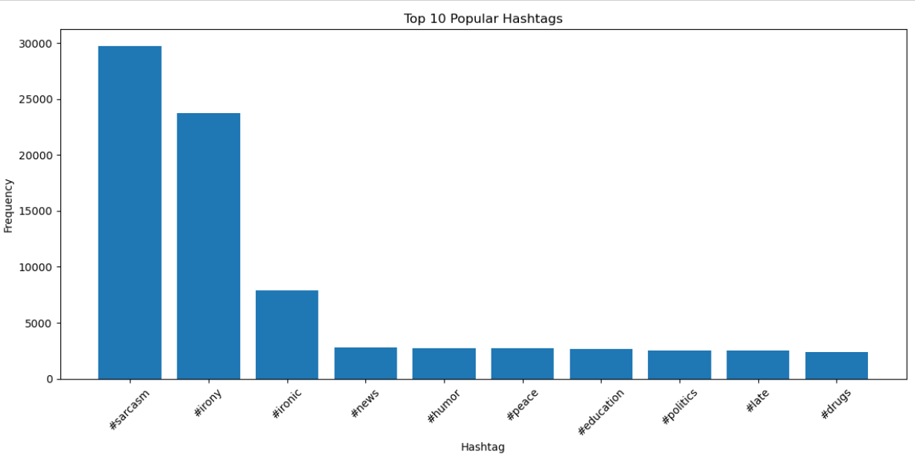
#Hashtag Analysis

Slide 12
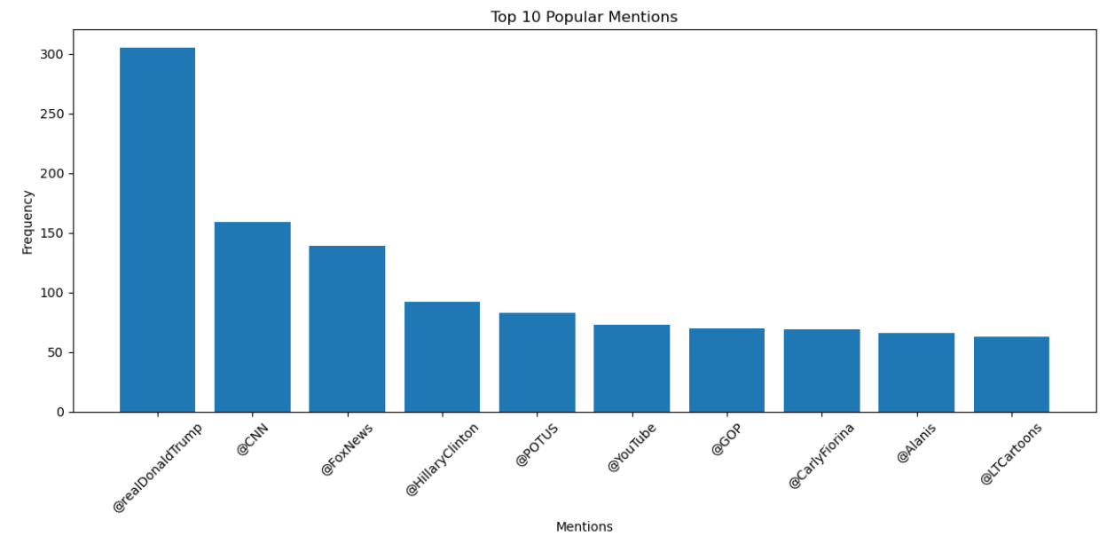
@Mention Analysis

Slide 13
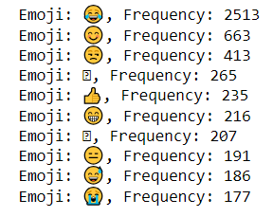
Emoji Analysis

Slide 14
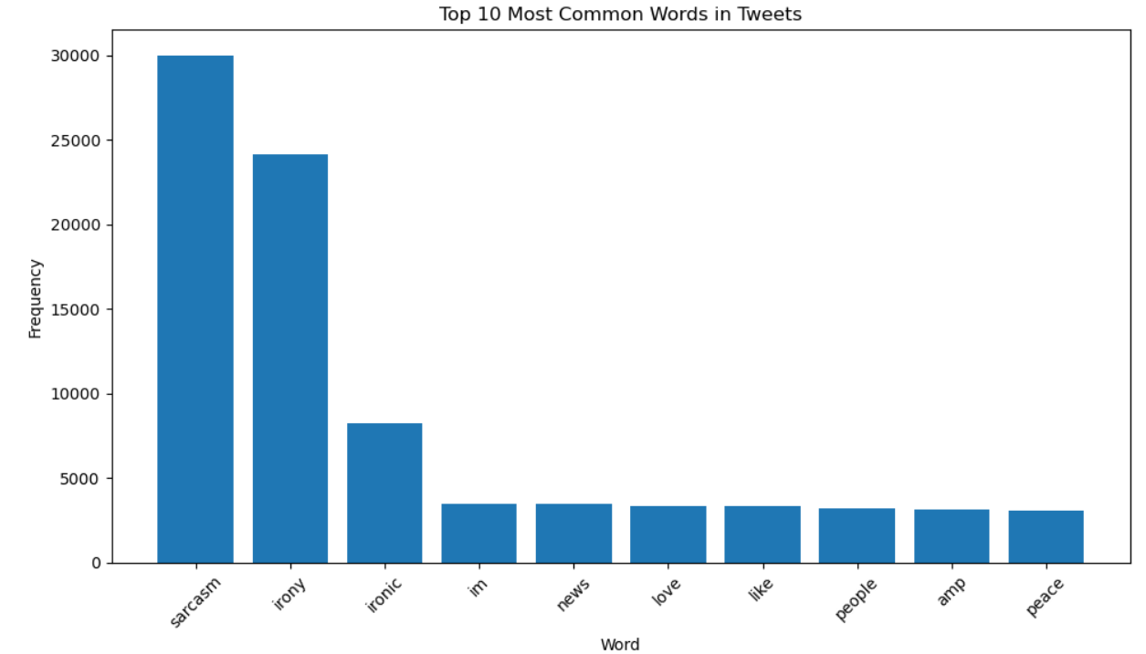
Word Frequency Analysis

Slide 15
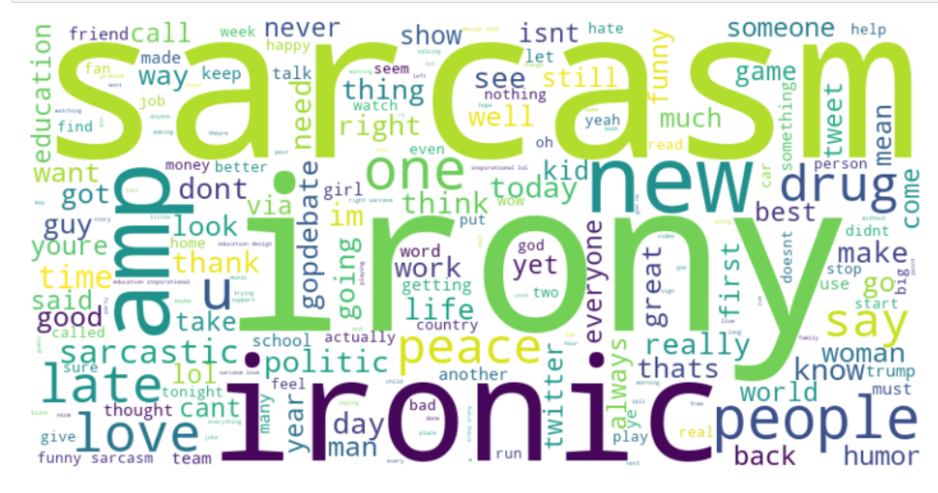
Word Cloud Analysis

Slide 16
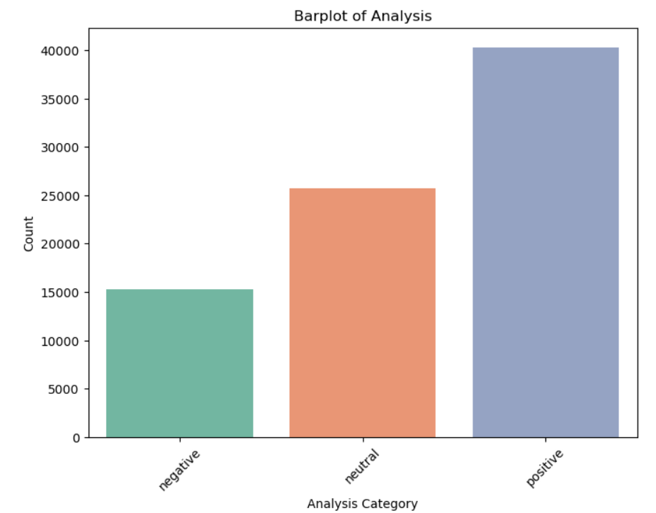
Sentiment Analysis

Slide 17
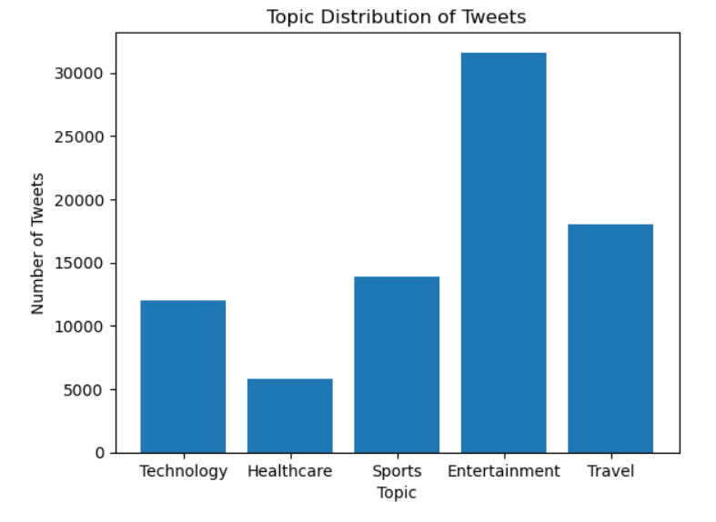
Topic Modelling

Slide 18
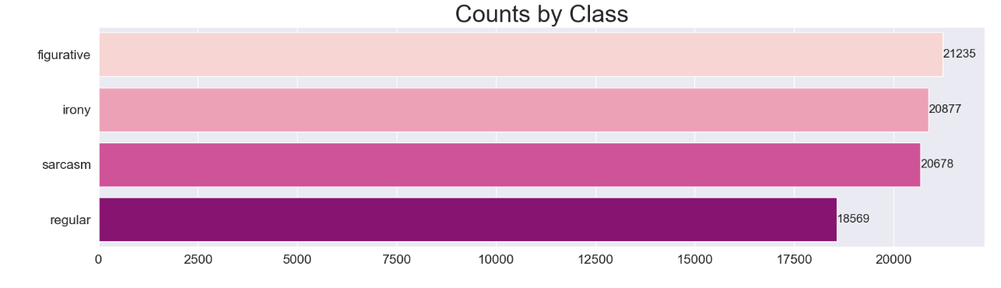
Class wise Analysis

Slide 19
05
Model Building

Slide 20
MODEL BUILDING
Naive Bayes: Naive Bayes classifiers are simple and efficient for text classification tasks. They work well with small to moderately sized datasets and can handle multi-class sentiment analysis.
Support Vector Machines (SVM): SVMs are effective for binary sentiment classification and can be extended to multi-class problems. They perform well when the feature space is high-dimensional.
Logistic Regression: Logistic regression is a straightforward and interpretable model for sentiment analysis. It can be used for both binary and multi-class sentiment classification.
Random Forest: Random Forest is an ensemble learning algorithm that can handle large datasets and capture complex relationships in text data. It's suitable for both binary and multi-class sentiment analysis.

Slide 21
BERT Model – NLP
BERT (Bidirectional Encoder Representations from Transformers) is a Natural Language Processing Model proposed by researchers at Google Research in 2018.
Bidirectional Context: BERT reads text bidirectionally, meaning it looks at the entire sentence when encoding a word. Traditional models like RNNs and LSTMs process text sequentially, which can limit their understanding of context.
Pre-trained: BERT is typically pre-trained on large corpora of text data, such as Wikipedia articles and books. During pre-training, it learns to predict missing words in sentences, effectively learning language understanding and context.
Transfer Learning: After pre-training, BERT can be fine-tuned on specific NLP tasks, such as text classification, question answering, and named entity recognition. Fine-tuning allows BERT to adapt its knowledge to perform well on these tasks with relatively small amounts of task-specific data.
State-of-the-Art Performance: BERT achieved state-of-the-art results on various benchmark NLP datasets when it was introduced. It demonstrated significant improvements in tasks like sentiment analysis, language translation, and text summarization.

Slide 22
Word2Vec
Word2Vec is a popular natural language processing (NLP) technique used to generate word embeddings. It was developed by Tomas Mikolov and his team at Google in 2013.
Word2Vec is a type of unsupervised learning algorithm that learns distributed vector representations (embeddings) of words from large text corpora. These word embeddings capture semantic relationships between words based on their co-occurrence patterns in the data.
Word Embeddings: Word2Vec represents words as dense vectors in a continuous vector space. Each word in the vocabulary is assigned a unique vector, and these vectors encode semantic and syntactic information about the words.
Mathematical Operations: Word embeddings produced by Word2Vec allow for mathematical operations like addition and subtraction between word vectors. For example, "king - man + woman" might result in a vector close to the word "queen.
Applications: Word2Vec embeddings are used in a wide range of NLP applications, including sentiment analysis, document classification, machine translation, and information retrieval, to name a few.

Slide 23
LDA
LDA stands for Latent Dirichlet Allocation, which is a statistical model used in natural language processing (NLP) and machine learning for topic modeling.
LDA is a generative probabilistic model that allows you to discover underlying topics within a collection of documents. Here are the key points about Latent Dirichlet Allocation (LDA):
Topic Modeling: LDA is primarily used for topic modeling, which is the process of identifying and extracting topics or themes from a collection of documents. These topics represent the underlying themes or subjects that are discussed in the documents.
Generative Model: LDA treats each document as a mixture of topics and each topic as a mixture of words. It assumes that documents are generated in a two-step process: first, topics are selected for a document, and then words are selected based on those topics.
Latent Variables: LDA introduces latent variables, which are hidden variables that influence the generation of documents. These latent variables include the topics themselves and the distribution of topics in each document.
Applications: LDA has a wide range of applications in text analysis, including document clustering, document classification, content recommendation, and information retrieval. It is also used in social network analysis and other fields where data can be represented as collections of text documents.

Slide 24
06
Model Evaluation

Slide 25
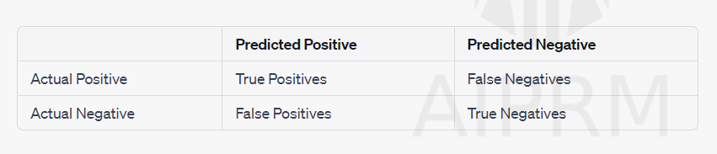
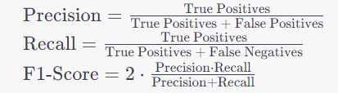
MODEL EVALUATION TECHNIQUES
Accuracy: Accuracy measures the proportion of correctly predicted sentiments (positive, negative, or neutral) out of the total predictions. It's a basic metric but can be misleading if the dataset is imbalanced (e.g., a lot more positive tweets than negative ones).
Precision, Recall, and F1-Score: Precision measures the ratio of correctly predicted positive sentiments to the total predicted positive sentiments. Recall measures the ratio of correctly predicted positive sentiments to the total actual positive sentiments. F1-score is the harmonic mean of precision and recall and is useful when there's an imbalance in the classes.

Slide 26
SVM (Support Vector Machine)
Support Vector Machine (SVM) is a popular machine learning algorithm that can be used for various tasks, including text classification with tweet data.
SVM is particularly effective when dealing with high-dimensional data like text, where the number of features (words or tokens) can be very large.
Model Evaluation:
Evaluate the SVM model's performance on the testing set using metrics like accuracy, precision, recall, F1-score, and confusion matrix.
Regular Maintenance:
Continue to monitor and update your SVM model as needed, especially if you plan to use it in a real-world application where new tweet data continuously arrives.

Slide 27
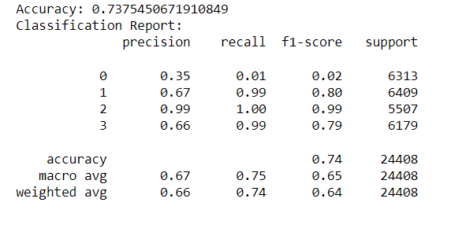
Accuracy Score of SVM

Slide 28
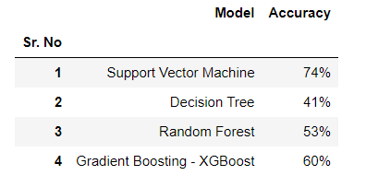
Accuracy of all models

Slide 29
07
Deployment

Slide 30
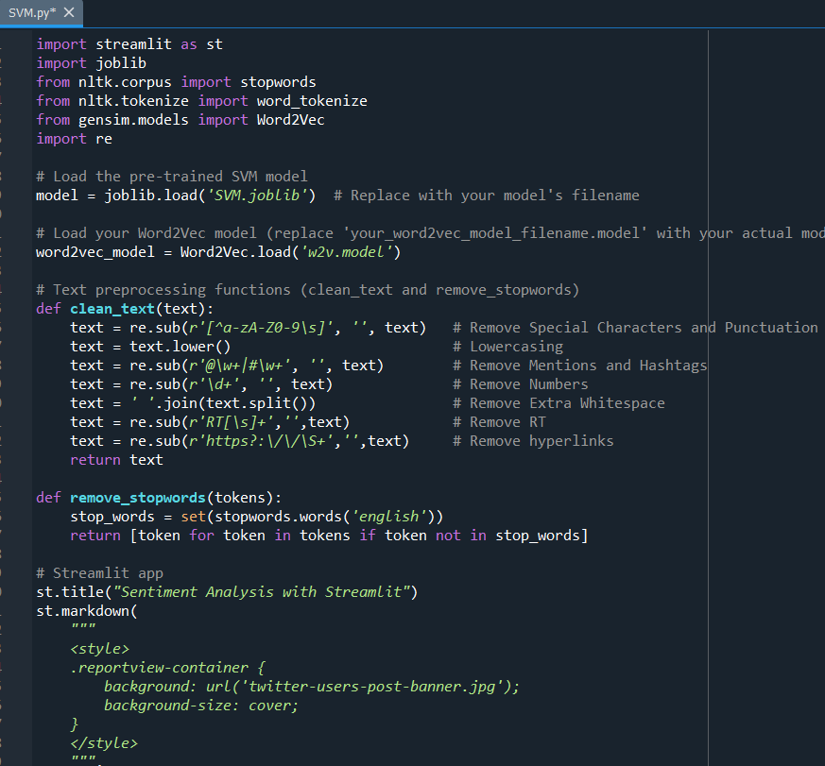
Deployment in Spyder

Slide 31
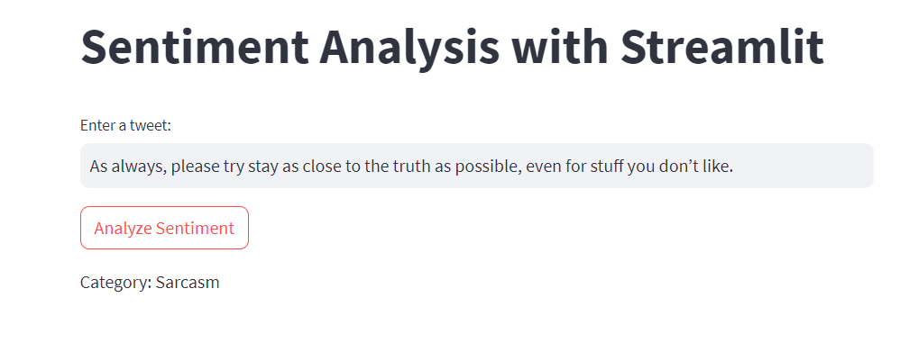
Streamlit App

