Slide 1
Bluetooth
Group Members: Gleb, Ian and Jordan

Slide 2
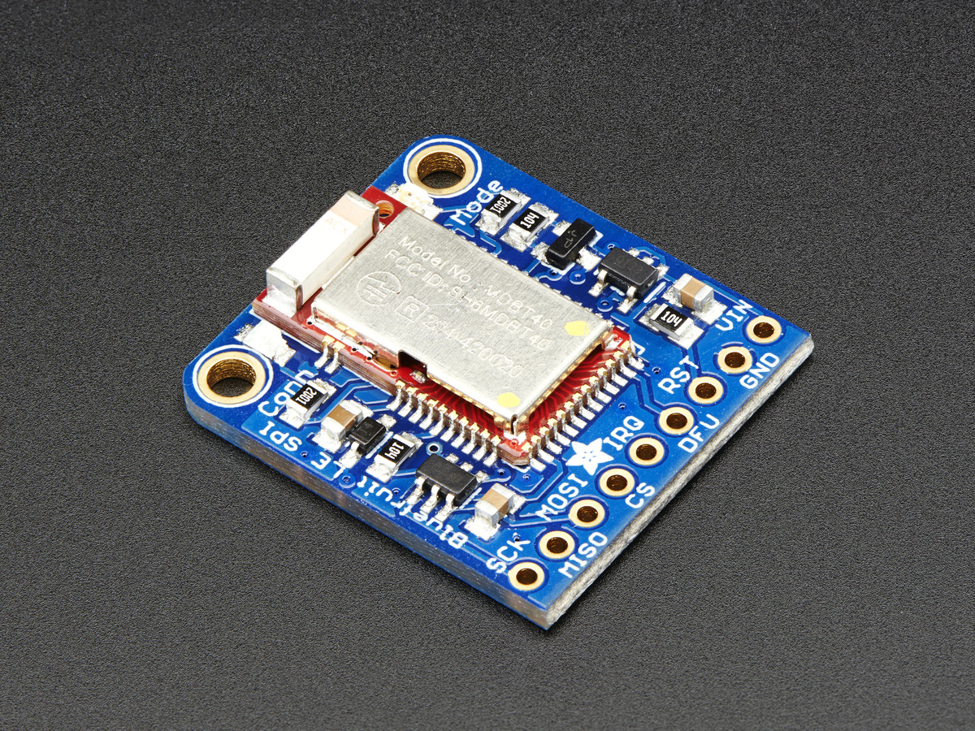
The Goal
Allow counter data to be collected/transferred from the trail counter to a mobile device and then to a web server

Slide 3
Milestones
Send/Receive serial data stream across bluetooth channel using SPI Bluefruit module and provided app.
Collect and analyze open field range test data. Develop operating constraints for wireless connectivity.
Develop firmware to upload counter data from trail counter.
Develop data collection app.

Slide 4
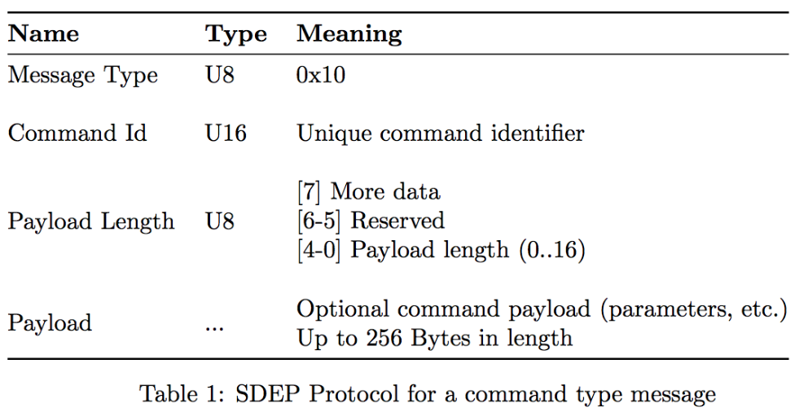
Milestone 1
Understanding the SDEP Protocol
Understanding AT commands

Slide 5
Milestone 2
Sending/ Receiving from STM32 to BlueFruit properly through SPI
Allowing Payload lengths > 16 bytes
Sending a constant stream of data to a device connected via bluetooth
Field testing

Slide 6
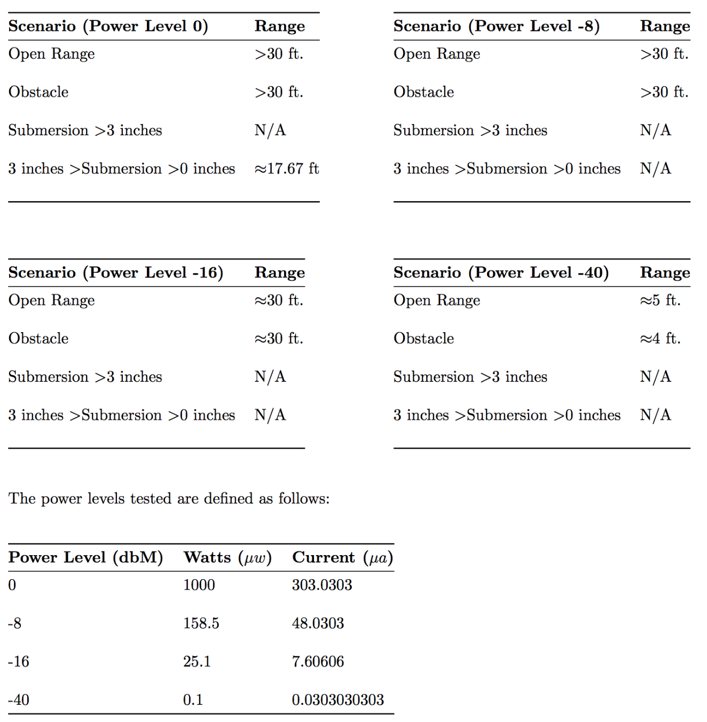
Milestone 2 (cont.)
Field Testing Results

Slide 7
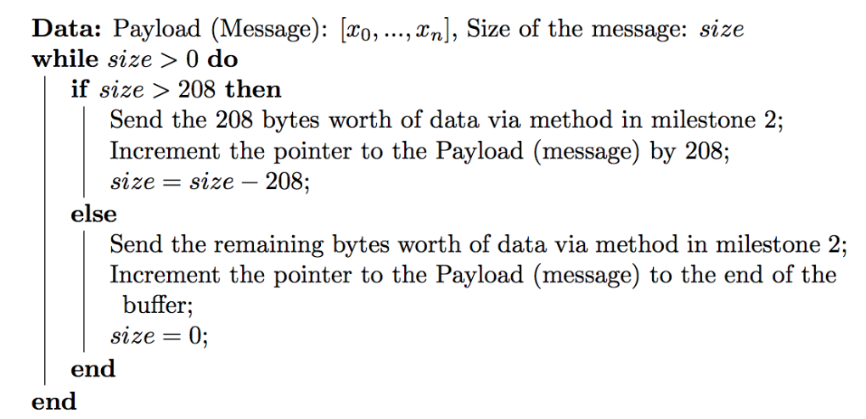
Milestone 3
Checking for a connected device
Handling large payloads (> 256 bytes)
Disconnecting/Advertising

Slide 8
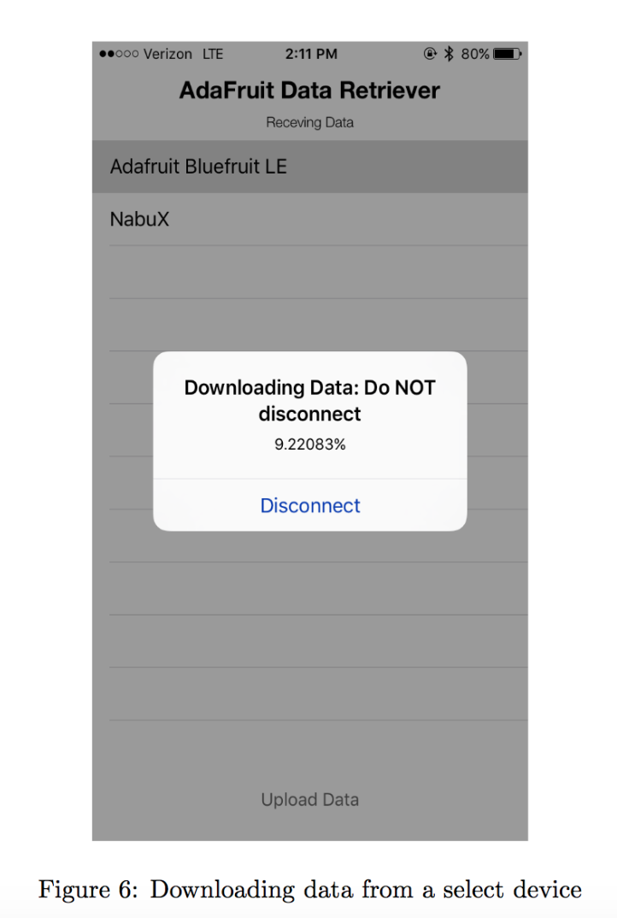
Milestone 4
Collect Data from the trail counter
Write an epoch time to the trail counter
Send the received data to a remote server

Slide 9
Future Work/Improvement
Receive epoch time on STM32
Gracefully handle disconnect from STM32
Bug Fixing (edge cases)
Optimization

Slide 10
Questions?

