Slide 1


Slide 2
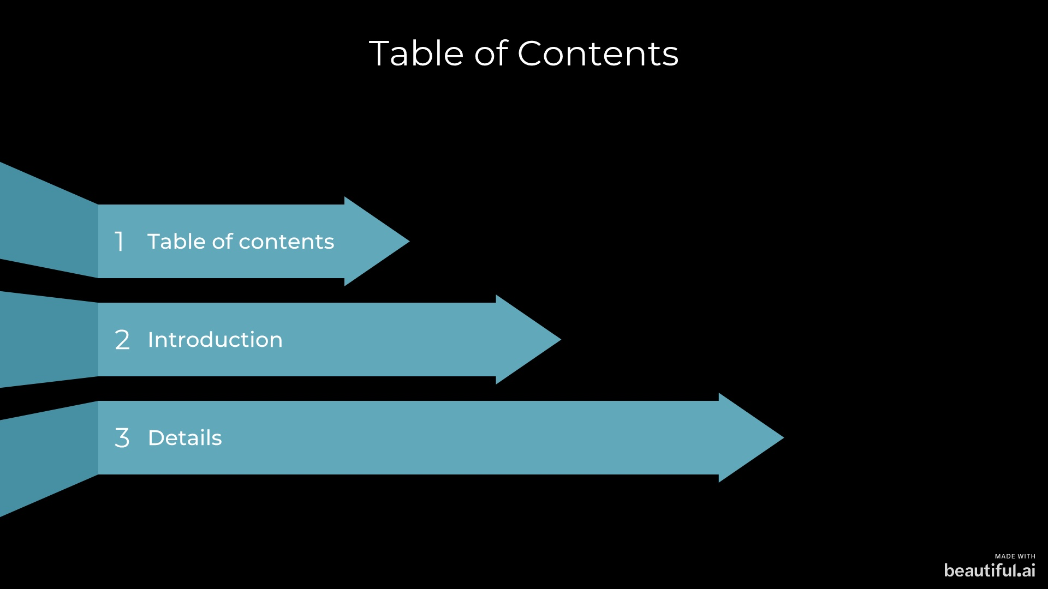

Slide 3

INTRODUCTION

Slide 4
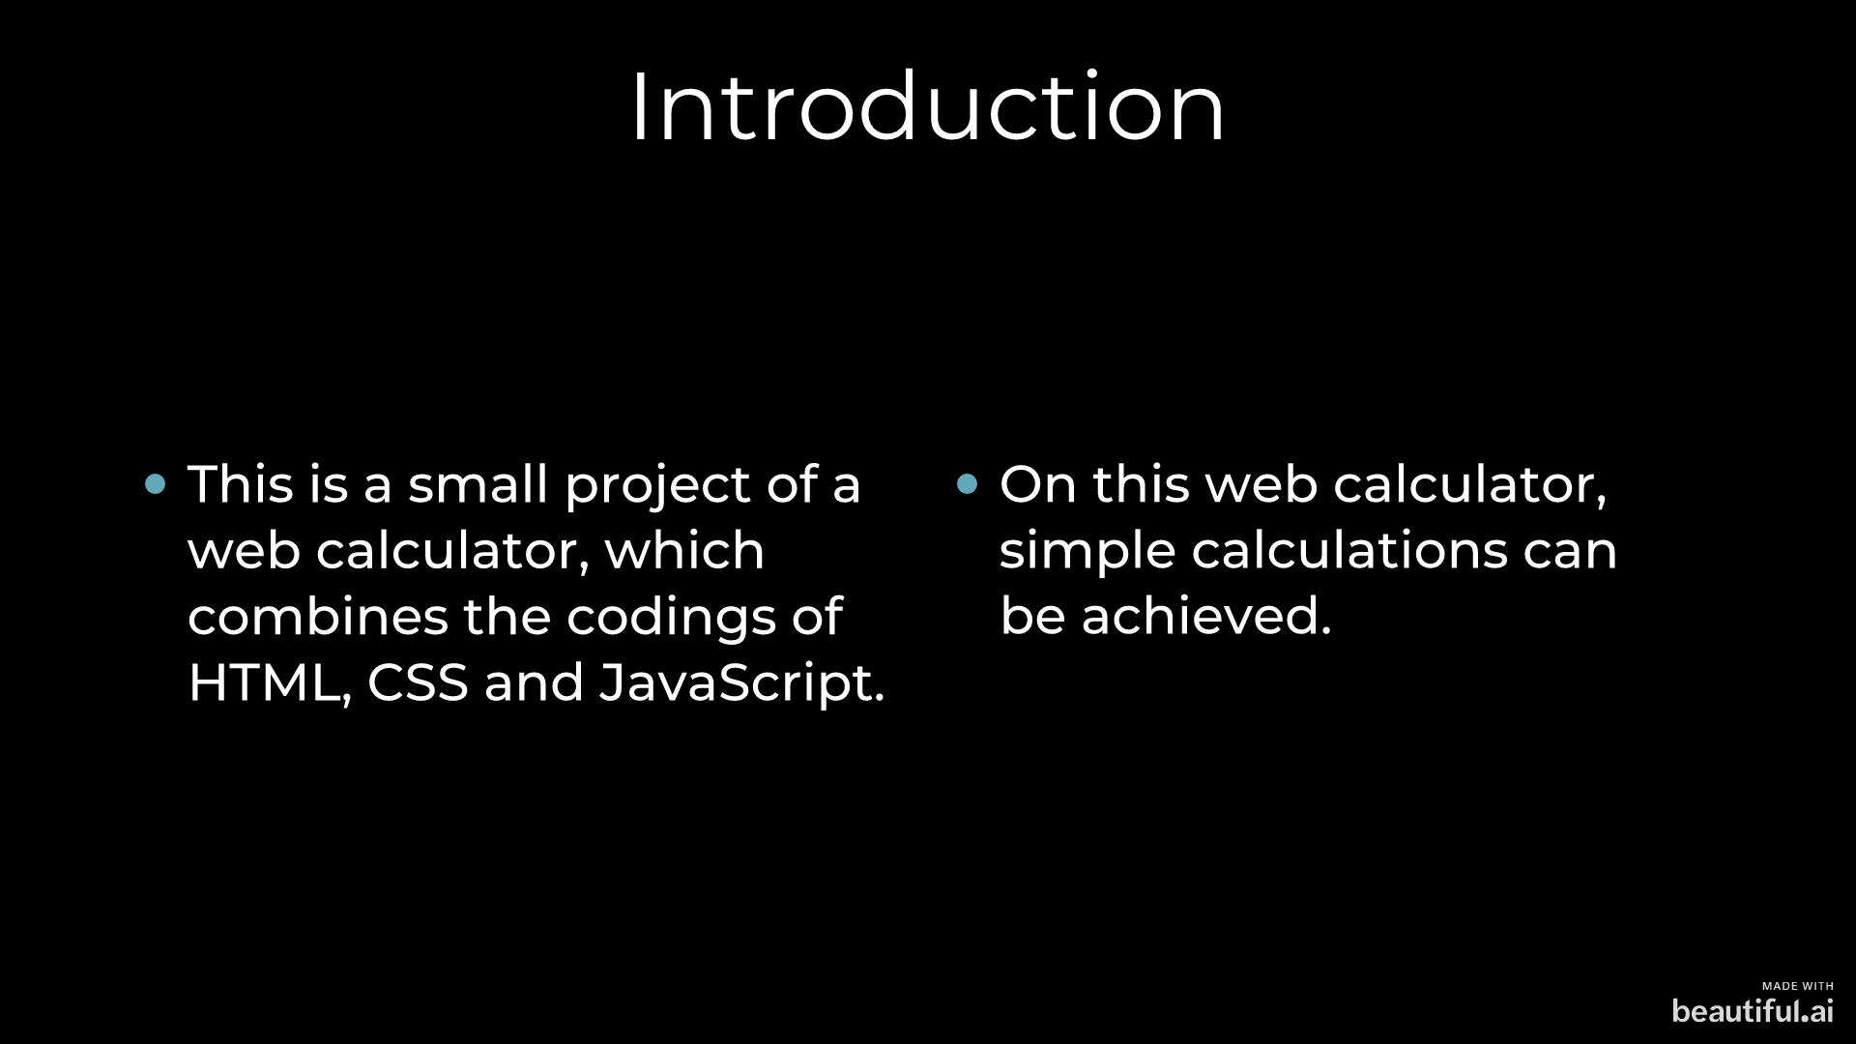

Slide 5
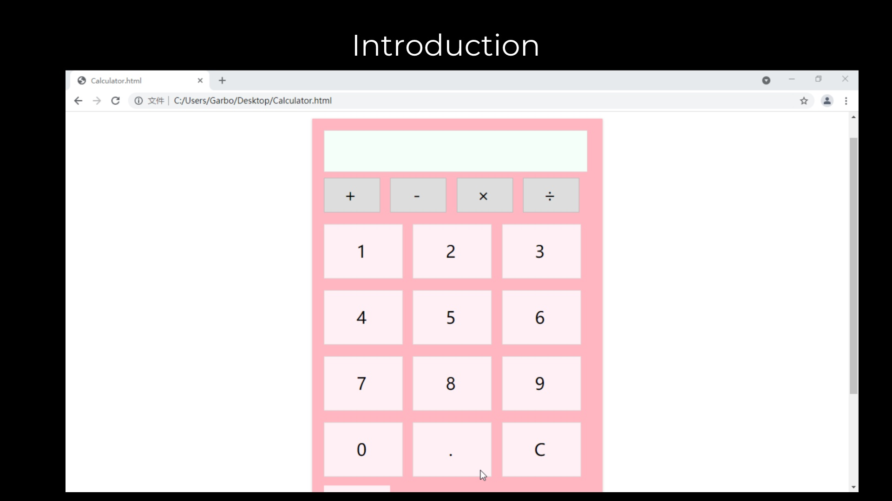

Slide 6
DETAILS

Slide 7
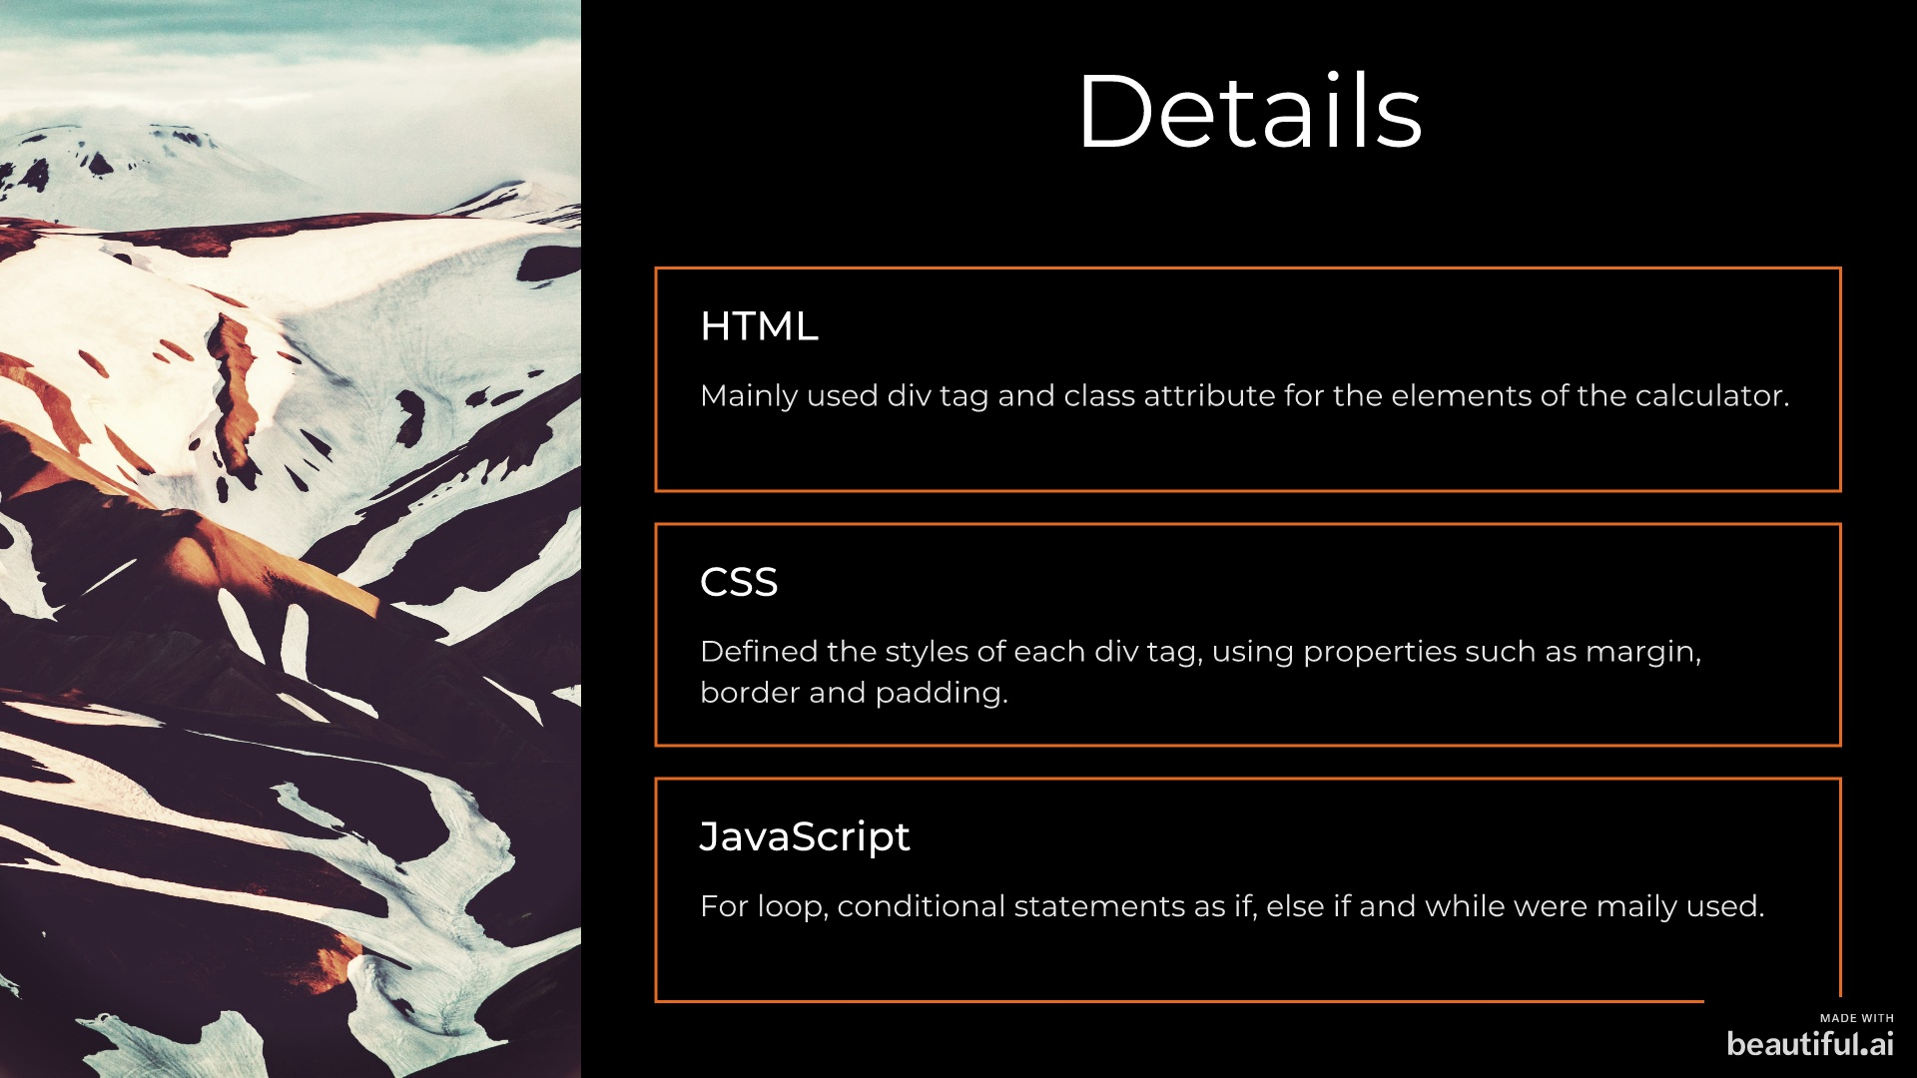

Slide 8


