Slide 1
Implementation
3 Methods
qLearning(state s, double epsilon)
Epsilon-greedy
If not random
PickBestAction()
Else
PickRandom()
Update value based on action chosen.
One more method to PickBestAction() and one to find HighestValue()
Estimate[rows*columns][4] ->
Estimate[s.x + s.y * columns][i]
If action is impossible, it keeps trying a new one until a possible action is chosen.

Slide 2
Experimental Setup
Changed Field
Multiple Rewards / Traps
Bigger Field
More obstacles
Number of episodes
Different learning rates (α)
Different cost-values (γ)
Different epsilons (ε)
Change policy

Slide 3






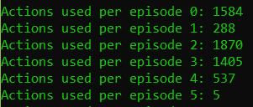

Results
Changed alpha
Epsilon: 0.1
Alpha: 1
Gamma: 0.9
Episodes: 100000
Epsilon: 0.1
Alpha: 0.4
Gamma: 0.9
Episodes: 1000
Changed gamma
Epsilon: 0.1
Alpha: 1
Gamma: 0.5
Episodes: 1000
Epsilon: 0.1
Alpha: 1
Gamma: 0.1
Episodes: 1000

Slide 4
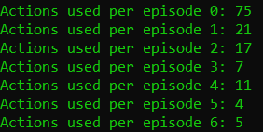



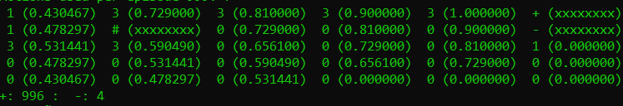
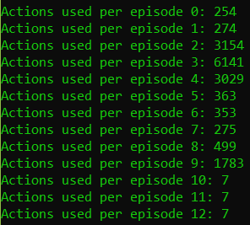
Results
Changed epsilon
Epsilon: 0.5
Alpha: 1
Gamma: 0.9
Episodes: 1000
Epsilon: 0.05
Alpha: 1
Gamma: 0.9
Episodes: 1000
Bigger field
Epsilon: 0.1
Alpha: 1
Gamma: 0.9
Episodes: 1000

Slide 5
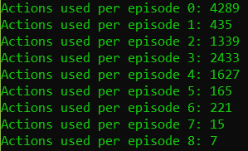
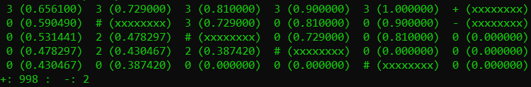
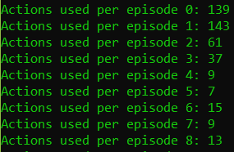
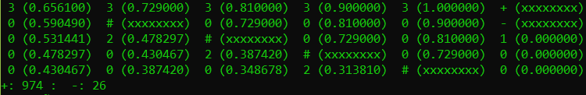
Results
Changed field, with more obstacles
Epsilon: 0.1
Alpha: 1
Gamma: 0.9
Episodes: 1000
Changed field, with more traps
Epsilon: 0.4
Alpha: 1
Gamma: 0.9
Episodes: 1000

Slide 6
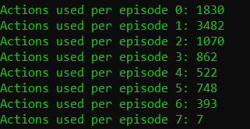

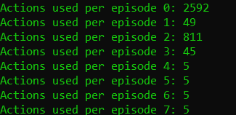

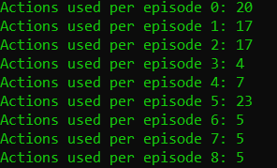

Results
More episodes
Epsilon: 0.1
Alpha: 1
Gamma: 0.9
Episodes: 10000
Epsilon: 0.1
Alpha: 1
Gamma: 0.9
Episodes: 100000
Changed Policy to explore if all surrounding areas are 0.
Epsilon: 0.1
Alpha: 1
Gamma: 0.9
Episodes: 1000

Slide 7
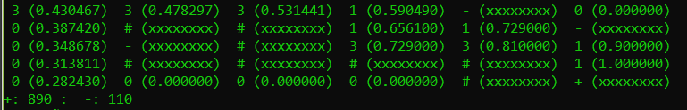
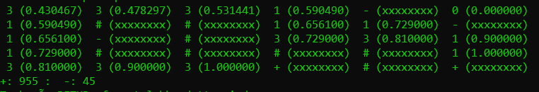
Result
Multiple traps along the way
Epsilon: 0.1
Alpha: 1
Gamma: 0.9
Episodes: 1000
Multiple rewards along the way
Epsilon: 0.1
Alpha: 1
Gamma: 0.9
Episodes: 1000

Slide 8
Conclusion
Changed Field
Multiple Traps – made it harder to find the reward
Multiple rewards –able to find both, depends on how it explores, but will always choose one when it learns
Bigger Field – more average actions, didnt change much – still succeeded
More obstacles (It always succeed, it just takes more time to learn the field).
Number of episodes – in case of this relatively simple task the algorithm learns quickly resulting in the non-existing need of many episodes. It affects the number of times et hits the mouse trap.
Different learning rates (α) – dosent effect much
Different cost-values (γ) – Changed the estimates of the actions in each state.
Different epsilons (ε) – faster learning, less times reached the cake
Change policy – faster learning based on more exploration

