Slide 1
Finite Differences Pendulum

Slide 2
Setup
6x6 RBFN
10 iterations with 0 gradient to terminate learning
Reward is based on time standing up
Roll-outs updates the current state and returns a reward based on the time the stick is standing up.
Weights are generated with the same seed each time.
Weights are updated after 36 roll-outs.
Starting angle is generated randomely between -20 and +20 degrees
Rollout temirnates after 10 seconds or if the angle is outside pi/7

Slide 3
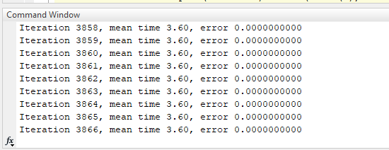
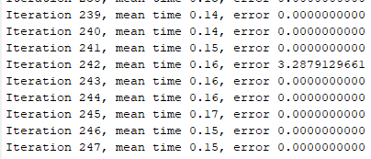
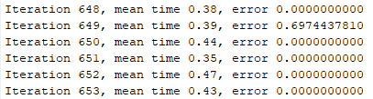
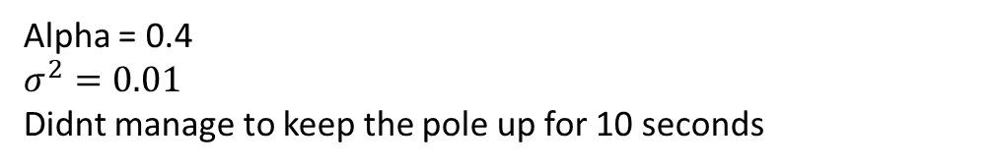
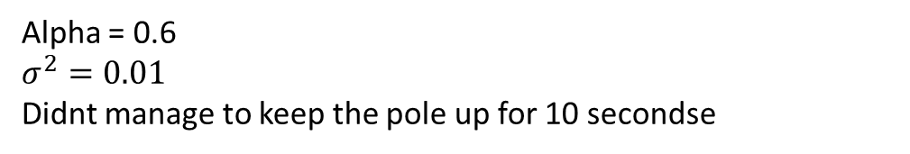
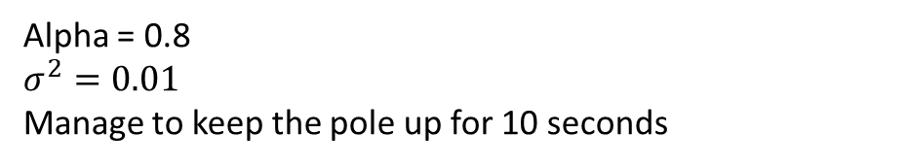
Results
Here the error is not the error, it is the norm
Alpha = 0.8
$$σ^{2}=0.01$$
Manage to keep the pole up for 10 seconds
Alpha = 0.4
$$σ^{2}=0.01$$
Didnt manage to keep the pole up for 10 seconds
Alpha = 0.6
$$σ^{2}=0.01$$
Didnt manage to keep the pole up for 10 secondse

Slide 4
Conclusion
Parameters could be more fine tuned.
Nr. of iterations could be lowered by doing so.
The way the reward is generated results in the pole not standing at 0 radians (upright), but a continous motion in one direction.

