Slide 1
Setup
4 bandits
  2000 different sets of 4 bandits
  1000 iterations each
10 bandits
  2000 different sets of 10 bandits
  1000 iterations each
Bandit initialization
  Set mean within a specified range
  Get reward based on mean + a random value in a specified range
Data saved to files and processed in matlab for evaluation

Slide 2
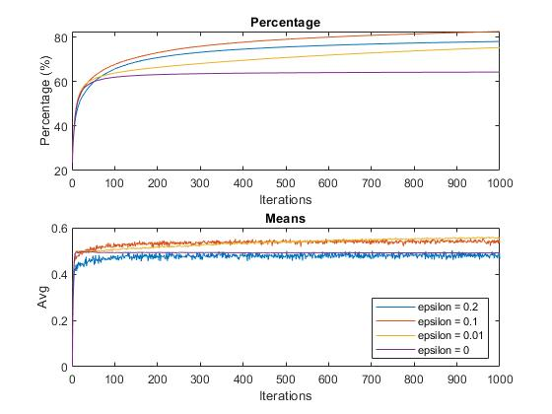
Results ε-greedy

Slide 3
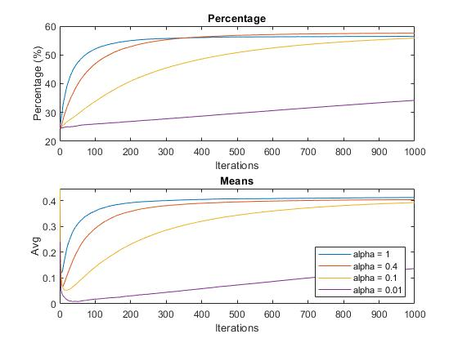
Results
Gradient

Slide 4
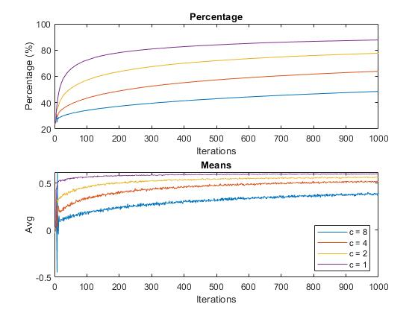
Results
UCB

Slide 5
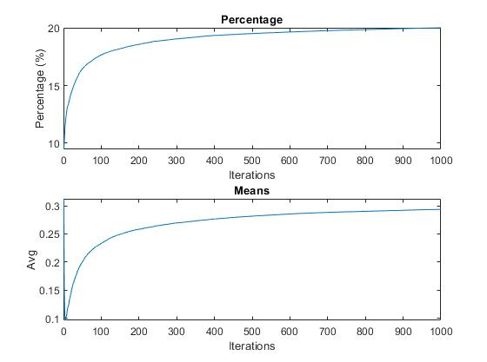
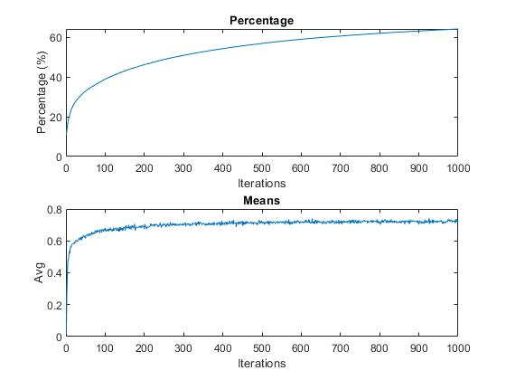
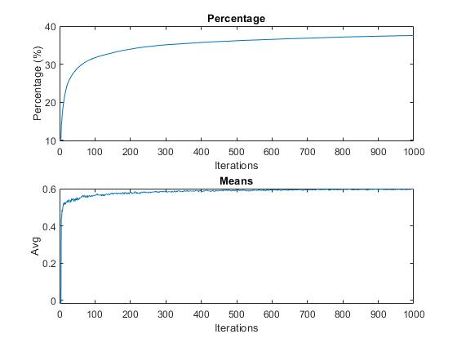
10 bandits
Gradient
ε-greedy
UCB

Slide 6
Conclusion
By increasing the number of bandits the algorithms had a harder time finding the right machine.
The epsilon-greedy method was the best in an increased number of bandits
For the ε-greedy algorithm with 4-bandits the best epsilon value was: 0.1
For the UCB algorithm with 4-bandits the best c value was: 1
For the gradient algorithm with 4-bandits the best alpha value was: 1

