Slide 1
Process

Slide 2
Process Concept
What to call the activities of CPU ?
User Programs
or
Tasks
Jobs
Batch System
Time Sharing System
These activities are called “Processes”
The terms “job” and “process” are used almost interchangeably.
Notes:
A question that arises in discussing operating systems involves what to call all the CPU activities.
A batch system executes jobs, whereas a time-shared system has user programs, or tasks.
A single-user system, a user may be able to run several programs at one time: a word processor, aWeb browser, and an e-mail package.
Even if a device or system does not support multitasking, the operating system may need to support its own internal programmed activities.
In many respects, all these activities are similar, so we call all of them processes.
Although we personally prefer the term process, much of operating-system theory and terminology was developed during a time when the major activity
of operating systems was job processing.

Slide 3
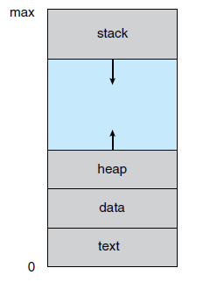
Process
A process is a program that is in execution.
But, it is more than the program codes. Program code is known as “text section” of a process.
Besides code of the program, it contains -
Program Counter and Registers: stores current activity of the process
Stack: Temporary data (function parameter, local variables, return addresses etc.)
Data Section: Global Variables
Heap: dynamically allocated memory during runtime

Slide 4
Program Vs Process
Program is a collection of instructions that can be executed
A program is a passive entity.
A process is an active entity.
A program becomes a process when it is loaded into memory for execution.
next address to execute
Program counter
Program
Loaded into
memory
a=10
b=5
print(a+b)
…
...
Value of a is 10
Data section
program1.exe
print(a+b)
b=5
Text section
a=10
Corresponding process in memory

Slide 5
Same program, Different Process
Process 1
Browser ( first window)
Code 1
Program code is same
Data, Heap, Stacks contains different information
Process 2
Browser ( second window)
Browser program
Process 3
Browser ( third window)

Slide 6
States of a Process
A process state defines the current activity of that process.
The states a process can be:
New: Process is being created
Running: Instructions are being executed
Waiting: Process is waiting for some event to occur
Ready: Waiting to be assigned to a processor
Terminated: Process has finished execution

Slide 7
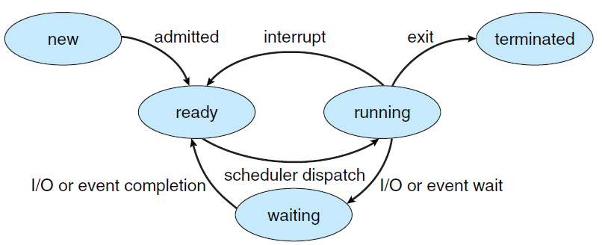
Process State Diagram

Slide 8
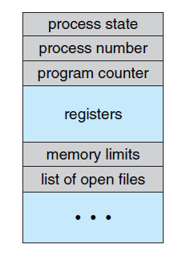
Representation of Processes in OS
Each process is represented in the operating system by a Process Control Block (PCB)
PCB is a data structure to store information of Processes such as -
Process state
Program counter
CPU registers
CPU scheduling information
Memory-management information
Accounting information
I/O status information
Process Control Block

