Slide 1
Process

Slide 2
Process Scheduling
Multiple process is ready to execute.
But, which Process should be executed first?
P1
P4
P1 -> P3 -> P2 -> P4 -> P5 ?
CPU
P2
P1 -> P2 -> P3 -> P5 -> P4 ?
P3
P5
CPU expecting processes to execute
Processes needs to be executed

Slide 3
Scheduling Queue
Stores the processes in different steps of OS.
Different queues are maintained in different steps.
Device 1
CPU
Device Queue
Job Queue
Ready Queue
Device Queue
Reside in Secondary Memory
Keeps all the processes of the system
Reside in Main Memory
Keeps all the processes that are waiting to be executed.
Processes wait here waiting for the device to be free
Device 2

Slide 4
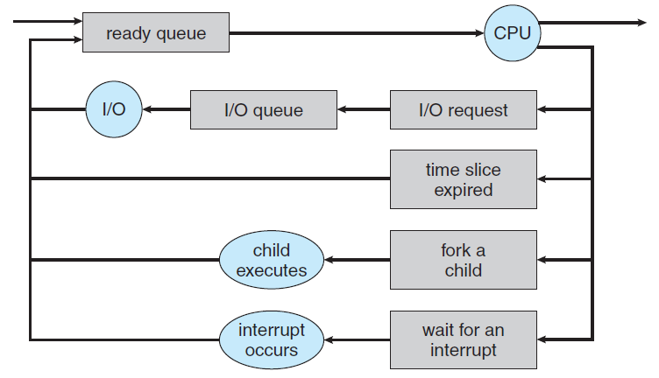
Queueing Diagram
Fig: Representation of Process Scheduling using Queueing-Diagram

Slide 5
Schedulers
Schedulers select processes from different queues to be passed to the next phase.
CPU
Long Term Scheduler
Short Term Scheduler
Job Queue
Ready Queue
Less frequently executed.
Controls degree of multiprogramming.
More frequently executed.

Slide 6
CPU Bound Vs I/O Bound Process
CPU bound processes spend more time doing computation using processors than I/O.
I/O bound processes spend more time in I/O than CPU.
Long Term Scheduler must select wisely !
What will happen if all processes are I/O bound ?
=> Empty ready queue
What will happen if all processes are CPU bound ?
=> Empty waiting queue
CPU
Ready Queue
End
I/O
I/O Queue

Slide 7
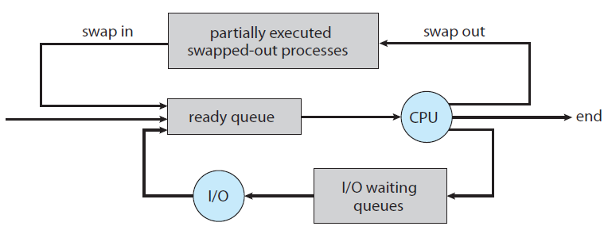
Medium Term Scheduler
Time-sharing system may use this scheduler.
Swapping reduce the degree of multiprogramming.
Fig: Addition of swapping in Queueing-Diagram

Slide 8
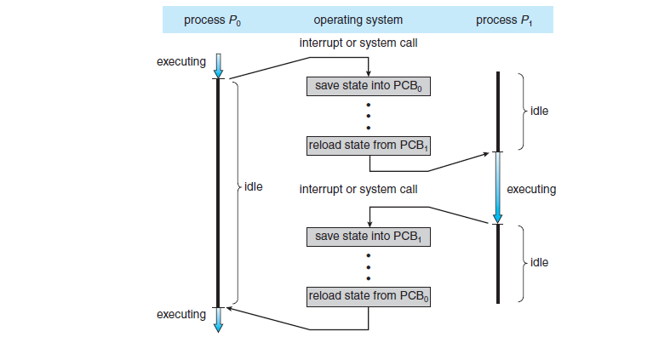
Context Switch
When an interrupt occurs, the system needs to save the current context (state) of the process running on the CPU.
Context Switch: 1. Storing currently executed process context
2. Restoring the next process context to execute
Overhead for context switch from P0 to P1
Overhead for context switch from P1 to P0

