Slide 1
Inter Process Communication

Slide 2
Processes in the system
Processes running concurrently may be -
Independent (cannot affect or be affected by other process)
Or
Cooperating (can affect or be affected by other process)
Process cooperation is needed for -
Information sharing
Computational speedup
Modularity
Convenience

Slide 3
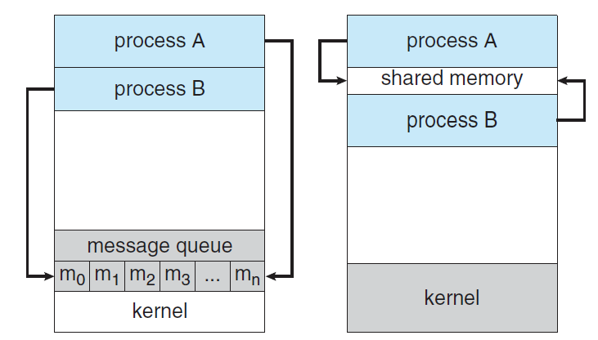
Inter Process Communication
IPC is a mechanism to exchange data and information among processes.
Two fundamental model of IPC -
Shared Memory
Message Passing

Slide 4
Shared Memory System
(Producer-Consumer Problem)
Producer: produces products for consumer
Consumer: consumes products provided by producer
Produce
Share Space /
Buffer
Consume
Producer
Consumer

Slide 5
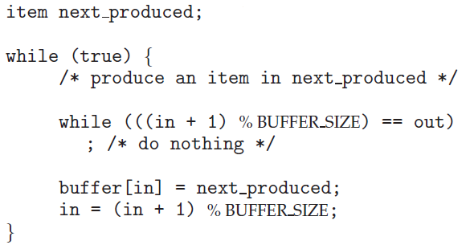
Producer-Consumer Problem (Producer)
in: next free position in buffer
out: first full position in buffer
Both initialized with 0.
in = 0
out = 0
Here, BUFFER_SIZE = 7
When buffer is full,
in = 6 , out = 0
When buffer is not full,
In = 5, out = 0
[0] [1] [2] [3] [4] [5] [6]
[0] [1] [2] [3] [4] [5] [6]

Slide 6
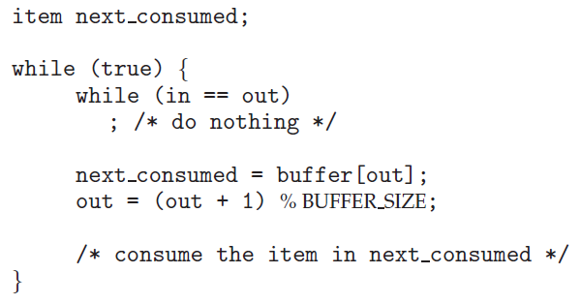
Producer-Consumer Problem (Consumer)
in: next free position in buffer
out: first full position in buffer
Both initialized with 0.
in = 0
out = 0
Here, BUFFER_SIZE = 7
When buffer is empty,
in = 0 , out = 0
When buffer is not empty,
In = 5, out = 0
[0] [1] [2] [3] [4] [5] [6]
[0] [1] [2] [3] [4] [5] [6]

Slide 7
Message Passing System
If processes P and Q want to communicate, they must send messages to and receive messages from each other.
A communication link must exist between P and Q.
send(message)
P
Q
M1
M2
M3
M4
receive(message)
Useful for exchanging small amount of data
More suited for distributed systems than shared memory

