Slide 1
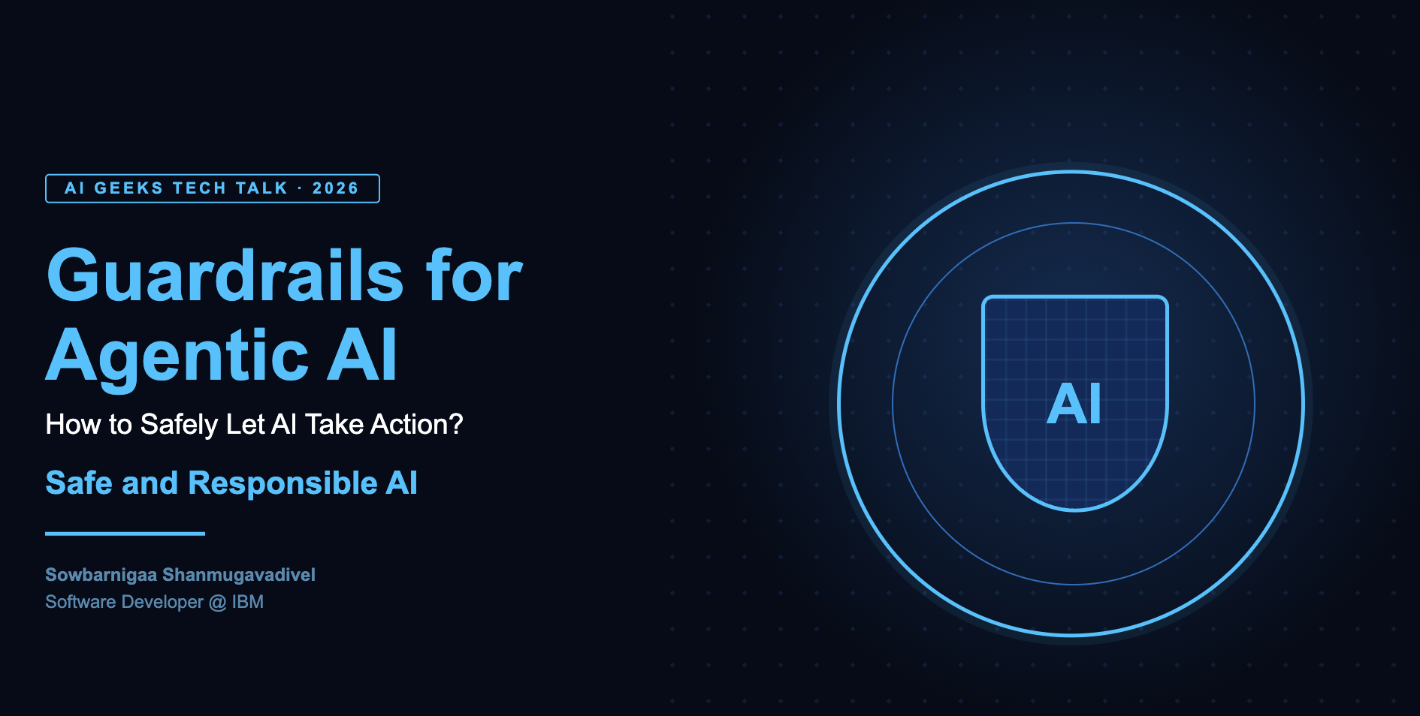


Slide 2
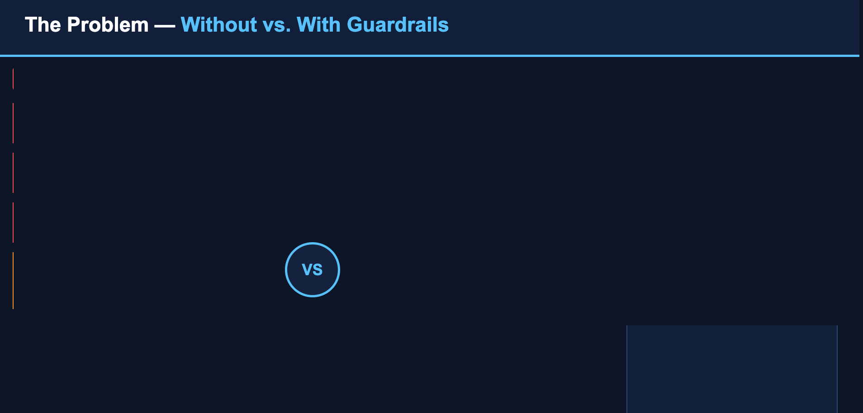


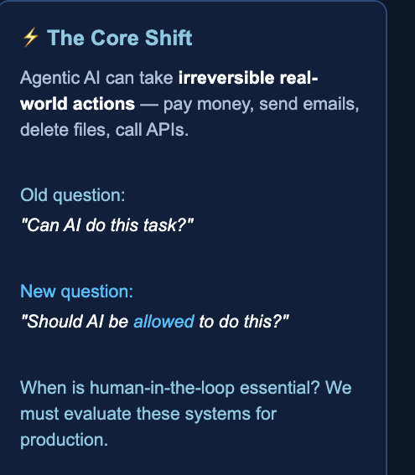









Slide 3

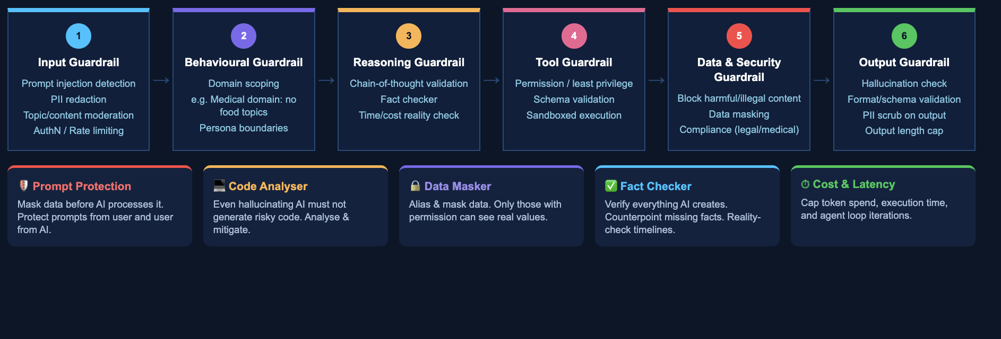
Six layers of Agentic AI guardrails

Slide 4
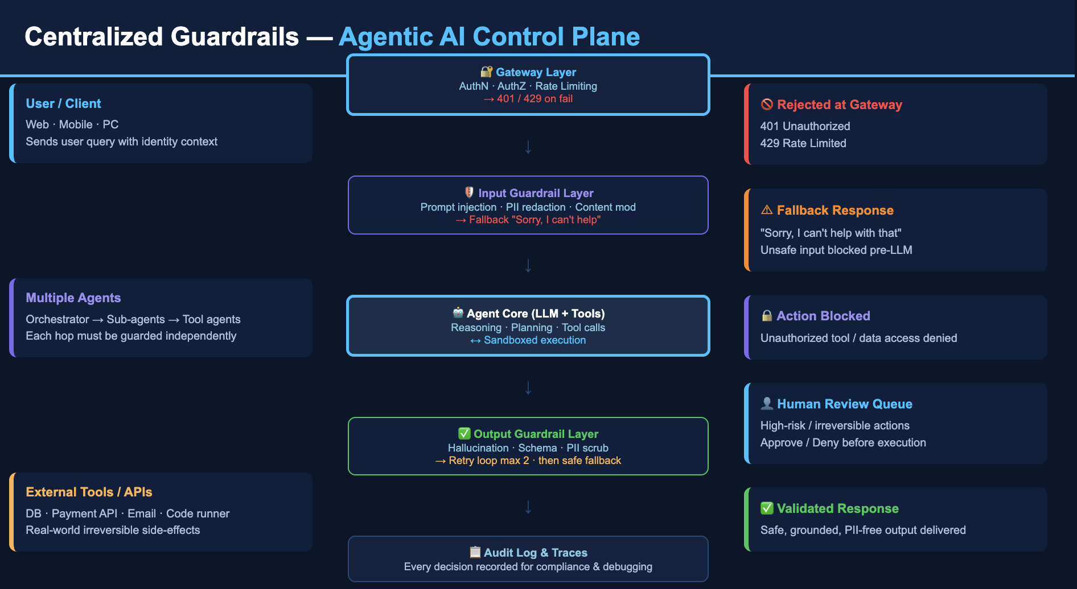

Slide 5

Are Guardrails just Filters ?

Slide 6
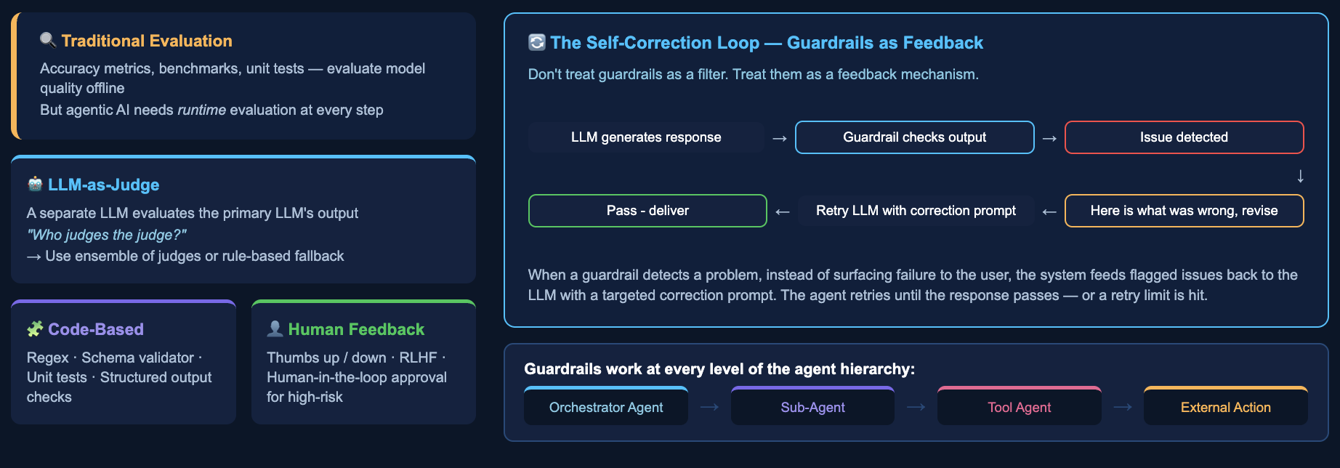
Evaluation

Slide 7
DEMO ……

Slide 8


