Slide 1

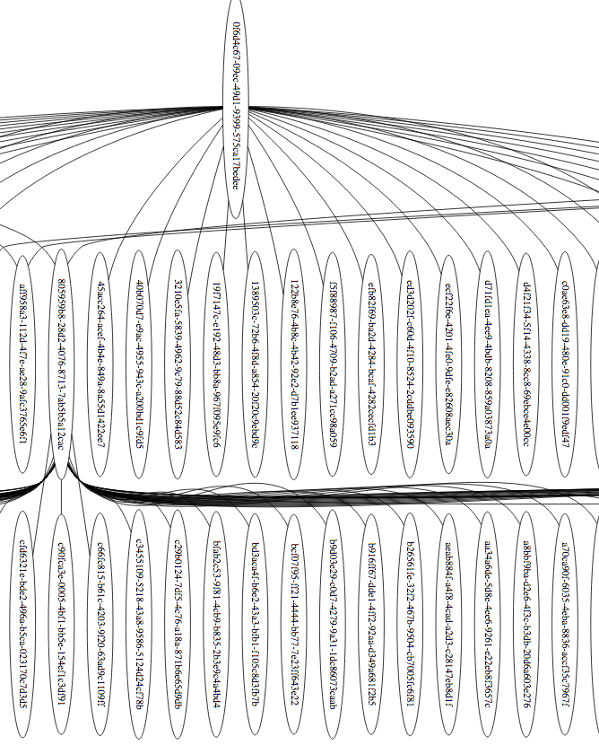
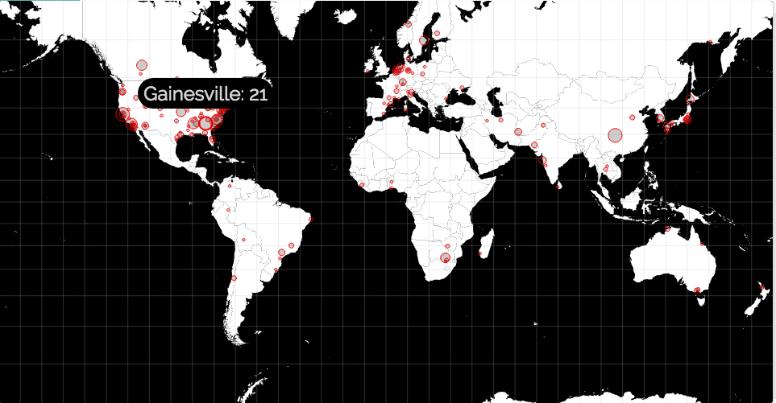
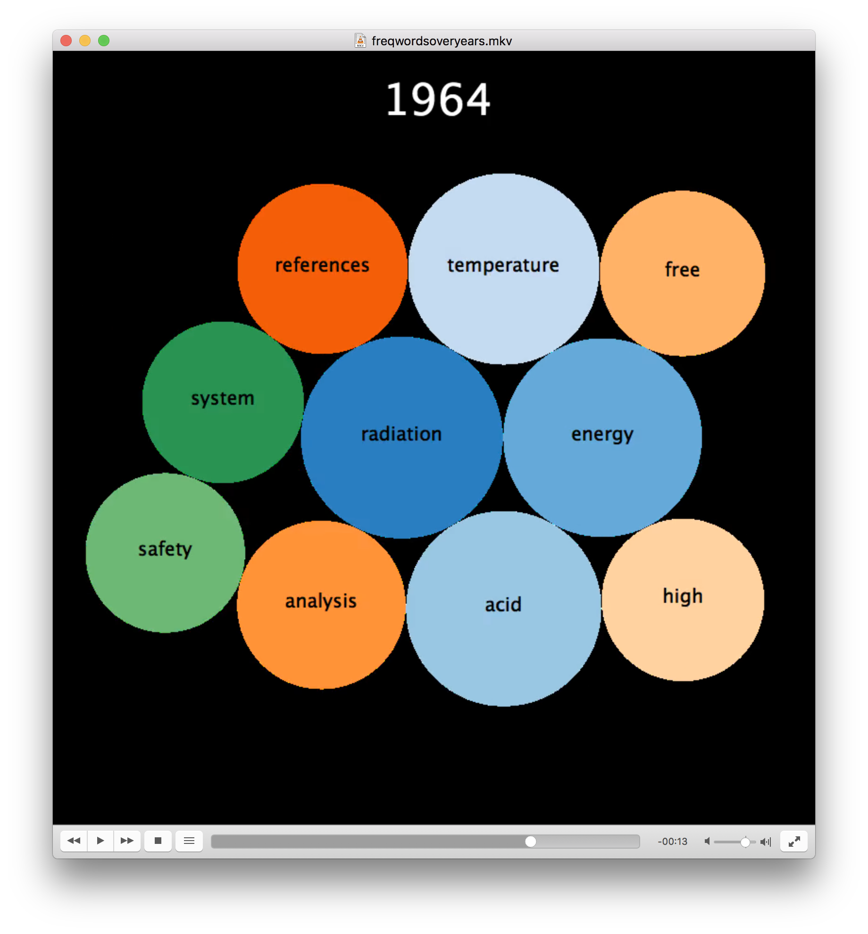
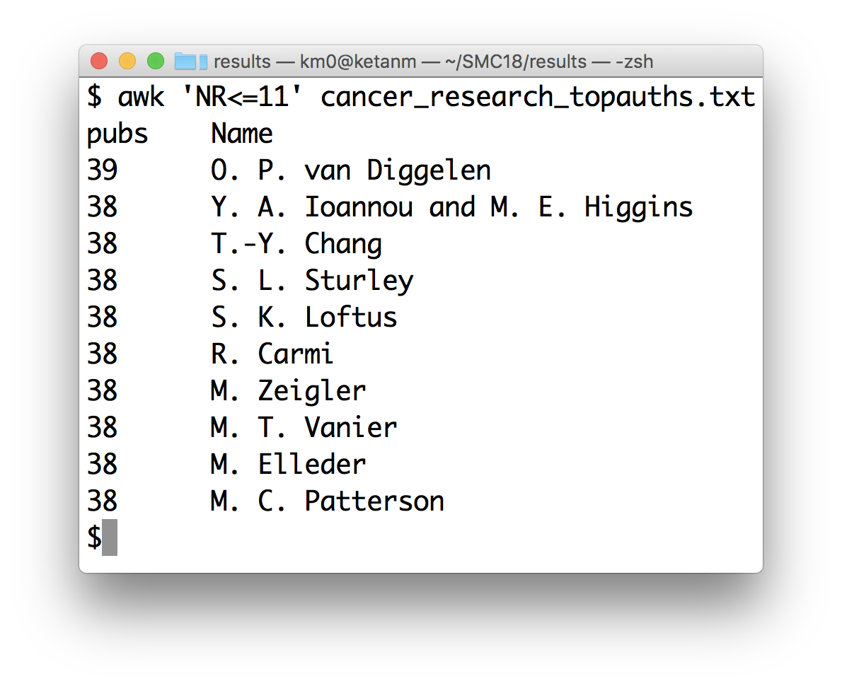
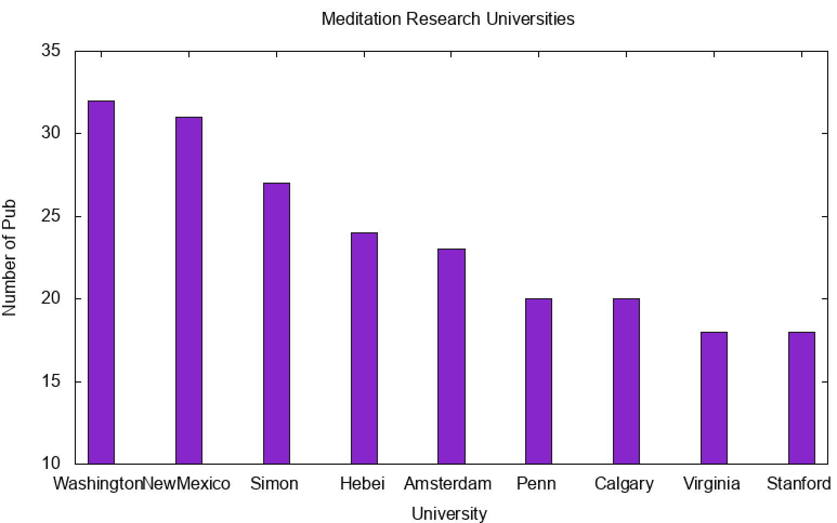
Scientific Publications Mining with Awk and Swift
Ketan C Maheshwari
CADES, ORNL
August 29, 2018
github.com/ketancmaheshwari/SMC18
Overview
Tools and Techniques
Data mining millions of scientific publication records
Useful findings such as influential authors, geographic locations of research, citation networks, and topic trends
Scalable computation by leveraging simplicity of classical linux tools and power of modern scalable workflow platform
jq to convert from json to tabular format
Awk to perform core data crunching
ANL's Swift to run awk in data-parallel setup
Classic Linux tools for post processing: sort, sed, uniq, tr
D3, graphviz, matplotlib, ffmpeg to visualize results
Data
Benefits of using Awk+Swift
256 million scientific publication records spread across 322 files
Total data size is 329 GB, format is json
Auxiliary data used: list of countries, cities, universities and a set of common words to filter from results
Awk is highly suitable to text-processing portable to Linux systems
Swift is portable to shared as well as distributed memory architectures
Swift is known to work on leadership class supercomputers, eg. Summit
Results
Performance
Bottomline
Three out of five solutions takes less than a minute to finish
Remaining two solutions takes less than an hour to finish
Swift radically improves run time by concurrently running awk over in-memory data across the input
Awk crunches massive amounts of data
Swift parallelizes hundreds of awk calls
In-memory computation for speedy runs
Portable across legacy and modern architectures
Scalable from laptop to leadership class systems
Acknowledgments
CADES for resources. Suhas Somnath, Brian Zachary, Drew Schmidt for valuable inputs. SMC organizers for hosting.

