Slide 1

Department of Information Technology BVRIT HYDERABAD College of Engineering for Women
Presentation on Colorizing Black and White Photo using Deep Learning Mini Project Review
Guide: Mr. L.Naveen Kumar Presented By Associate Professor K.Sowjanya Department of IT 20WH1DB004

Slide 2
Objectives
Introduction
Literature Survey
Technologies used
Problem Statement.
Proposed Method
Societal Impact
System Architecture
Project Modules
Results
Conclusion
References

Slide 3
Introduction
Colorization of grayscale images has become a more researched area in the recent years, thanks to the advent of deep convolutional neural networks.
The same concept is used to colorization of images obtained from internet.

Slide 4
Introduction
Previous similar research focused mainly colorization of small set of images, while colorization of different images is traditionally done by leveraging manual scribble methods.
The proposed method is a fully automated process. To implement it proposes convolutional neural network architectures trained under various loss functions.

Slide 5
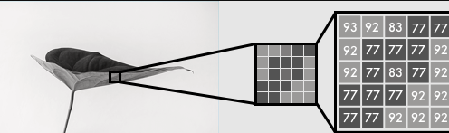
Literature Survey
According to Emil Walner, Black and white images can be represented in grids of pixels. Each pixel has a value that corresponds to its brightness. The values span from 0–255, from black to white.

Slide 6
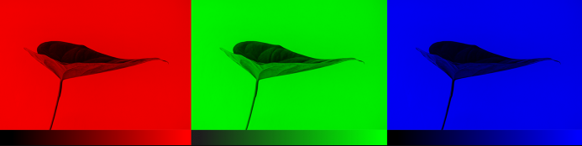
Literature Survey
Color images consist of three layers: a red layer, a green layer, and a blue layer. Imagine splitting a green leaf on a white background into the three channels. Intuitively, you might think that the plant is only present in the green layer.
But, as seen below, the leaf is present in all three channels. The layers not only determine color, but also brightness.

Slide 7
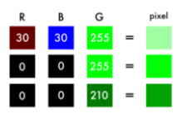
Literature Survey
To achieve the color white, for example, you need an equal distribution of all colors. By adding an equal amount of red and blue, it makes the green brighter. Thus, a color image encodes the color and the contrast using three layers:

Slide 8
Literature Survey
Just like black and white images, each layer in a color image has a value from 0–255. The value 0 means that it has no color in this layer. If the value is 0 for all color channels, then the image pixel is black.
The neural network creates a relationship between an input value and output value. To be more precise with our colorization task, the network needs to find the traits that link grayscale images with colored ones.

Slide 9
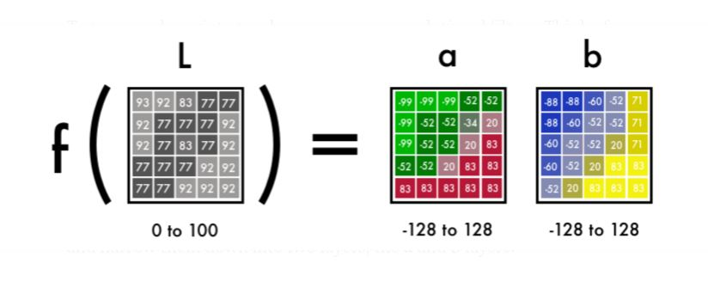
Literature Survey
In sum, we are searching for the features that link a grid of grayscale values to the three color grids.

Slide 10
Convolutional neural network
Convolutional neural network (CNN), a class of artificial neural networks that has become dominant in various computer vision tasks, is attracting interest across a variety of domains, including radiology.
CNN is designed to automatically and adaptively learn spatial hierarchies of features through backpropagation by using multiple building blocks, such as convolution layers, pooling layers, and fully connected layers.

Slide 11
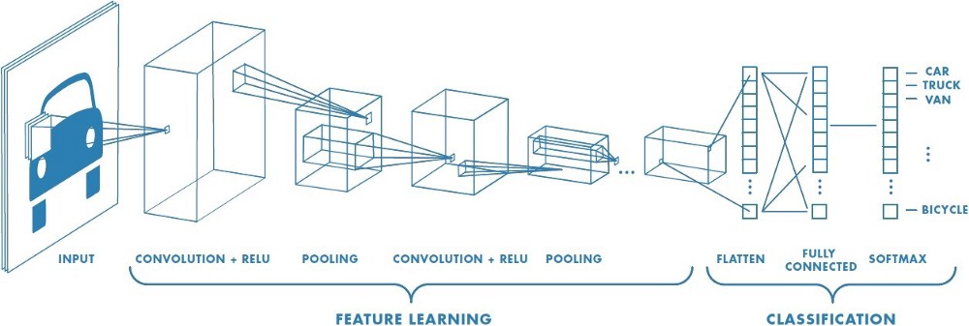
A Convolutional neural network for classification - Basic

Slide 12
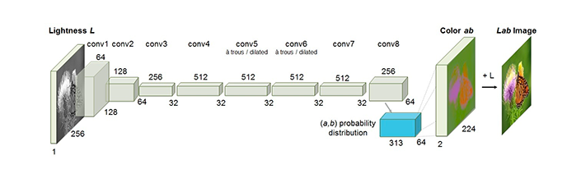
Convolutional neural network Structure Used

Slide 13
Convolutional neural network
From B&W to color: Our final prediction looks like this-We have a grayscale layer for input, and we want to predict two color layers, the ab in Lab. To create the final color image we’ll include the L/grayscale image we used for the input. The result will be creating a Lab image.
To turn one layer into two layers, we use convolutional filters. The network can either create a new image from a filter or combine several filters into one image.

Slide 14
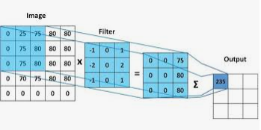
Convolutional neural network
For a convolutional neural network, each filter is automatically adjusted to help with the intended outcome. We’ll start by stacking hundreds of filters and narrow them down into two layers, the a and b layers.

Slide 15
Technologies used
Hardware Requirements:
RAM : 4Gb
Processor:intel i3
Hard disk: 200GB
Software Requirements:
Front End: Python using Flask
Backend Programming Language : Python Language,Keras, Tensor Flow, Scikit Learn
Tools: Anaconda (Jupiter Notebook)

Slide 16
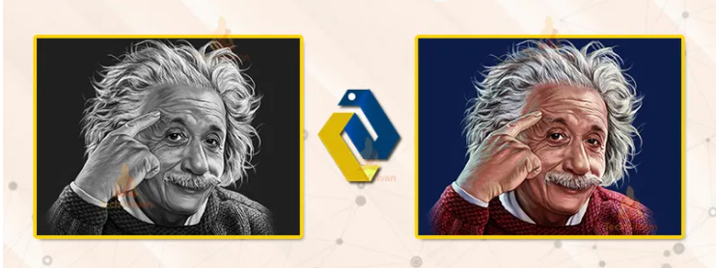
Problem Statement
The problem statement is to predict a and b channels from given an input grayscale image and generate colored Image.

Slide 17
Proposed Method
Initially the grayscale input is provided to L channel to the network.From there the network must learn to predict the a and b channels.
The Loss Function “LogCosh” is used to reduce the loss value from the existing method which used “MSE” loss function.

Slide 18
Societal Impact
The satellite cameras are very expensive to install for colour images, so lot of weather forecasting satellites Captures black and white images for weather forecasting. So we can improve the forecasting with this type of algorithms we convert those images to colour images. This process can save lot of money on the satellite colour image sensors.

Slide 19
Societal Impact
Photographers and photo studio also use this type to applications to colorize the old people photos into new colour images.
Lot of production studios also use this kind of algorithms to convert old black and white movies into colour movies by colorizing the each frame in the video. Because video is nothing but a series of images.
In social media networks we use colorizing technique to add more filters to the images to colorize black and white images.

Slide 20
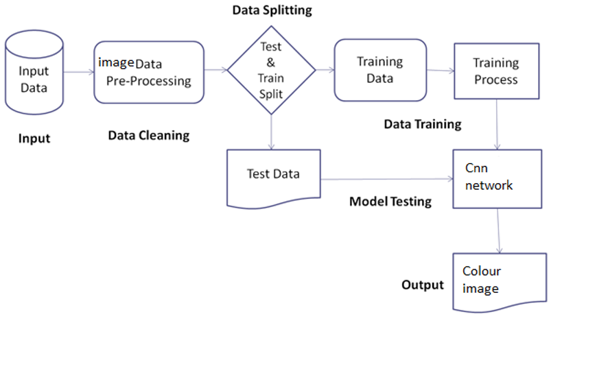
System Architecture

Slide 21
Project Modules
Environment setup
Collecting the dataset
Image pre processing
Defining the cnn model
Generating Colorised Image

Slide 22
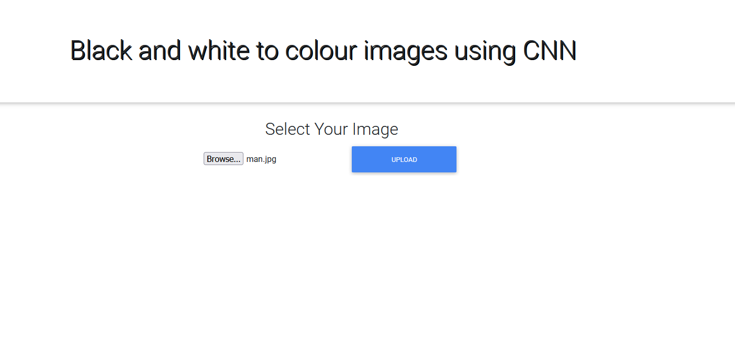
Results

Slide 23
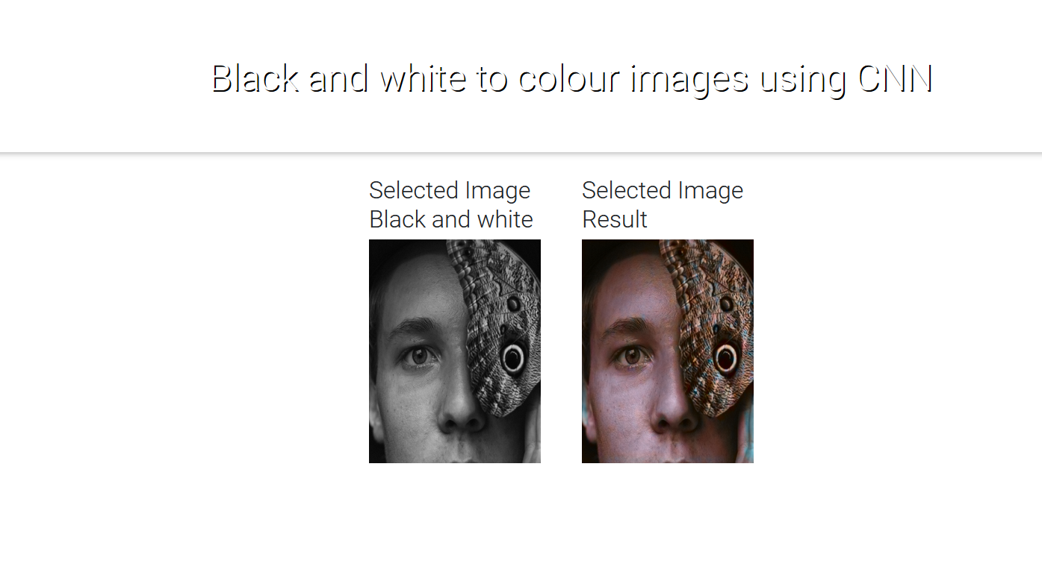
Results

Slide 24
Conclusion
When the model is trained with high computational abilities present, a perfect model is used to convert the grayscale images into beautiful colour images with small amount of loss.
Successful colorization of high-level image components such as the human faces is achieved

Slide 25
References
Zhang et al.’s 2016 ECCV paper, Colorful Image Colorization
https://techvidvan.com/tutorials/deep-learning-project-colorize-black-white-images-with-python
Impementation of our paper Deep Koalarization: Image Colorization using CNNs and Inception-ResNet-v2 (2017)
https://emilwallner.medium.com/colorize-b-w-photos-with-a-100-line-neural-network-53d9b4449f8d

Slide 26
Thank you. Any questions?

