Slide 1

Department of Information Technology BVRIT HYDERABAD College of Engineering for Women Presentation on Colorizing Black and White Photo using Deep Learning Mini Project Review- II Dated: 28 August 2021
Guide: Mr. L.Naveen Kumar Presented By Associate Professor K.Sowjanya Department of IT 20WH1DB004

Slide 2
INTRODUCTION
In this project, the neural net is trained with the L channel of image as input data and a,b channels as target data by understanding the core parts of the network.
It's built to color one image.

Slide 3
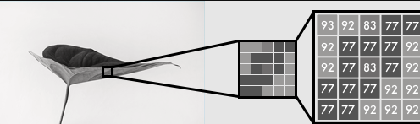
Literature Survey
Black and white images can be represented in grids of pixels. Each pixel has a value that corresponds to its brightness. The values span from 0–255, from black to white.

Slide 4
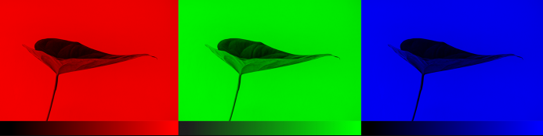
Literature Survey
Color images consist of three layers: a red layer, a green layer, and a blue layer.Imagine splitting a green leaf on a white background into the three channels. Intuitively, you might think that the plant is only present in the green layer.
But, as you see below, the leaf is present in all three channels. The layers not only determine color, but also brightness.

Slide 5
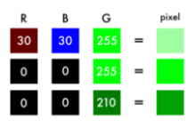
Literature Survey
To achieve the color white, for example, you need an equal distribution of all colors. By adding an equal amount of red and blue, it makes the green brighter. Thus, a color image encodes the color and the contrast using three layers:

Slide 6
Literature Survey
Just like black and white images, each layer in a color image has a value from 0–255. The value 0 means that it has no color in this layer. If the value is 0 for all color channels, then the image pixel is black.
As you may know, a neural network creates a relationship between an input value and output value. To be more precise with our colorization task, the network needs to find the traits that link grayscale images with colored ones.

Slide 7
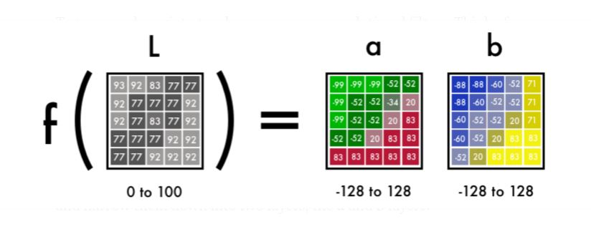
Literature Survey
In sum, we are searching for the features that link a grid of grayscale values to the three color grids.

Slide 8
Technologies Used
Hardware Requirements:
RAM : 4Gb
Processor:intel i3
Hard disk: 200GB
Software Requirements:
Front End: Python using Flask
Backend Programming Language : Python Language
Tools: Anaconda (Jupiter Notebook)
Operating system: windows 10

Slide 9
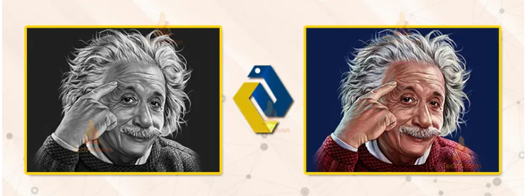
Problem Statement
The problem statement is to predict a and b channels from given an input grayscale image and generate colored Image.

Slide 10
Proposed Method and Improvement Added
Initially the grayscale input is provided to L channel to the network.From there the network must learn to predict the a and b channels.
Science fact — 94% of the cells in our eyes determine brightness. That leaves only 6% of our receptors to act as sensors for colors. We consider the grayscale image is a lot sharper than the color layers. This is the reason to keep the grayscale image in our final prediction for the inital build with improvements.

Slide 11
Societal Impact of Project
According to Zhang et al. decided to attack the problem of image colorization by using Convolutional Neural Networks to “hallucinate” what an input grayscale image would look like when colorized.

Slide 12
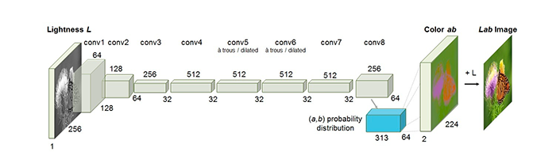
System Architecture

Slide 13
System Architecture
From B&W to color: Our final prediction looks like this-We have a grayscale layer for input, and we want to predict two color layers, the ab in Lab. To create the final color image we’ll include the L/grayscale image we used for the input. The result will be creating a Lab image.
To turn one layer into two layers, we use convolutional filters. The network can either create a new image from a filter or combine several filters into one image.

Slide 14
System Architecture
For a convolutional neural network, each filter is automatically adjusted to help with the intended outcome. We’ll start by stacking hundreds of filters and narrow them down into two layers, the a and b layers.

Slide 15
Project Modules
Preparing Data
Preprocessing :Pad and scale the images to allow for batch training
1. 400x400 for Input Image for our Model
2. Center the pixel values in the range [−1, 1]
Training using Convolution Neural Networks
Generating Colorised Image

Slide 16
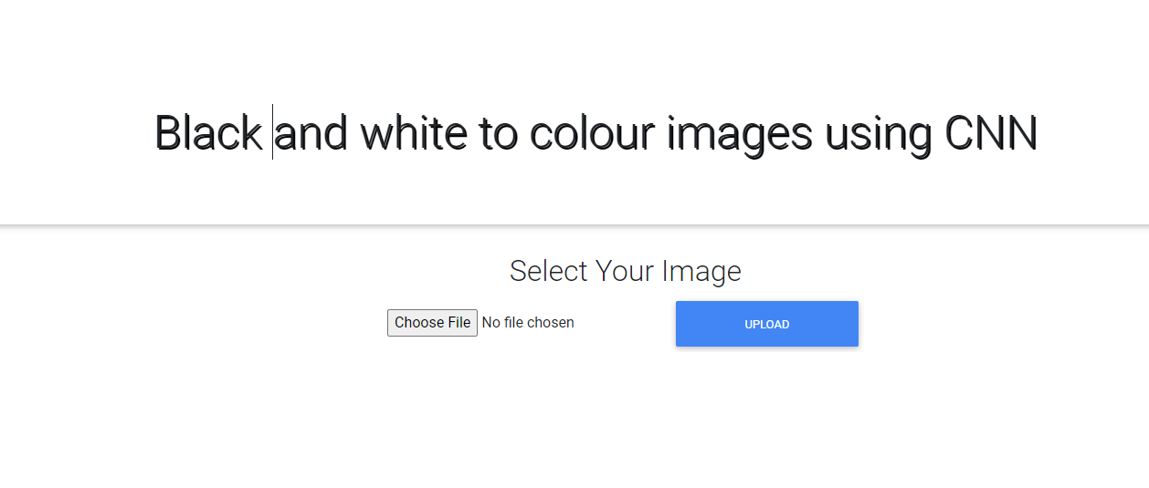
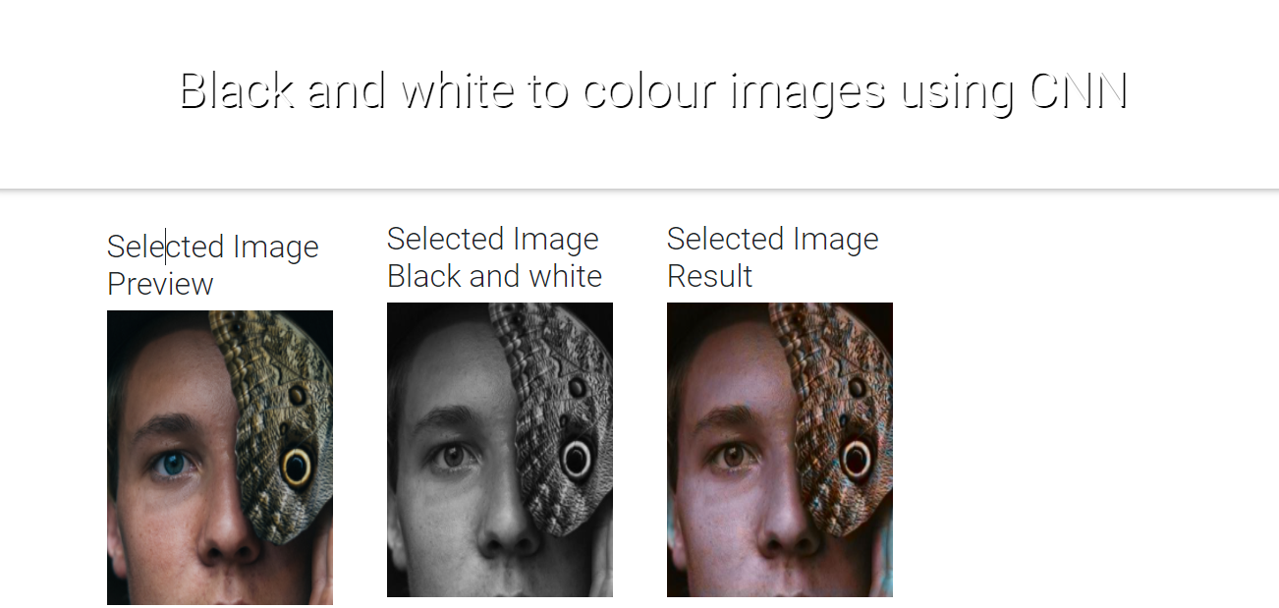
Results

Slide 17
Application Demo
Application Demo will be showed on my Laptop...!

Slide 18
Conclusion
Achievements:
Successful colorization of high-level image components such as the human faces
Take Aways:
Reading research papers is challenging. Once I summarized the core characteristics of each paper, it became easier to skim papers. It also allowed me to put the details into a context.
Starting simple is key.Most of the implementations I could find online were 2–10K lines long. That made it hard to get an overview of the core logic of the problem.

Slide 19
Reference
Zhang et al.’s 2016 ECCV paper, Colorful Image Colorization
https://www.pyimagesearch.com/2019/02/25/black-and-white-image-colorization-with-opencv-and-deep-learning
https://techvidvan.com/tutorials/deep-learning-project-colorize-black-white-images-with-python
Impementation of our paper Deep Koalarization: Image Colorization using CNNs and Inception-ResNet-v2 (2017)
https://emilwallner.medium.com/colorize-b-w-photos-with-a-100-line-neural-network-53d9b4449f8d

Slide 20
Queries
...?

Slide 21
THANK YOU...!

