Slide 1
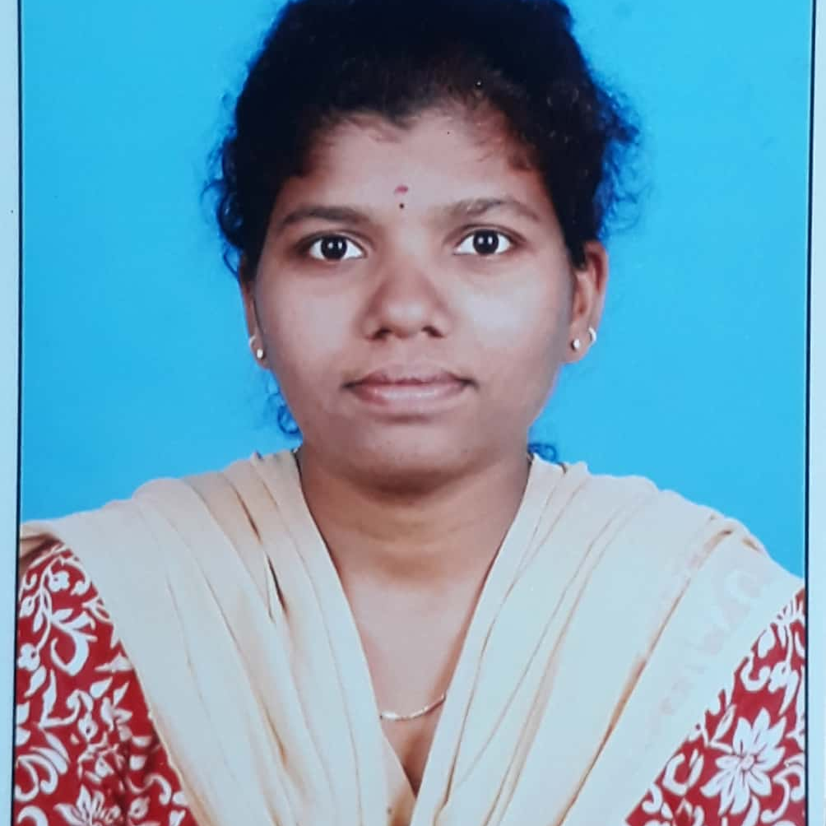

Sowjanya Tangallapalli
Analyst/Software Engineer
Bachelor of Technology, Computer Science : 2015 - 2019
Skills
C# | C# Basics, OOPS, Generics, Collections, Array, Loops, LINQ
.NET | ADO.NET,ASP.NET with MVC5 and WEBAPI, Entity Framework
Java | Intermediate
Database | SQL Server Management Studio
Web Technology | HTML & CSS and JavaScript, Typescript, Bootstrap
Tools | Git, Postman, Swagger, Visual Studio, Visual Studio Code
Add On skills | Self Learning, Communication Skills, Team Management
Bangalore
sowjanya.tangallapalli@capgemini.com
+91 9010991648
A4
Online Shopping Cart Application
Created Online Shopping Cart Application With MySQL as a Backend and WebAPI Core as middleware and Angular as frontend Using HTML, CSS and TypeScript for the designing.
Check Out the full Project With Code On My GitHub.
Full Stack Developer
Hands on experience on C#, ADO.NET, LINQ, Entity framework, SQL Server, ASP.NET MVC5 with WEB API, ASP.NET CORE WEB API.
Git and GitHub
SQL and RDBMS
Good Knowledge of java programming.
ASP dot Net Core Web App(MVC)
Asp dot Net Core Web API
HTML, CSS , JavaScript , Typescript
Proficient in creating Single page Web Application in Angular with Authentication with routing.
Ongoing training on Azure
Check out my work on GitHub

