Slide 1
Youth Drug Use Analysis & Prediction

Slide 2
Introduction
This project mainly focuses on analyzing the National Survey on Drug Usage and Health data and make predictions.
Explored three different problems
Binary Classification – (This is to classify whether the youth use marijuana or not.)
Multi Class Classification – (This involves estimating the frequency of marijuana use over the past year.)
Regression – (This involves predicting the age of first marijuana use.)
Dataset
Includes data on Substance use, Age of first use of each substance use, parental monitoring, peer behavior, school engagement.
Demographic details
Methods used to interpret model for the above problems:
Decision Trees
Ensemble methods (Bagging, Random Forest, Boosting)

Slide 3
Background
For the defined problems I have used decision trees including ensemble methods to make better predictions & classifications.
Decision Tree
- Built using top-down greedy or recursive binary splitting approach.
- Measure of Goodness ( Classification error, Gini Index, Entropy).
- Stopping criteria is specified in terms of tree depth, optimal tree size.
- PRUNING is performed to reduce the complexity of the model and improve accuracy.
To reduce overfitting ensemble methods are used
Bagging: Bootstrapping the training data, build the model and combine the models.
Classification (majority vote), Regression (Average). Hyperparameters – Number of trees, maximum depth of tree.
Random Forest: Random set of variables are chosen along with random sample of data.
Number of predictors at each split = sqrt(Total number of predictors)
Hyperparameters – Number of trees, number of predictors, maximum depth of tree.
Boosting: This creates a strong learner by gradually adding weak learners.
Hyperparameters – Shrinkage Values, Number of trees

Slide 4
Methodology
National Survey on Drug Use and Health(NSDUH) dataset.
Data Cleaning
- Removed the data with missing values or the column where the response is not known.
- Renamed the columns
Variable Selection
Features were chosen from peer influence, parental involvement, behavioral risks, school engagement, and religious orientation based on relevant features and correlation strength with the target variable.
The dataset is split in which 20% is for testing and 80% for training.
Classification:
- The performance is evaluated using accuracy score.
- Performed cross validation and best model is chosen with highest accuracy and feature importance is plotted for the analysis.
Regression:
- Each model is evaluated using cross validation and the best model is selected on the basis of mean squared error (MSE) values.

Slide 5
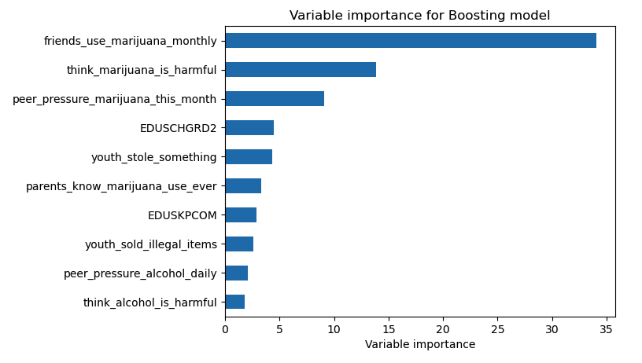
Binary Classification
The model helps to find whether the youth use marijuana or not.
Target variable: ‘mrjflag’ which indicates marijuana ever used (0=never, 1=ever)
Predictors: Included basic demographic details(sex, income,gender,etc), youth specific demographic details(parental presence in the household and school attendance) and the youth experiences.
- Evaluated model performance based on accuracy score and performed cross validation to get for which shrinkage value the model has performed well based on accuracy.
Model | Accuracy
Decision Tree | 84.08%
Pruned Tree | 87.87%
Bagging | 87.28%
Random Forest | 88.04%
Boosting | 88.04%

Slide 6
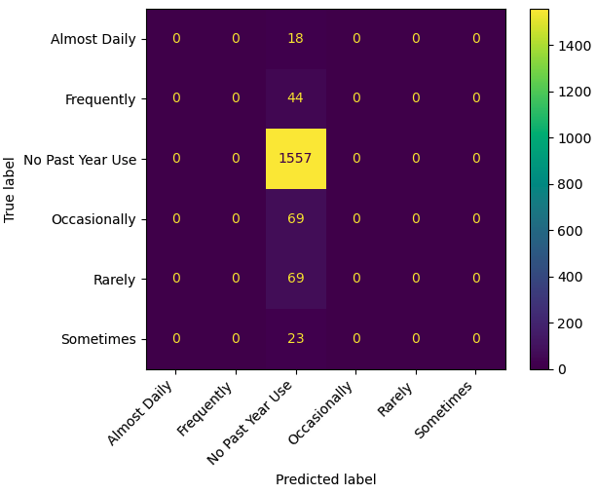
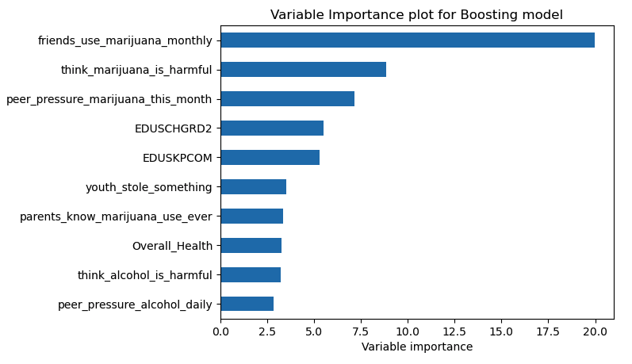
Multi-Class Classification
This involves predicting number of days of marijuana use in the past year.
Target variable: 'mrjydays’ indicates number of days of marijuana in past year.
Based on number of days they’re classified into 6 categories.
(1.'Rarely’, 2: 'Occasionally’, 3: 'Sometimes’, 4: 'Frequently’, 5: 'Almost Daily’, 6: 'No Past Year Use’)
Model | Accuracy
Decision Tree | 80.90%
Pruned Tree | 87.47%
Bagging | 87.02%
Random Forest | 87.13%
Boosting | 87.35%
Though pruning gave best results, but the optimal tree size evaluated using cross validation is 2. This is likely due to the imbalance dataset.
The class 6 dominates ~87% of the data. Due to which the model by default predict the ‘No Past Year Use’ for boosting the accuracy.

Slide 7
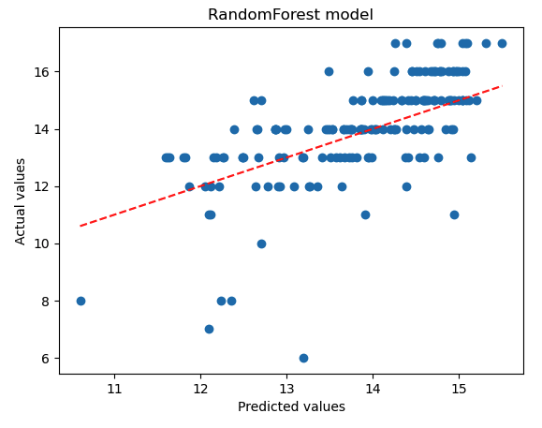
Regression
This involves predicting predicting the age of first marijuana use.
Target variable: ‘irmjage’ indicates age of first marijuana use
Removed the never used values for better prediction.
- Used Decision Tree Regressor, Random Forest Regressor.
- Performed cross validation to get for which shrinkage value the model has performed well based on MSE.
Model | MSE
Decision Tree | 4.53
Pruned Tree | 2.23
Bagging | 1.96
Random Forest | 1.91
Boosting | 2.38
- The graph shows the model is not predicting accurately as most of the data points are out of the decision boundary.

Slide 8
Discussion
The dataset provides an overview of demographic and behavioral variables that offer valuable insights into substance use patterns.
Basic Decision Trees underperformed due to overfitting; pruning and ensembling helped improve generalization significantly.
Top predictive features included peer influence, parental awareness, school engagement have larger impact on youth using marijuana.
Multiclass prediction was affected by class imbalance. We can address this issue using class balancing techniques (e.g SMOTE).
Training time was higher for ensemble models but justified by improved accuracy and robustness.

Slide 9
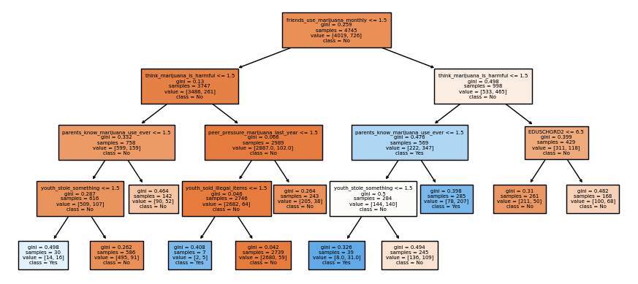
Pruned Tree – Binary Classification

Slide 10
Conclusion
Binary Classification:
- The gradient boost and random forest achieved an accuracy of 88.04%.
Peer influence has greater impact on youth consuming marijuana.
Multi-Class classification:
The model was only good at predicting if an individual has never used marijuana in the previous year.
Highest accuracy is achieved by pruned decision tree which is 87.47%
Regression
- The random forest model shows a decent performance with low MSE about 1.91.
From the plot the data points don’t cluster perfectly around the diagonal line. This suggests that the model is not making very good predictions.
Future Scope:
- Addressing the class imbalance in the multiclass classification task using resampling techniques like SMOTE (Synthetic Minority Over-sampling Technique).

Slide 11
References
[1] National Survey on Drug Use and Health (NSDUH) 2020. [Codebook].
https://www.samhsa.gov/data/data-we-collect/nsduh-national-survey-drug-use-and-health/datafiles/2020
[2] https://scikit-learn.org/stable/modules/ensemble.html
[3] https://hastie.su.domains/ISLP/ISLP_website.pdf.download.html
[4] https://scikit-learn.org/stable/modules/cross_validation.html

Slide 12
Thank You

