Slide 1
Youth Drug Use Analysis & Prediction

Slide 2
Introduction
This project mainly focuses on analyzing the National Survey on Drug Usage and Health data and make predictions.
Explored three different problems
Binary Classification – (This is to classify whether the youth use marijuana or not.)
Multi Class Classification – (This involves estimating the frequency of marijuana use over the past year.)
Regression – (This involves predicting the age of first marijuana use.)
Dataset (National Survey on Drug Use and Health(NSDUH))
Includes data on Substance use, Age of first use of each substance use, parental monitoring, peer behavior, school engagement.
Demographic details

Slide 3
Background
Model | Working | Advantages | Dis-Advantages
Decision Tree | Recursively partitions data using rules that reduces impurity (Gini Index or Entropy) | Easy to train and interpret | Can easily be overfit without pruning
Bagging Classifier | Builds multiple trees from random data subsets and combines results by majority vote or average | Improves model stability. Cannot overfit | Dominant features might overshadow others
Random Forest | Extends bagging by injecting randomness into feature selection at each tree split. | Enhances robustness and accuracy, especially on noisy data. | Less interpretable due to many trees
Gradient Boosting | Sequentially trains trees where each tree learns to fix the mistakes of the previous. Hyperparameters – Shrinkage Values, Number of trees. | Reduces bias through sequential learning. | Sensitive to noise and overfitting if learning rate is too high

Slide 4
Methodology
Data Cleaning
- Removed the data with missing values or the column where the response is not known.
Renamed the columns
One hot encoding for categorical variables
Mapped ordinal labels to suitable class names
Variable Selection
Features were chosen from peer influence, parental involvement, behavioral risks, school engagement, and religious orientation based on relevant features and correlation strength with the target variable.
The dataset is split in which 20% is for testing and 80% for training.
Classification:
- The performance is evaluated using accuracy score.
- Performed cross validation and best model is chosen with highest accuracy.
Regression:
- Evaluated using cross validation and the best model is selected on the basis of mean squared error (MSE).

Slide 5
Binary Classification
The model helps to find whether the youth use marijuana or not.
Target variable: ‘mrjflag’ which indicates marijuana ever used (0=never, 1=ever)
Predictors: Demographic details(sex, income,gender,etc), youth specific demographic details(parental presence in the household and school attendance) and the youth experiences.
- Evaluated model performance based on accuracy score and performed cross validation to get for which shrinkage value the model has performed well based on accuracy.
Model | Accuracy | Precision Score | Recall
Decision Tree | 84.67% | 0.46 (used) | 0.47 (used)
Pruned Tree | 87.87% | 0.64 | 0.32
Bagging | 87.28% | 0.57 | 0.40
Random Forest | 87.95% | 0.61 | 0.40
Boosting | 88.29% | 0.63 | 0.42

Slide 6
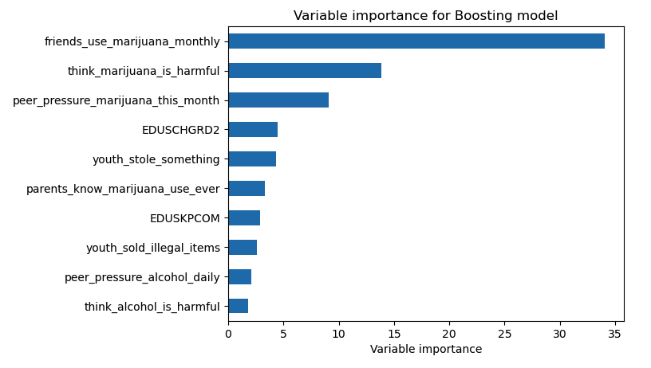
Binary Classification Feature Importance

Slide 7
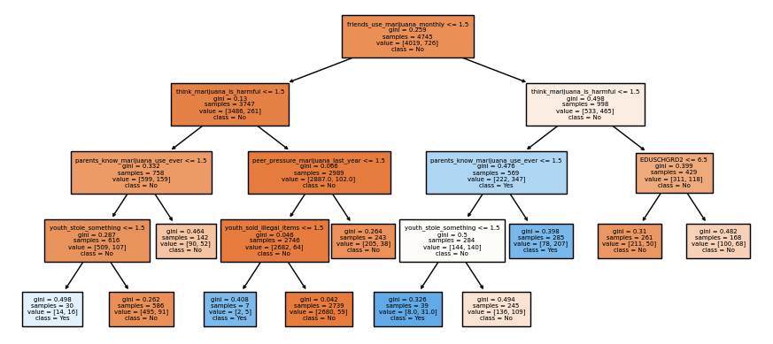
Pruned Tree – Binary Classification

Slide 8
Multi-Class Classification
This involves predicting number of days of marijuana use in the past year.
Target variable: 'mrjydays’ indicates number of days of marijuana in past year.
Based on number of days they’re classified into 6 categories.
(1.'Rarely’, 2: 'Occasionally’, 3: 'Sometimes’, 4: 'Frequently’, 5: 'Almost Daily’, 6: 'No Past Year Use’)
Model | Accuracy | Precision Score | Recall
Decision Tree | 81.07% | 0.81 ('No Past Year Use’) | 0.81('No Past Year Use’)
Pruned Tree | 87.47% | 0.77 | 0.87
Bagging Model | 86.85% | 0.79 | 0.87
Random Forest | 87.13% | 0.80 | 0.87
Boosting Model | 87.69% | 0.82 | 0.88

Slide 9
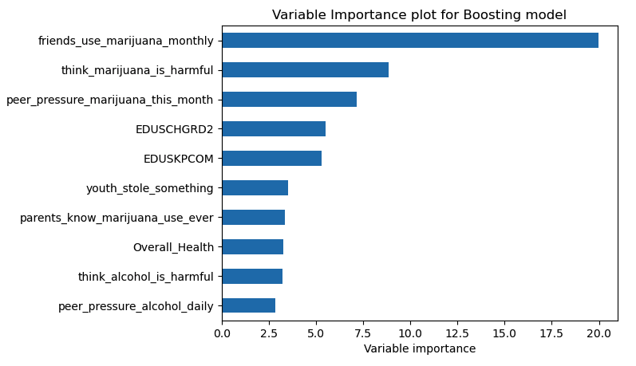
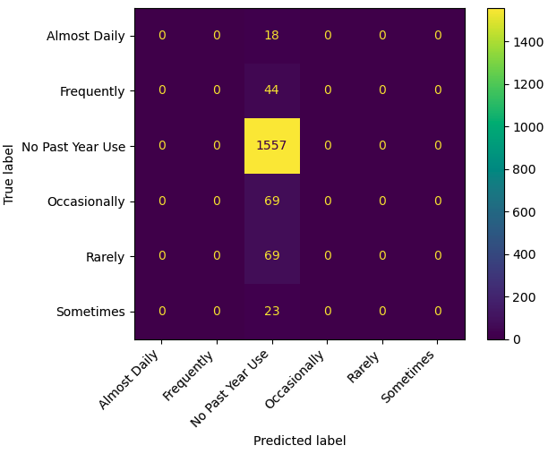
Feature Importance
Though pruning gave best results, but the optimal tree size evaluated using cross validation is 2. This is likely due to the imbalance dataset.
The class 6 dominates ~87% of the data. Due to which the model by default predict the ‘No Past Year Use’ for boosting the accuracy.

Slide 10
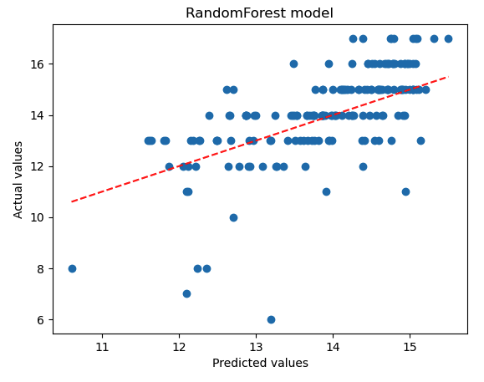
Regression
This involves predicting predicting the age of first marijuana use.
Target variable: ‘irmjage’ indicates age of first marijuana use
Removed the never used values for better prediction.
Used Decision Tree Regressor, Random Forest Regressor.
- Performed cross validation to get for which shrinkage value the model has performed well based on MSE.
Model | MSE
Decision Tree | 4.53
Pruned Tree | 2.23
Bagging | 1.96
Random Forest | 1.91
Boosting | 2.38

Slide 11
Discussion
The dataset provides an overview of demographic and behavioral variables that offer valuable insights into substance use patterns.
Basic Decision Trees underperformed due to overfitting; pruning and ensembling helped improve generalization significantly.
Top predictive features included peer influence, parental awareness, school engagement have larger impact on youth using marijuana.
Multiclass prediction was affected by class imbalance. We can address this issue using class balancing techniques (e.g SMOTE).
Training time was higher for ensemble models but justified by improved accuracy and robustness.

Slide 12
Conclusion
Task | Model Insights | Model Performance
Binary Classification | Peer pressure is a strong indicator of marijuana use | Gradient Boosting: 88.29%
Multi-Class Classification | Model best only at identifying "never used" individuals (Class Imbalance) | Gradient Boosting: 87.69% accuracy
Regression | Model struggles with precise prediction of usage days | Random Forest: MSE ≈ 1.91
By identifying key predictors such as peer influence, parental involvement, and socioeconomic status this work can inform public health strategies and early intervention programs.
Future Scope:
- Addressing the class imbalance in the multiclass classification task using resampling techniques like SMOTE (Synthetic Minority Over-sampling Technique).

Slide 13
References
[1] National Survey on Drug Use and Health (NSDUH) 2020. [Codebook].
https://www.samhsa.gov/data/data-we-collect/nsduh-national-survey-drug-use-and-health/datafiles/2020
[2] https://scikit-learn.org/stable/modules/ensemble.html
[3] https://hastie.su.domains/ISLP/ISLP_website.pdf.download.html
[4] https://scikit-learn.org/stable/modules/cross_validation.html

Slide 14
Thank You

