Slide 1

ArcFace: Advancing Deep Learning in Face Recognition
PRESENTED BY:
Roshini Bandi
Prasad Thamada
Sowjanya Linga
Vamshi Thatikonda

Slide 2
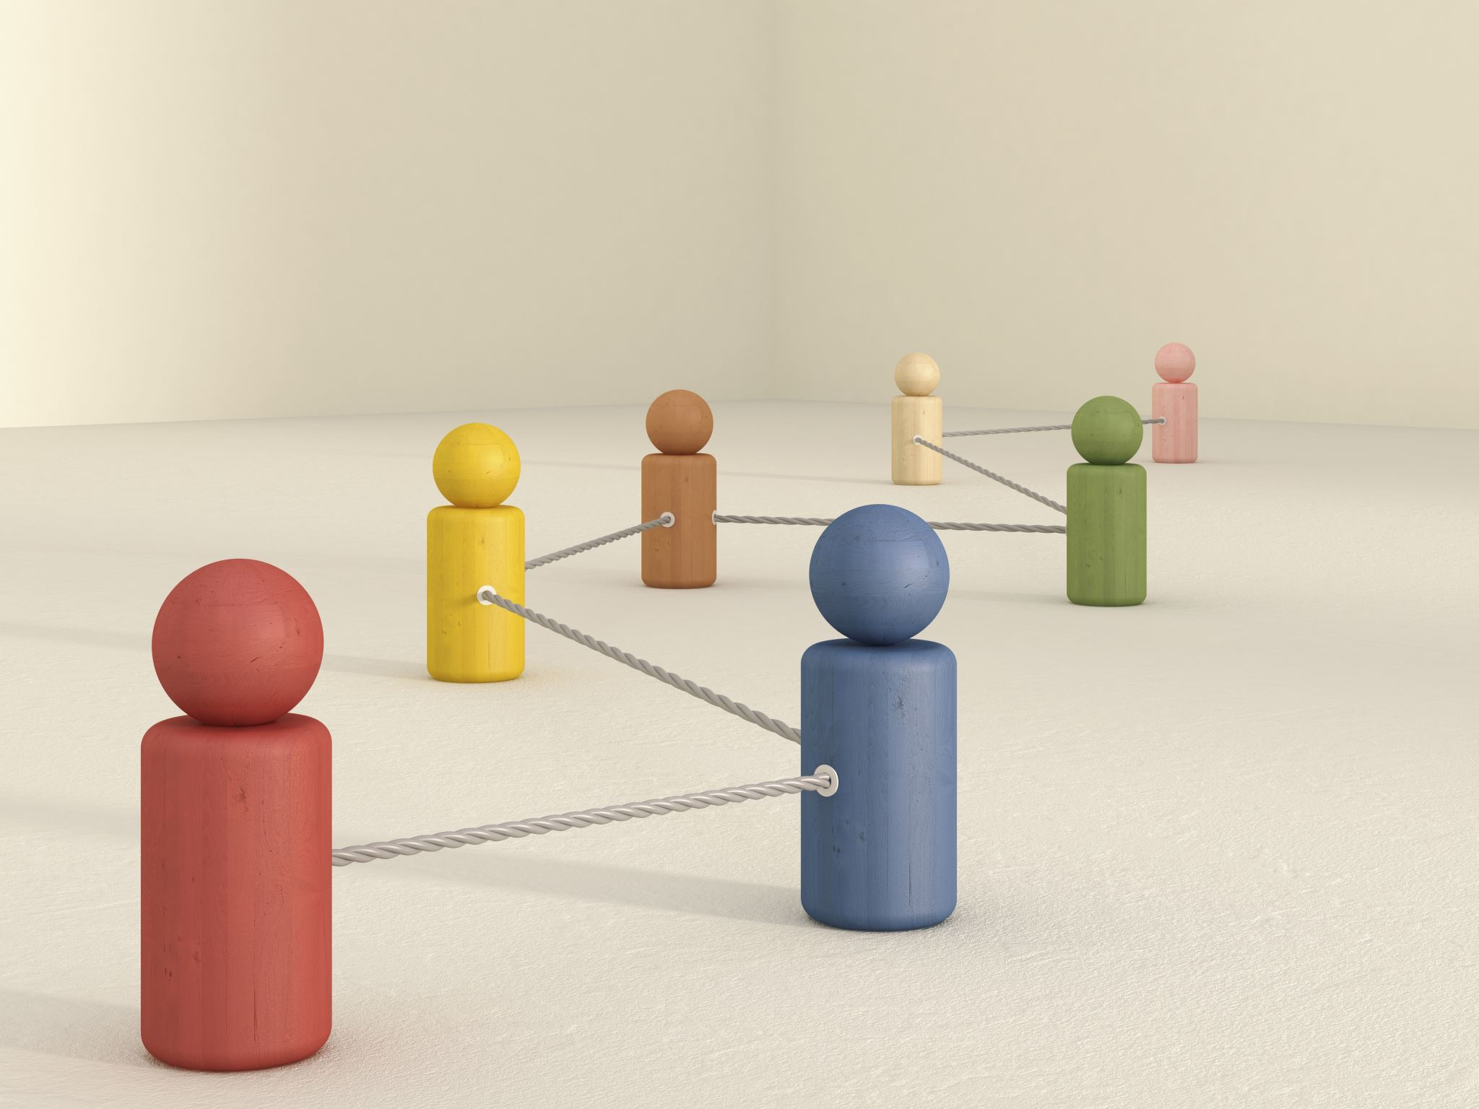
Objectives:
Implementing ArcFace method in facial recognition system.
Enhancing differentiation between faces in images.
Utilizing Additive Angular Margin Loss for improved accuracy.
Consideration of feature distances and angular relationships.
Improving robustness in challenging scenarios.
Integrating ArcFace into existing deep learning models.
Training model on relevant datasets.
Evaluating performance through testing and validation.

Slide 3



Value Statement:
Review of the State of the Art and Relevant Works:
This project is worth pursuing as it aims to enhance the accuracy and robustness of facial recognition systems, which have significant implications in various domains such as security, authentication, and personalized user experiences.
By implementing advanced techniques like ArcFace with Additive Angular Margin Loss and leveraging efficient models like MobileFaceNet, ResNet, VGG, the project seeks to push the boundaries of facial recognition technology, addressing challenges in real-world scenarios and contributing to the advancement of AI-driven solutions.
The project builds upon existing research in deep face recognition, particularly focusing on the ArcFace method with Additive Angular Margin Loss(Deep Face Recognition: A Survey (Zhao et al., 2019).
Relevant works include papers such as "ArcFace: Additive Angular Margin Loss for Deep Face Recognition" by Jiankang Deng et al., which introduces the ArcFace method and its effectiveness in improving face recognition accuracy.
Paper Link: https://ieeexplore-ieee-org.unh-proxy01.newhaven.edu/document/9449988

Slide 4
Approach:
Algorithm: ArcFace method with Additive Angular Margin Loss
Datasets: Utilize face recognition datasets such as LFW, CelebA, and MS-Celeb-1M
https://www.kaggle.com/datasets/hereisburak/pins-face-recognition
Models: Implement ArcFace within existing deep learning architectures (e.g., ResNet, MobileFaceNet, VGG)
Tools: Utilize TensorFlow or PyTorch for implementation and training.
Techniques: Train models using supervised learning with ArcFace loss function

Slide 5
Dataset Information
Dataset Size: 2500 samples
Individuals: 50 people
Images per Individual: 50
Data Split:
Training/Validation: 90% of the dataset
Test: 10% of the dataset
Stratified Split for Training/Validation:
Training: 88% of the Training/Validation set
Validation: 12% of the Training/Validation set

Slide 6
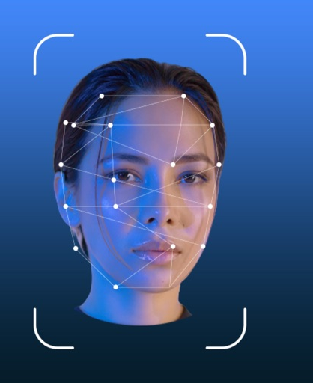
Data Processing
Labeling: Assigned labels to images and stored them in a CSV file.
Image Cropping: Cropped images based on facial regions.
Transformations: Resized images to 112x112 pixels, converted to tensors, and normalized pixel values.
Our facial recognition system leverages MobileFaceNet, VGG, and ResNet architectures to achieve efficient and accurate face recognition.

Slide 7
Deliverables:
Trained facial recognition model using the ArcFace method with Additive Angular Margin Loss.
01
Curated dataset of 2500 facial images with annotations and labels.
02
Implementation code in PyTorch or TensorFlow.
03
Documentation detailing the project methodology, experiments, and results.
04

Slide 8

Evaluation Methodology:
Metrics:
Test Loss: Measures the prediction error on the test set.
Test Accuracy: Indicates the percentage of correctly classified instances.
This methodology ensures a comprehensive evaluation of the deep face recognition system, focusing on both predictive accuracy and generalization ability.

Slide 9
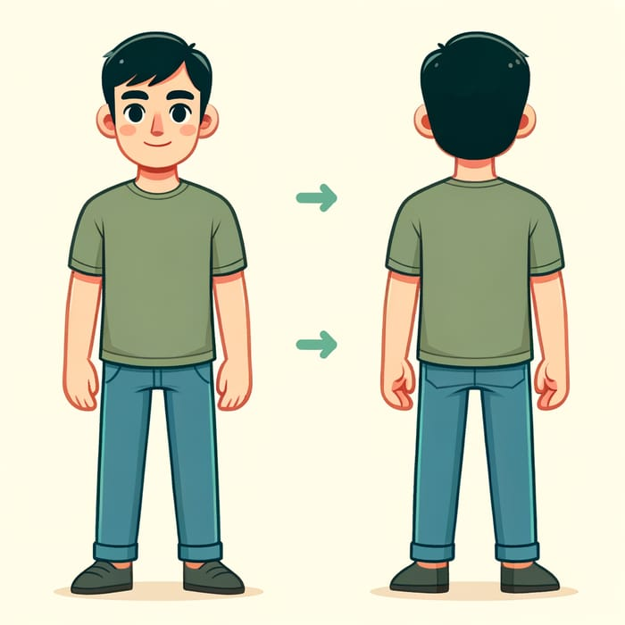
Raw
Annotated
Processed

Slide 10

THANK YOU

