Slide 1

Legal Text Classification for Document Categorization in Law
Team Members:
1. Sowjanya Linga
2. Vamshi Thatikonda

Slide 2
Project Objectives :
The project aims to develop a Legal Text Classification System for Document Categorization in Law. The system will utilize state-of-the-art NLP techniques to automatically categorize legal documents into predefined classes, enhancing efficiency and accuracy in legal document management.
The primary objectives of our project include:
Developing an NLP-based system for automated document categorization in the legal domain using LSTM, Random forest classifier, SVM.
Enhancing efficiency in legal document management and analysis through accurate and scalable text classification.
Enabling faster retrieval of relevant legal documents based on categorized topics.

Slide 3
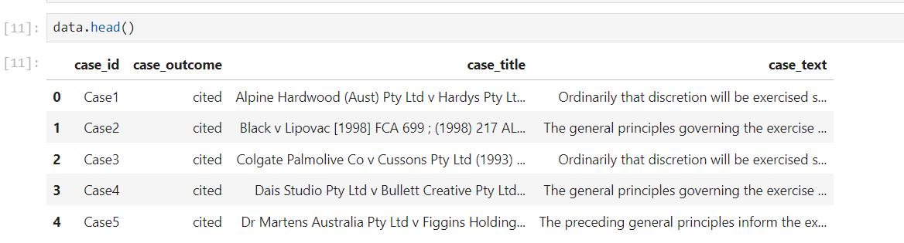
Data Set:

Slide 4
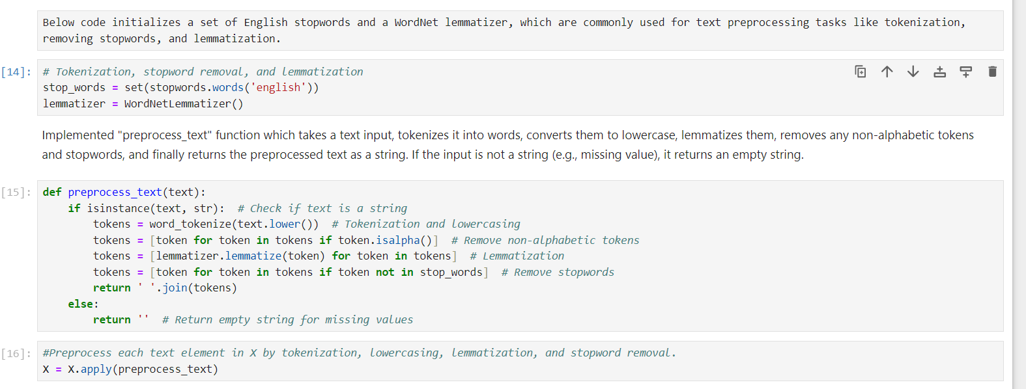
Data Preprocessing:
Tokenization
Stop word Removal
Lemmatization
Handling Missing Values

Slide 5
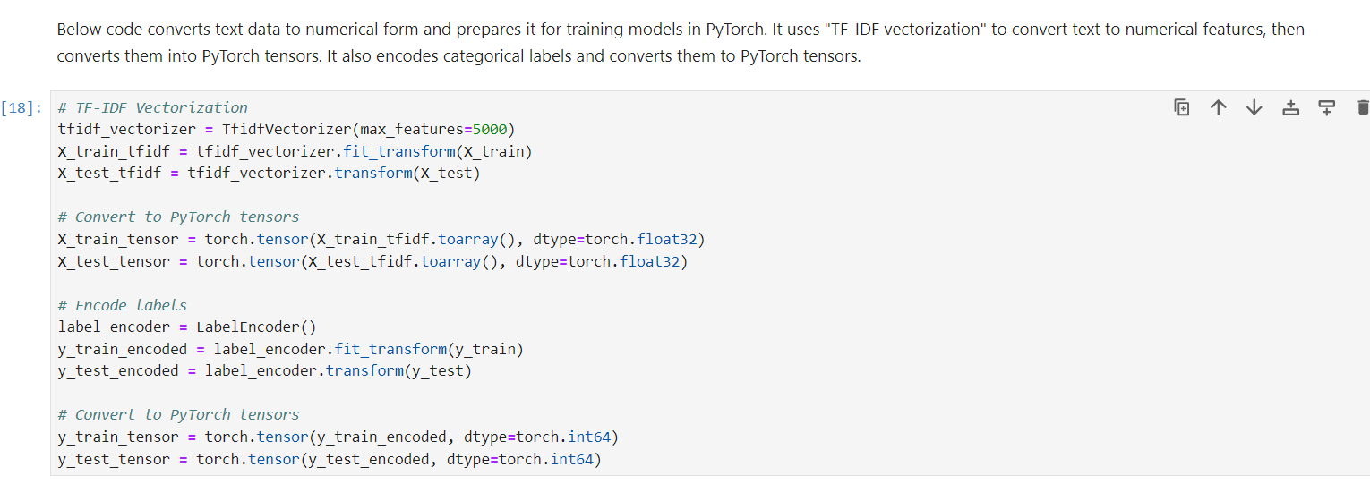
Text Vectorization:
TF-IDF Vectorization
Feature Extraction
Encoding Labels

Slide 6
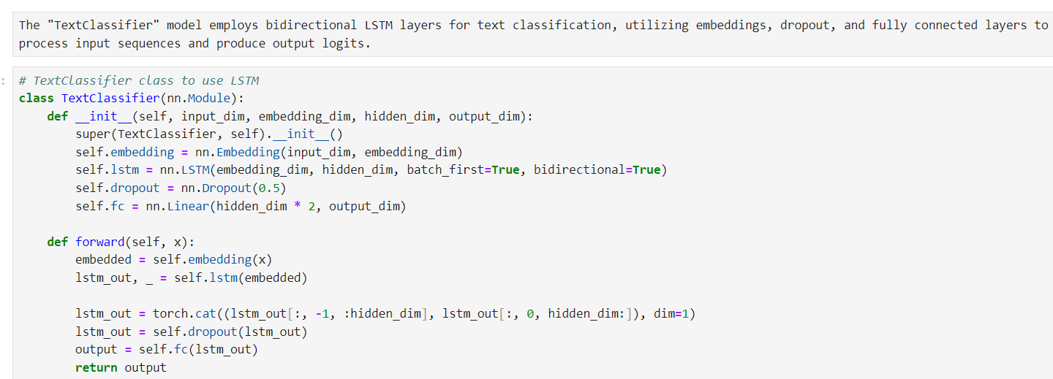
LSTM Classifier Overview:
Long Short-Term Memory (LSTM) is a type of recurrent neural network (RNN) architecture designed to overcome the vanishing gradient problem and capture long-term dependencies in sequential data.
Architecture Overview:
1. Embedding Layer: Converts input tokens into dense vectors of fixed size.
2. Bidirectional LSTM Layer: Processes input sequences in both forward and backward directions to capture contextual information.
3. Dropout Layer: Regularizes the network by randomly setting a fraction of input units to zero during training to prevent overfitting.
4. Fully Connected (Dense) Layer: Maps the output of the LSTM layer to the output classes.
5. Softmax Activation: Computes the probabilities of each class.

Slide 7
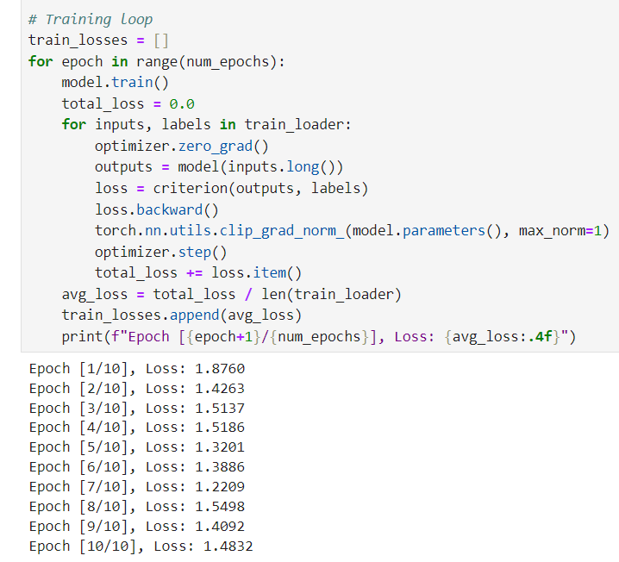
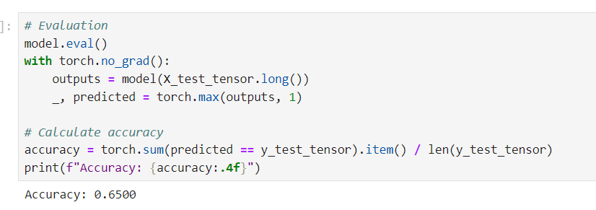
LSTM Model Training and Evaluation :
Training:
Utilized a bidirectional LSTM neural network architecture.
Trained over 10 epochs using the Adam optimizer.
Implemented with PyTorch, leveraging GPU acceleration.
Evaluation:
Achieved a test accuracy of 65% on legal outcome classification.
Evaluated with standard metrics: Accuracy, Precision, Recall, and F1 Score.
Visualized the Confusion Matrix for deeper insight.

Slide 8
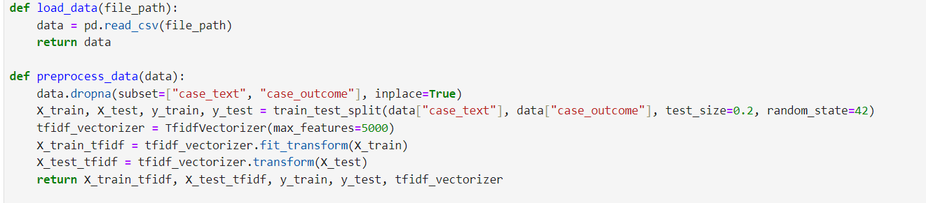
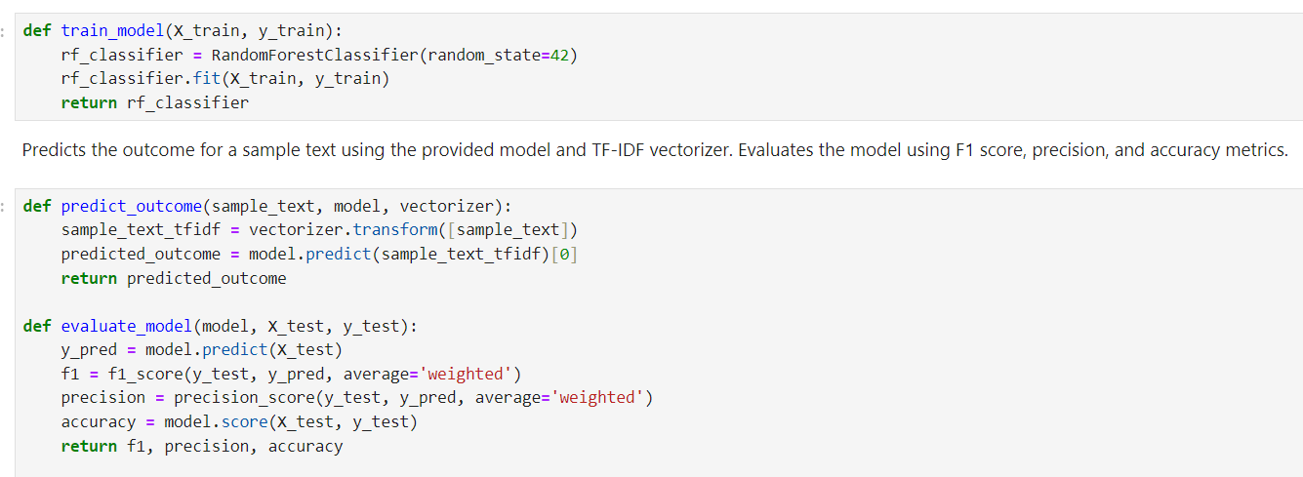
Random Forest Classifier:
Utilizes the Random Forest Classifier algorithm for legal outcome classification.
Preprocessing includes handling missing values and TF-IDF vectorization.

Slide 9
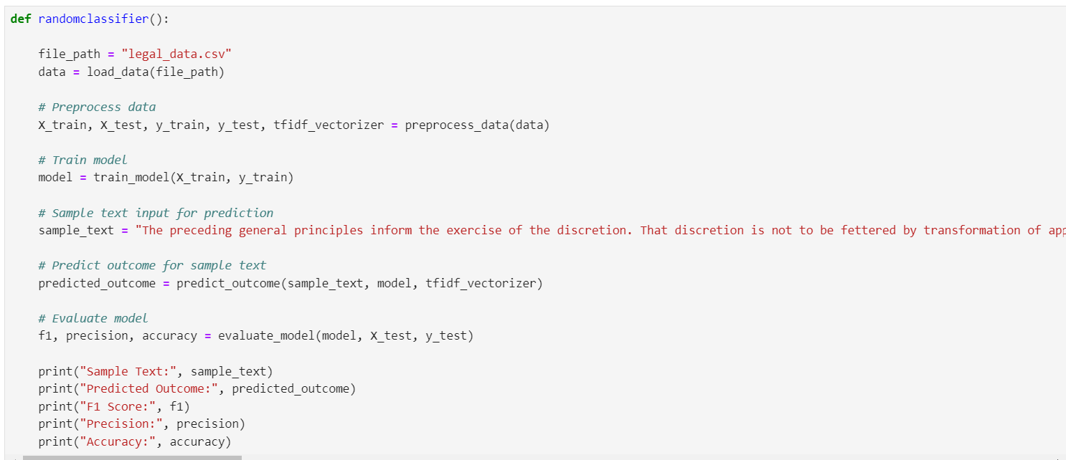
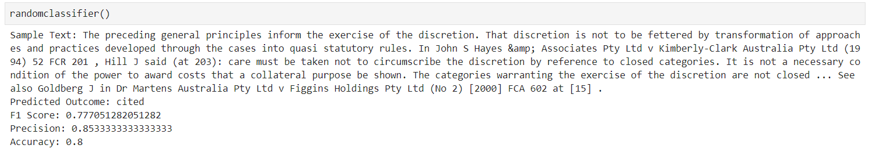
Random Forest Model Training and Evaluation:
Trains the classifier on a dataset of legal texts and their corresponding outcomes.
Predicts legal outcomes based on input legal text.
Evaluates model performance using F1 Score, Precision, and Accuracy metrics.

Slide 10
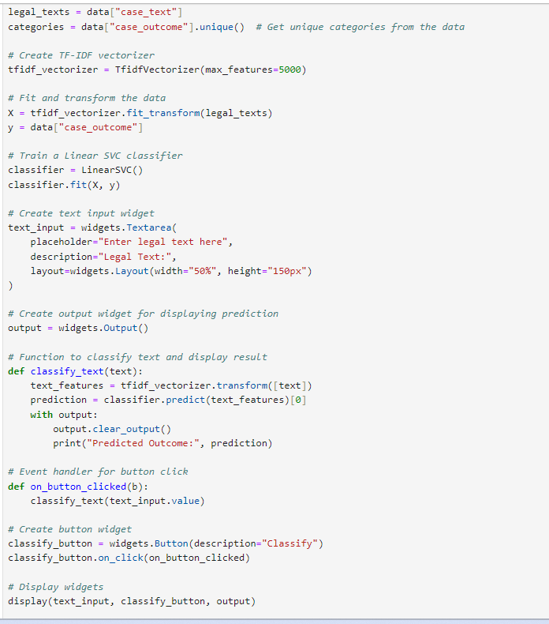
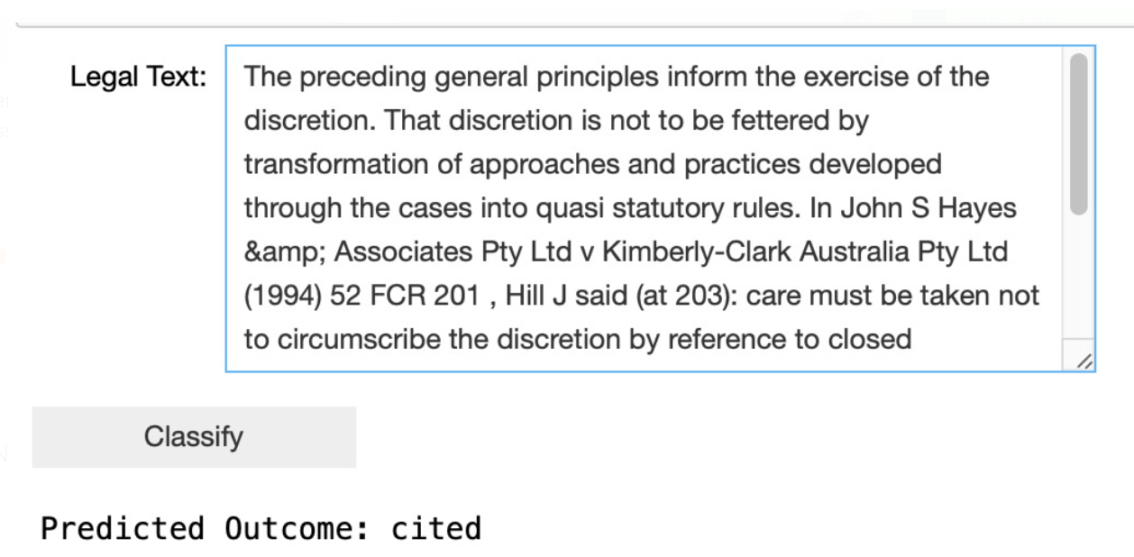
Real World Model Application using SVM classifier:
Below code implemented using SVM, specifically Linear SVC, for text classification. It loads legal text data, extracts features using TF-IDF, trains the SVM model, and creates a simple UI for users to input text for classification. When the user inputs text, the model predicts the outcome category and displays it.

Slide 11
Conclusion:
Objective Achieved: Successfully applied the Random Forest Classifier algorithm for legal outcome classification based on case text data.
Preprocessing: Handled missing values and utilized TF-IDF vectorization for text data.
Model Performance: Achieved a promising F1 score of approximately 0.78 and an accuracy of 80% on the test set.
Implications: The model offers insights into potential legal outcomes based on case text inputs, aiding legal professionals in decision-making processes and case analysis.
Future Directions: Further optimization and fine-tuning of the model can be explored to enhance performance and cater to specific legal domains or use cases.

Slide 12

Thank You!

