Slide 1
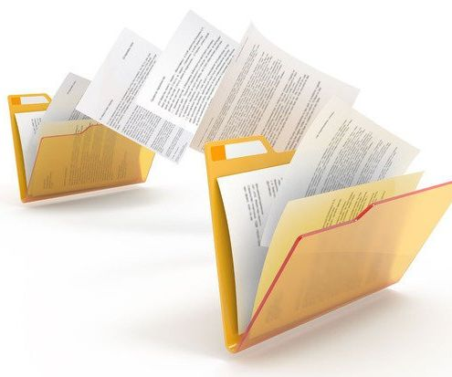
Legal Text Classification for Document Categorization in Law
Team Members:
1. Sowjanya Linga
2. Vamshi Thatikonda

Slide 2
Project Objectives :
The project aims to develop a Legal Text Classification System for Document Categorization in Law. The system will utilize state-of-the-art NLP techniques to automatically categorize legal documents into predefined classes, enhancing efficiency and accuracy in legal document management.
The primary objectives of our project include:
Developing an NLP-based system for automated document categorization in the legal domain.
Enhancing efficiency in legal document management and analysis through accurate and scalable text classification.
Enabling faster retrieval of relevant legal documents based on categorized topics.

Slide 3

Statement of Value :
This project is worth pursuing due to several reasons:
Legal text classification is a critical task in the legal domain, and automating this process can save significant time and resources for legal professionals.
The project contributes to the advancement of NLP applications in specialized domains, showcasing the versatility and practicality of deep learning models.
The developed system has the potential to be deployed in legal firms, courts, and government agencies, leading to improved document organization and retrieval.

Slide 4
Review of State of the Art :
Legal documents often had a complex layout with many different headings, headers, footers, side notes, etc. For further processing, it was important to extract these individual components correctly from a legally binding document, for example, a signed PDF. A common approach used to classify each (text) region of a page was using its geometric and textual features. This approach worked well when the training and test data had a similar structure and when the documents of a collection to be analyzed had a rather uniform layout [1].
Josi, Wartena, and Heid [2] demonstrated in their study that utilizing global page properties could enhance the accuracy of text element classification. Initially, each page was categorized into one of three layout types. Subsequently, a classifier was trained for each of these three-page types, resulting in improved accuracy on a manually annotated collection of 70 legal documents comprising 20,938 text elements. They developed a feature-based method for page layout detection, which was evaluated against a standard implementation of a CNN image classifier.

Slide 5
Review of State of the Art :
Brazil’s justice system faced grave case backlogs stemming from surging caseloads. This research explored automated text classification to expedite legal document analysis. Supervised machine learning approaches leveraging BERT embeddings fine-tuned on Brazilian legal text were evaluated using a 30,000 document dataset encompassing ten motion types from the Rio Grande do Norte Court of Justice. Documents were encoded into semantic representations via a BERT model adapted to local jurisprudence. The resulting optimized embeddings were used to train and benchmark models including KNN, Naive Bayes, SVM, neural networks, CNNs, and deep learning architectures. Despite BERT’s state-of-the-art capabilities, TF-IDF outperformed neural techniques across considered metrics. High similarity between certain classes was hypothesized to have hindered BERT’s contextual embedding [3].
Minaee et al. [4] conducted a comprehensive review of 150 deep learning models developed over the past six years, which significantly enhanced text classification tasks. They also provided an overview of more than 40 popular datasets and performed an analysis of model performance on public benchmarks. Additionally, they discussed key challenges and suggested future research directions in the field.

Slide 6

Approach:
Our approach involves collecting a diverse dataset of legal documents and preprocessing the text data. We then extract features and train a classification model, evaluating its performance using various metrics.
Datasets: Labeled legal documents dataset from Kaggle (https://www.kaggle.com/datasets/shivamb/legal-citation-text-classification)
Algorithms: LSTM (Long Short-Term Memory), SVM (Support Vector Machine), Random Forest
Models: SVM, Random Forest, LSTM
Tools: Python, scikit-learn, TensorFlow, PyTorch, Transformers
Techniques: Data preprocessing (tokenization, stop-word removal, lemmatization), feature extraction (TF-IDF, word embeddings), deep learning architectures

Slide 7
Deliverables :
1
2
3
4
Legal Text Classification Model: A robust NLP-based model capable of accurately categorizing legal documents into predefined topics/categories.
Document Categorization Interface: An intuitive user interface for legal professionals to classify new documents based on the trained model's predictions.
Evaluation Metrics and Analysis: Comprehensive evaluation metrics and analysis of the model's performance against stated objectives, including comparative analysis with baseline models.
User Documentation: Detailed user documentation and guidelines for deploying and using the classification system in legal workflows.

Slide 8
Evaluation Methodology
Our evaluation methodology includes the following steps:
Model Performance Metrics: Measuring the model's performance using accuracy, precision, recall, F1-score, and confusion matrix analysis on a held-out validation dataset.
Comparative Analysis: Conducting comparative analysis with baseline models or existing legal document management systems to assess improvements.
User Feedback Integration: Gathering feedback from legal professionals through usability testing and incorporating suggestions for system enhancements.
Final Model Refinement: Iteratively refining the model based on evaluation results and user feedback to optimize performance.

Slide 9

Thank You!

