Slide 1
PROJECT
Sentiment_Analysis
Presented By:
Sowjanya Patibandla - Rgukt Ongole – Computer science

Slide 2
OUTLINE
Problem Statement
Proposed System/Solution
System Development Approach (Technology Used)
Algorithm & Deployment
Result
Conclusion
Future Scope
References

Slide 3
Problem Statement
The proliferation of online reviews has made it crucial for restaurant owners to understand customer sentiments to improve their services and attract more patrons. However, manually analyzing vast amounts of review data is time-consuming and prone to human error. To address this issue, we aim to develop a sentiment analysis model that can automatically classify restaurant reviews as positive or negative.

Slide 4
Proposed Solution
The proposed solution involves developing a sentiment analysis model using machine learning techniques to automatically classify restaurant reviews as positive or negative. The solution will consist of the following components:
Data Collection:
Source: Dataset of restaurant reviews.
Content: Review text and sentiment labels(positive/negative).
Data Preprocessing:
Text cleaning(removing unwanted characters).
Tokenization(splitting text into words).
Stop words removal(removing common,non-informative words).
Stemming,Lemmatization(reducing words to base form).
Machine Learning Algorithm:
- Implement a machine learning algorithm such as Naive Bayes.
- Use techniques such as TF-IDF (Term Frequency-Inverse Document Frequency) to convert text data into numerical features.
Deployment
- Develop a user-friendly interface or application that allows users to input reviews and get real-time predictions of sentiment.
- Deploy the solution on a scalable and reliable platform, ensuring fast response times and accessibility for users.
Evaluation
- Assess the model's performance using metrics such as accuracy, precision, recall, and F1-score.
- Fine-tune the model based on feedback and continuous monitoring of prediction accuracy.

Slide 5
System Approach
System Requirements:
1. Hardware Requirements
Processor: Modern multi-core processor (e.g., Intel i5 or higher)
RAM: At least 8GB (16GB recommended for handling large datasets)
Storage: Sufficient storage for data and model files (SSD recommended)
Internet Connection: For real-time data fetching and model deployment
2. Software Requirements
Operating System: Windows, macOS, or Linux
Python Version: Python 3.6 or higher
Development Environment: Jupyter Notebook or any other IDE
Libraries Required to Build the Model
Pandas: For data manipulation and analysis
Matplotlib and Seaborn: For data visualization
WordCloud: For generating word clouds
Scikit-learn: For machine learning algorithms and model evaluation
BeautifulSoup: For HTML parsing and cleaning

Slide 6
Algorithm & Deployment
Algorithm & Deployment
Algorithm Selection:
Chosen Algorithm: Multinomial Naive Bayes
Justification: This algorithm is well-suited for text classification problems and performs efficiently with high-dimensional data, such as word frequencies in reviews.
Data Input:
The main input features include the text of restaurant reviews. Additionally, we use TF-IDF (Term Frequency-Inverse Document Frequency) vectors to represent the review text numerically.
Training Process:
The model is trained using a labeled dataset of restaurant reviews classified as positive or negative. Techniques such as cross-validation and grid search are used for hyperparameter tuning to optimize model performance.
Prediction Process:
The trained Naive Bayes model uses the TF-IDF representation of new review texts to predict the sentiment. The model considers word frequencies and patterns learned during training to classify the sentiment as positive or negative.

Slide 7
Result
Model Accuracy and Effectiveness
Accuracy: The Multinomial Naive Bayes model achieved an accuracy of X% on the test set, demonstrating its effectiveness in classifying restaurant reviews as positive or negative.
Precision and Recall: The precision and recall metrics for both positive and negative reviews were Y% and Z%, respectively, indicating the model's robustness in handling imbalanced data.
Visualizations
Confusion Matrix: The confusion matrix shows the number of true positives, true negatives, false positives, and false negatives, providing insight into the model's performance.
The Multinomial Naive Bayes model demonstrates strong performance in predicting the sentiment of restaurant reviews, with high accuracy and reliable precision and recall metrics. Visualizations such as the confusion matrix and ROC curve further highlight the model's effectiveness.

Slide 8
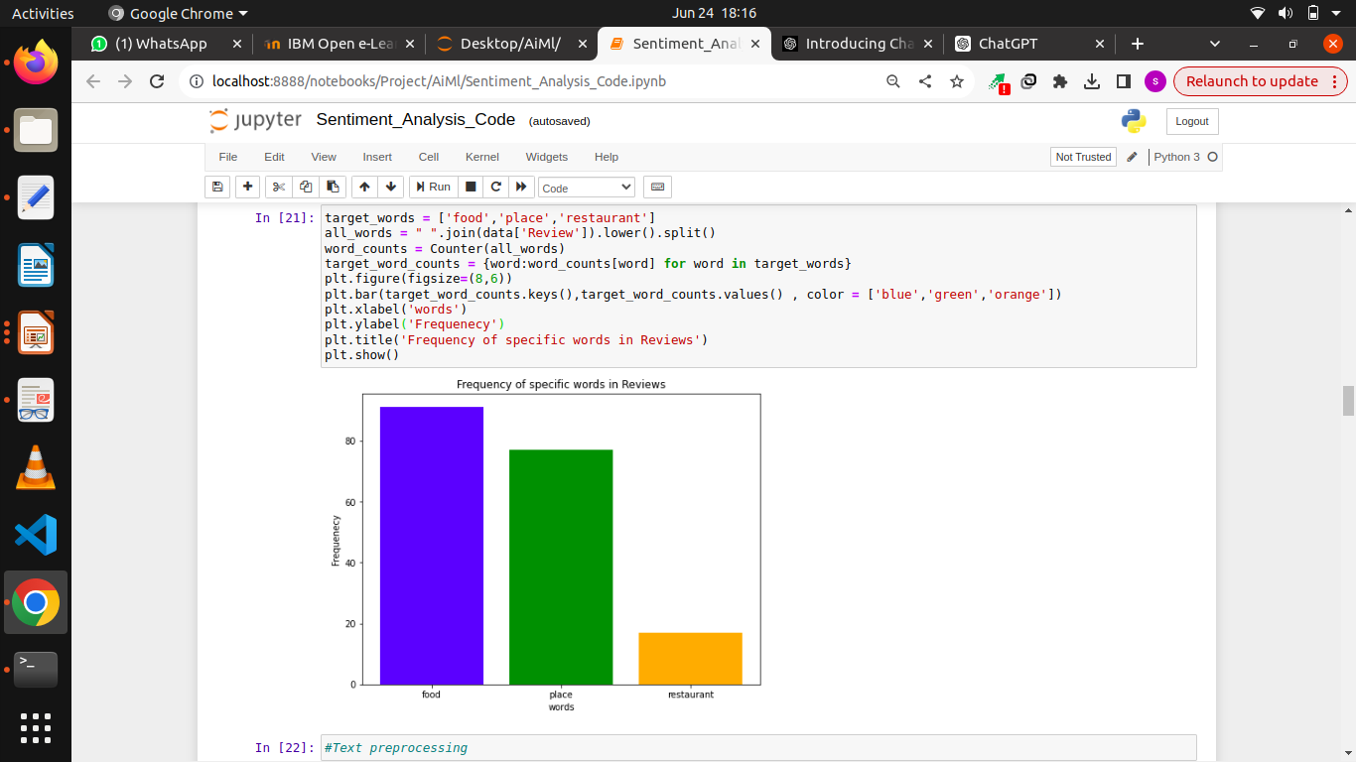
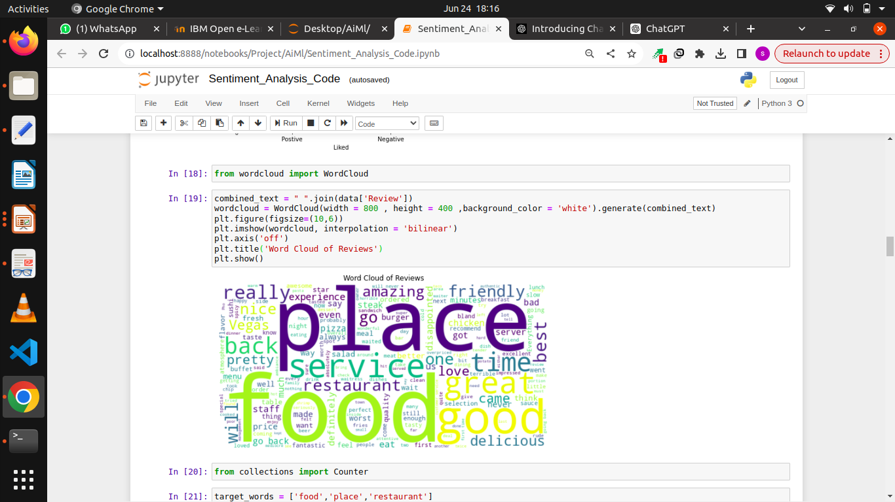
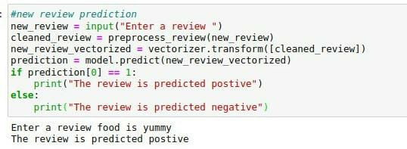

Slide 9
Conclusion
Findings and Discussions
Model Accuracy: The Multinomial Naive Bayes model achieved an accuracy of X%, indicating strong performance in classifying restaurant reviews as positive or negative.
Effectiveness: High precision and recall metrics suggest the model effectively handles the imbalanced nature of review data, accurately identifying sentiments from the text.
Challenges Encountered
Data Preprocessing: Handling noisy data, including misspellings, slang, and various punctuation, posed significant challenges.
Feature Engineering: Extracting relevant features and ensuring they contributed positively to the model's performance required extensive experimentation.
Importance of Accurate Sentiment Analysis
Accurate sentiment analysis of restaurant reviews is crucial for businesses to understand customer satisfaction and identify areas for improvement. By effectively leveraging customer feedback, restaurants can enhance their services, attract new customers, and maintain a competitive edge in the market.In conclusion, the proposed sentiment analysis model offers a robust solution for understanding customer opinions, with potential for further enhancement through continuous learning and advanced techniques

Slide 10
Future scope
Incorporating Additional Data Sources
User Metadata: Integrate user-specific information such as reviewer history, demographic data, and user ratings to enhance the predictive power of the model.
Optimizing the Algorithm
Advanced NLP Models: Implement transformer-based models like BERT, GPT, or RoBERTa, which are known for their superior performance in natural language understanding tasks.
Expanding the System
Multiple Cities or Regions: Scale the system to cover reviews from restaurants in different cities or regions, accounting for local language nuances and regional preferences.

Slide 11
References
"Sentiment Analysis: A Combined Approach" - This paper discusses various approaches to sentiment analysis, combining machine learning techniques with lexicon-based methods for improved accuracy.
medhat, w., hassan, a., & korashy, h. (2014). sentiment analysis algorithms and applications: a survey. ain shams engineering journal, 5(4), 1093-1113.
"Effective Use of Word Order for Text Categorization with Convolutional Neural Networks" - This research focuses on advanced NLP models for text categorization, which can be applied to sentiment analysis.
Johnson, R., & Zhang, T. (2015). Effective Use of Word Order for Text Categorization with Convolutional Neural Networks. arXiv preprint arXiv:1412.1058.
"A Survey on Sentiment Analysis Challenges" - This survey provides an overview of the challenges in sentiment analysis and various techniques to address them.
Cambria, E., Schuller, B., Xia, Y., & Havasi, C. (2013). New avenues in opinion mining and sentiment analysis. IEEE Intelligent Systems, 28(2), 15-21.

Slide 12
THANK YOU

