Slide 1

CAPBOOK

Slide 2
TEAM 3
Srikhar Reddy. M
K. Avinash
A. Neeraj
K. Shiva Kumar
B. Sowjanya

Slide 3
List of modules
Logged in user profile page content
Add a friend
Approve/Reject request
Friends List
Online Friends

Slide 4
Friends List
List of all the friends of the user will be available on user's profile page (home page).
15
List of all the friends of the user will be available on user's profile page (home page).
15
It displays the list of all the friends of a particular user.
List of all the friends of the user will be available on the user’s profile page(home page).

Slide 5
Tables used from the database
User_Profile
Friend_Request

Slide 6
MVC layout
Controller:
FriendListController
Dao layers:
IFriendListDAO
Service layers:
IFriendListService
FriendListService

Slide 7
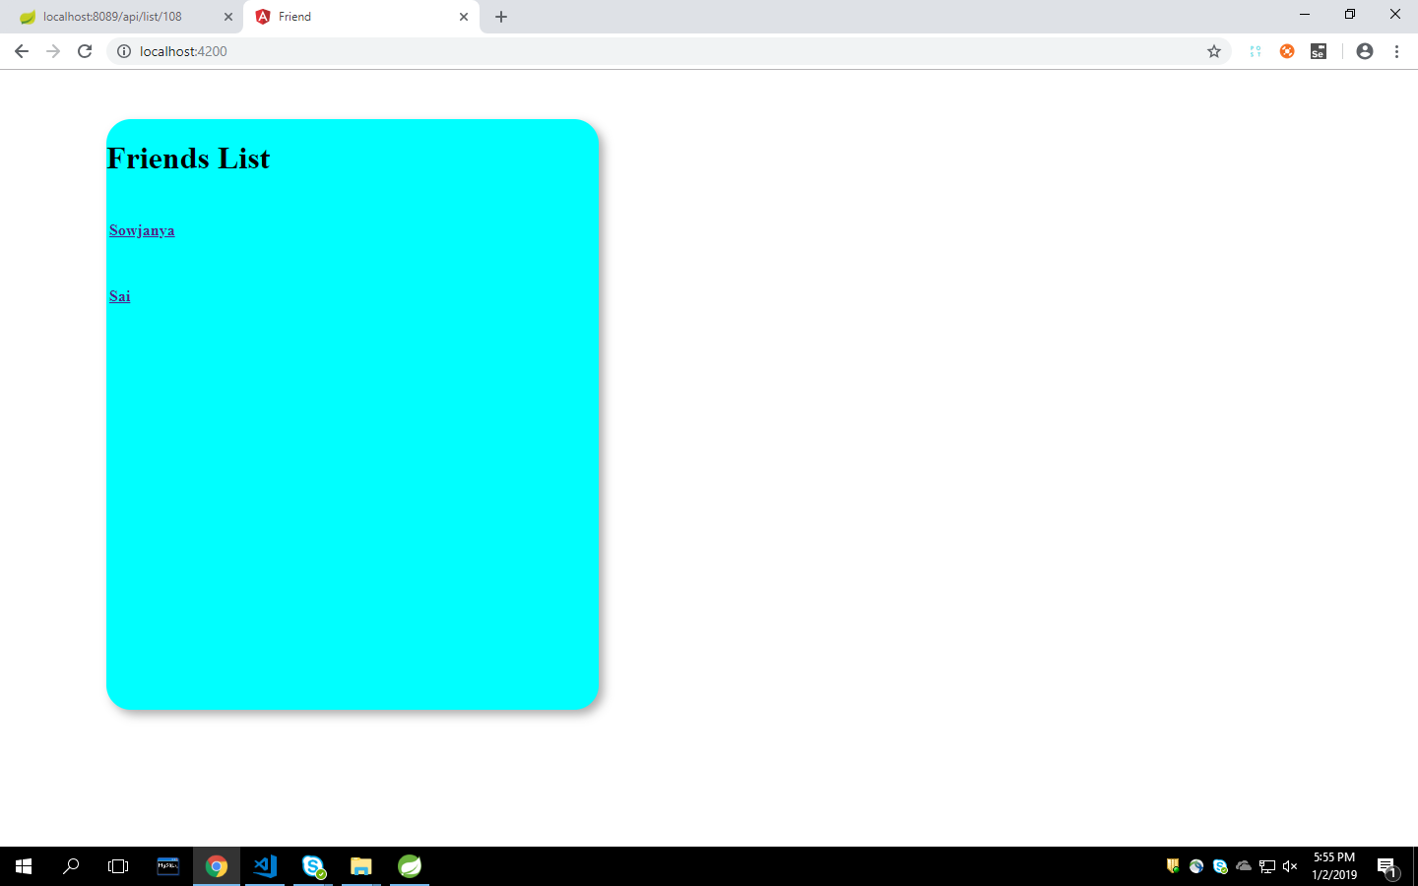

Slide 9
Thank you…!!

