Slide 1
FAKE PROFILE DETECTION ON SOCIAL MEDIA USING LSTM
Presented By KOTI. SOWJANYA ESWARI 19A91F0009
Internal Guide:
K.C.Pradeep

Slide 2
CONTENTS
Abstract
Existing system and Disadvantages
Proposed system and Advantages
System Architecture
Proposed Algorithm
Functional Requirements
System Requirements
Modules
UML Diagrams
Screenshots
Conclusion

Slide 3
ABSTRACT
Social media is gaining more popularity in present days because of its open nature. It allows users to have conversations, share information and web content.
By using social media, user can able to create user profiles to interact with each other. At the same time users are facing lot of issues such as hacking, cybercrimes, harassments.
The social media fake profiles are considered to cause more harm than any other. There are many detection methods to eradicate these fake profiles to implementing a new detection method by using a classification algorithm.

Slide 4
To overcome these problems, a new classification algorithm called LSTM to detect these fake profiles in an effective way.
This LSTM is an advanced Recurrent Neural Network. It is a sequential network that allows previous information and used to process the current input.
By using this method, It can detect fake profiles as the number of training data increases the classifier becomes more and more accurate in predicting the fake profiles.

Slide 5
EXISTING SYSTEM
The Existing system uses very fewer factors to decide whether the profile is fake or not. These factors largely effect the way decision making occurs. The commonly used algorithm in existing system is naive bayes algorithm.
This naive bayes algorithm is a simple technique for constructing classifiers. It is typically used to predict spam emails, fake ones.
Naive bayes is a kind of algorithm that makes an assumption that the predictor variables are independent or unrelated to each other. During this process, it takes more time to produce the results.

Slide 6
When it comes to categorical data in naive bayes algorithm, the test data set wasn’t available in the training dataset i.e., it assigns zero probability for categorical data.
Disadvantages:
All features are independent or unrelated.
It is a time taken process to produce the accurate result.
Large data records are required to achieve an accurate result.
It is difficult by human readers because the values are numeric.

Slide 7
PROPOSED SYSTEM
Due to the advancement in creation of fake profiles, the advancement of detecting methods are increasing day-by- day in the present market. When it comes to proposed system, it is completely an advancement of existing system.
The implementation of LSTM algorithm is to get better and good results. LSTM is an advanced Recurrent neural network, a sequential network that allows information to persist.
An LSTM recurrent unit tries to remember all the past knowledge that the network is seen so far and to forget irrelevant data.

Slide 8
This LSTM can add, delete, update the information which is carefully controlled by structures called gates.
Advantages:
It takes less time to produces the result.
It ignores irrelevant data and takes the relevant information which is needed.
It will store the short-term data long time.
High accuracy in prediction.

Slide 9
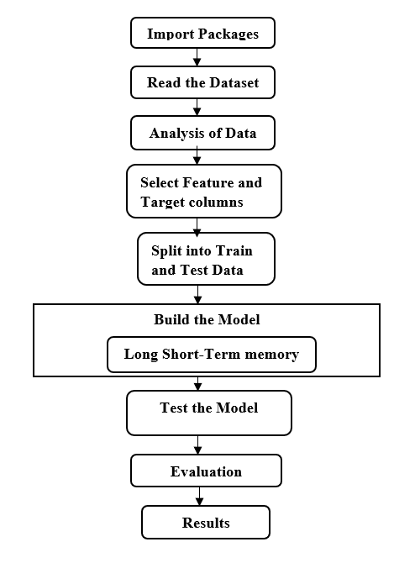
SYSTEM ARCHITECTURE

Slide 10
Architecture Description:
The system architecture has following steps:
Import Necessary Packages
Read the Dataset
Exploratory Data Analysis
Selecting Features and Target columns
Data splitting to training and test data
Build the model
Test the model
Evaluating results

Slide 11
The Import packages are used to import the required packages.
After importing the packages, it reads the dataset. The format of the dataset is in .csv format. The entire dataset will be analysed and modified.
The Feature and Targeted columns are used for detects selected columns.
The selected data will be splitted into train and test data.
After splitting the data, it Builds the model with the selected data and then test the model.
By implementing this process, the results will be evaluated.

Slide 12
PROPOSED ALGORITHM
Long Short-Term Memory Algorithm(LSTM):
This algorithm is used to store the short-term data long time. This approach is an advanced Recurrent Neural Network, this recurrent unit tries to remember all the past knowledge that the network is seen so far and to forget irrelevant data. By using gates, it will add, update, delete the information.
Forget gate: It forgets irrelevant information.
Input gate: It adds / updates the information.
Output gate: It passes the updated information.

Slide 13
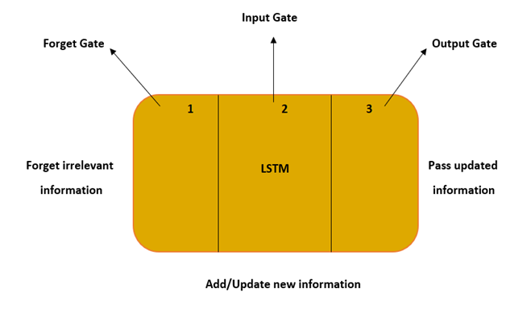
Step 1: Forget gate decides how much past data it should remember.
Step 2: Input gate decides how much this unit adds to the current state.
It adds/update the new information.
Step 3: Output gate decides what part of the current state makes it
to the output.

Slide 14
FUNCTIONAL REQUIREMENTS
A user profile is defined as the collection of information associated with a user. It can contains the critical information used to identify an individual, like name , screen name, bio, birth date.
The number of friends count also makes your account seems more interesting and it plays huge role in someone’s decision to follow you or not.
Active status shows your friends and their connections when your active or currently in the same chat or were recently active on social media.

Slide 15
SYSTEM REQUIREMENTS
Minimum Hardware Requirements:
Processor :Intel Core i5
RAM :8 GB
Hard Disk :500 GB
Software Requirements:
Language :Python 3.9
IDE :Jupyter Notebook 6.3.0
Operating System :Windows 11.

Slide 16
MODULES

Slide 17
Modules Description:
Data Collection:
This step describes the collection of data that is a set of social media profiles collected from a given dataset. The data for which it displays the resultant value to decide whether the profile is fake or not. Therefore, it is called labelled data. It collects the data from a dataset and search for a target variable.
Data Pre-Processing:
The data pre-processing is done by involves formatting, cleaning and sampling. While pre-processing the data it will separate the data into train and test data for a clear solution.

Slide 18
UML DIAGRAMS

Slide 19
Usecase Diagram

Slide 20
USECASE TEMPLATES
Use case template for Uploading and accessing dataset
Use case name | Uploading Dataset
Participating actors | User, ML Engine
Flow of events | The operation performed between the ML Engine and user to detect the name of the dataset that is uploaded. Choose the file to upload. User opens the dataset which is uploaded
Entry condition | Open the location of the data to be upload
Exit condition | Data uploaded successfully.

Slide 21
Use case template to pre-process the data from a dataset
Use case name | Data Pre-process
Participating actors | User, ML Engine
Flow of events | The User pre-process the data by using the dataset in ML Engine. The pre-processed data has been validated.
Entry condition | Data Pre-processing
Exit condition | It Detects the fake profiles and produces the analysis of a result.

Slide 22
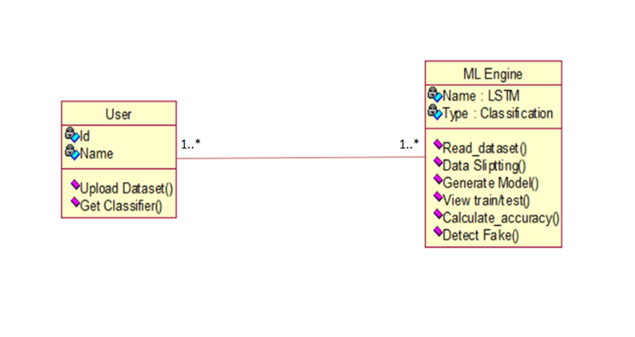
CLASS DIAGRAM

Slide 23
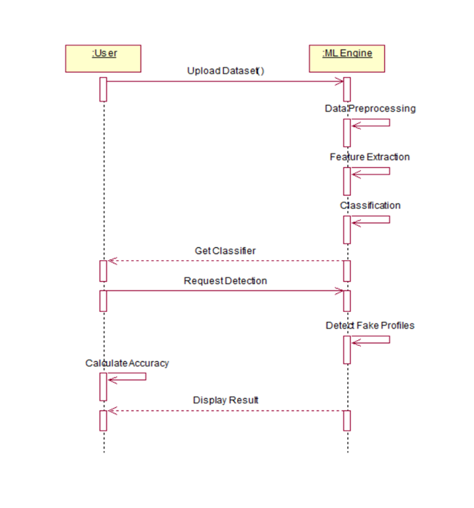
SEQUENCE DIAGRAM

Slide 24
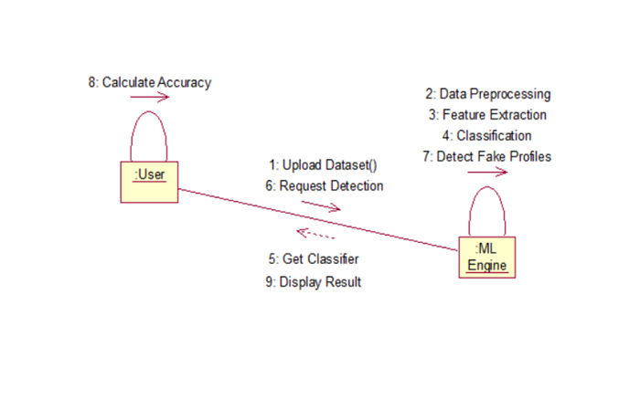
COLLABRATION DIAGRAM

Slide 25
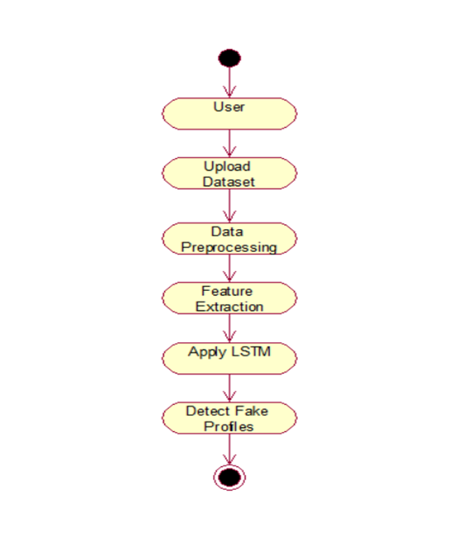
ACTIVITY DIAGRAM

Slide 26
SCREENSHOTS

Slide 27
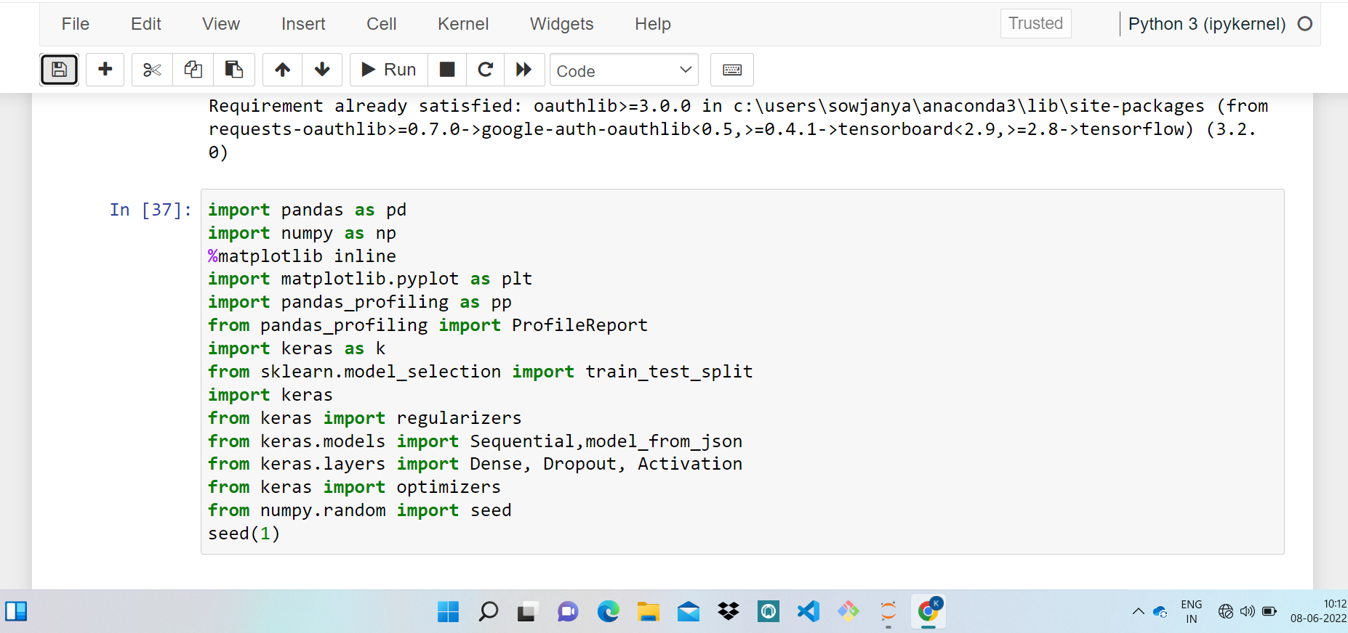
Importing and Accessing necessary packages

Slide 28
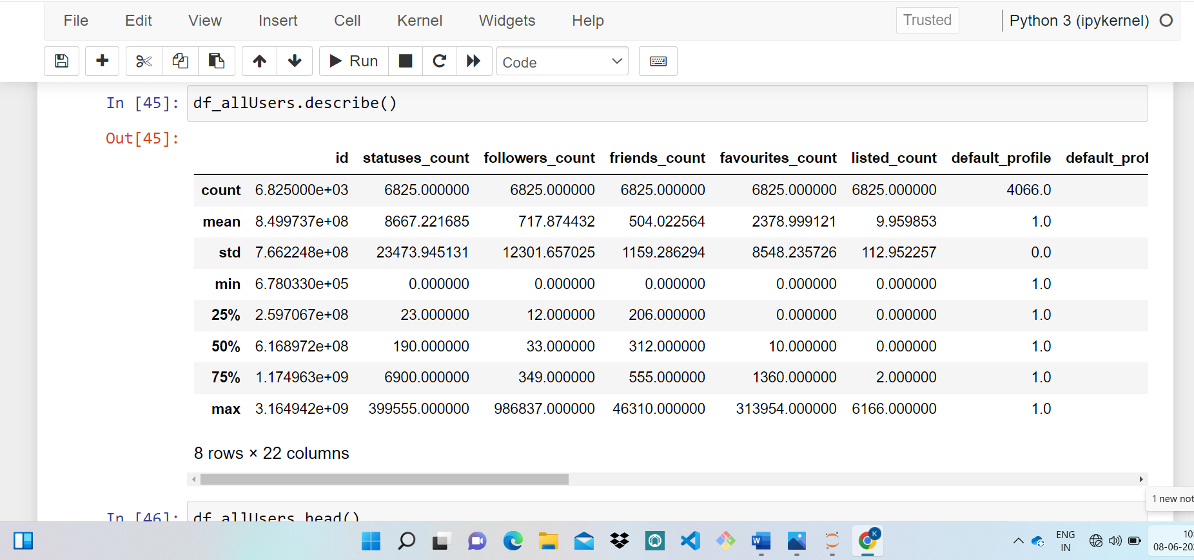
Defining the dataset description

Slide 29
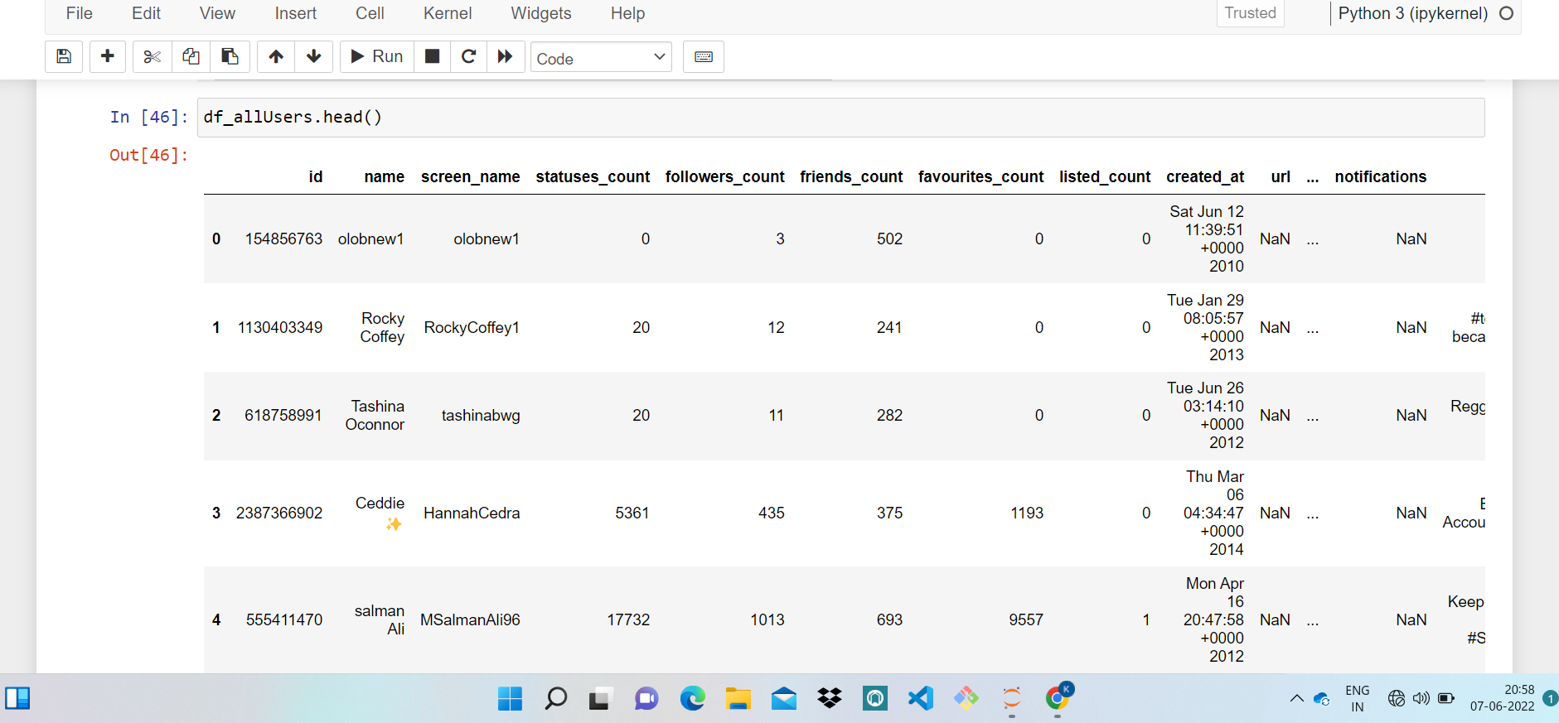
Describes the head of the dataset

Slide 30
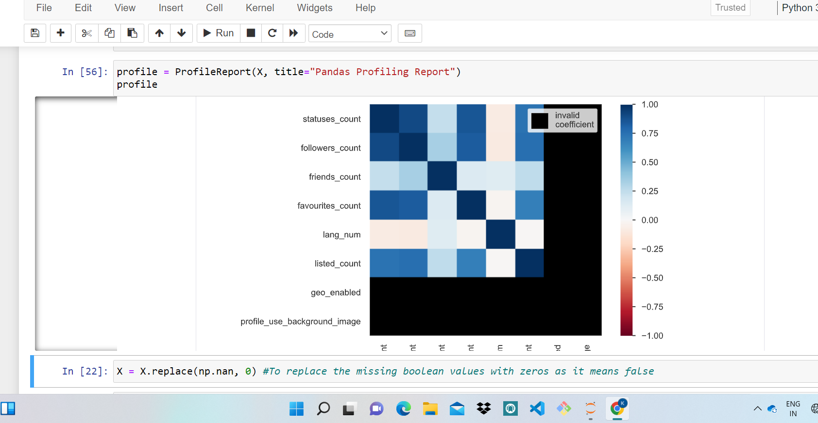
Performing correlation matrix

Slide 31
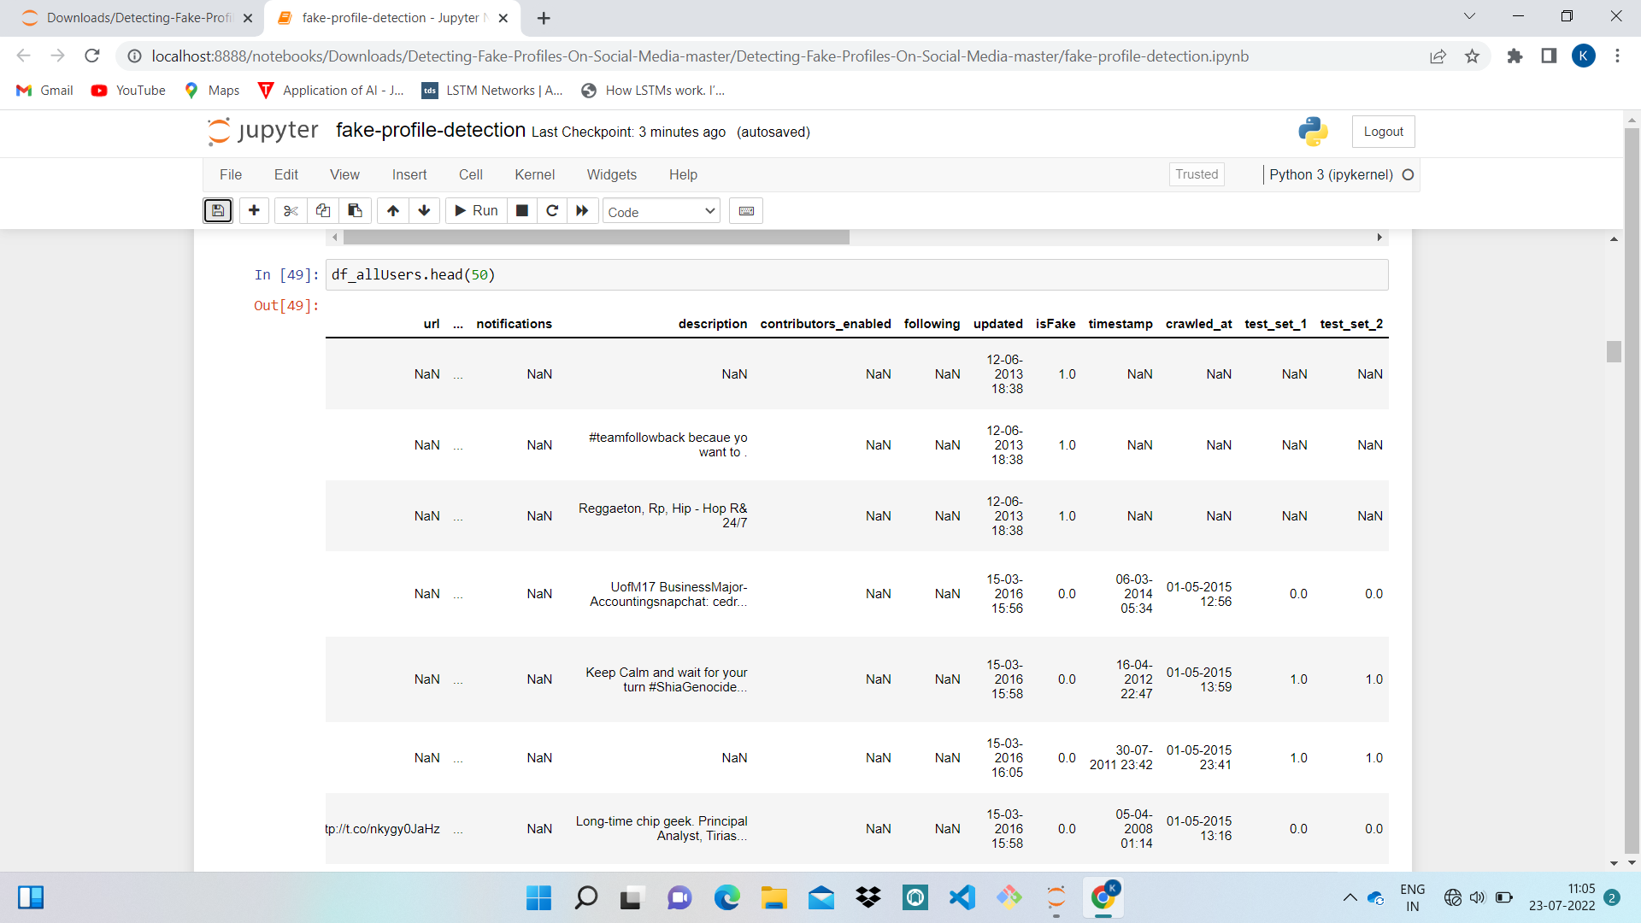
Displays Fake and Original profiles

Slide 32
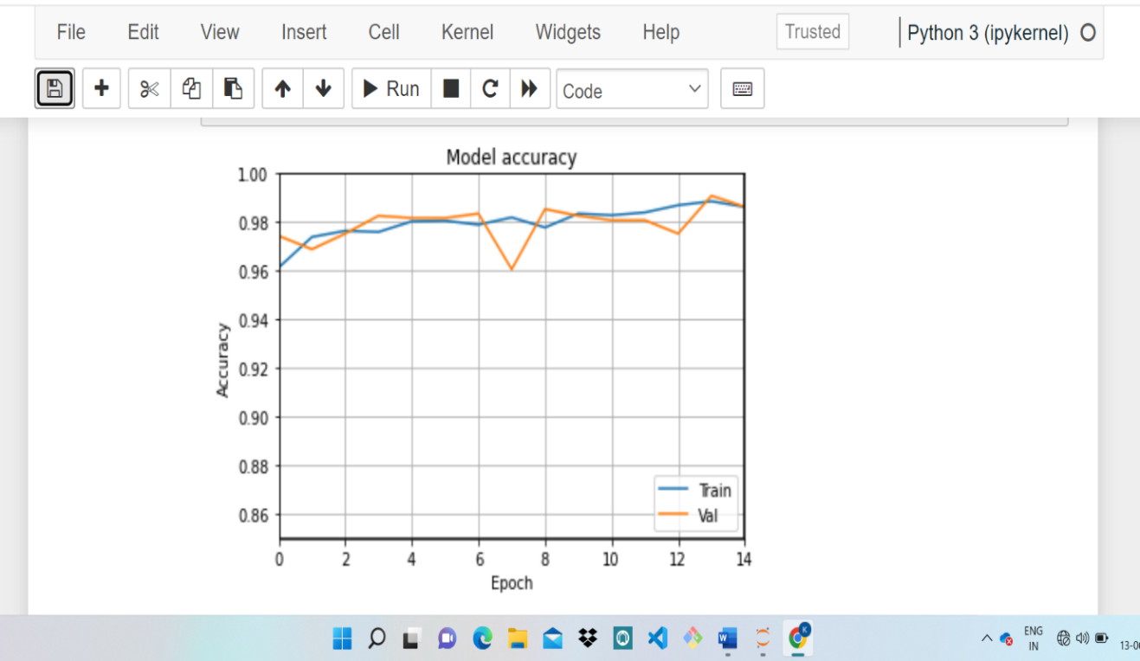
Shows the graphical representation for model accuracy using LSTM

Slide 33
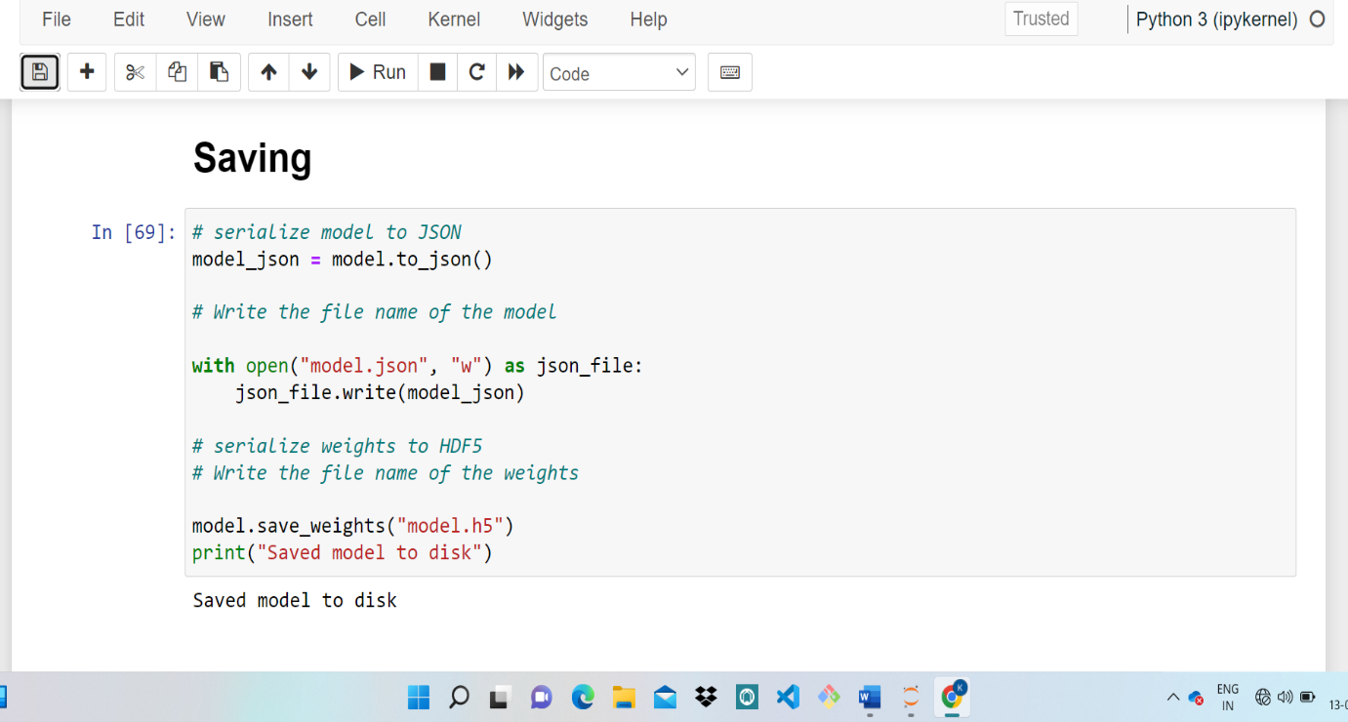
Displaying the saved data

Slide 34
CONCLUSION
Social media is gaining more popularity day-by-day. The social networking sites are making our social lives better but there are lot of issues faced by the users which are need to be addressed. In order to address this issue, it is required to protect the profiles and increasing the security. So, the updated technology which solves the various issues found in the previous algorithms. This newly classification algorithm which requires a huge protection factors by which the given data in a dataset is pre-processed by a variety of python libraries. This mechanism based on similarity approach that uses Long Short-Term Memory Algorithm along with dimensionality reduction to improve the performance to detect the profile is fake or not.

Slide 35
THANK YOU

