Slide 1

Customer Segmentation
using Unsupervised Learning
Telecom Churn Dataset Analysis

Slide 2




Problem Statement
The telecom industry faces significant challenges retaining customers. Without understanding who customers are, retention strategies fail to deliver results.
High Customer Churn
Costly Acquisition
Generic Strategies Fail
Telecom companies lose a significant share of customers every year, directly impacting revenue and growth.
Acquiring a new customer costs 5–7× more than retaining an existing one, making churn extremely expensive.
One-size-fits-all retention campaigns miss the mark — different customers have very different needs and behaviors.
Need for Data-Driven Segmentation
Behavioral segmentation enables precise, personalized retention strategies that actually work.

Slide 3
Why Unsupervised Learning?
Unsupervised learning was chosen because customer behavior data has no pre-existing labels — the goal is to discover hidden natural groupings.
✅ Unsupervised Learning
❌ Supervised Learning — Why Not?
No Labeled Data Needed
Requires Labeled Training Data
Works directly on raw behavioral data without manual annotation
Needs pre-classified churn/no-churn labels which may be biased
Discovers Hidden Patterns
Predicts Known Outcomes Only
Reveals natural groupings invisible to human analysts
Cannot discover new, unexpected behavioral clusters
Proactive Retention
Less Exploratory
Enables targeted action before a customer churns
Does not reveal the underlying structure of customer behavior

Slide 4
Dataset Overview
The Telecom Churn Dataset is a well-known benchmark dataset containing rich behavioral features for customer analysis.
3,333
20
Customer Records
Features
Total samples in dataset
Behavioral attributes per customer
📞 Call Usage
🎧 Service Calls
📅 Account Length
Day, Evening, Night & International minutes and charges
Number of customer service interactions per account
Duration of customer relationship with the telecom provider

Slide 5




Algorithms Used
Four techniques were applied — three clustering algorithms and one dimensionality reduction method — to segment customers effectively.
KMeans Clustering
DBSCAN
Partitions customers into k groups by minimizing intra-cluster variance. Fast, scalable, and interpretable.
Density-Based Spatial Clustering. Identifies arbitrarily shaped clusters and detects noise/outlier customers.
Hierarchical Clustering
PCA
Builds a dendrogram of nested clusters. Useful for understanding cluster structure at different granularities.
Principal Component Analysis reduces 20 features to 2–3 components for visualization and noise reduction.

Slide 6
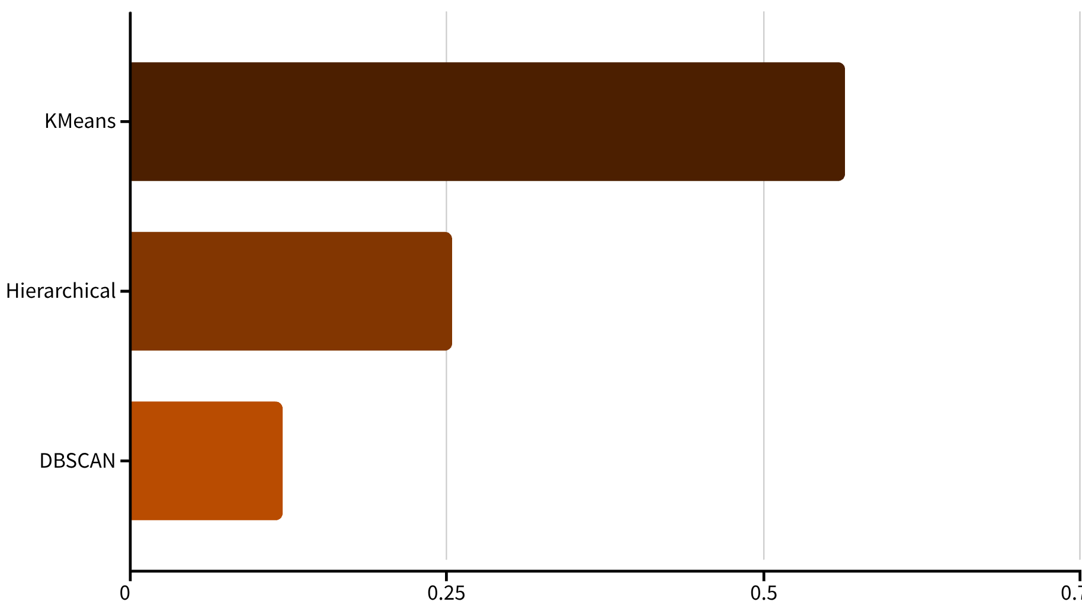
Algorithm Performance Comparison
KMeans outperformed both Hierarchical Clustering and DBSCAN on the Silhouette Score metric — a higher score indicates better-defined, well-separated clusters.
KMeans — Best
Silhouette Score: 0.564. Fastest convergence and most stable cluster assignments.
Hierarchical — Moderate
Score: 0.254. Useful for visualization but computationally heavy on larger datasets.
DBSCAN — Noise Detected
Identified outlier customers but produced less consistent cluster boundaries.

Slide 7

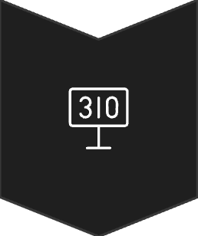


Optimal Number of Clusters
Two methods were used together to validate the ideal number of customer segments — ensuring clusters are meaningful and stable.
Elbow Method
Plot inertia vs. k. The "elbow" bend reveals where adding more clusters gives diminishing returns.
Silhouette Score
Measures how similar a point is to its own cluster vs. others. Peaks at optimal k.
Best k = 3
Both methods confirmed 3 clusters as the optimal segmentation for this dataset.
Both the Elbow Method and Silhouette Score independently agreed on k = 3, providing high confidence in the segmentation result.

Slide 8



Customer Segments Identified
KMeans with k=3 revealed three distinct, actionable customer profiles — each requiring a different retention strategy.
Cluster 1 — High-Value Loyal
Cluster 2 — Price-Sensitive Moderate
Cluster 3 — At-Risk Low Engagers
Long account tenure, high call usage, low service complaints.
Average usage, moderate account age, some service interactions.
Low usage, high service call frequency, short tenure.
→ Reward programs & premium upselling
→ Flexible plans & targeted discounts
→ Proactive outreach & service improvement

Slide 9
Real-World Business Impact
Applying data-driven customer segmentation to retention campaigns delivers measurable improvements across all key business metrics.
+35%
+18%
-42%
$4.2M
Campaign Response Rate
Customer Lifetime Value
Retention Cost
Annual Savings
Targeted strategies eliminate wasteful spend on wrong customers
Projected yearly benefit from reduced churn and optimized spend
Personalized offers outperform generic campaigns significantly
Loyal customers spend more when engaged with relevant offers
Key Insight
Why It Works
Cluster 3 (At-Risk) customers, when identified early and reached proactively, show a 3× higher response to retention offers compared to untargeted campaigns.
Right message to the right customer at the right time
Resources focused on highest-churn-risk segments
Continuous model retraining improves accuracy over time

Slide 10
Conclusion
1
Hidden Patterns Revealed
2
KMeans Performed Best
Unsupervised learning successfully uncovered 3 natural customer segments in the telecom churn dataset without requiring any labeled data.
With a Silhouette Score of 0.564, KMeans clustering outperformed DBSCAN and Hierarchical Clustering in stability and interpretability.
3
Proactive Retention Enabled
4
Data-Driven Decisions Improve ROI
Segment-aware strategies allow telecom providers to act before customers churn — not after.
The model delivers measurable impact: +35% campaign response, -42% retention cost, and $4.2M in projected annual savings.
Thank You

