Slide 1
SOWMIYA A

Slide 2
Using AI To Build A YouTube Video Summarizer

Slide 3


AGENDA
Project statement
Project overview
End users
Solution and proposition
Significance of solution
Modelling
Result
3/21/2024 Annual Review

Slide 4

PROBLEM STATEMENT
Create an AI-powered YouTube video summarizer that efficiently condenses lengthy videos into concise summaries, enabling users to quickly grasp the main points and key information without having to watch the entire video.

Slide 5

PROJECT OVERVIEW
The AI-Powered YouTube Video Summarizer project aims to create a system that automatically generates concise summaries for YouTube videos. By leveraging natural language processing (NLP) and computer vision techniques, the system analyzes video content to extract key information and main points, providing users with quick access to valuable insights without the need to watch the entire video.

Slide 6

WHO ARE THE END USERS?
1. Researchers needing to efficiently extract insights from a large volume of video content.
2. Students looking to gather information for projects or study purposes.
3. YouTube creators interested in understanding competitor videos or industry trends.
4. Creators seeking to identify popular topics or formats in their niche.

Slide 7

MY SOLUTION AND ITS VALUE PROPOSITION
Solution:
The AI-Powered YouTube Video Summarizer automates the process of generating concise summaries for YouTube videos.
Value Proposition:
Time-saving: Enables users to quickly grasp main points without watching entire videos, saving time and effort.
Efficiency: Facilitates efficient extraction of insights from a large volume of video content, benefiting researchers, students, and professionals.
Enhanced Learning: Enriches educational experiences by providing curated video content for educators and students.
Value Proposition:Time-saving: Users can quickly grasp the main points of YouTube videos without investing the time to watch them in their entirety, making content consumption more efficient.Efficiency: Researchers, students, content creators, educators, and business professionals can extract valuable insights from a large volume of video content in a fraction of the time it would take to watch each video individually.Enhanced Learning: Educators can curate relevant video content for educational purposes, enriching lesson plans and online courses with engaging multimedia resources.

Slide 8

THE WOW IN YOUR SOLUTION
The wow factor of the YouTube video summarizer project lies in its ability to revolutionize the way people interact with and consume video content:
Efficiency: Users can quickly access valuable insights from lengthy videos, saving time and effort.
Innovation: Leveraging cutting-edge NLP and computer vision technologies, the project demonstrates advancements in AI-driven content analysis.
Accessibility: The summarizer makes video content more accessible by providing concise summaries, catering to users with varying time constraints or preferences.
3/21/2024 Annual Review

Slide 9
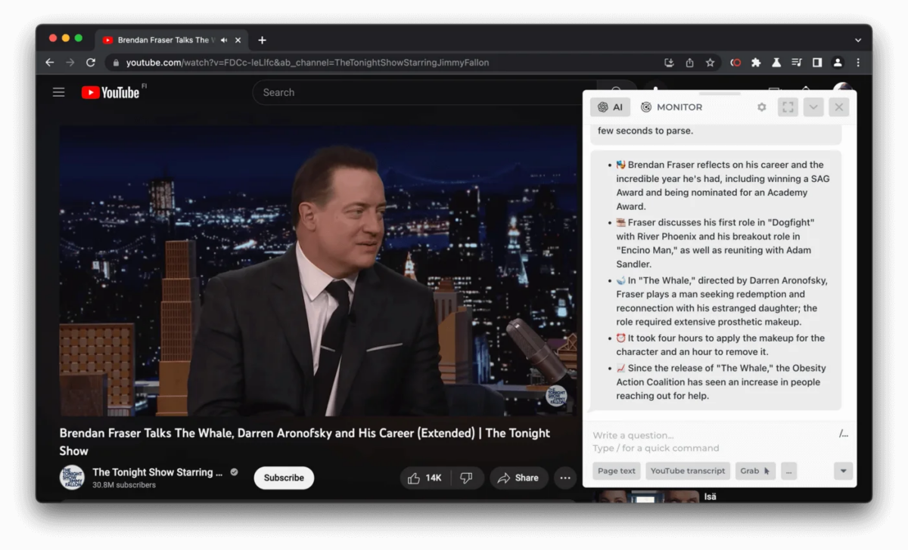
MODELLING

Slide 10
RESULTS
The YouTube Video Summarizer app seamlessly integrates the power of React and OpenAI, providing users with a tool to distill the essence of YouTube videos. While the core functionality is complete, there are potential enhancements you could make to improve this application. For example, you can adapt the app to use OpenAI’s Whisper model to summarize videos lacking a transcript.

