Slide 1
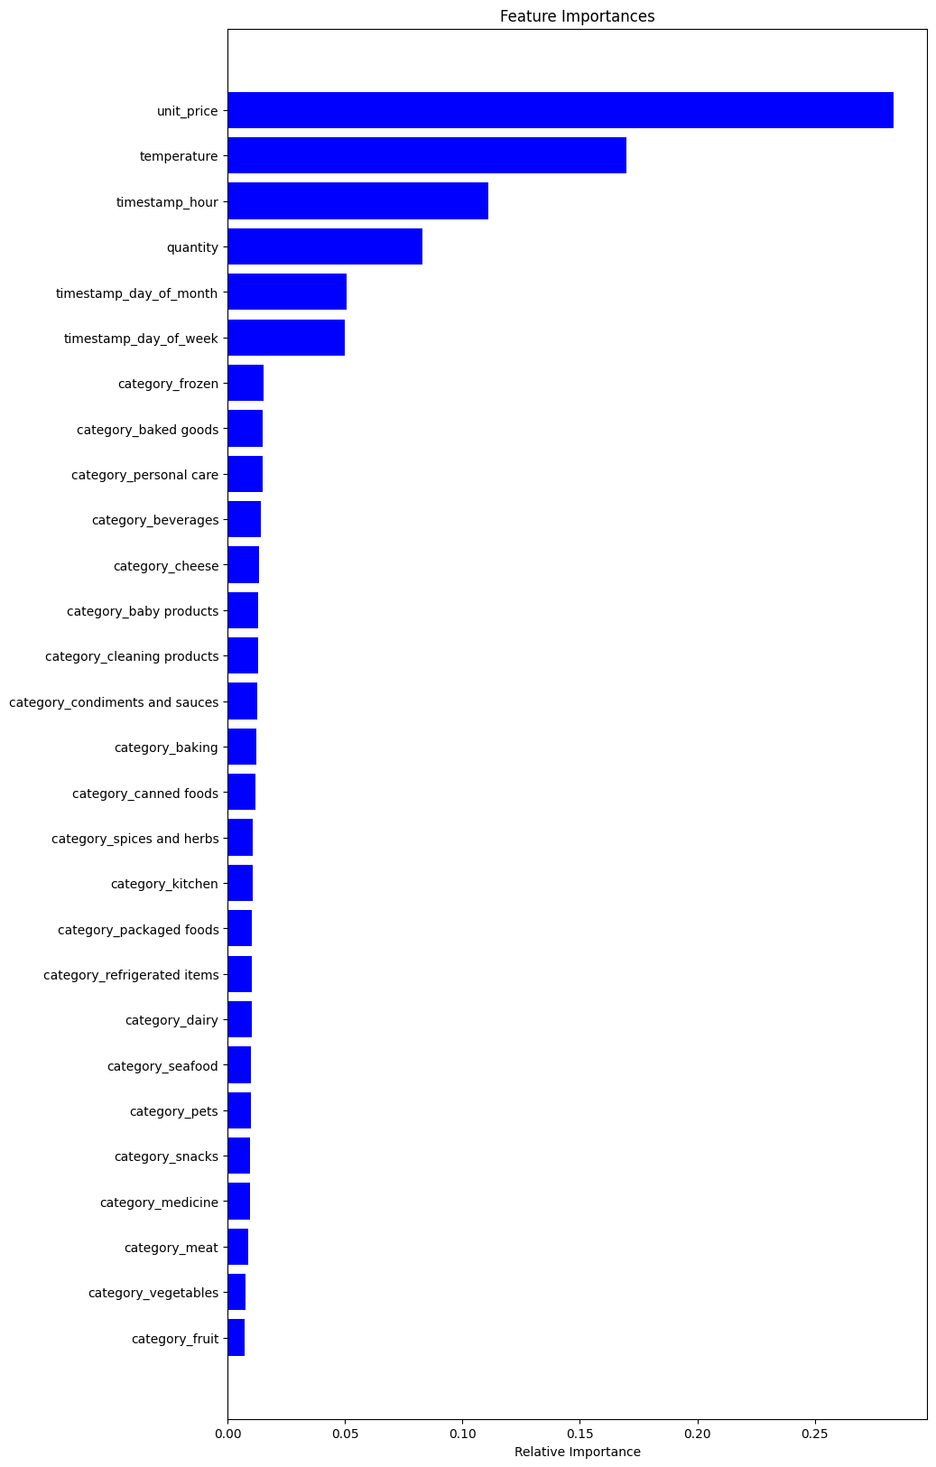
Relative Importance of Features
When predicting estimated stock percentage
MORE DATA IS REQUIRED
Approximately 50% accuracy with the current set of data and features that were created. In order to test this results, we need large sets of data.
PRICE IS IMPORTANT
Price was an important feature in the model, but category was not. Are there more features about the products that we can used to include in the model.
BUILD ON IoT
Temperature was also significant within the model, with more IoT data across a larger time period, we believe the accuracy of this model will increase. It also opens up the potential to use open source data, such as weather.

