Slide 1
Garbage Collector Robot

Slide 2
Project Partner Details:
Md. Robiul Islam Rony, roll : 34
Sree Sowmik Kumar Sarker, roll : 54
Afia Anjum Tamanna, roll : 09

Slide 3
Description
We made a garbage collector robot. It can move randomly in a specified area and can detect object in that area marked by a border. We used sensors to detect objects and it returns the object information. After getting the informations it picks up the object and keeps it outside the border. We used motors to moving armature to pick up the objects.

Slide 4
Motivation
Some motivation to do this project are listing below :
This robot can be used as a home cleaner and reduce hard work for cleaning.
This robot can be used to detect different types of obstacle in an area.
It can be used to remove garbage of a discarded building if any tragedy happens.
It can be used in factories to remove and store obstacles in a specific place where human can face trouble in working.
That‘s why we have decided to make “Garbage Collector Robot“

Slide 5
Components
DC motors for wheels.
Color sensor (To detect primary colors).
IR sensors.
Servo motor.
Arduino board.
Bread board.
Wires.
Arm
Battery, power supply etc.

Slide 6
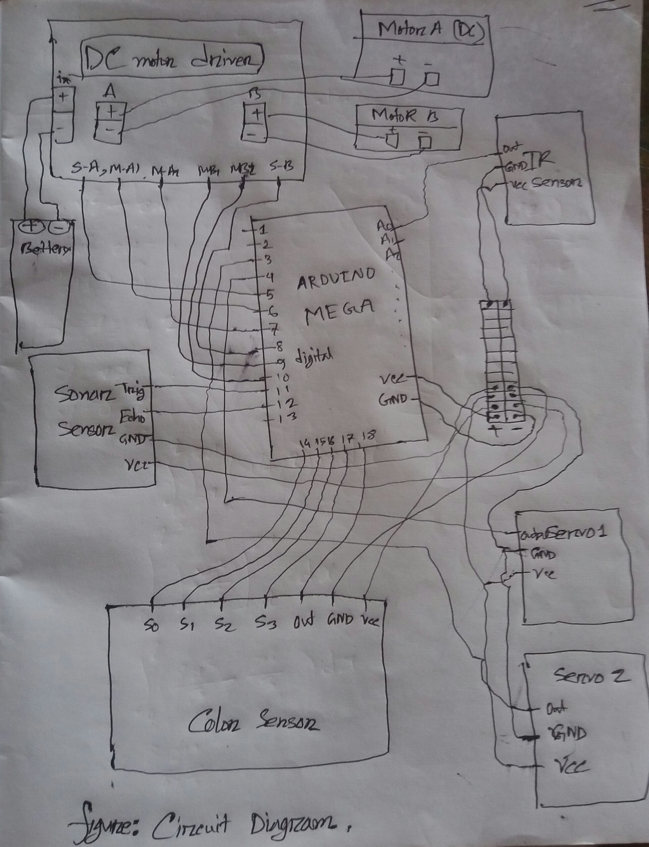
Circuit Diagram

Slide 7
Algorithm
State-01 :
The robot is always searching something and control his area. If found black area then go back and then go left and then round and search object. Also sonar sensor always test sonar signal and if got or detect something less than 10 cm then go strictly to the object slowly. and stop in front of the object and go to step-02.
State-02:
Detect object''s color. If color is true or wanted color then It go step -03. Otherwise it go back and then turn left and then go state-01.
State-03:
It start's sarvo1 motor down and then servo2 motor keep that means servo2 motor collect the object and then servo1 motor up and then the robot go forward untill black color detect . If black color detect the stop and go to state-04. Otherwise go to forwar.
State-04:
Servo1 motor down and servo2 motor out function call so that it can remove the object in the outside area. Then it go back and then start state-01.
Thus, Garbage collector robot works.

Slide 8
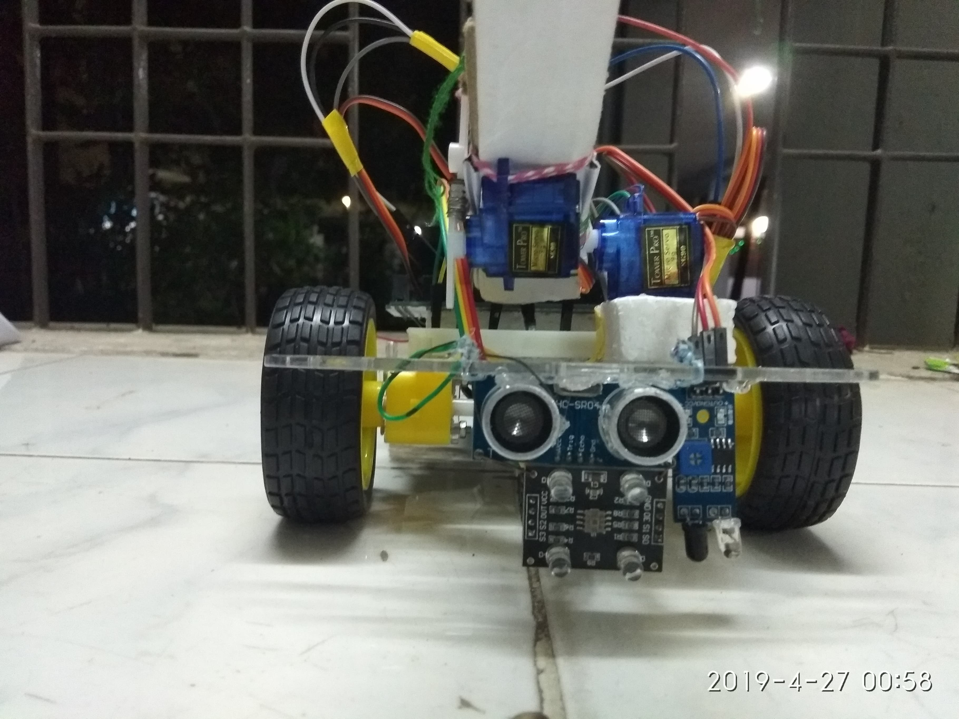
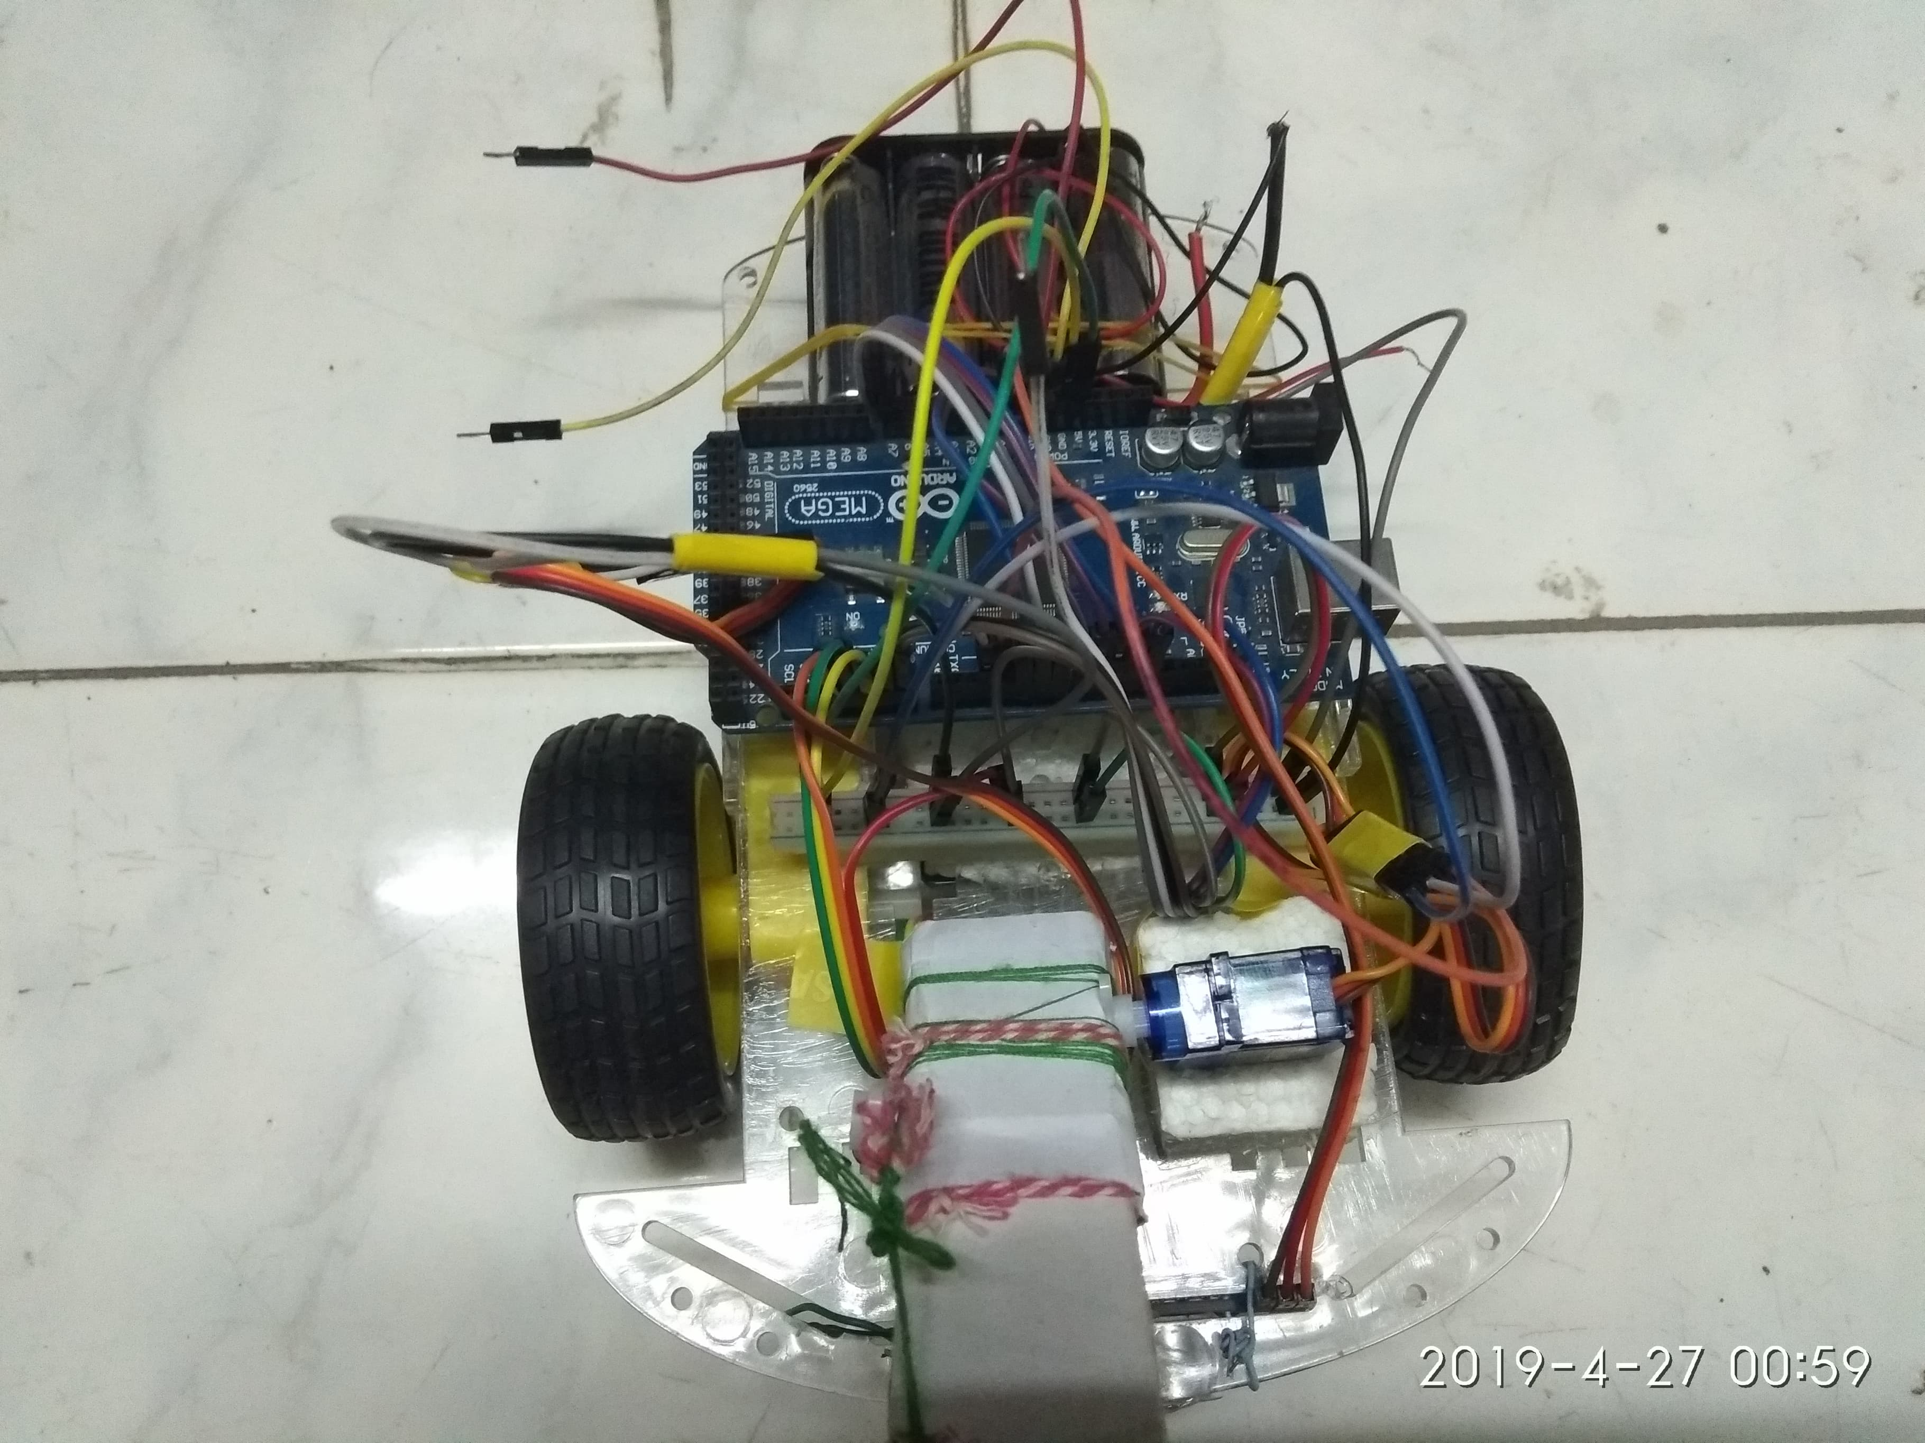
Bot Pic

Slide 9
Contribution

Slide 10


