Slide 1

EduInsight
A Predictive Analytics System for Student Performance Analysis
------------------------------------------------------------
Presented By: GUIDE:
B. SOWMIKA CH.RAVALI
24H71F0013 Assistant Professor

Slide 2
ABSTRACT
Executive Abstract
Problem & Need: In modern higher education, traditional evaluation systems monitor academic failure reactively after end-of-semester examinations take place. Consequently, faculty and administration lack early diagnostic tools to identify at-risk students before academic degradation becomes irreversible.
Proposed Solution: EduInsight is an AI-powered Decision Support System (DSS) developed using Laravel 12, Python Flask ML service, and MySQL. It continuously evaluates student attendance percentages, internal assessment marks, and exam records to calculate real-time risk scores.
Key Technologies: Full-stack PHP Laravel 12 framework, Scikit-Learn Random Forest Classifier (Flask API on Port 5005), Natural Language Processing (English-to-SQL parser), SMTP Email Engine, and Tailwind CSS Dual-Theme UI.
Core Benefits: Enables early advisory intervention, automates low-attendance email notifications to parents/students, provides 4 role-tailored dashboards (Admin, HOD, Faculty, Student), and delivers actionable academic recommendations.

Slide 3
Problem Statement & Institutional Challenges
1. Reactive Monitoring
2. Data Fragmentation
Current institutional systems evaluate performance post-examination, preventing timely counseling or academic remediation.
Attendance records, internal test marks, and course rosters exist in isolated spreadsheets with no unified analytics.
3. Communication Gaps
4. Query Barriers
Parents and department heads receive delayed alerts regarding student attendance deficits or failing grades.
Faculty & HODs must rely on SQL database administrators to extract custom academic reports or cohort analysis.

Slide 4
Existing System vs. Institutional Limitations
Traditional ERP Systems
Student Info Systems (SIS)
Basic LMS Tools
Focus purely on fee transactions and administrative registration. Lack predictive analytics or ML capabilities.
⚠️ Limitations:
• Manual Excel tracking • No predictive ML model • Delayed parent alerts • Static reporting templates
Store static demographic data. No automated risk detection or natural language querying.
⚠️ Limitations:
• Manual Excel tracking • No predictive ML model • Delayed parent alerts • Static reporting templates
Track assignment uploads. Do not synthesize multi-subject attendance and exam scores into unified risk scores.
⚠️ Limitations:
• Manual Excel tracking • No predictive ML model • Delayed parent alerts • Static reporting templates

Slide 5
Proposed EduInsight System
01
AI & ML Engine: Random Forest Classifier evaluates attendance & marks to output risk scores.
02
NLP Query Parser: Translates plain English queries into structured SQL SELECT statements.
03
Role Dashboards: Tailored portals for Admin, HOD, Faculty, and Student with real-time charts.
04
Recommendation Engine: Rule-driven advisory generator offering custom academic improvement steps.
05
Notification Dispatch: Automated SMTP email delivery for low attendance (<75%) & risk alerts.

Slide 6
Key Objectives
Predictive Risk Modeling
Natural Language Interface
Automated Alerts Engine
Train a Random Forest Classifier to categorize student academic risk (Low, Medium, High) based on real-time attendance and marks.
Implement an NLP parser (`NlpQueryParser`) to allow non-technical staff to query the database using plain English text.
Integrate SMTP notification delivery to send warning emails to students and parents when attendance drops below 75%.
RBAC Security Architecture
Modern Responsive UI
Enforce strict Role-Based Access Control across 4 user levels (Admin, HOD, Faculty, Student) with query scoping.
Develop an intuitive, dual Light/Dark theme user interface built with Tailwind CSS, Flowbite, and Alpine.js.

Slide 7
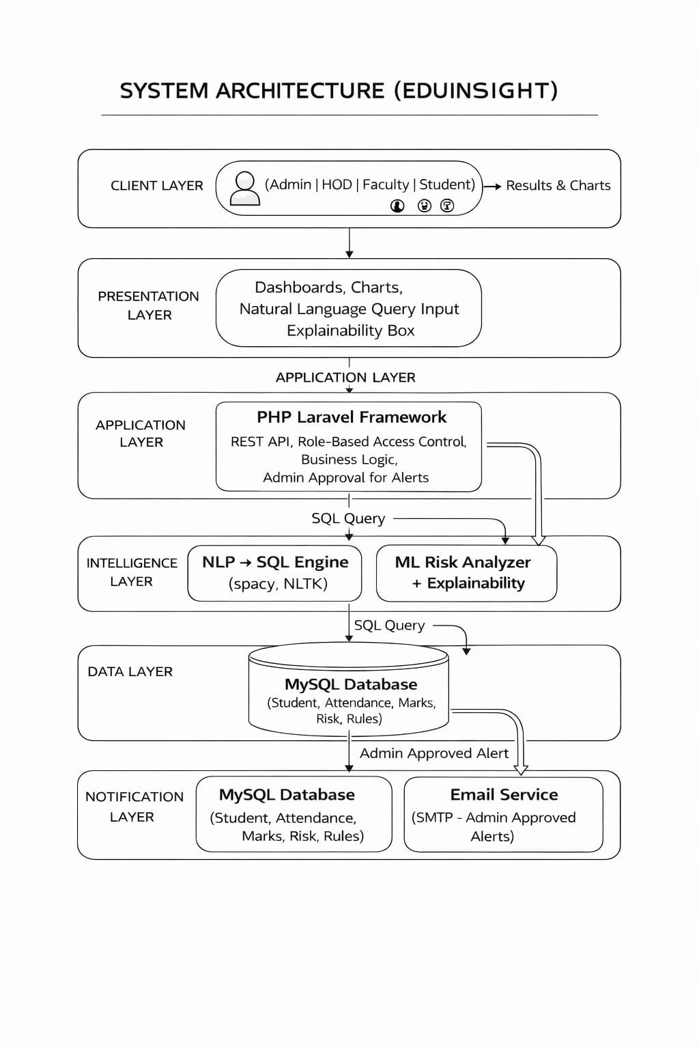
Enterprise 3-Tier System Architecture
MCA FINAL YEAR VIVA PRESENTATION
🔷 Presentation Layer (Frontend)
Tailwind CSS, Alpine.js, Flowbite, Chart.js
Dual Theme Engine (Light/Dark Switcher)
Responsive Mobile & Desktop Navbars
🔷 Application Layer (Backend Server)
Authentication Middleware (Auth & AuthRole)
NlpQueryParser Engine & Recommendation Service
SMTP Email Dispatcher & Audit Logger
🔷 AI Microservice & Database Layer
Random Forest Classifier (`risk_prediction_model.pkl`)
MySQL DB (`eduinsight`) with 222 Active Mapped Users
NL Query Logs & System Alerts Storage

Slide 8
Technology Stack
Backend Framework
AI & ML Microservice
✔ Laravel 12.x
✔ PHP 8.2 (CLI)
✔ Composer Package Manager
✔ RESTful Routing
✔ Python 3.10
✔ Flask Web API
✔ Scikit-Learn 1.3
✔ Joblib & NumPy
Database & ORM
Frontend & UI
✔ MySQL 8.0 Engine
✔ Laravel Eloquent ORM
✔ 222 Active Mapped Users
✔ SQL Migrations & Seeders
✔ Tailwind CSS 4.0
✔ Alpine.js 3.x
✔ Flowbite UI Library
✔ Chart.js 4.4 Data Charts

Slide 9
MODULES & OUTPUT

Slide 10
Complete System Modules Breakdown
Administrator Module
HOD Module
• Faculty Approval & Management • Course Catalog Maintenance • Student Roster & Enrollment • System Email Logs & Audit
• Department Performance Overview • Faculty Workload & Courses • Student Cohort Analytics • EduInsight AI Assistant
Faculty Module
Student Module
• Course Attendance Recording • Assessment Marks Entry • Student Risk Prediction • Class Email Dispatch
• Personal Performance Dashboard • Marks & Attendance Tracker • Risk Advisory & Recommendations • Notifications Center

Slide 11
Administrator Management Workspace
MCA FINAL YEAR VIVA PRESENTATION
Faculty Approvals
Course Management
Approve or reject pending faculty registrations and assign maximum student advisory capacity.
Create, update, and manage academic course catalogs, credit allocations, and faculty assignments.
Student Directory
Email Delivery Logs
Access comprehensive student records across all programs (B.Tech CSE, IT, MCA, MBA).
Audit system-wide email notifications, delivery status (`sent`/`failed`), and SMTP logs.

Slide 12
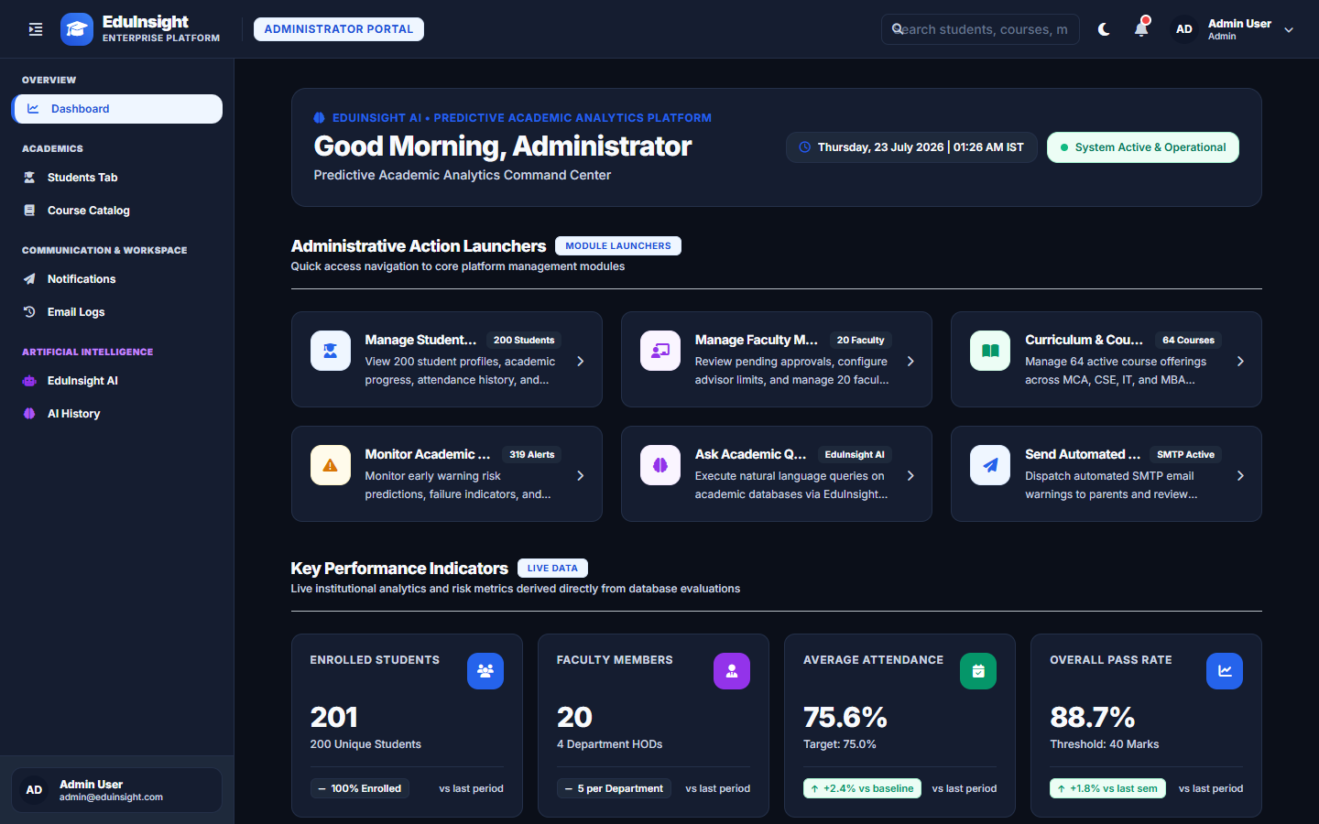

Slide 13
Faculty & HOD Intelligence Workspaces
Attendance Entry
Marks Entry
Record date-wise class attendance with automatic percentage calculations.
Input internal and external examination scores with instant grade generation.
ML Risk Trigger
Department Analytics
Execute 1-click risk predictions calling Python ML API for enrolled students.
HOD overview tracking department-wide pass percentages, attendance, and AI queries.

Slide 14
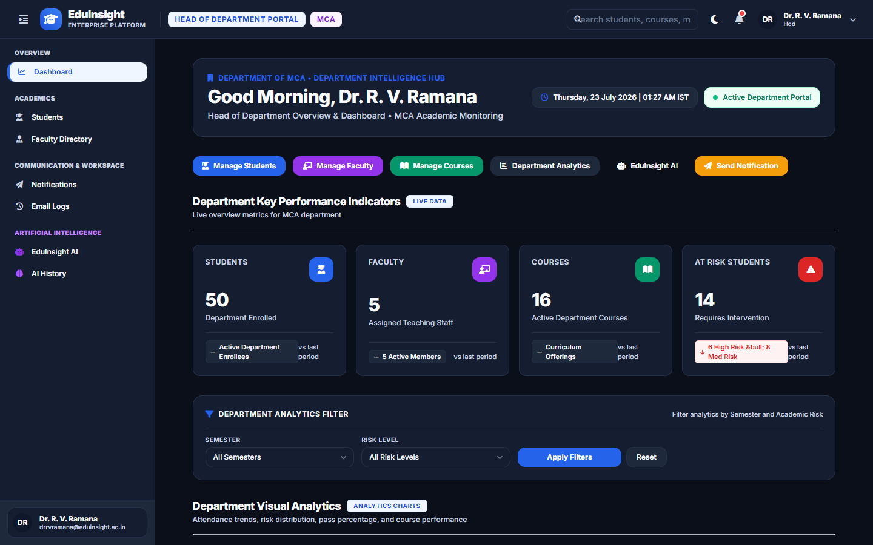

Slide 15
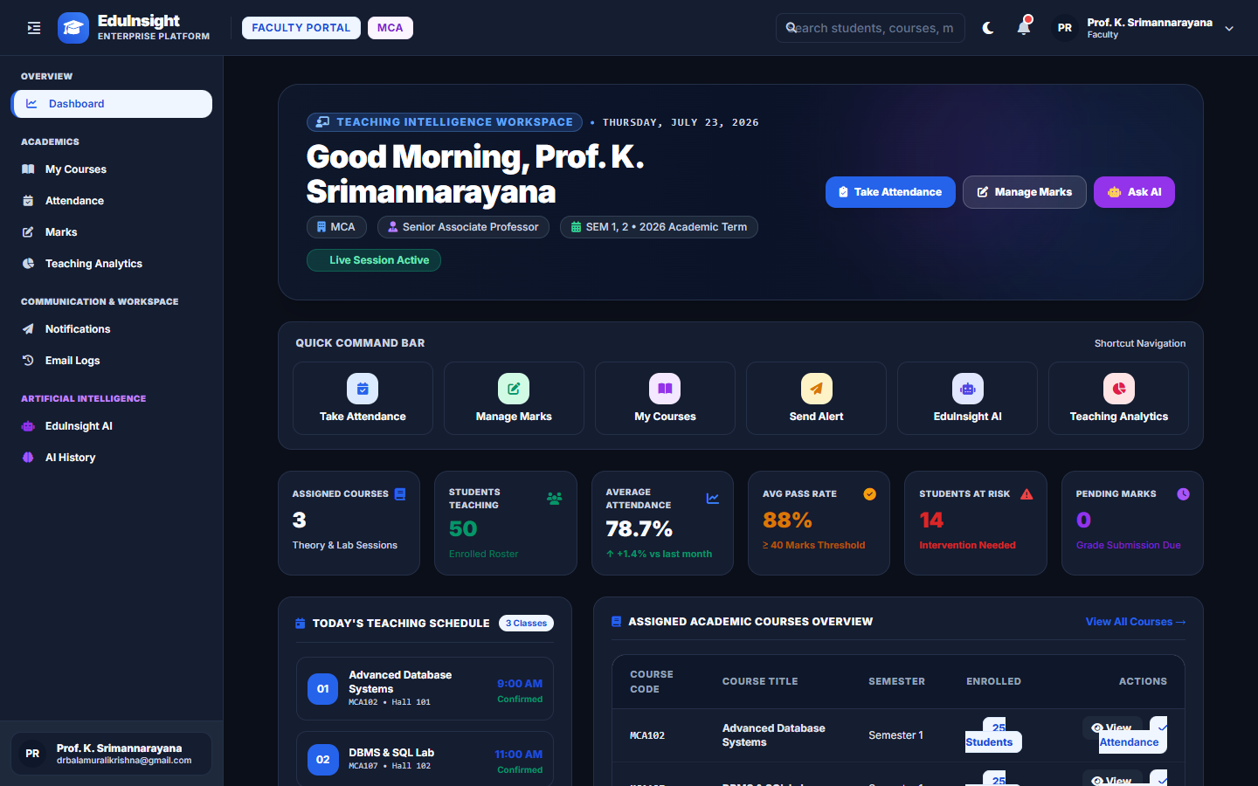

Slide 16
Student Personal Intelligence Portal
Executive Dashboard
Attendance & Marks
Track CGPA, current semester GPA, overall attendance percentage, and active risk level.
Detailed subject-wise breakdown of attendance history and midterm/final examination grades.
Risk & Recommendations
Scoped AI Assistant
View AI-predicted academic risk score and customized study recommendations.
Ask questions about personal academic performance with automatic query security scoping.

Slide 17
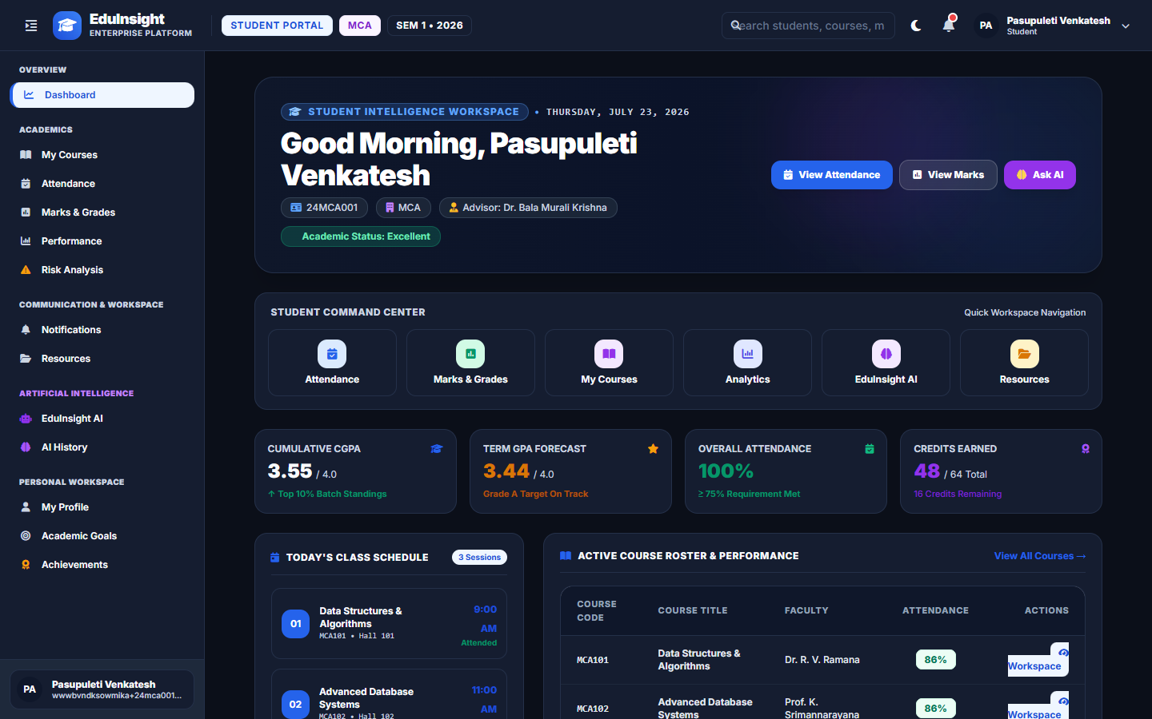

Slide 18
Artificial Intelligence & Analytics Modules
1. Natural Language Processing (NLP)
2. Machine Learning Risk Classifier
Translates English text prompts into executable SQL queries (`NlpQueryParser.php`). Eliminates need for manual SQL knowledge.
Random Forest model (`risk_prediction_model.pkl`) evaluates attendance and marks to output numerical risk score (0-1).
3. Recommendation Engine
4. Decision Support System (DSS)
Generates contextual academic improvement plans based on student attendance thresholds and exam performance.
Synthesizes multi-dimensional student data into role-based interactive Chart.js analytics for department heads and faculty.

Slide 19
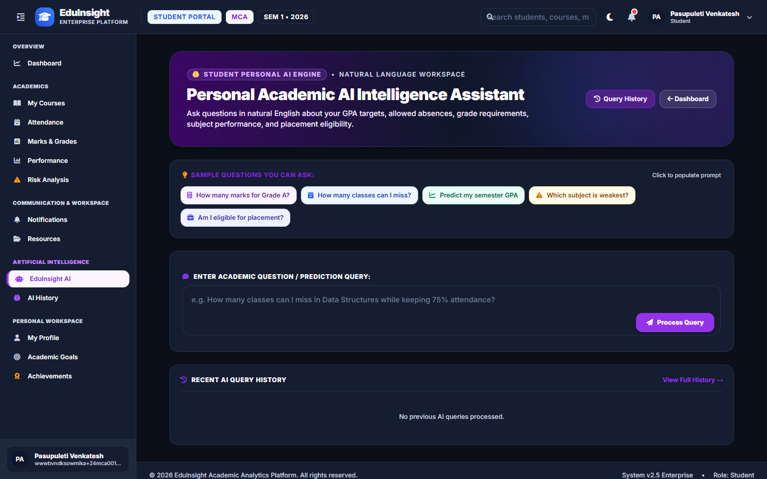

Slide 20
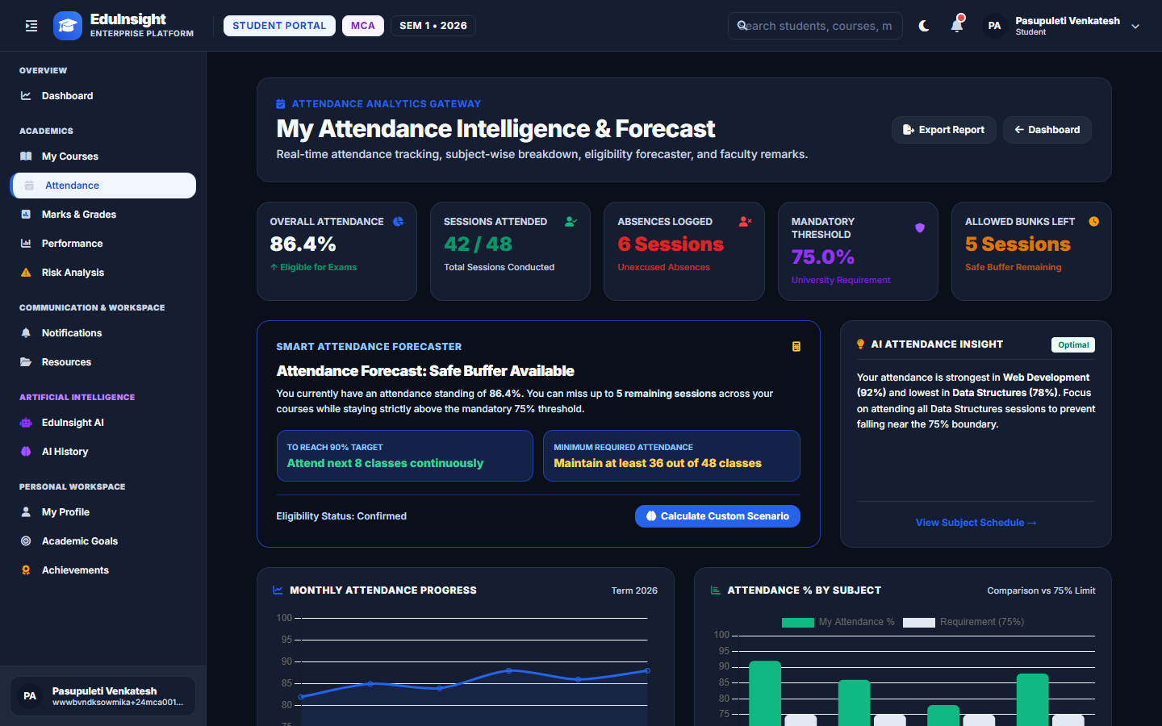

Slide 21
Natural Language Processing (NLP) Execution Flow
Step 1: User Input
Step 2: Intent Parsing
Step 3: SQL Generation
User submits plain English prompt (e.g. 'Show low attendance students').
`NlpQueryParser` analyzes intent, key entities, and conditions.
Converts parsed entities into valid MySQL `SELECT` query statement.
Step 4: RBAC Scoping
Step 5: DB Execution
Step 6: Visualization
Applies `WHERE student_id = X` if query is executed by a student.
Queries MySQL database engine and formats output array.
Renders results into formatted data tables & Chart.js charts.

Slide 22
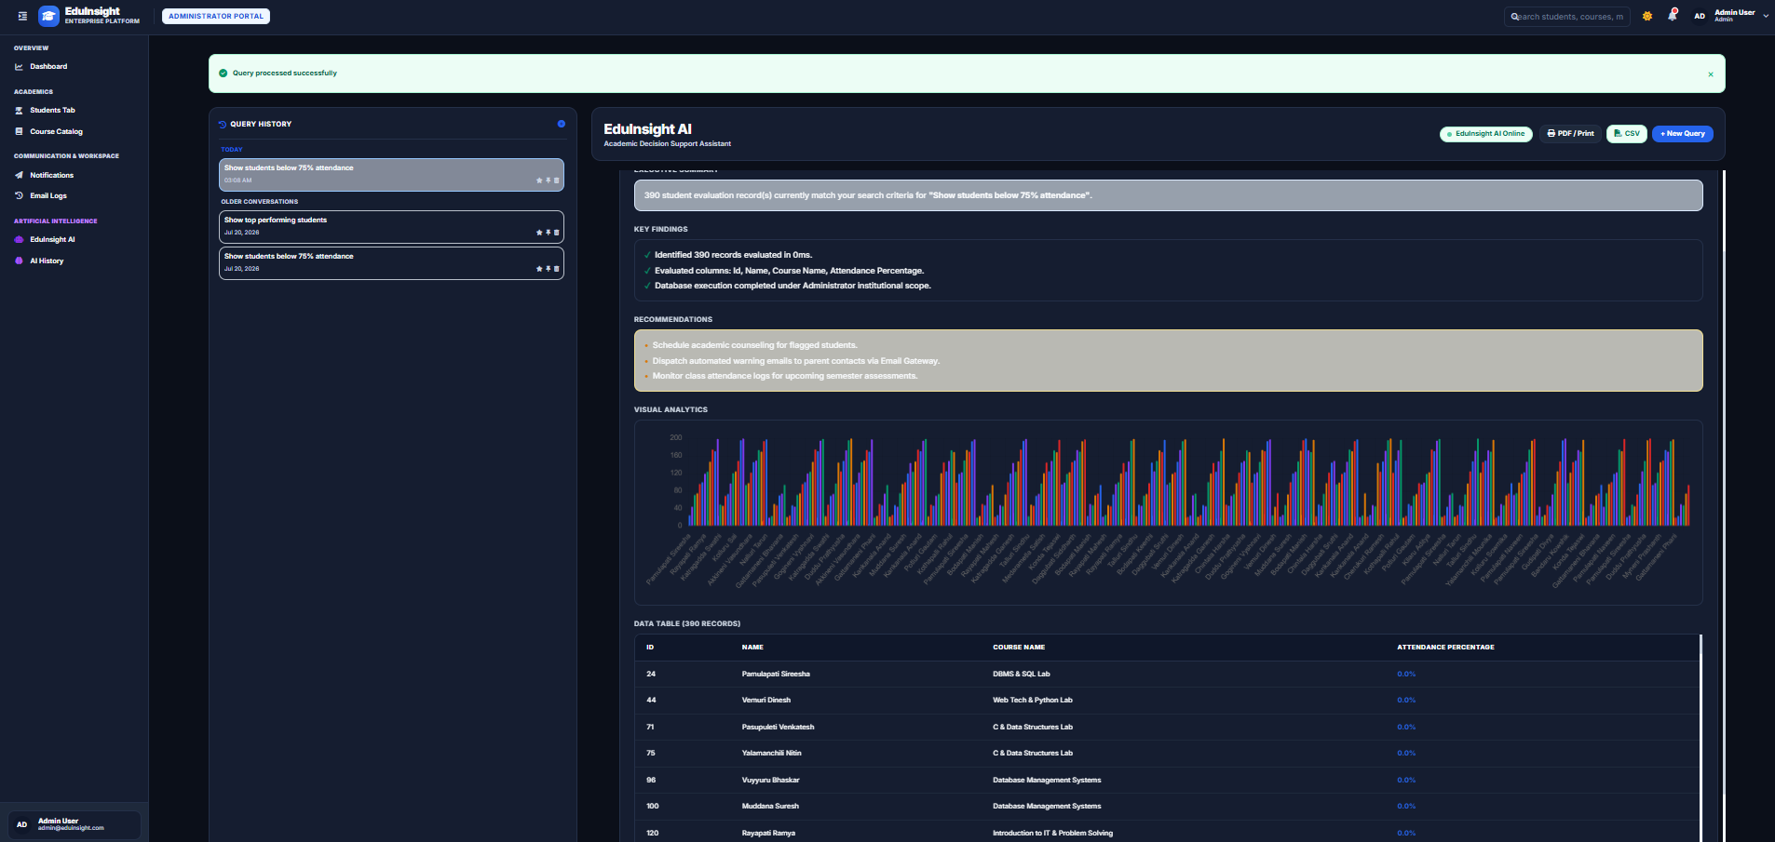

Slide 23
Database Design & Entity Relationships
🗄️ Users & Roles
🗄️ Students , Faculty & HOD
🗄️ Courses & Enrollments
Primary auth table (`role_id` 1=Admin, 2=Faculty, 3=HOD, 4=Student). Stores email & password hash.
Profile tables linked 1-to-1 with `users`. Contain employee IDs, batch, program, & semester.
Stores course codes (e.g., CS201), credits, faculty assignment, & student course enrollments.
🗄️ Marks & Attendance
🗄️ Academic_Risks & Alerts
🗄️ NL_Queries & Email_logs
Stores internal/external marks, grades, and date-wise attendance status (`present`/`absent`).
Stores ML risk scores, risk levels (`Low`, `Medium`, `High`), recommendations, & warning alerts.
Logs natural language AI queries, generated SQL, execution time, and SMTP email logs.

Slide 24
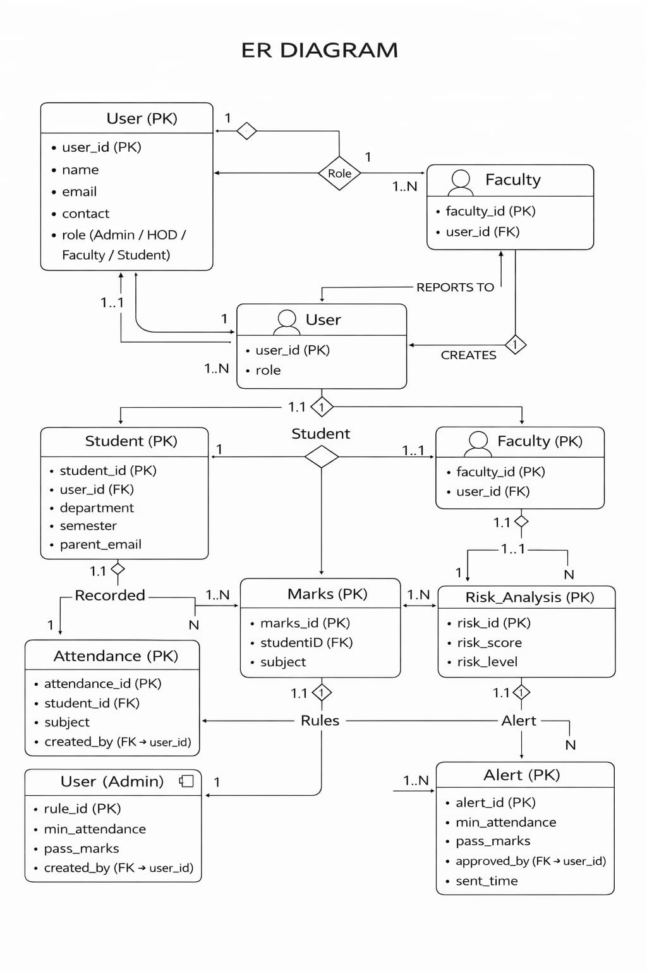

Slide 25
Recommendation Engine Logic & Rules
1. Data Ingestion: Ingests attendance percentage, internal test marks, and external exam scores.
2. Rule Evaluation: Evaluates against institutional criteria: - Attendance < 60% (Critical Warning) - Total Marks < 40 (Failing Risk)
3. Risk Classification: Maps student status into Low Risk, Medium Risk, or High Risk.
4. Advisory Generation: Outputs actionable improvement steps: - 'Schedule advisor session' - 'Enroll in remedial tutoring'
5. Portal Delivery: Displays advisory on Student & Faculty dashboards and dispatches email notifications.

Slide 26
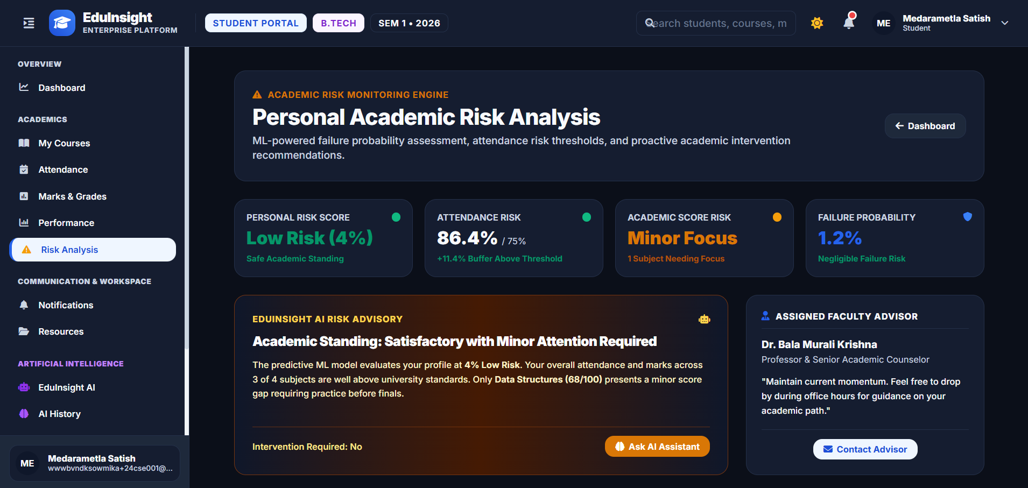

Slide 27
Challenges & Future Enhancements
⚡ Challenges Overcome
🚀 Future Roadmap
1. Dynamic Risk Prediction: Integrating Python ML microservice seamlessly with PHP Laravel backend.
2. Natural Language Parsing: Implementing robust English-to-SQL intent mapping without external API dependencies.
3. RBAC Security Scoping: Ensuring strict data isolation for student queries.
4. Theme Consistency: Building bulletproof CSS overrides for instant Light/Dark mode switching.
1. LLM Integration: Upgrade NLP parser with fine-tuned LLaMA / DeepSeek models for conversational AI.
2. Native Mobile Application: Build Flutter / React Native mobile app for push notifications.
3. University ERP Integration: Connect directly with SAP / Banner institutional ERP databases.
4. Explainable AI (XAI): Implement SHAP values to explain specific risk score drivers to faculty.

Slide 28
Thank You!
EduInsight: A Predictive Analytics System for Student Performance Analysis

