Slide 1

Department of Electronics and Communication Engineering
Smart shopping cart: Enhancing Retail Experience with IOT and automated Billing
Name of the Guide
Mr. Mohammed Abdul Aziz
Asst. Prof
Students Name and Roll Numbers
1. 218T1A0480(M.Sowmika)
2.218T1A0483(M.Venkata Subhash)
3.218T1A0453(A.S.N.M.Vasanth)
4.218T1A0490(P.Yaswanth)

Slide 2
Contents
Abstract
Introduction
Literature survey
Problem statement
Existing methodology
Proposed methodology
Results
Future scope
Conclusion
References

Slide 3
Abstract
With the increasing number of shoppers in urban areas, especially during holidays and special promotions, long queues at supermarket checkout counters have become a major inconvenience.
Traditional shopping methods require customers to manually collect items, carry a basket or cart, and wait in long lines for billing, which results in inefficiencies and wasted time. To address these challenges, this research proposes the development of a smart shopping basket integrated with barcode scanning and real-time billing features.
By integrating real-time price calculation, automated billing, and IoT-based data transfer, this smart shopping basket enhances convenience, reduces shopping time, and improves the overall retail experience.
This innovation aims to revolutionize supermarket shopping by introducing a seamless, efficient, and user-friendly alternative to traditional checkout systems.

Slide 4
Introduction
The current shopping system struggles with the time-consuming billing process and the need for trolleys with children.
A project aims to reduce this by implementing an automatic billing system using RFID technology.
The system also allows trolleys to move based on WiFi signal strength, allowing customers to shop conveniently while their children are present.
This innovative solution improves the shopping experience. The Internet of Things (IoT) is a network of devices with sensors, processing capabilities, and software that connect and exchange data over the internet.
IoT applications offer significant value in our lives, with wireless networks, superior sensors, and computing capabilities.
With billions of everyday objects equipped, IoT applications could become the next frontier.

Slide 5
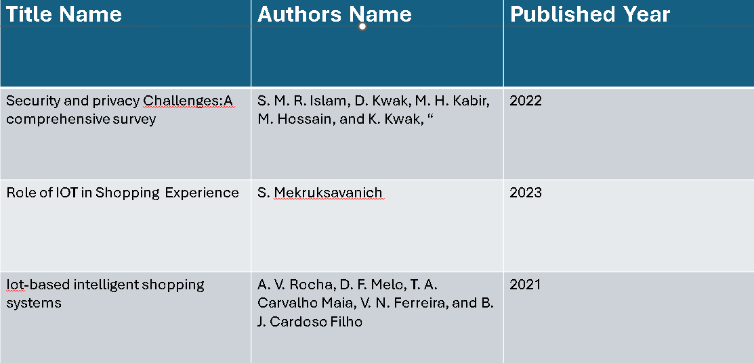
Literature Survey

Slide 6
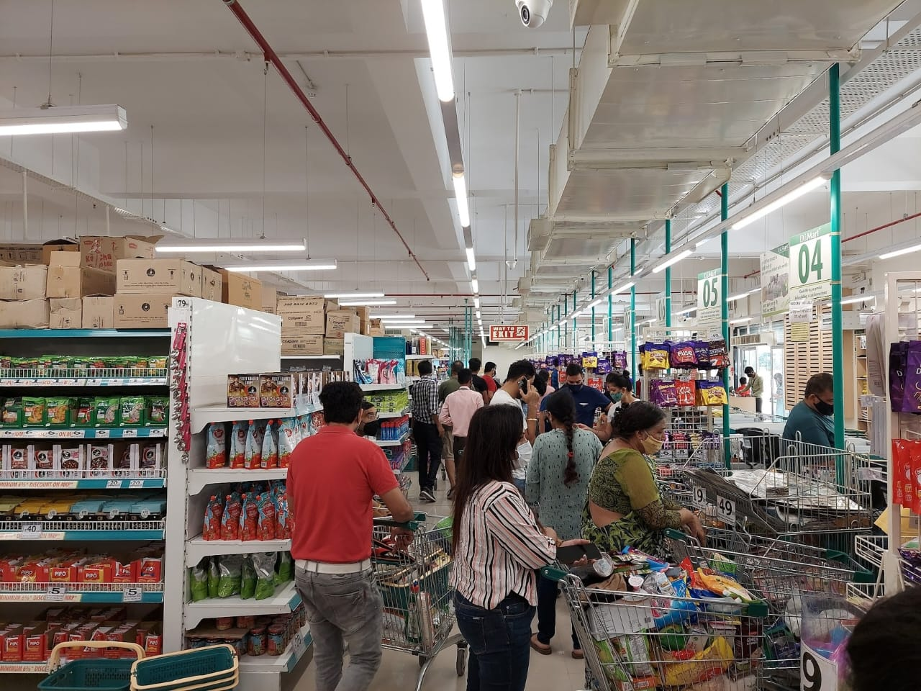
Problem statement
Customers often face long checkout queues due to the manual billing process, leading to inconvenience and time wastage.
Additionally, carts lack smart features such as automatic product detection and real-time billing updates.
The waiting time and congestion can make shopping a stressful experience.
Customers may avoid physical stores and prefer online shopping due to inefficiencies.

Slide 7

Shopping carts, while widely used, come with several disadvantages.
Maneuvering heavy carts can be physically demanding, especially for elderly shoppers.
Moreover, hygiene remains a major issue, as multiple users frequently touch cart handles, increasing the risk of germ transmission.
These challenges highlight the need for an innovative smart shopping cart system that enhances efficiency, security, and customer experience."

Slide 8
Existing Methodology
Product Scanning with Barcode Technology:
Customers use a barcode scanner integrated into a mobile application to scan product barcodes as they place items in the smart shopping basket.
Weight Sensor Verification:
A weight sensor (load cell) is installed at the base of the shopping basket. The weight of the added products is recorded and compared with the expected weight from the barcode database to ensure accuracy and prevent fraud.
Real-Time Data Processing and Billing:
The scanned product details and total cost are processed by a microcontroller and stored in memory.
Wireless Communication and IoT Integration:
The basket communicates wirelessly with the store’s central computer using Wi-Fi or another communication protocol.

Slide 9
Proposed Methodology
The system begins with the customer connecting their smartphone to the trolley using a QR code, establishing a secure link between the trolley and the mobile application. This application manages billing, tracking, and user preferences throughout the shopping process.
Once connected, the trolley autonomously follows the customer using Wi-Fi communication and its signal strength by having threshold values, eliminating the need for manual pushing.
The trolley adjusts its speed and position based on real-time data, ensuring smooth and effortless movement. Instead of traditional barcode scanning, RFID technology is used to automatically detect product prices, allowing seamless item addition without manual intervention. The total bill is continuously updated and displayed on the mobile app, enabling customers to track their expenses in real time.
Finally, the billing process is completed digitally, allowing customers to pay directly through the application, avoiding long queues and crowded checkout areas.

Slide 10
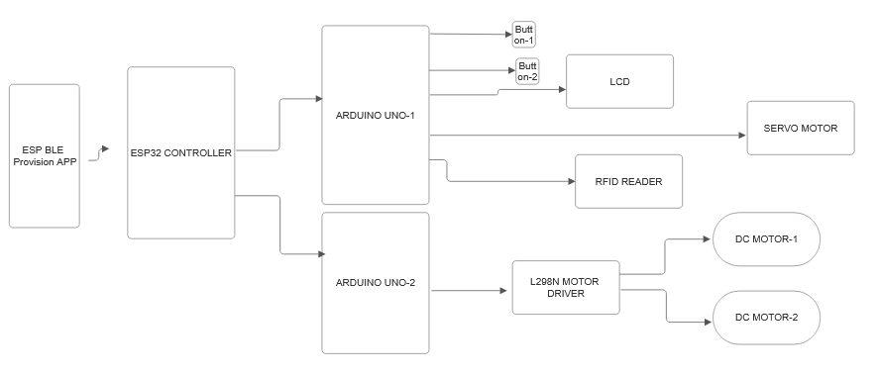
Block Diagram

Slide 11
Explanation
ESP32 is responsible for communication with a mobile device. It connects via WiFi/Bluetooth to transfer shopping cart data
Arduino UNO controls all operations including motor movement, RFID scanning, and display updates also sends control signals to the motor driver and RFID reader.
Motor driver L298n receives control signals from Arduino Uno and converts the signals into motor power to drive the DC motors.
RFID System (Product Detection) scans RFID tags attached to products in the shopping cart and sends item details to Arduino for further processing.
Switch Button (ON/OFF Control) used for powering ON/OFF the RFID reader. When ON, the RFID reader scans product tags. When OFF, scanned product will be removed.
LCD Display (User Interface) shows product details, total cost, and cart status after scanning.

Slide 12
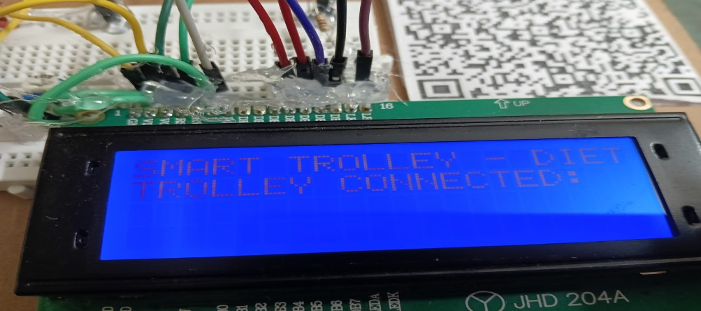
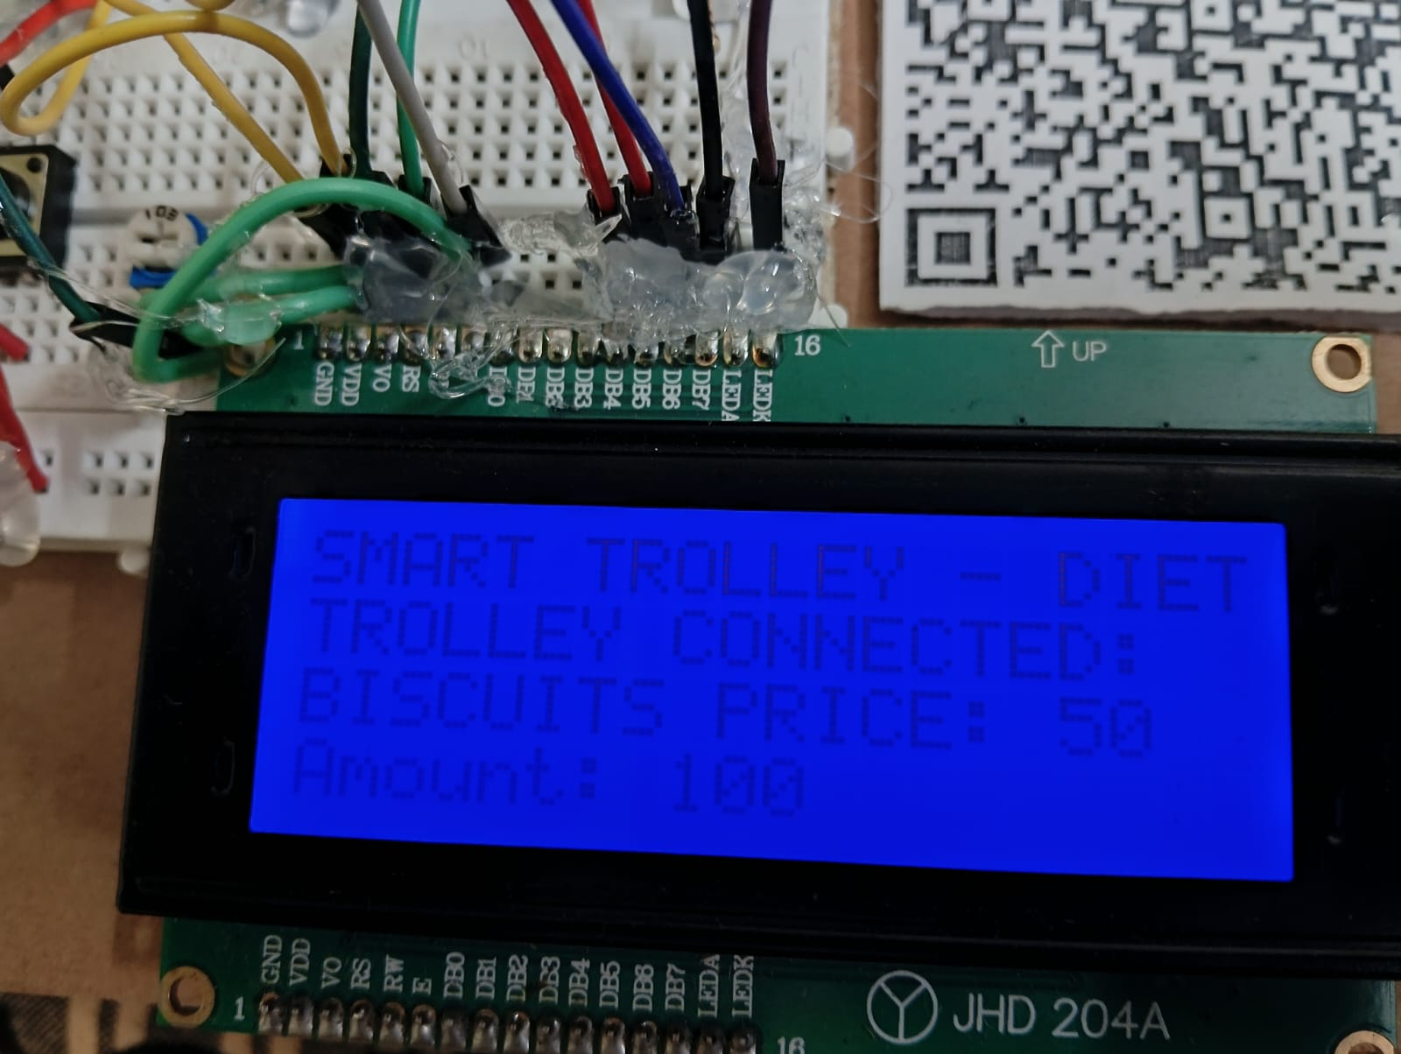
Results
The "SMART TROLLEY - DIET" is a smart shopping trolley system. The trolley has successfully established a connection with a server, database, or user authentication system.
The RFID tag scans an item, detecting product details. The LCD screen displays the item name, price, and total amount. The servo motor gently opens, allowing the product to be placed inside the trolley.

Slide 13
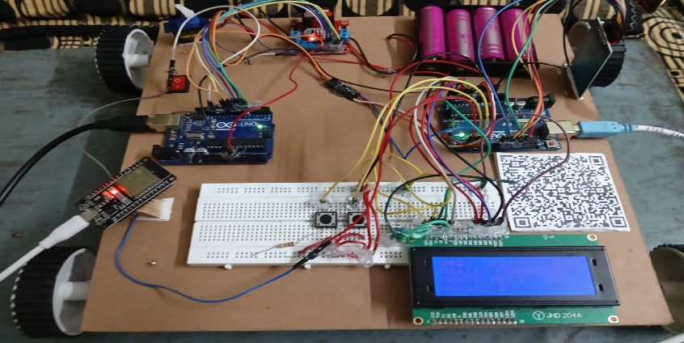

Slide 14
Conclusion
By enabling customers to connect their smartphones to the trolley via a secure QR code link, the system ensures seamless interaction throughout the shopping process.
The trolley's autonomous movement, powered by Wi-Fi communication and real-time data processing, eliminates manual pushing and allows effortless navigation based on predefined thresholds.
Replacing traditional barcode scanning with RFID technology further enhances efficiency by automatically detecting product prices and updating the total bill in real time.
This approach reduces errors, minimizes manual intervention, and ensures accurate expense tracking for customers via the mobile application.
The final step of digital billing simplifies the checkout process, allowing customers to pay directly through the application, thereby eliminating long queues and crowded counters.

Slide 15
References
A. Kumar, A. Gupta, S. Balamurugan, S. Balaji, and R. Marimuthu, “Smart shopping cart,” in 2017 International conference on Microelectronic Devices, Circuits and Systems (ICMDCS), Aug 2017, pp. 1–4.
S. Karjol, A. Holla, and A. c b, An IOT Based Smart Shopping Cart for Smart Shopping, 04 2018, pp. 373–385.
P. Chandrasekar and T. Sangeetha, “Smart shopping cart with automatic billing system through rfid and zigbee,” 2014 International Conference on Information Communication and Embedded Systems, ICICES 2014, 02 2015.
S. Nitnaware, “Smart trolley using iot,” International Journal for Research in Applied Science and Engineering Technology, vol. V, pp. 1990– 1991, 10 2017.
W. Shi, J. Cao, Q. Zhang, Y. Li, and L. Xu, “Edge computing: Vision and challenges,” IEEE Internet of Things Journal, vol. 3, no. 5, pp. 637–646, Oct 2016.

Slide 16
Thank You

