Slide 1
Real-Time Defect Detection in Check Valve Manufacturing
Using QR Code & Machine Learning
By [SOWMI R]

Slide 2
Problem Statement
• Manual quality checks are slow and error-prone
• Incorrect products can be dispatched unknowingly
• Need for a fast, automated defect detection system

Slide 3
Proposed Solution
• Encode product measurements in QR codes
• Scan QR to extract measurement data
• Use ML model to predict defective products
• Display result instantly in a Streamlit app

Slide 4
Technologies Used
• Python (Pandas, NumPy, scikit-learn)
• OpenCV (QR decoding)
• qrcode (QR generation)
• Streamlit (Web App UI)
• Excel (Data Input)

Slide 5
Dataset & Features
• valve_id
• body_height
• inlet_radius
• outlet_radius
• disc_thickness
• spring_length
• Target: Defective (1) / Not Defective (0)

Slide 6
Model Training
• Algorithm: K-Nearest Neighbors (KNN)
• Used GridSearchCV for hyperparameter tuning with accuracy of 0.99%
• Model saved using Pickle for prediction use

Slide 7
System Architecture / Flow
1. Prepare data from Excel
2. Generate QR for each product
3. Scan QR code using Streamlit app
4. Extract data and predict using ML model
5. Show prediction: ❌ Defective or ✅ Not Defective

Slide 8
Final Output Demo
• Upload QR code image in Streamlit app
• View extracted measurements
• View model prediction
• Example outputs for both Defective and Not Defective valves

Slide 9
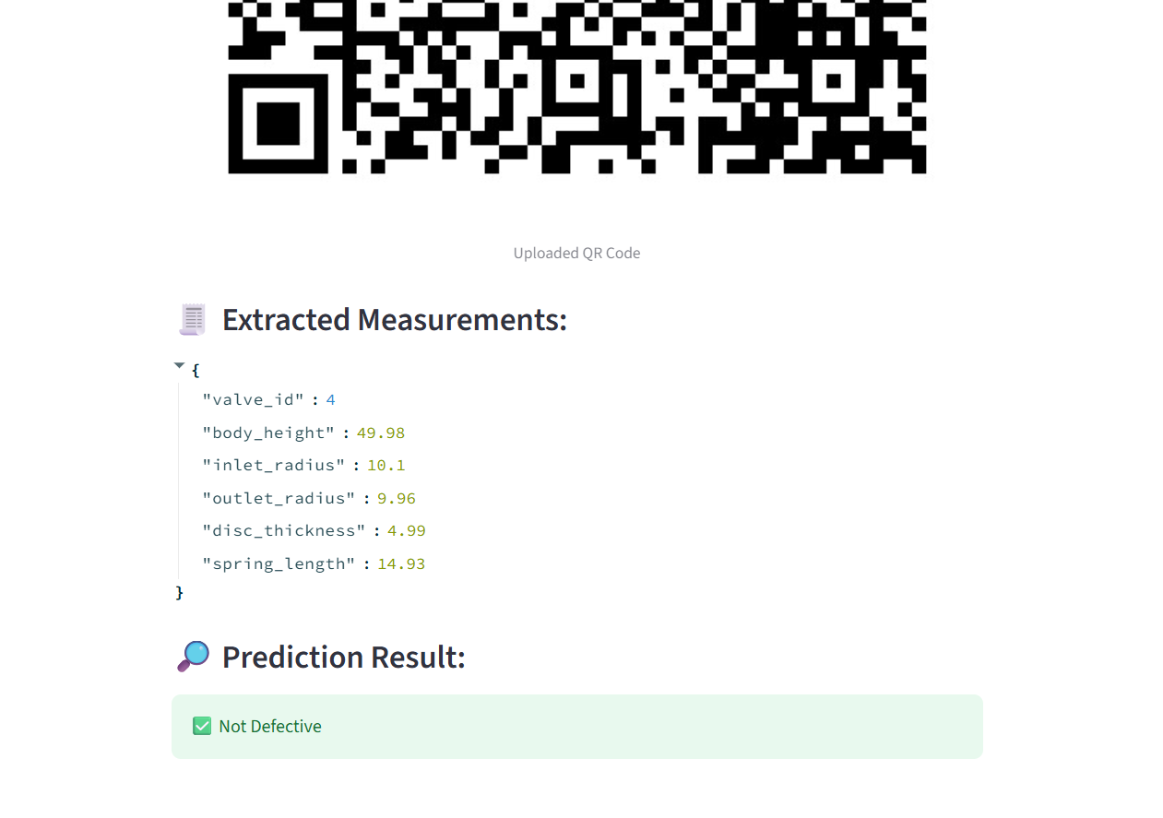

Slide 10
Conclusion & Future Scope
• Project automates defect detection from QR
• Saves time and reduces manual errors
• Future: Add batch scanning, real-time dashboard, and IoT integration

