Slide 1


Personal Finance Management
Personal finance management is the process of planning, budgeting, saving, investing, and protecting your financial resources to achieve your financial goals and improve your overall financial well-being.
Name: SOWMIYA P D
Date Submitted: 09-07-2024

Slide 2
Business Problem and Problem Statement
Managing personal finances can be complex and challenging.
Difficulty in maintaining accurate records of income, expenses, and savings.
Existing financial tools are often too complex or costly.
Need for a simple, cost-effective solution for financial tracking and reporting.

Slide 3

Project Description
Budget Tracking
Analytical Insights
Provide a user-friendly interface to track income, expenses, and savings, helping users stay on top of their financial activities.
Generate detailed reports and visualizations to help users understand their spending patterns, identify areas for improvement, and make informed financial decisions.
1
2
3
Goal Setting
Enable users to set personalized financial goals, such as debt reduction, retirement planning, or saving for a down payment on a house.

Slide 4
Main Functionalities
1
Add Income
Record income amount and description..
2
Add Expense
Record expense details, including category.
3
Add Saving
Record saving amount and description.
4
View Transaction
View all incomes, expenses, and savings.
5
View Balance
Display current available balance.

Slide 5

Additional Functionalities
6
Generate Monthly Income
Summarize incomes, expenses, and savings for a specified month
7
View Saved Reports
Access previously saved monthly financial reports
8
User Authentication
Ensure secure access to the application...
9
Logout
Securely exit the application.

Slide 6

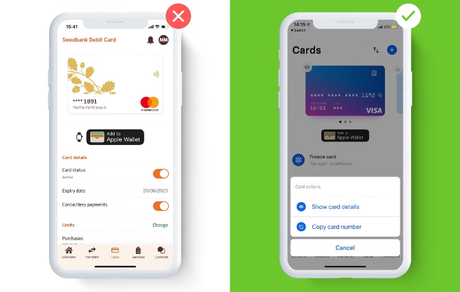
Input Versatility
Manual Entry
Allow users to manually input income, expenses,
and savings.
Flexibility
Accommodate a wide range of financial situations, from simple to complex, to meet the needs of diverse users.
Customization
Enable users to personalize the app to their specific preferences and financial goals.

Slide 7


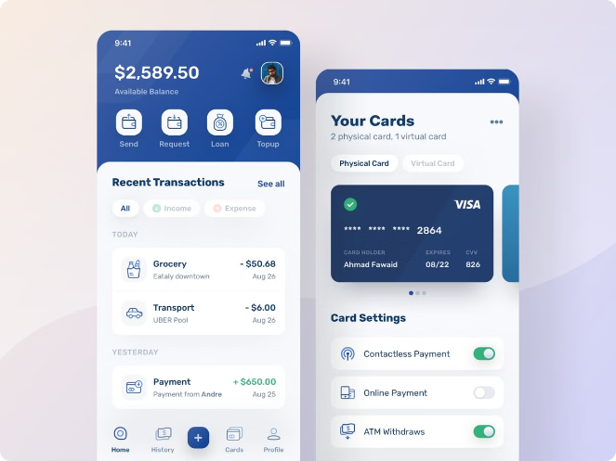



Error Handling
Validation
Implement robust data validation to
ensure accurate and complete user input.
Error Messages
Provide clear and helpful error messages to
guide users in resolving any issues.
Retry Functionality
Allow users to easily correct and resubmit
any erroneous information.
Customer Support
Offer a dedicated support channel for users
to get assistance with any problems.

Slide 8



Exception Handling
File Errors
Exception handling for file operations to manage potential errors
Managing file not found errors during report loading
Invalid Entries
Handling invalid amount entries.

Slide 9
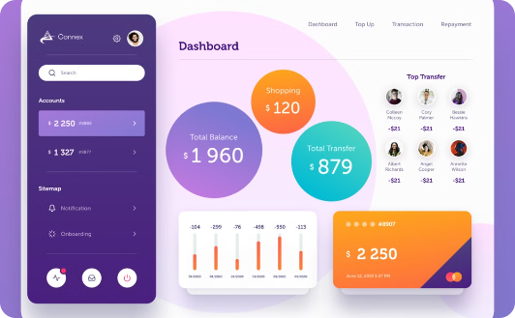
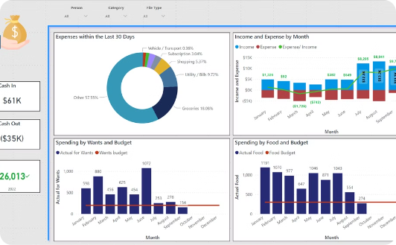
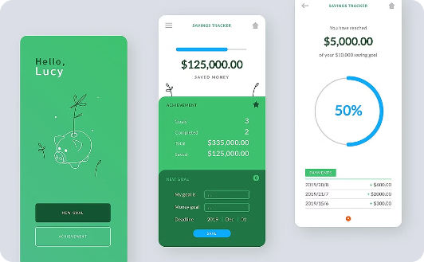
Results and Outcomes
Results Achieved
Outcomes
Visuals
Effective tracking of incomes, expenses, and saving. Detailed monthly financial reports.
Users can make informed financial decisions. Improved financial planning and budgeting.
Example report summaries, balance updates.

Slide 10

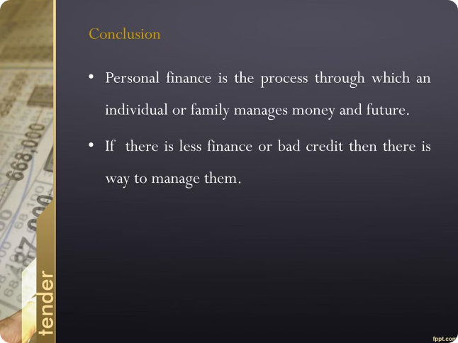
Conclusion
1
Summary:
Developed a user-friendly personal finance management application. Provided tools for accurate financial tracking and reporting
2
Significance:
Helps users gain control over their finances. Simplifies financial management.
3
Future Development:
Potential for additional features like graphs and charts. Integration with online banking for automatic transaction updates.

Slide 11

THANK
YOU

