Slide 1
Smart River Cleaning Boat
Sowmiya Ashokkumar
Deepika
sanjana
Anand Institute of higher technology

Slide 2
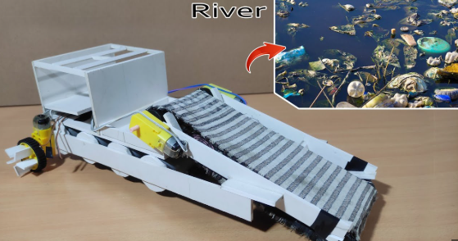
Problem Statement
Water pollution caused by floating waste in rivers and lakes poses severe environmental and health risks. Manual cleaning is inefficient, costly, and dangerous.
Need: A smart, automated, and cost-effective system to clean and sort river waste.

Slide 3
Proposed Solution
Develop a remote-controlled boat equipped with a conveyor mechanism to collect waste.
- Gesture-controlled navigation using Bluetooth and mobile app
- Raspberry Pi for camera-based waste detection
- Real-time segregation of plastic and organic waste
- Expandable system with solar power and automation

Slide 4
Hardware Components Used
- Arduino Uno
- Raspberry Pi 3/4
- DC Motors, Servo Motor
- RF or Bluetooth Module (HC-05)
- Camera Module
- L298N Motor Driver
- IR/Ultrasonic Sensors
- Battery, Propellers, Frame

Slide 5
Working Model
1. User controls boat via mobile app (J-Robot)
2. Arduino receives gesture commands via Bluetooth
3. Raspberry Pi processes camera feed to classify waste
4. Conveyor lifts and segregates waste accordingly
5. Waste is collected in separate onboard bins

Slide 6
Raspberry Pi – Waste Detection Logic
- OpenCV-based color or object detection
- Identifies plastic vs organic
- GPIO triggers motorized sorting mechanism
- Optional: Integrate ML model for better classification

Slide 7
Future Scope
- GPS tracking for autonomous navigation
- Solar panel integration for sustainable power
- App-based live monitoring of trash collection
- Improved AI for multi-type waste classification

Slide 8
Thank You!
Connect with me:
LinkedIn: linkedin.com/in/sowmiya-ashokkumar
Email: sowmiyaashokkumar@gmail.com
Happy to collaborate and improve this project!

