Slide 1
Data Science Capstone Project
-SowmIya. r

Slide 2
INTRODUCTION
This project focuses on evaluating sports performance data through two key datasets: players and games.
By leveraging Python libraries like Pandas, the analysis delves into comprehensive exploration and transformation of these datasets to extract valuable insights.
The study aims to tackle business or performance-oriented challenges using statistical methods, data visualization, and advanced processing techniques.
This systematic approach is designed to deliver meaningful, actionable outcomes for strategic decision-making in sports analytics.

Slide 3
Agenda
Project Title:
Sports Performance Analysis: Data-Driven Insights for Decision-Making
Objective:
Analyze players and games datasets to uncover trends, patterns, and actionable insights,
supporting performance improvement and strategic decisions.
Key Deliverables:
Exploratory Data Analysis (EDA)
Statistical Analysis
Insights and Recommendations
Interactive Visualizations (Tableau/Excel)
Tools and Technologies:
Python (Pandas, NumPy, Matplotlib, Seaborn)
Tableau, Excel

Slide 4
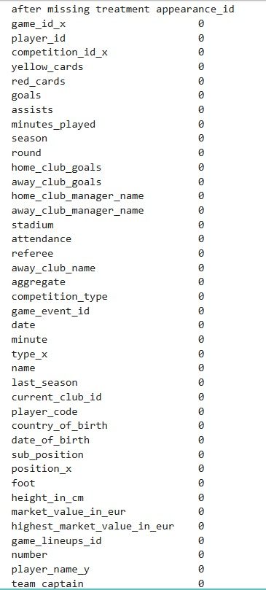
Data Preprocessing
Data Preprocessing :Data preprocessing is the essential step of preparing raw data for analysis. It involves:
Cleaning: Removing missing, duplicate, or irrelevant data.
Transformation: Normalizing, scaling, or encoding data to make it usable.
Reduction: Reducing data size while keeping valuable information (e.g., feature selection).
This ensures the data is accurate, consistent, and suitable for analysis or modeling.

Slide 5
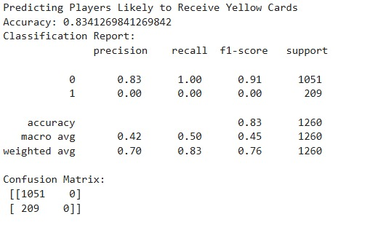
PERFORMANCE ANALYSIS
Predict players likely to receive yellow cards
Interpretation:
Logistic regression identifies the likelihood of a player receiving a yellow card based on factors like minutes played, goals, and red cards. The model highlights key predictors, but recall could improve with more data.

Slide 6
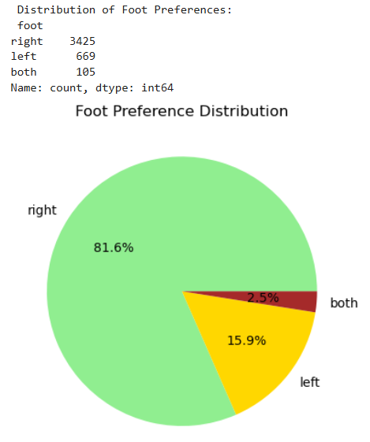
Player Profile and Market Value
Distribution of foot preferences among players
Interpretation:
The distribution of players’ preferred foot shows a dominance of right-footed players, with a significant share of left-footed and ambidextrous players, which informs scouting and team-building strategies.

Slide 7
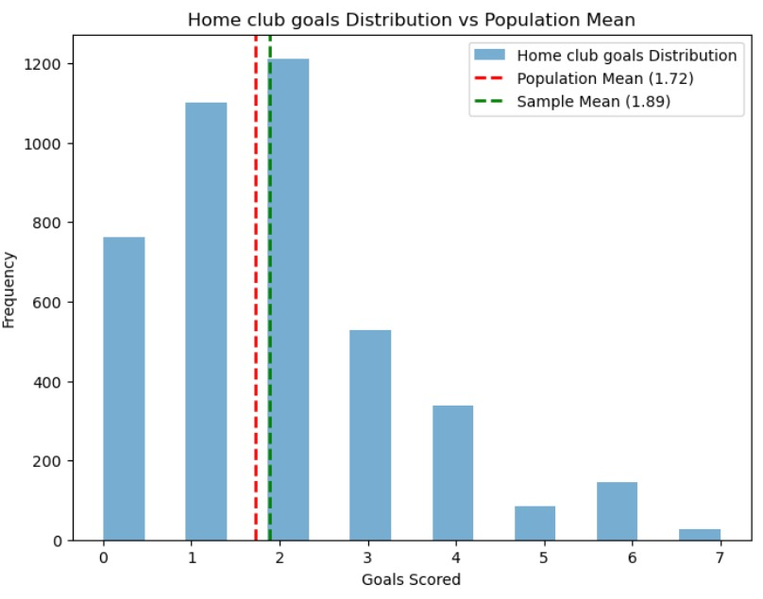
Team Comparison:
Calculate population mean (average goals in all games)
Interpretation:
If the p-value is less than 0.05, reject the null hypothesis and conclude that home teams score significantly more goals than the population mean.

Slide 8
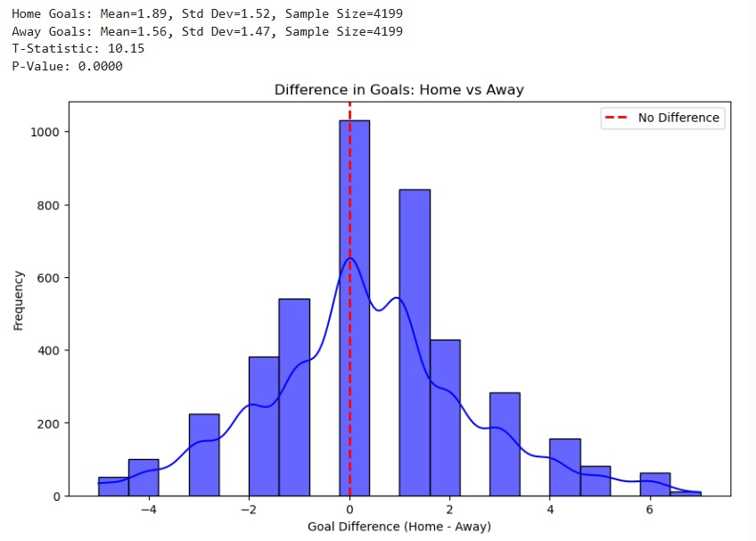
Do players score significantly more goals in home games compared to away games?
Interpretation:
The paired t-test compares the average goals scored by home and away teams.
Means: Home teams scored more goals on average than away teams.
T-Statistic & P-Value: A significant t-statistic (with a low p-value) indicates a statistically significant difference between home and away goals.

Slide 9
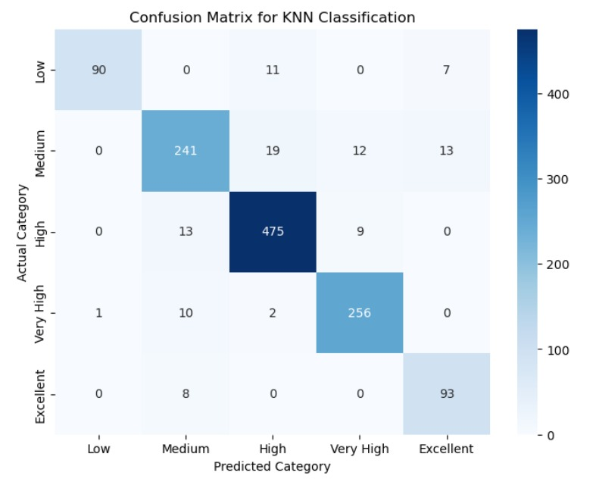
Attendance and Stadium Analysis
Classify: attendance into levels (e.g., Low, Medium, High, Very High)
Interpretation:
The classification report and confusion matrix provide insights into the model's overall performance, including the accuracy of each category prediction.

Slide 10
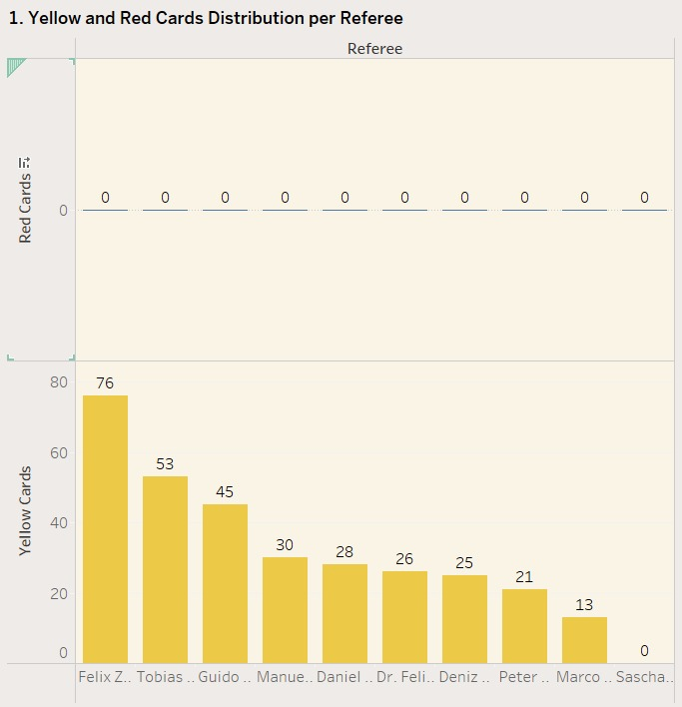
Referee Analysis
Yellow and Red Cards Distribution per Referee.
Interpretation:
The bar chart displays the total number of yellow and red cards issued by each referee.
Yellow Cards: Represented by yellow bars, showing which referees gave the most warnings.
Red Cards: Represented by red bars stacked on top, highlighting stricter actions.

Slide 11
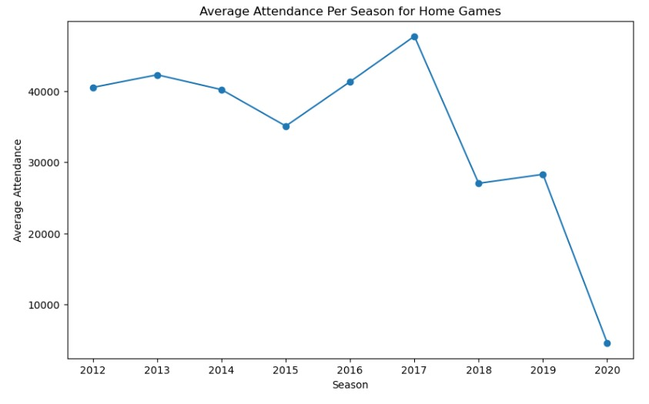
Contract Management Analysis
Average attendance per season for home games (Descriptive Analysis)
Interpretation:
This code calculates the average attendance for home games grouped by season. The line graph illustrates how attendance varies across different seasons. It provides insight into how the team's performance, player popularity, or stadium changes affect the fan attendance at home games.

Slide 12
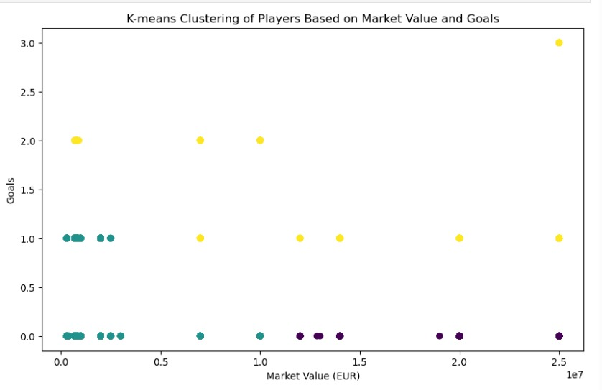
Player Attributes and Demographics Analysis
Can we group players into clusters based on their market value and goals scored
Interpretation:
The K-means clustering algorithm groups players based on their market value and goals scored. Players with similar characteristics are assigned to the same cluster. The scatter plot helps visualize the groups, which can identify high-performing players who may be undervalued or overvalued.

Slide 13
Conclusion:
Defined clear objectives for analysis (e.g., impact of home/away status on attendance, factors influencing team performance).
Derived actionable insights from data (e.g., weekend games drive higher attendance, player performance linked to team success).
Increase attendance by scheduling more weekend home games and targeting local rivalries.
Improve team performance through training focused on possession and key performance metrics.
Marketing should focus on promoting high-impact games.
Focus on performance metrics that drive team success, such as possession and shots on target.
This format highlights the main points clearly and concisely for your presentation.

Slide 14
THANK YOU

