Slide 1
WELCOME

Slide 2
BIOMETRIC AUTHENTICATION FOR ACCIDENT VICTIMS USING IOT
TEAM MEMBERS:
SOWMIYA. J
SURUTHI L

Slide 3
CONTENT :
OBJECTIVE
PROBLEM STATEMENT
EXISTING SYSTEM
BLOCK DIAGRAM
ADVANTAGES
CONCLUSION

Slide 4
OBJECTIVE:
The objective of the biometric authentication of accident victims using IoT project is to develop a system that quickly and accurately identifies victims using biometric data, such as fingerprints or facial recognition, in emergency situations.
This system aims to automate the retrieval of medical records, enabling healthcare providers to access crucial information like medical history and allergies in real time.

Slide 5
PROBLEM STATEMENT :
While at unconsciousness without proper identification, making it difficult to access their medical history and provide timely, appropriate treatment.
This lack of immediate identification can delay critical cases, leading to risks in patient safety and to start treatment.

Slide 6
EXISTING SYSTEM
In existing method we should identify the patient in emergency condition we have to know the patient relation number to inform.
No option are available for patient identification.
More complicated system.
Human effort needed.
No fingerprint technology are used.

Slide 7
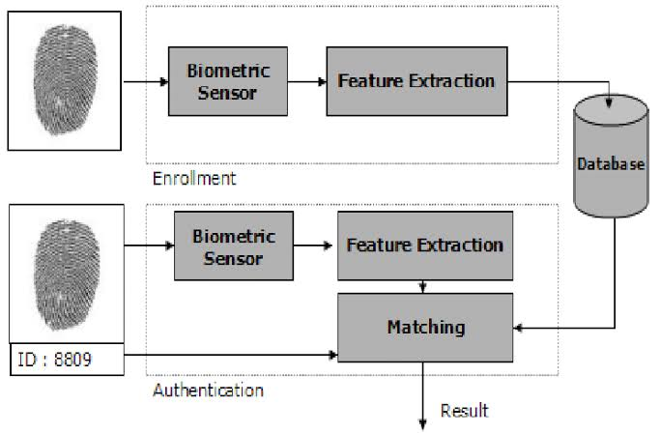
BLOCK DIAGRAM

Slide 8
ADVANTAGES
Rapid Identification
Access to Medical Records
Prevents Misidentification
Automated Alerts
Fraud Prevention

Slide 9
CONCLUSION
In conclusion, biometric authentication for accident victims using IoT presents a transformative solution for healthcare systems.
It ensures rapid, accurate identification of individuals, providing immediate access to critical medical records, which can be life-saving in emergency situations.
This technology minimizes human errors, prevents misidentification, and safeguards patient data from misuse or fraud.

Slide 10
THANK YOU

